Slide 1
Detecting fraud
In App advertisement traffic
Dawn E. Walker
Galvanize TTP Capstone 3

Slide 2
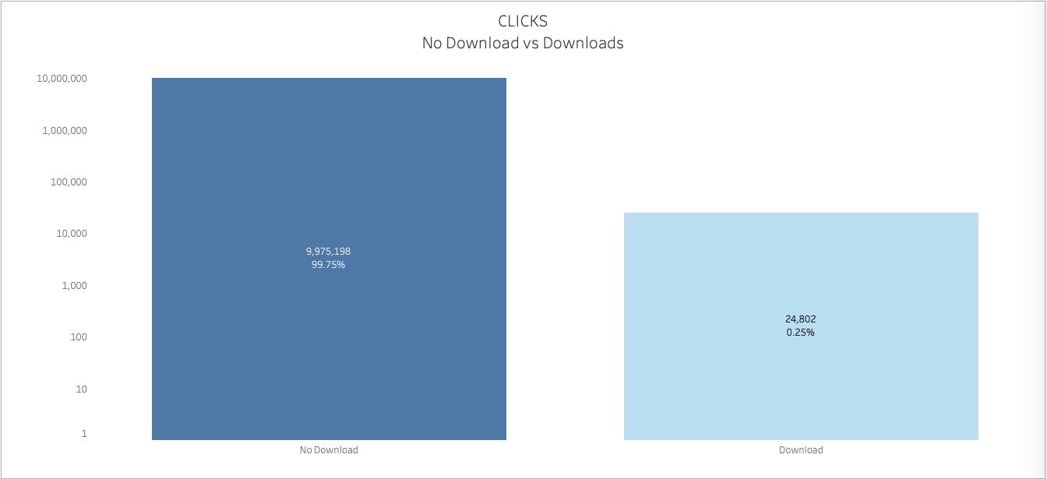
An examination of 10,000,000 sample data points (out of 184+ Million) indicates that, overwhelmingly, most clicks on the app advertisement do not result in a download of the app

Slide 3

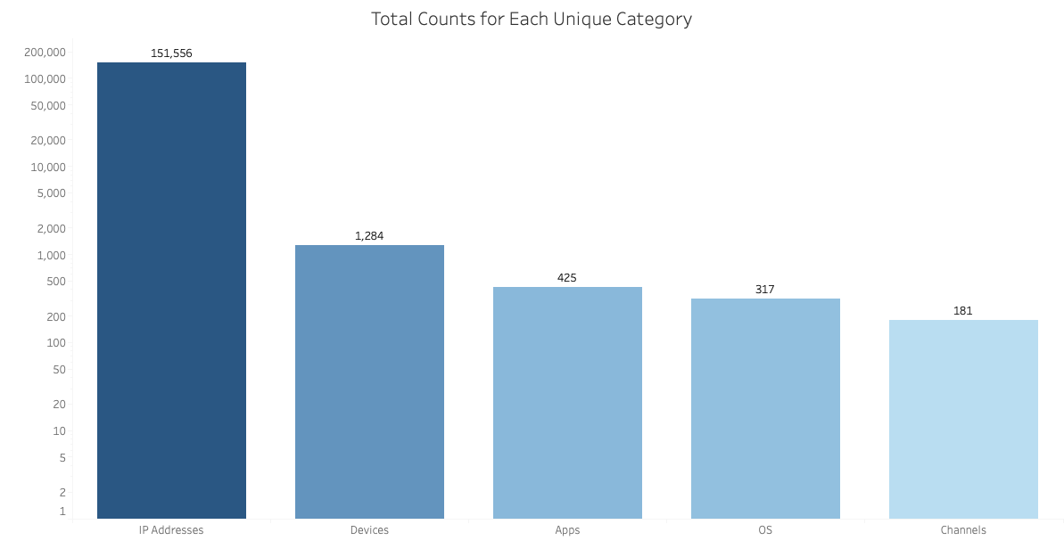
TALKINGDATA BLOCKS IP ADDRESSES AND DEVICES WITH A HIGH RATE OF CLICKS THAT DO NOT RESULT IN AN APP DOWNLOAD
SCOPE:
WHICH IP ADDRESSES AND DEVICES HAVE THE HIGHEST NUMBER OF ‘FRAUD CLICKS’?
CAN WE SHOW THAT THERE IS A ‘STATISTICALLY SIGNIFICANT’ DIFFERENCE BETWEEN DEVICES ASSOCIATED WITH MULTIPLE IP ADDRESSES VS. DEVICES ASSOCIATED WITH A SINGLE IP ADDRESS?

Slide 4
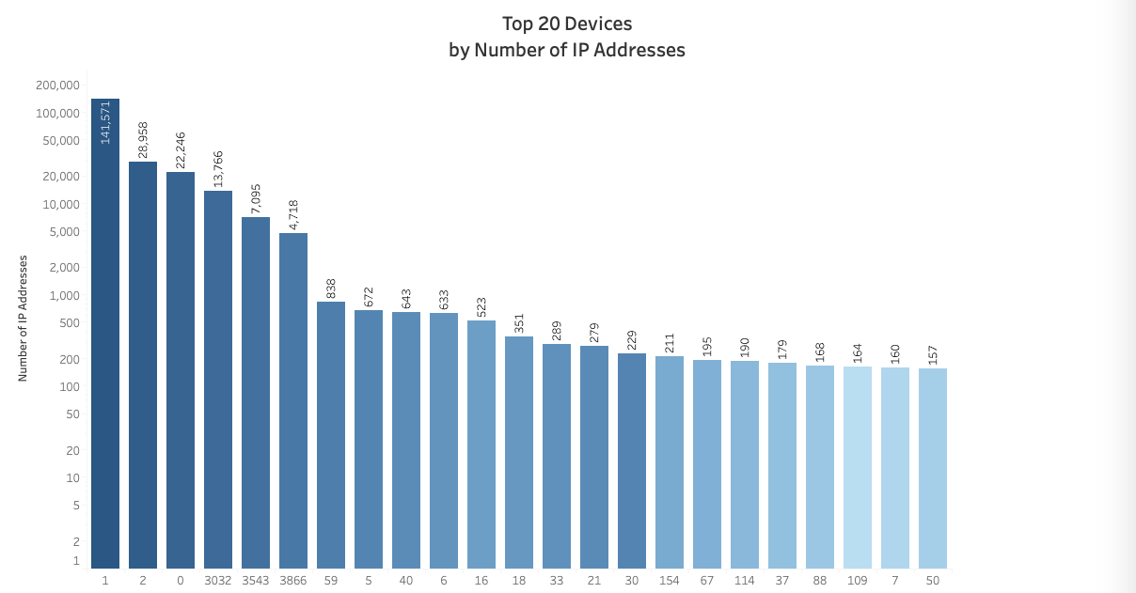
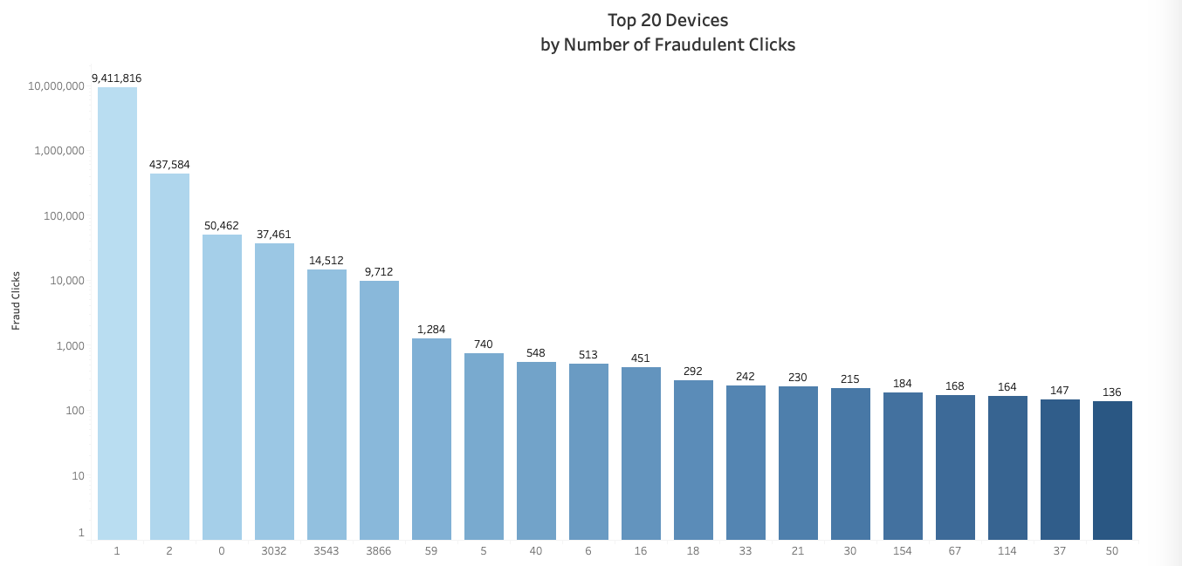
For Devices, 96% of IP addresses come from only 3 of the 1,284 unique device types represented in the data set.
I examined the devices associated with multiple IP addresses as subset of the larger dataset. 728 Devices, or 56%, were associated with multiple IP addresses.
But are these 728 devices responsible for a higher rate of ‘click_fraud’?
When the 728 Devices were examined in relation to the number of fraudulent clicks associated with that device, I see the same 3 device types making up 99% of the fraudulent clicks.
Statistical analysis can support the suspicion that the multi-IP devices are driving a majority of the ‘click fraud’. if the analysis is not supported, the recommendation to TalkingData would be not to block these devices based on the prevalence of the IP Addresses alone as it may not do much to help prevent ‘click fraud’.

Slide 5
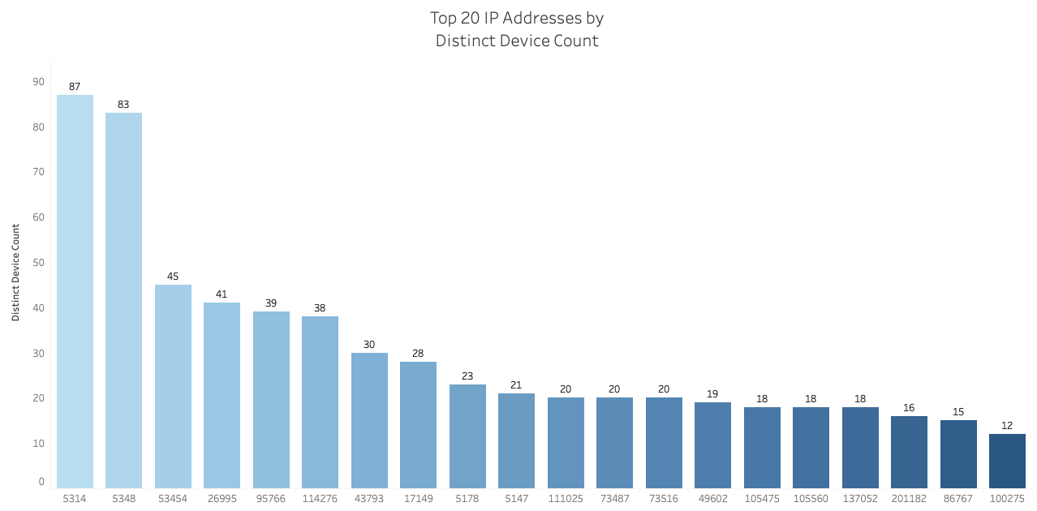
Hypothesis: Devices associated with multiple IP addresses have the same average number of fraudulent clicks (clicks that did not result in a download) as devices associated with a single IP address.
The Average number of fraudulent clicks for device types associated with multiple IP addresses was 13701.54 which much greater than .85, the average number of clicks for device types associated with single IP address.
Is the difference in these mean values enough to say that the multi-IP address device types have a higher rate of ‘click fraud’?
After applying the Independent T-test using the means, I failed to reject the above Null Hypothesis.
The p-value of 0.290 falls outside of the area of rejection of .05. There is not enough evidence to reject the above Null Hypothesis.
Although the concentration of IP Addresses and device types driving the fraudulent clicks looks suspicious, there is no statistical proof that they are the main drivers of fraudulent clicks.
The concentration of the same IP Address across multiple devices is very strange behavior and represents thousands of ad clicks, most of which do not result in a download of the App

Slide 6
Conclusions and Next steps:
Unable to prove statistically that the most common device types represented in the data had a higher number of fraudulent clicks compared to less common device types.
Analysis of these these devices and their specific IP Addresses as a unit would enable us to better pinpoint the bad actors driving the majority of the ‘click fraud’ with a lot more certainty.
Performing additional statistical analysis (Chi- Squared?) where the IP and Device type Categories are examined in relation to a True or False ‘Fraud Click’ Category could help strengthen this analysis.
Deeper analysis of the IP, Device, and App Categories in relation to each other might also be revealing.
Additional analysis to better understand the repeated occurrence of specific IP Addresses and what these repeat occurrences mean.
The data points for each category were encoded. More explicit information for each data point for each category might provide more interesting insights.

