Slide 1
Gender disparity in insurance charges

Slide 2
Can gender be used to predict insurance charges?
Is the difference in charges between men and women in this data set statistically significant?
Does the region in which you live effect your charges?
“While women and men both feel the impact of health costs, such as insurance premiums, co-payments, and deductibles, they can be particularly burdensome for women who on average earn lower wages, have fewer financial assets, accumulate less wealth, and have higher rates of poverty than men.” - Women's Coverage, Access, and Affordability: Key Findings from the 2017 Kaiser Women’s Health Survey

Slide 3
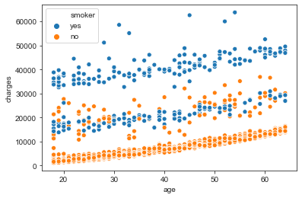
SAMPLE DATA SET OF 676 MALES AND 662 FEMALES
AGED 18 – 64 WITH AN AVERAGE AGE OF 39
AS EXPECTED, CHARGES INCREASE FOR WOMEN AND MEN AS THEY GET OLDER
THE CHARGES OUTLIERS IN THIS DATA SET ARE NOT EXPLAINED. IT IS UNKOWN IF THEY REPRESENT CHRONIC ILLNESSES, ACCIDENTS ETC
LOOKS LIKE TWO SEPARATE DATA SETS

Slide 4
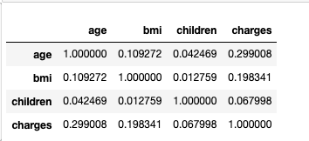
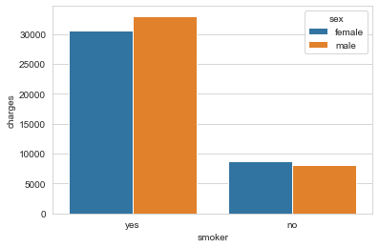
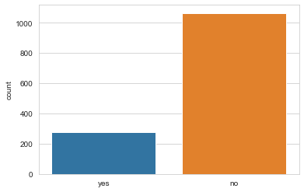
Smokers account for only 26% of the data, but 49.5% of the charges IN THIS DATA SET
Outliers and smokers obscure other factors that may affect charges

Slide 5
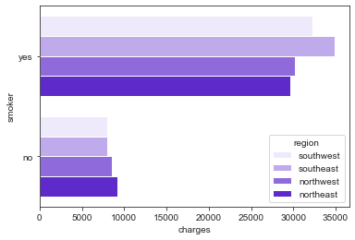
Smokers in the SE and SW have more charges
But for non-smokers, the charges look almost flat

Slide 6
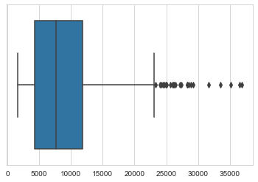
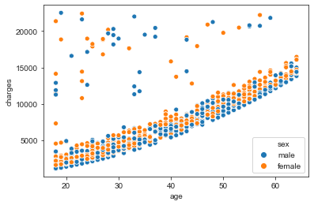
LOOK AT NON SMOKERS AND REMOVE THE ‘NOISE’, outliers in outer regions of the data After removing 24% of outlier we created a model that is applicable to 74% of cases"

Slide 7
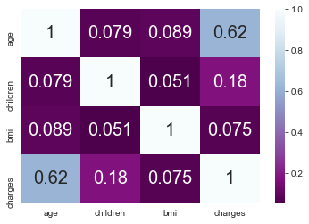
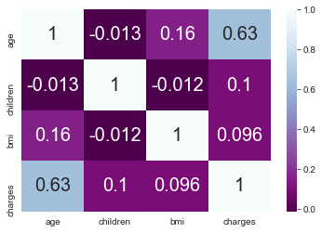
When we examine non-smokers AS an independent group, only AGE appears highly correlated with costs, for both men and women.
Women
Men

Slide 8
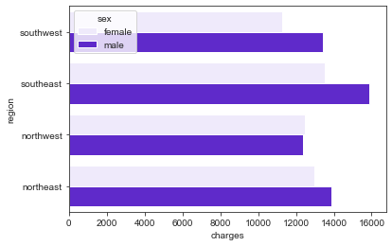
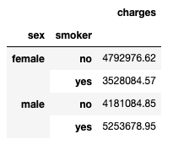
When we look only at the non-smokers, WE SEE WOMEN’S CHARGES ARE 13% HIGHERregardless of region
ARE REGION AND GENDER SIGNIFICANTLY RELATED TO COSTS?
Charges for non-smokers, men and women, by region
Even accounting for other factors like bmi, # of children, age, women’s charges are higher
Is there a statistical difference in average charges between men and women?

Slide 9
For this data, the difference between women’s avg charges and men’s avg charges was statistically significant.
BUT I WAS NOT ABLE TO BUILD A RELIABLE LINEAR REGRESSION MODEL
THE LOGISTIC REGRESSION MODEL WAS RIGHTONLY ABOUT ½ THE TIME

Slide 10
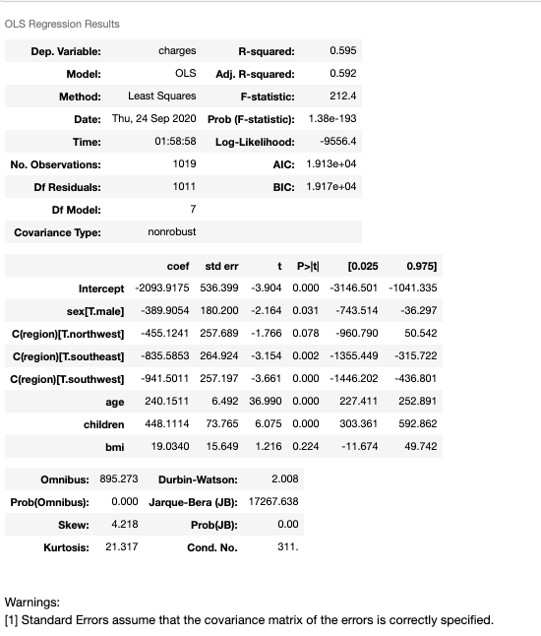
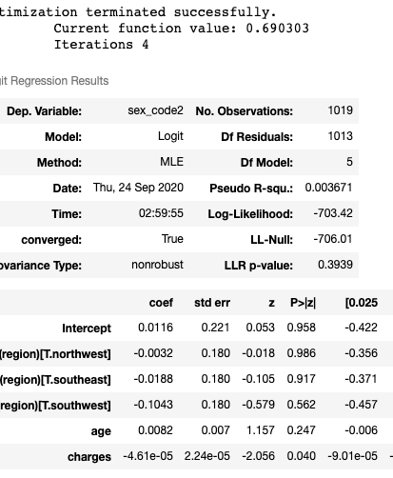
THE MODELS
THE LINEAR REGRESSION MODEL WAS NOT A GOOD FIT
THE LOGISTIC REGRESSION MODEL WAS RIGHT ONLY ABOUT 56% OF THE TIME

Slide 11
SUMMARY AND NEXT STEPS
EXPLORE OTHER MODELS OR STATISTICAL TECHNIQUES THAT MIGHT PROVE MORE INSIGHT
THE DATA SET WAS LIMITED IN SIZE AND SCOPE, REPEAT PROJECT WITH MORE DETAILED AND LARGER DATA SETS
EXPLORE UNEXPLAINED DATA ANOMOLIES AND BIMODAL ACTIVITY

