Slide 1
HIDDEN disparitIES in insurance charges
Notes:
GOOD MORNING, MY NAME IS DAWN WALKER. MY TOPIC OF DISCUSSION TODAY IN ‘HIDDEN DISPARITIES IN INSURANCE CHARGES’

Slide 2
Can gender be used to predict insurance charges?
Is the difference in charges between men and women in this data set statistically significant?
Does the region in which you live effect your charges?
“While women and men both feel the impact of health costs, such as insurance premiums, co-payments, and deductibles, they can be particularly burdensome for women who on average earn lower wages, have fewer financial assets, accumulate less wealth, and have higher rates of poverty than men.” - Women's Coverage, Access, and Affordability: Key Findings from the 2017 Kaiser Women’s Health Survey

Slide 3
THE SAMPLE DATA SET ONE YEAR OF insurance charges for 1,338 people
TOTAL CHARGES FOR THE YEAR
676 MALES, 662 FEMALES
AVERAGE AGE OF 39
BMI, NUMBER OF CHILDREN, REGION
AS EXPECTED, CHARGES INCREASE FOR WOMEN AND MEN AS THEY GET OLDER
THE CHARGES OUTLIERS IN THIS DATA SET ARE NOT EXPLAINED. IT IS UNKOWN IF THEY REPRESENT CHRONIC ILLNESSES, ACCIDENTS ETC

Slide 4
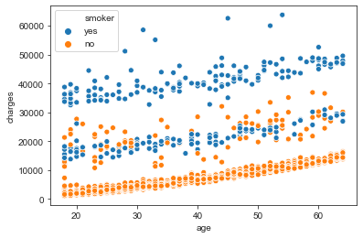
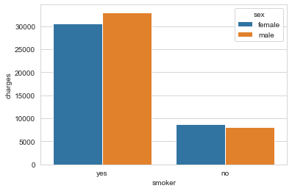
BIMODAL, 2 DISTINCT DATA SETS?
UNEXPLAINABLE OUTLIERS
CHARGES INCREASE WITH AGE
NON-SMOKERS: 1064
SMOKERS: 274
26% of the data, but 49.5% of the charges

Slide 5
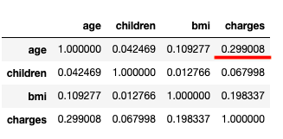
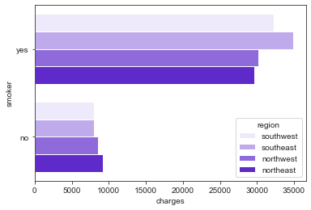
WHAT ELSE IS HERE?
Slight relationship between charges and age, much weaker correlation
Smokers in the SE and SW have more charges
But for non-smokers, the charges look almost flat

Slide 6
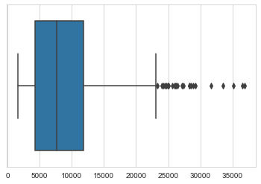
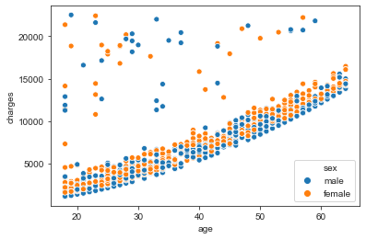
REMOVE OUTLIERS: TOTAL CHARGES > 22,500 After removing 24% of outlier we created a DATA SET that is applicable to 74% of cases
VIEW OF NON-SMOKERS ONLY

Slide 7
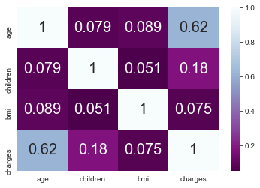
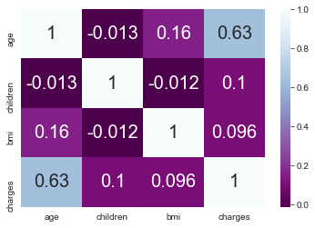
for both men and women non-smokers, only AGE appears highly correlated with costs.
Double click on Non-Smokers as the Larger Population (excluding outliers)
After removing 24% of the outliers data, the data set was now in a model that was applicable to 74% of cases. This allowed for a cleaner data set to be able to examine the larger population, non-smokers. For non-smoking men and women, only age appears highly correlated with costs.
Women
Men

Slide 8
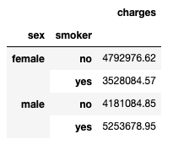
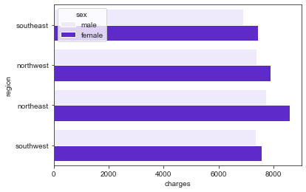
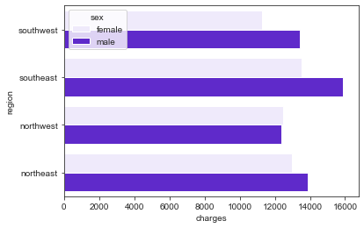
When we look only at the non-smokers, WE SEE WOMEN’S CHARGES ARE 13% HIGHER regardless of region
ARE REGION AND GENDER SIGNIFICANTLY RELATED TO COSTS?
Charges for non-smokers, men and women, by region
Even accounting for other factors like bmi, # of children, age, women’s charges are higher
Is there a statistical difference in average charges between men and women?

Slide 9
For this data, the difference between women’s avg charges and men’s avg charges was statistically significant.
BUT I WAS NOT ABLE TO BUILD A RELIABLE LINEAR REGRESSION MODEL
THE LOGISTIC REGRESSION MODEL WAS RIGHTONLY ABOUT ½ THE TIME

Slide 10
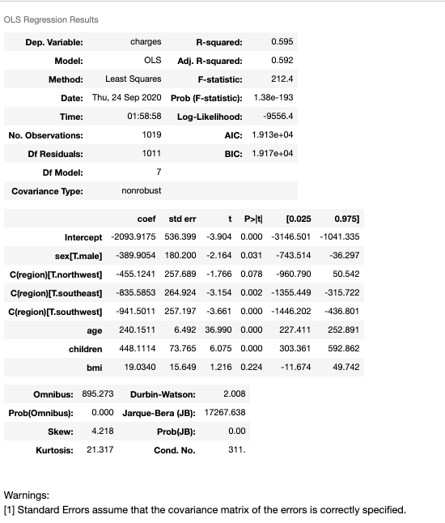
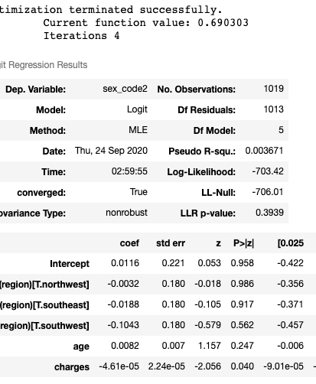
THE MODELS
THE LINEAR REGRESSION MODEL WAS NOT A GOOD FIT
THE LOGISTIC REGRESSION MODEL WAS RIGHT ONLY ABOUT 56% OF THE TIME

Slide 11
SUMMARY AND NEXT STEPS
EXPLORE OTHER TYPES OF STATISTICAL MODELS THAT MIGHT FIT THE DATA BETTER
THE DATA SET WAS LIMITED IN SIZE AND SCOPE, REPEAT PROJECT WITH MORE DETAILED AND LARGER DATA SETS
EXPLORE UNEXPLAINED DATA ANOMOLIES AND BIMODAL ACTIVITY

