Slide 1
HIDDEN disparitIES in insurance charges
Notes:
GOOD MORNING, MY NAME IS DAWN WALKER. MY TOPIC OF DISCUSSION TODAY IN ‘HIDDEN DISPARITIES IN INSURANCE CHARGES’

Slide 2
THE SAMPLE DATA SET ONE YEAR OF insurance charges for 1,338 people
TOTAL CHARGES FOR THE YEAR
676 MALES, 662 FEMALES
AVERAGE AGE OF 39
BMI, NUMBER OF CHILDREN, REGION

Slide 3

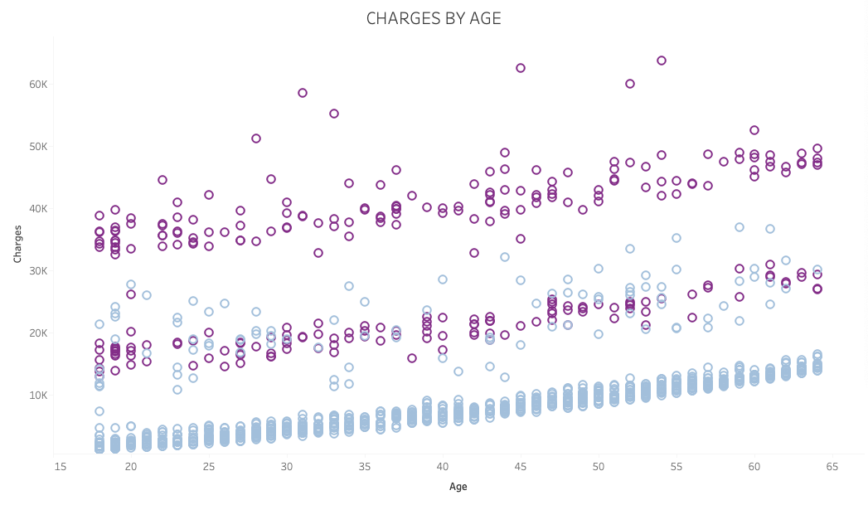
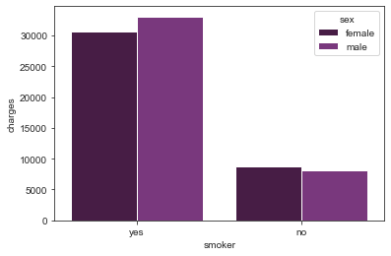
BIMODAL, 2 DISTINCT DATA SETS?
UNEXPLAINABLE OUTLIERS
CHARGES INCREASE WITH AGE
SMOKERS PAY MORE
NON-SMOKERS: 1064
SMOKERS: 274
26% of the data, but 49.5% of the charges
Notes:
There are many unexplained outliers for both smokers and non-smokers regardless of gender and age. Given the limited details of the dataset, I can not say if the outliers are due to chronic illness, accident etc that might result in very high insurance charges

Slide 4
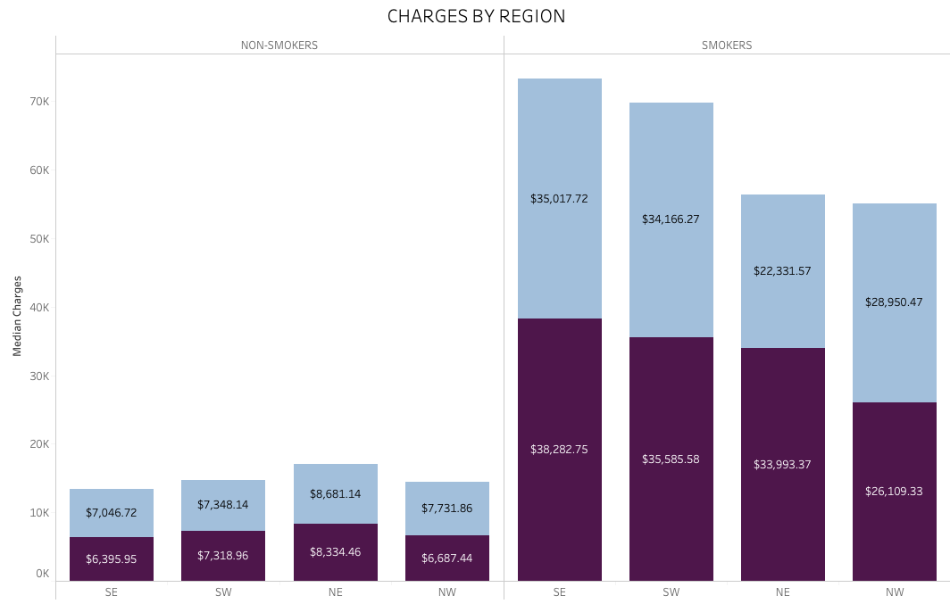

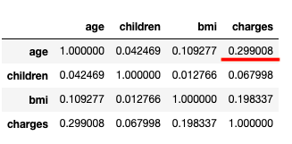

Slide 5
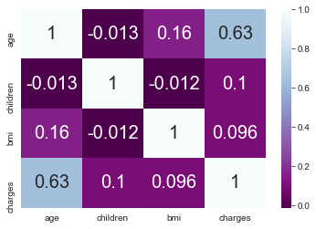

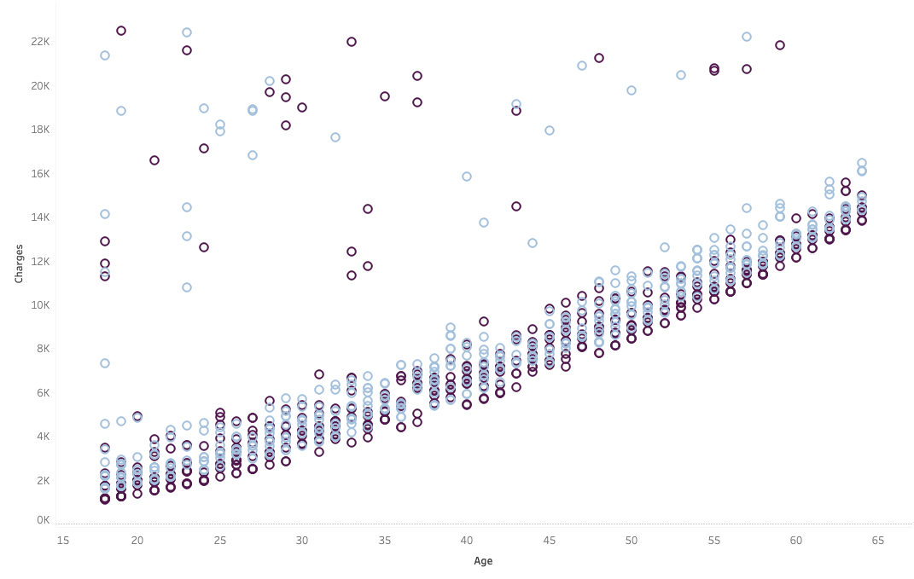
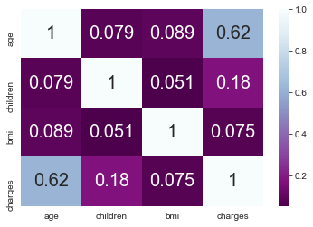
Non-smokers only with charges under $22,500
Notes:
To examine the data more deeply too a look at Non-smokers as a separate group.
We can see a very linear relationship between age and charges. There are both males and females whose charges don’t
After removing 24% of outlier we created a DATA SET that is applicable to 74% of cases

Slide 6
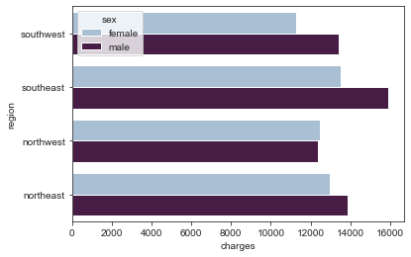
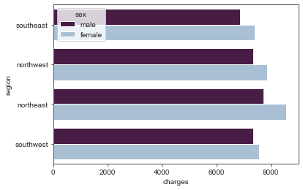
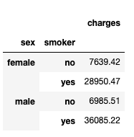
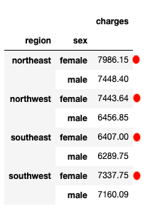
When we look only at the non-smokers, WE SEE WOMEN’S CHARGES ARE 13% HIGHER regardless of region
DO GENDER AND REGION SIGNIFICANTLY EFFECT YOUR CHARGES?
SMOKERS AND NON-SMOKERS
NON-SMOKERS ONLY
Notes:
Even if you don’t smoke, where you live can significantly effect your charges
If you are a woman, gender and where you live effect your charges

Slide 7
For this data, the difference between women’s avg charges and men’s avg charges was statistically significant.
Even if you don’t smoke, where you live can significantly effect your charges
If you are a woman, gender and where you live effect your charges
BUT I WAS NOT ABLE TO BUILD A RELIABLE LINEAR REGRESSION MODEL
THE LOGISTIC REGRESSION MODEL WAS RIGHTONLY ABOUT ½ THE TIME

Slide 8
SUMMARY AND NEXT STEPS
EXPLORE OTHER TYPES OF STATISTICAL MODELS THAT MIGHT FIT THE DATA BETTER
THE DATA SET WAS LIMITED IN SIZE AND SCOPE, REPEAT PROJECT WITH MORE DETAILED AND LARGER DATA SETS
EXPLORE UNEXPLAINED DATA ANOMOLIES AND BIMODAL ACTIVITY

Slide 9
Can gender be used to predict insurance charges?
Is the difference in charges between men and women in this data set statistically significant?
Does the region in which you live effect your charges?
“While women and men both feel the impact of health costs, such as insurance premiums, co-payments, and deductibles, they can be particularly burdensome for women who on average earn lower wages, have fewer financial assets, accumulate less wealth, and have higher rates of poverty than men.” - Women's Coverage, Access, and Affordability: Key Findings from the 2017 Kaiser Women’s Health Survey

Slide 10
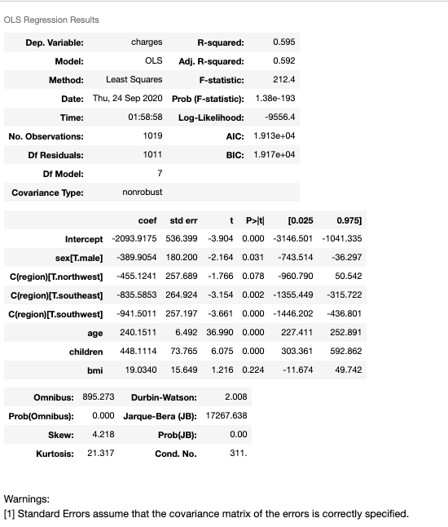
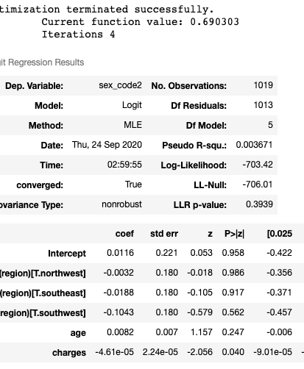
THE MODELS
THE LINEAR REGRESSION MODEL WAS NOT A GOOD FIT
THE LOGISTIC REGRESSION MODEL WAS RIGHT ONLY ABOUT 56% OF THE TIME

Slide 11
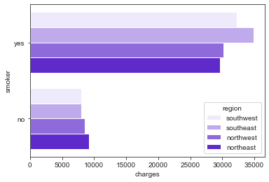
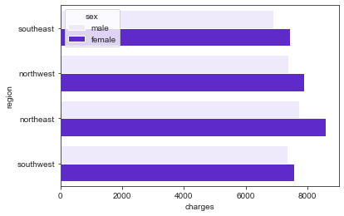
WHAT ELSE IS HERE?
Smokers are 26% of the data, but 49.5% of the charges
Slight relationship between charges and age, much weaker correlation
Smokers in the SE and SW have more charges
But for non-smokers, the charges look almost flat
Notes:
When you look at the smoker and non-smokers as a single data set, you don’t see a very strong correlation between age and the charges.
Smoking is such a determining factor that is obscures other stories this data might tell

Slide 12
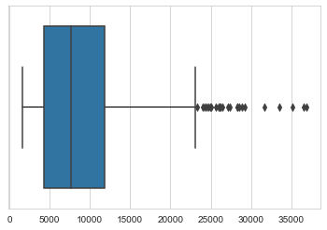
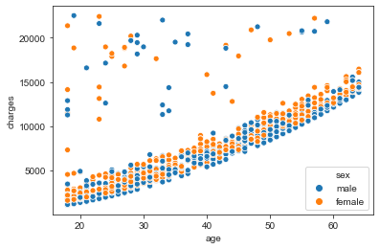
REMOVE OUTLIERS: TOTAL CHARGES > 22,500 After removing 24% of outlier we created a DATA SET that is applicable to 74% of cases
VIEW OF NON-SMOKERS ONLY
Notes:
To examine the data more deeply too a look at Non-smokers as a separate group.
We can see a very linear relationship between age and charges. There are both males and females whose charges dont

Slide 13
for both men and women non-smokers, only AGE appears highly correlated with costs.
Double click on Non-Smokers as the Larger Population (excluding outliers)
After removing 24% of the outliers data, the data set was now in a model that was applicable to 74% of cases. This allowed for a cleaner data set to be able to examine the larger population, non-smokers. For non-smoking men and women, only age appears highly correlated with costs.
Women
Men
Notes:
WHAT WAS ONLY A WEAK CORRELATION WHEN I EXAMINED SMOKERS AND NON-SMOKERS TOGETHER, THE RELATIONSHIP BETWEEN AGE AND CHARGES IS MUCH MORE HIGHLY CORRELATED AND CLEARER CLEARER WHEN NON-SMOKERS ARE VIEWED INDEPENDENTLY. THE RELATIONSHIP BETWEEN AGE AND CHARGES IS ALMOST IDENTICAL FOR MEN AND WOMEN

