Slide 2
Can gender be used to predict insurance charges?
Is the difference in cost between men and women in this data set statistically different?
How big of an effect is where you live on what you are charged?

Slide 3
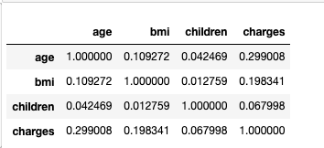
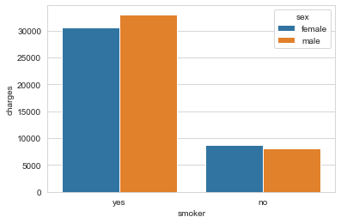
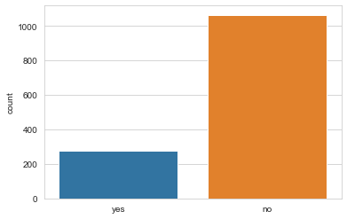
Smokers account for only 26% of the data, but 49.5% of the charges represented
Outliers and smokers prevent us from telling the full story for this dataset

Slide 4
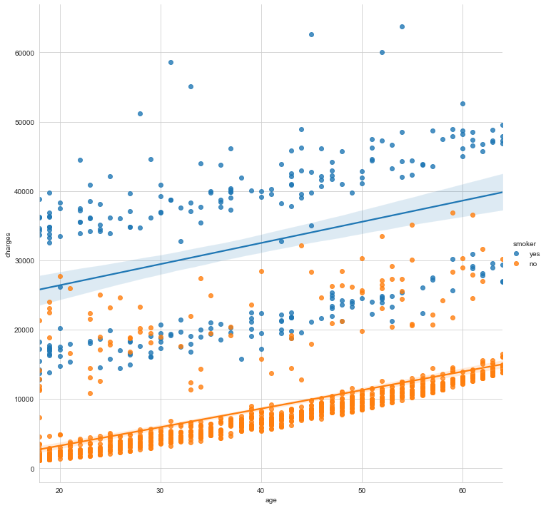
Smoking is such a driving force for higher cost in this data set, that it obscures other factors that may also contribute to costs

Slide 5
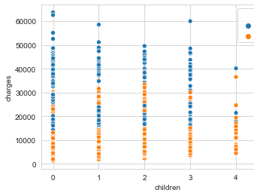
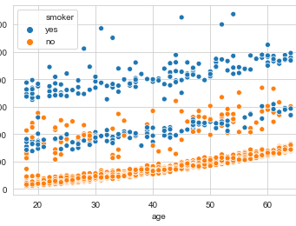
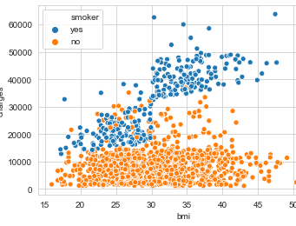
Smoking is such HUGE predicter of higher cost in this data set, that it obscures other factors that may also contribute to costs, SUCH AS BMI, AGE, THE REGION YOU LIVE IN, AND WHETHER OR NOT YOU HAVE CHILDREN.

Slide 6
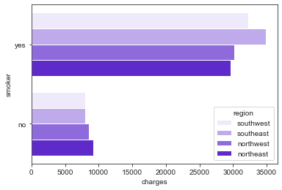
Smokers in the SE and SW have more charges
But for non-smokers, the charges look almost flat

Slide 7
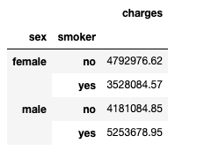
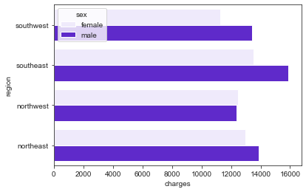
When we look only at the non-smokers, we see women appear tO pay more regardless of region
Charges for non-smokers, men and women, by region
Even accounting for other factors like bmi, # of children, age, women’s charges are higher
Is there a statistical difference in average charges between men and women?

Slide 8
For this data, the difference between women’s avg charges and men’s avg charges was statistically significant.
I have to talk about the outliers I removed.
What percentage of the data they represented
And the resulting model that used sex as a measure of charges

Slide 9
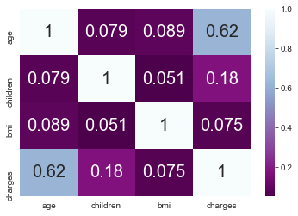
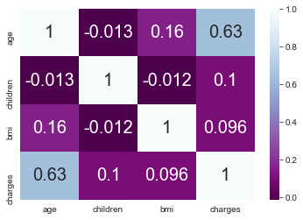
When we examine non-smokers an independent group, only AGE seems to be highly correlated with costs, for both men and women.
Women
Men

Slide 10
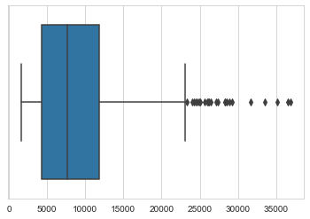
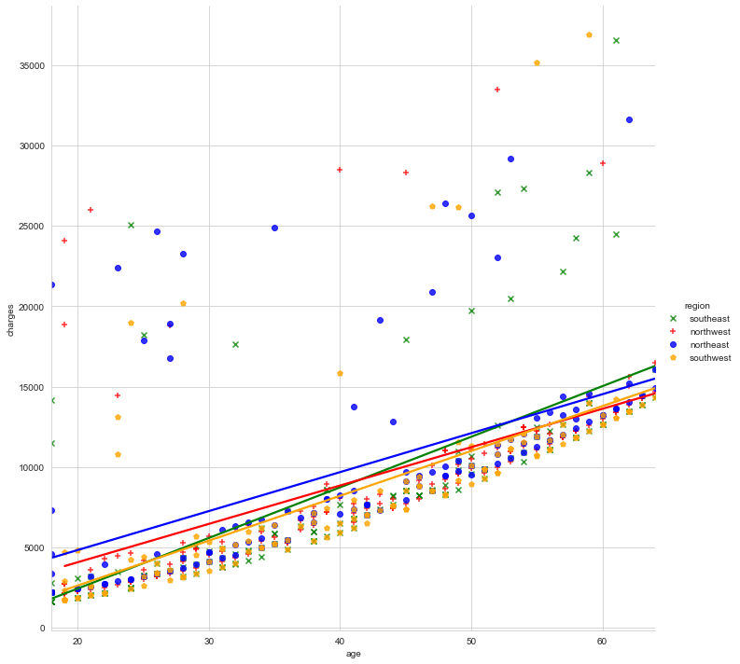
THIS GRAPH ILLUSTRATES A LINEaR RELATIONSHIP BETWEEN COSTS AND AGE. BUT THERE ARE ALSO A LOT OF STRANGE OUTLIERS The boxplot above also illustrates the extreme cost outliers with the data available there is no way to know what factors are causing the huge increases in cost for the outliers
Will use $17,500 as the cutoff for examining these outliers. If there is enough to indicate a reliable model, with examine this subset further. If not, will model non-smoking women without these outliers.

