Slide 1
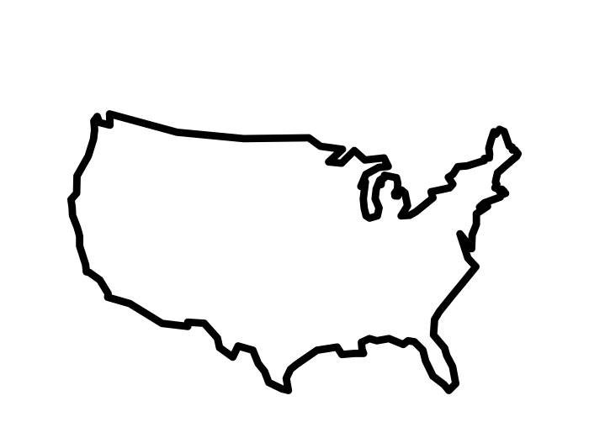
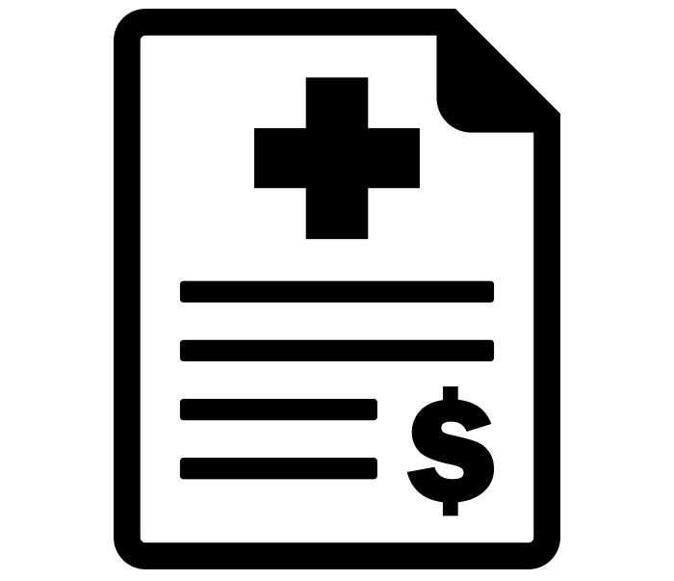
HOW SMOKING SKEWS INSURANCE CHARGES IN THE U.S.
Dawn e. Walker

Slide 2

AN EXPLANATION OF THE DATASET
1,338 data points
Total insurance charges for one year
676 males, 662 females
Body Mass Index (BMI)
Had children, or not
Smoker or non-smoker
Region: southeast, southwest, northeast, northwest

Slide 3


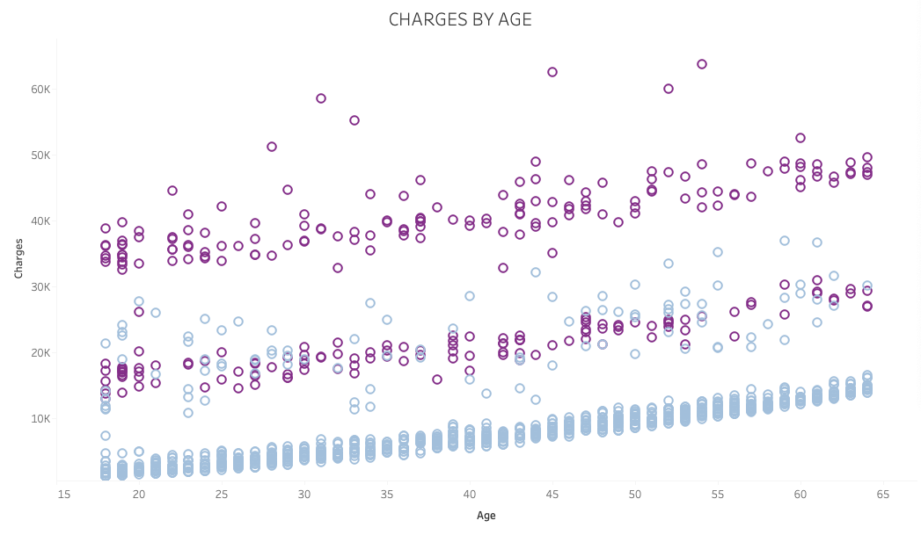
SMOKERS HAVE AN OUTSIZED INFLUENCE
ON THE DATASET
AVG BMI: 36
AVG BMI: 26
NON-SMOKERS:
1064
SMOKERS: 274

Slide 4
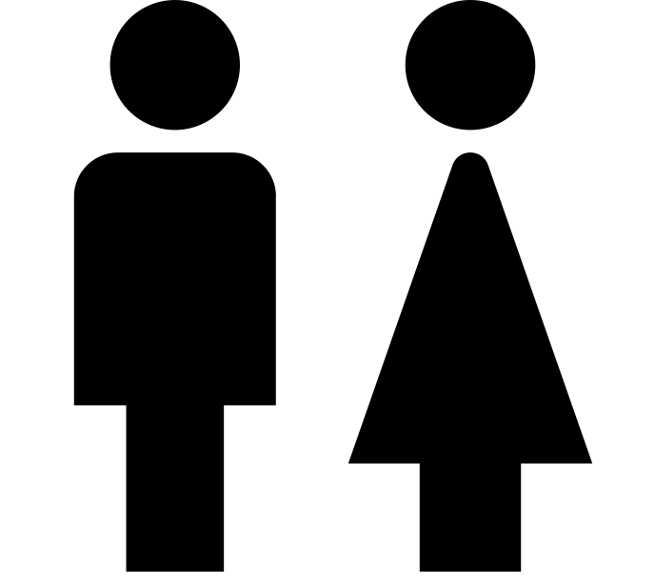
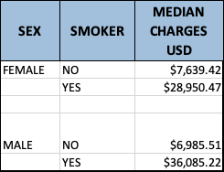
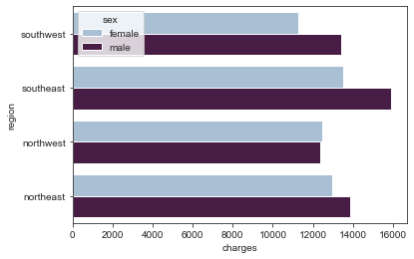
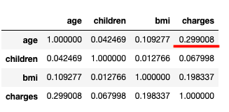
ALTHOUGH ONLY 26% OF THE DATASET, SMOKERS ACCOUNT FOR
49.5% OF TOTAL CHARGES

Slide 5

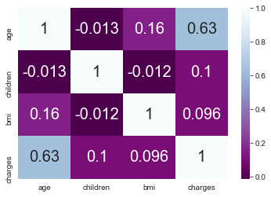

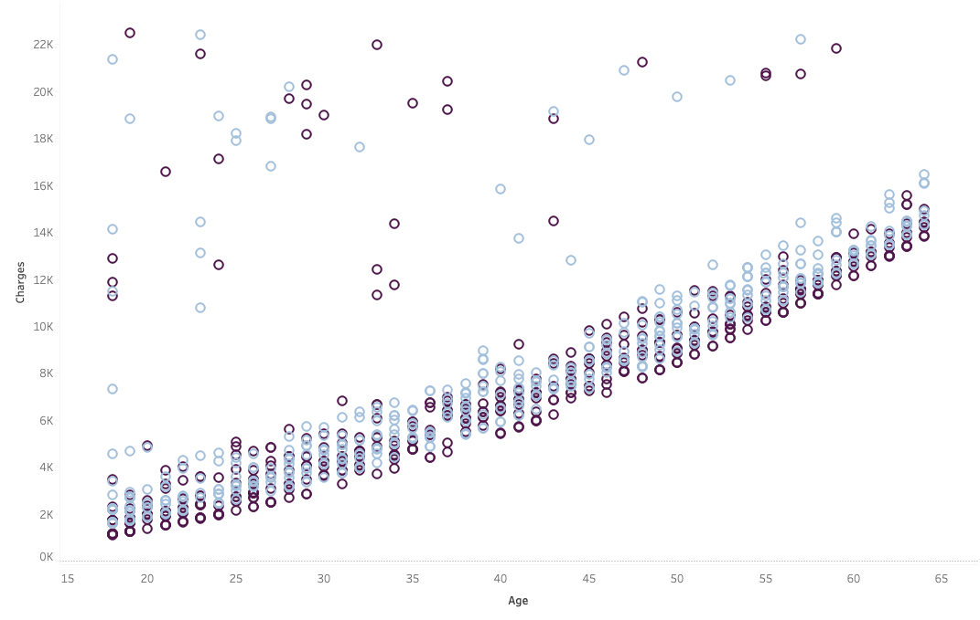
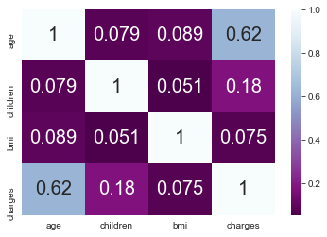
Non-smokers CHARGES ARE MOST INFLUENCED BY AGE
MALES
FEMALES

Slide 6

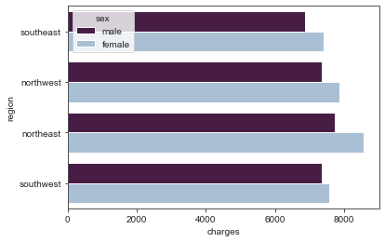
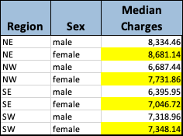
FOR NON_SMOKERS, ARE DIFFERENCES IN CHARGES BY GENDER AND REGION
STATISTICALLY SIGNIFICANT?

Slide 7
STATISTICAL ANALYSIS (non-smokers):
ARE AVERAGE CHARGES THE SAME FOR NON-SMOKING MEN AND WOMEN?
The average charges for men and women were tested using the Welch’s T-Test which indicated a significant difference between average charges for men and women.
I also built a model (Logistic Regression) to predict the correct gender. This model was able to classify the correct gender about 0.51 of the time.
STATISTICAL ANALYSIS (non-smokers):
IS THERE A STATISTICAL RELATIONSHIP BETWEEN REGION AND CHARGES?
Charges for non-smokers were modeled using A Linear Regression but the results were inconclusive.
A model (Logistic Regression) was used to predict Region based on the other categories. It was accurate about .29 of the time.

Slide 8
SUMMARY
There is a strong relationship between gender and charges for this data set
Models to predict region were too weak
NEXT STEPS
Explore other types of statistical models that might fit the data better, particularly the region category
The data set was limited in size and scope, repeat project with more detailed data sets (info on specific cities, marital status, income)
Explore unexplained data anomalies in the non-smoking group
More detailed analysis of smokers as an independent group
View the models and data exploration:
https://github.com/Dewalk/final_capstone
Contact me:
https://www.linkedin.com/in/dawnewalker

