Slide 1
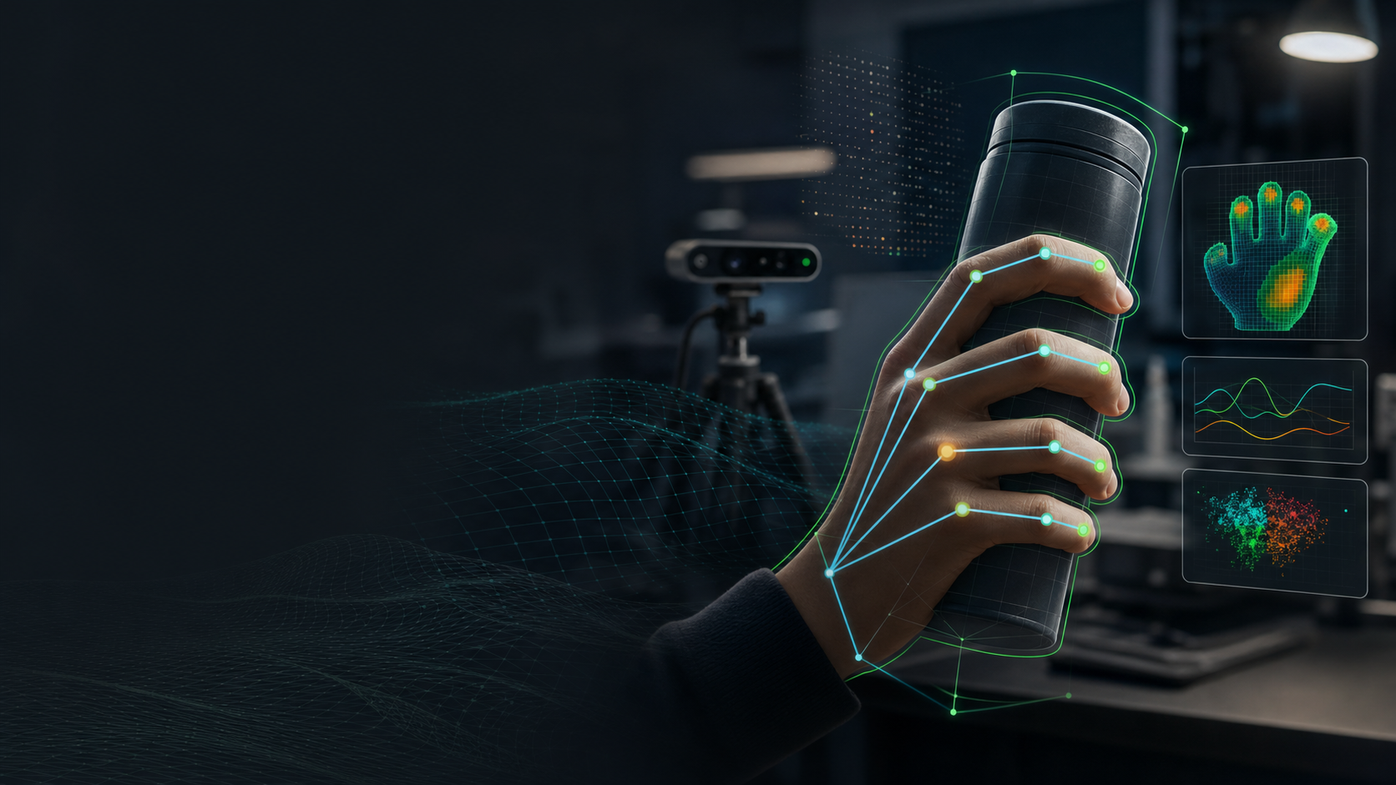
AX TRANSFORMATION PIPELINE
GripSense RGB
RGB-only trained-object grip estimation for faster object-interaction research
Inventor: Dewanshu Haswani | Samsung Research Institute Bangalore (SRIB)
Live + offline
Object-first
Browser-first
webcam and uploaded video analysis
target identity gates grip scoring
local privacy-preserving prototype
GripSense RGB | AX Transformation | SRIB | 01

Slide 2
EXECUTIVE THESIS
GripSense RGB turns ordinary cameras into an object-interaction intelligence layer.
A browser-first platform that connects object identity, hand pose, grip evidence, and temporal stability so R&D teams can evaluate how people hold, move, and manipulate real products.
What it is
Why it matters
AX value
A working RGB webcam/offline-video app for trained-object detection and visual grip-stability estimation.
It reduces the friction of collecting interaction evidence before teams invest in depth hardware, smart objects, gloves, or lab rigs.
It packages AI + automation into a reusable toolchain for experimentation, dataset creation, validation, and product-interaction analysis.
The platform is honest by design: the percentage is visual grip stability, not measured physical force.
GripSense RGB | AX Transformation | SRIB | 02

Slide 3
WHY AX
The same interaction question keeps appearing across teams.
Before automating, augmenting, simulating, or optimizing a task, teams need repeatable evidence of which object is present, how it is held, and whether the interaction is stable.
XR
Can a headset understand hand-object interaction without markers?
Visual Intelligence
Can RGB models distinguish object presence from empty-hand false positives?
Robotics
Can demos capture grasp affordances, slip risk, and manipulation intent?
On-device AI
Can the perception pipeline run locally with privacy and latency constraints?
GripSense RGB | AX Transformation | SRIB | 03

Slide 4
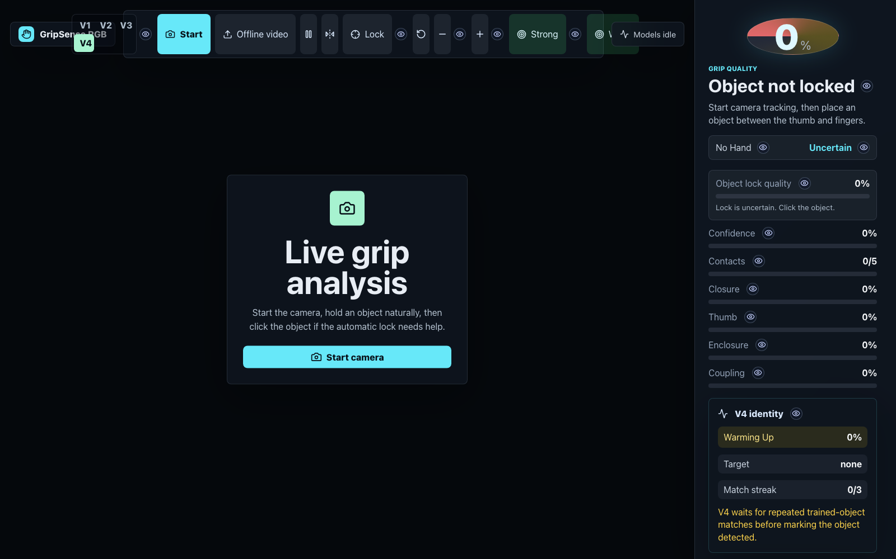
TOOL OVERVIEW
Product flow: train object -> enable target -> detect target -> estimate grip.
The UI separates object lock quality, object identity match, visual grip stability, and the limitation that RGB cannot measure true force.
1
Train object profile
Capture/crop/mask multiple angles and save locally.
2
Enable target object
Choose exactly what the app should track.
3
Detect target
Require temporal match before turning detection green.
4
Estimate grip
Score visible contact, wrap, support, and motion stability.
GripSense RGB | AX Transformation | SRIB | 04

Slide 5
SYSTEM PIPELINE
From RGB frames to team-readable grip evidence.
The architecture is deliberately modular: stronger descriptor providers or a local inference server can replace the browser descriptor without rewriting the UI or scoring layer.
Camera / video
Hand landmarks
Object profile
Temporal identity
Grip scoring
Export / review
webcam stream or uploaded clip
MediaPipe Tasks Vision
masked crops, descriptors, augmentation
multi-frame match and anti-flicker state
mode-specific visual stability evidence
timeline, diagnostics, CSV/JSON
V4 design principle
Never call a grip strong just because the hand is closed. First verify that the enabled target object is actually present and stable across several frames.
GripSense RGB | AX Transformation | SRIB | 05

Slide 6
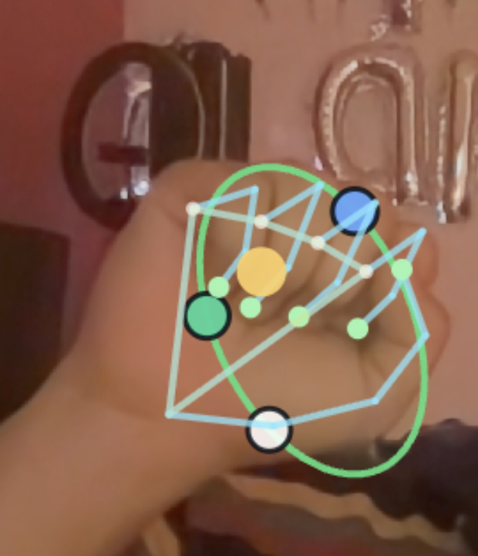
IDENTITY FIRST
V4 fixes the core failure mode: empty hand should not become a confident object grip.
The model now treats object identity and object lock as separate gates before visual grip scoring is allowed to look strong.
Object lock
Identity match
Is the region real, not skin-only/background?
Does it match an enabled trained object?
Temporal match
Grip evidence
Has it persisted for repeated frames?
Only then estimate stability and guidance.
Observed learning case
GripSense RGB | AX Transformation | SRIB | 06

Slide 7
OBJECT PROFILE V4
Training is a guided capture workflow, not a blind browser session.
Users can add camera captures or uploads, crop/mask the object, name it, and save a profile locally for later use.
Front view
Side view
Rotated view
canonical product face
shape/aspect robustness
pose variance
Object in hand
Object alone
Negative examples
occlusion reality
clean descriptor anchor
nearby backgrounds / similar non-targets
Training is not blocked; the UI grades it as weak, good, or robust profile so experimentation can continue while quality remains visible.
GripSense RGB | AX Transformation | SRIB | 07

Slide 8
DESCRIPTOR MODEL
The browser descriptor is stronger than color matching, and prepared for embeddings.
V4 uses handcrafted multi-signal descriptors now, while the ObjectDescriptorProvider interface keeps the path open for ONNX, CLIP, DINO, or a local Python server.
Signal
Current V4 browser implementation
Why it improves accuracy
Color
HSV + normalized RGB/chroma histograms
More robust under lighting shifts than raw RGB only
Edges
Orientation histograms + local gradients
Catches phone/bottle silhouettes and side edges
Shape
Aspect, coverage, contour/tightness features
Rejects huge boxes and background-like regions
Texture
Small grayscale patch statistics
Adds weak material cues for remotes, mugs, tools
Augmentation
Flip/brightness/contrast variants
Improves matching across camera exposure changes
GripSense RGB | AX Transformation | SRIB | 08

Slide 9
TEMPORAL IDENTITY
Target detection is a state machine, not a one-frame decision.
This reduces flicker, wrong detections, and the common issue where a closed hand looks like an object.
No target
Warming up
Detected
Grip active
Lost/uncertain
no enabled profile
candidate match appears
match streak passes threshold
hand-object relationship is stable
match drops or lock quality collapses
Object match
86%
Motion agreement
72%
Slip risk
18%
Lock quality
81%
GripSense RGB | AX Transformation | SRIB | 09

Slide 10
VISUAL GRIP STABILITY
Grip percentage is a weighted evidence model, not force measurement.
The score estimates whether the object appears visually secure in RGB frames by combining mode-specific features.
Visible contact
Guidance states
Slip persistence
Finger wrap
Strong hold: stable identity + strong visual evidence
Grip
stability
Improve grip: object detected, but support/contact is partial
Object uncertain: detection/lock is the weak part
Slip risk: sustained relative motion, not a noisy frame
Motion stability
Palm support
Thumb support
GripSense RGB | AX Transformation | SRIB | 10

Slide 11
MODE-SPECIFIC SCORING
Different objects need different grip logic.
A phone-side grip, bottle power grip, mug handle grip, pinch grip, and hook grip should not be scored with the same formula.
Grip mode
Primary evidence
Failure to avoid
Phone / remote side grip
side-edge support, finger segments, thumb-side opposition, temporal identity
low score because only 1-2 fingertips are visible
Bottle / power grip
wrap, palm containment, coupling, slip persistence
false slip when the object and hand are idle
Pinch grip
thumb-index opposition, small-object center stability
penalizing small objects for low enclosure
Hook grip
finger curl and object support over fingertips
requiring visible thumb when thumb is naturally absent
Open hand
low closure, no target identity, low containment
empty hand becoming strong grip
GripSense RGB | AX Transformation | SRIB | 11

Slide 12
OFFLINE ANALYSIS
Uploaded videos become transparent, reviewable grip-analysis timelines.
Offline mode supports repeatable analysis when live demo timing is difficult or when teams need a reportable record.
Timeline outputs
Grip %
LIVE DEMO VIDEO PLACEHOLDER
Object match
Insert screen recording of GripSense RGB V4 here
Slip risk
Export CSV / JSON report
GripSense RGB | AX Transformation | SRIB | 12

Slide 13
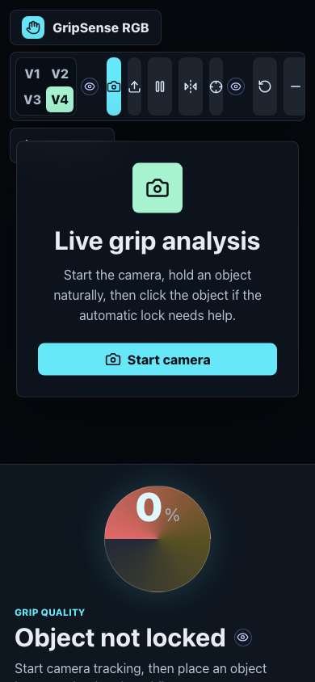
PRODUCT FEATURES
V4 is already shaped as a working internal platform.
It is not only an algorithm demo; it includes the product surfaces needed for training, evaluation, debugging, and reporting.
Object profiles
Guided training
list trained objects, enable/disable target tracking
camera capture/upload, crop/mask, multi-angle roles
Live diagnostics
Offline review
object lock, identity match, grip stability, motion state
video timeline, weak segments, slip events, report export
Explainability
Privacy-first
info buttons and debug evidence for every score
browser-local v1 path with optional stronger local server
GripSense RGB | AX Transformation | SRIB | 13

Slide 14
TEAM IMPACT: XR
XR can use GripSense as a rapid hand-object interaction probe.
Useful before headset integration, especially for markerless object affordance experiments and human-object interaction datasets.
Object-aware hand overlays for AR interaction prototypes
Example XR experiments
Grip-state cues for controller-free object manipulation
detect when a mug/tool is being held vs touched
compare phone-side grip stability before gesture trigger
Offline replay for comparing gestures across users/objects
collect annotated affordance data without markers
test AR hint overlays around suggested grip points
Target-object gating to reduce false contextual actions
GripSense RGB | AX Transformation | SRIB | 14

Slide 15
TEAM IMPACT: VISUAL INTELLIGENCE
Visual Intelligence gets a practical benchmark for RGB object-hand reasoning.
The tool creates reusable examples of hard cases: occlusion, poor lighting, target confusion, empty-hand false positives, and object-in-motion tracking.
Dataset creation
Model evaluation
Generate structured samples with object labels, masks, grip states, motion states, and frame timelines.
Compare browser descriptors, ONNX embeddings, CLIP/DINO-style local servers, and segmentation/detection models.
Failure mining
Explainability
Collect false positives/negatives as replayable cases for model improvement.
Score breakdown makes model behavior inspectable by engineers and product owners.
GripSense RGB | AX Transformation | SRIB | 15

Slide 16
TEAM IMPACT: ROBOTICS
Robotics can turn human demonstrations into grip and manipulation evidence.
GripSense can help robotics teams study how people naturally hold objects before translating them to robot grasps, fixtures, or task policies.
Human demo
record object handling with webcam/offline video
Grip evidence
extract stable/weak/slip intervals and suggested contact zones
Robot insight
inform grasp candidates, imitation learning labels, and manipulation tests
GripSense RGB | AX Transformation | SRIB | 16

Slide 17
TEAM IMPACT: ON-DEVICE AI
On-device teams get a privacy-first benchmark for deployable perception.
The current implementation keeps inference local in the browser, while the V4 interfaces are prepared for edge embeddings and model-compression experiments.
RGB-only
Local-first
Embedding-ready
Explainable
works before depth/sensors are available
no backend required for V4 prototype
ONNX/local server descriptor path
diagnostic scores map to modules
On-device research questions it can support
What descriptor size is enough? How many frames are needed for stable identity? What is the latency budget for grip guidance? Which failure cases require depth, IMU, or sensor fusion?
GripSense RGB | AX Transformation | SRIB | 17

Slide 18
AX IMPACT
The platform creates reusable leverage beyond one demo.
GripSense can become a shared experimentation asset for product interaction, automation, model validation, and internal R&D storytelling.
Faster experiments
Lower equipment cost
Better datasets
turn webcam tests into structured observations in minutes
start with RGB before depth rigs or smart objects
save object profiles, masks, examples, timelines, exports
More honest AI
Team reuse
Investor/IP signal
uncertainty states prevent misleading high scores
same pipeline supports XR, VI, Robotics, and On-device AI
novel object-first visual grip estimation workflow
GripSense RGB | AX Transformation | SRIB | 18

Slide 19
NOVELTY
The novelty is in the productized perception loop, not a single isolated model.
GripSense combines target-object training, temporal identity, grip-mode scoring, and explainable diagnostics into one live/offline workflow.
Target object identity
92%
Research direction
Temporal stability
86%
Move from RGB visual stability to calibrated grip confidence by adding embeddings, depth, IMU, pressure sensors, or smart-object data when needed.
Grip-mode evidence
78%
Offline reports
70%
Sensor-free start
95%
GripSense RGB | AX Transformation | SRIB | 19

Slide 20
LIMITATIONS AND ROADMAP
The system is useful because it is honest about what RGB can and cannot know.
The current app estimates visual stability; it does not directly measure physical force. That boundary keeps research conclusions defensible.
RGB limitation
cannot measure real pressure, torque, or hidden contact force
Near
V4 object profiles, better motion stability, offline reports
Occlusion
hidden fingers/object surfaces reduce evidence quality
Next
Lighting
glare and low light can affect descriptors and landmarks
browser ONNX embeddings or local CLIP/DINO server
Object ambiguity
similar products need stronger embeddings or negatives
Future
depth, IMU, pressure sensors, gloves, smart objects
GripSense RGB | AX Transformation | SRIB | 20

Slide 21
ADOPTION PLAN
A practical 90-day AX transformation path.
Use the prototype to create measurable internal value quickly, then harden the perception stack where teams show demand.
0-30 days
31-60 days
61-90 days
Internal demo and team feedback
Dataset and model bake-off
Pilot workflows
XR/VI/Robotics/On-device teams test common objects and log failure cases.
Compare browser descriptor with ONNX/local embedding server on shared scenarios.
Offline reports, trained object registry, team-specific dashboards, acceptance criteria.
Success metrics: false-positive reduction, stable detection latency, object-profile robustness, offline report completion rate, and number of team reuse cases.
GripSense RGB | AX Transformation | SRIB | 21

Slide 22
LIVE DEMO AND ASK
Demo flow: train target object, enable it, move it, then review live and offline grip evidence.
This slide intentionally leaves a clean placeholder for the final screen-recorded demo video.
Submission ask
Approve AX transformation submission as an internal reusable R&D tool
INSERT LIVE DEMO VIDEO
Run pilot with XR, Visual Intelligence, Robotics, and On-device AI teams
Recommended: 45-75 seconds showing object training, target detection, grip score, motion stability, and offline export.
Collect shared test objects and failure cases
Evaluate embedding-based V4/V5 upgrade path
Inventor: Dewanshu Haswani
GripSense RGB | AX Transformation | SRIB | 22

