Slide 1



Prediction of Gene Expression from Chromatin Landscape
Onepunch team
Ding-Yang Wang
12/11/2025

Slide 2
Essential for any project
The data
What do we have for this study/competition?
What are the limitations of the current dataset?
Preprocessing
What preprocessing steps are appropriate?
Feature engineering
What features do we need and why?
Model selection
Which state-of-the-art models fit this dataset?
Training & evaluation
How will we design the training strategy and evaluation protocol?
Do Exploratory Data Analysis (EDA)!

Slide 3
Overview the dataset
Gene Expression
Gene Information
H3K27me3 (ChIP-seq)
H3K4me1 (ChIP-seq)
H3K4me3 (ChIP-seq)
H3K27ac (ChIP-seq)
H3K36me3 (ChIP-seq)
H3K9me3 (ChIP-seq)
Chromatin Accessibility (DNase-seq)
Chromatin Landscape

Slide 4
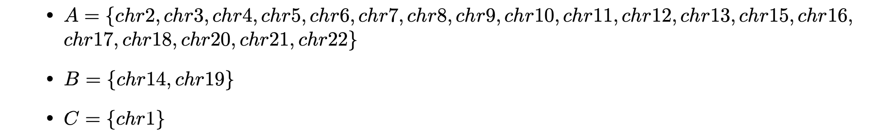
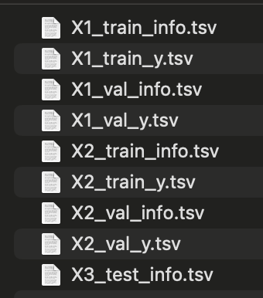
EDA - Gene Information
Cell line: X1, X2, X3
X1, X2 train =
X1, X2 val =
X3 test =
This task is about cross-chromosome and cross-cell lines prediction!
Choose your training strategy wisely!

Slide 5
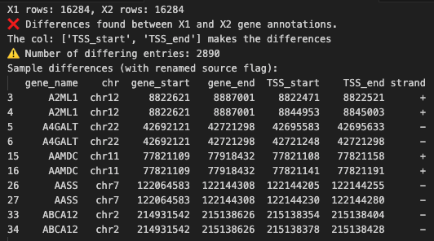
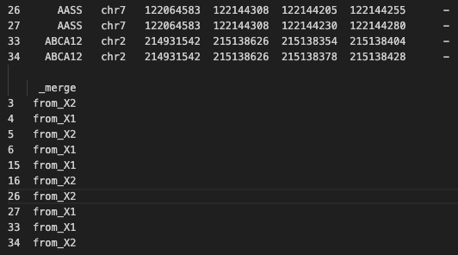
EDA – Reference Gene Information
Only the TSS values differ.
X1 and X2 share the same gene set.
Different TSSs can alter a gene’s transcript abundance and isoform composition. (Xi Wang et al. 2016)
Karlsson et al. (2017) showed that TSSs within the same gene are largely co-regulated, exhibiting positive correlations in usage.
TSS_start = min(TSS_start_X1, TSS_start_X2)
TSS_end = max(TSS_end_X1, TSS_end_X2)
Notes:
Multiple TSSs can modulate the same gene’s transcript abundance and isoform composition.
In this study, TSSs within the same gene are largely co-regulated, showing positive correlations in usage.
Correlation strength depends on distance: proximal TSSs (≈ within the same promoter) correlate more strongly, whereas distant alternative promoters show weaker correlations.

Slide 6
EDA – Reference Gene Information
Only the TSS values differ.
X1 and X2 share the same gene set.
Therefore, all three cell lines should share the same gene set.
X1, X2 + X3 = reference chr1-22 gene set

Slide 7
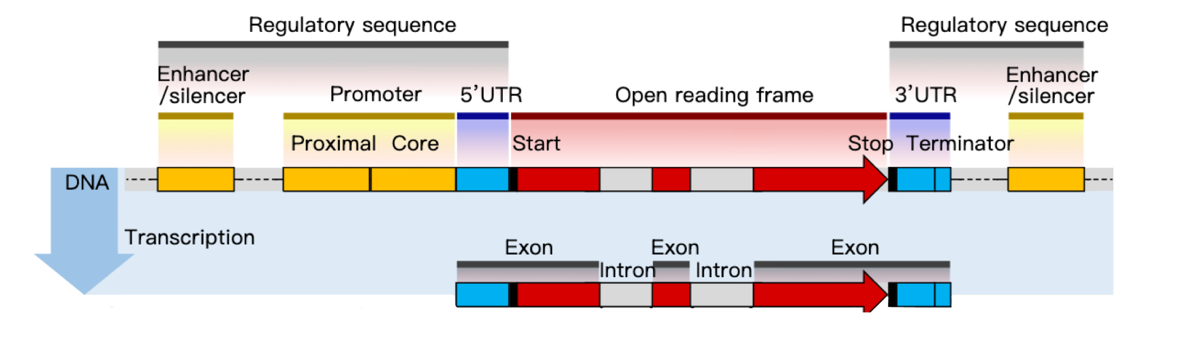
EDA – Gene Information
window size
TSS
RNA
Key regulatory signals cluster near the promoter/TSS (ENCODE Project Consortium et al., 2020).
Therefore, we need to set and find the optimal window size.

Slide 8
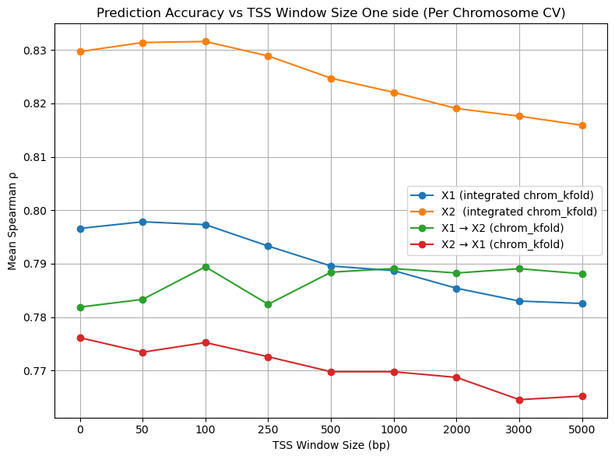
EDA – The Optimal Window Size

Slide 9
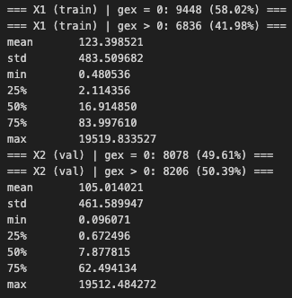
EDA – Gene Expression
Roughly 50% zeros
Consider a two-stage approach (classifier for zero vs. non-zero, then regression on positives).
Skewed, long-tailed gex
Apply a transformation (e.g., log1p/Box-Cox/yeo-Johnson/rank) to stabilize gradients and improve learnability.
gex -> rank_gex

Slide 10
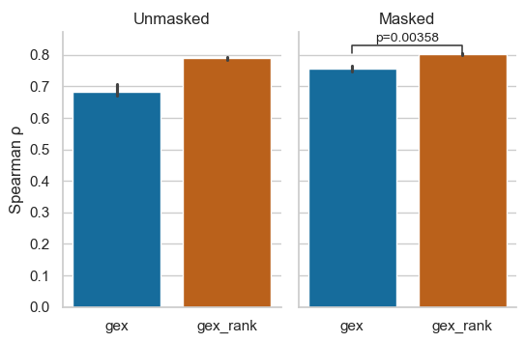
EDA – Gene Expression
P = 0.0033

Slide 11
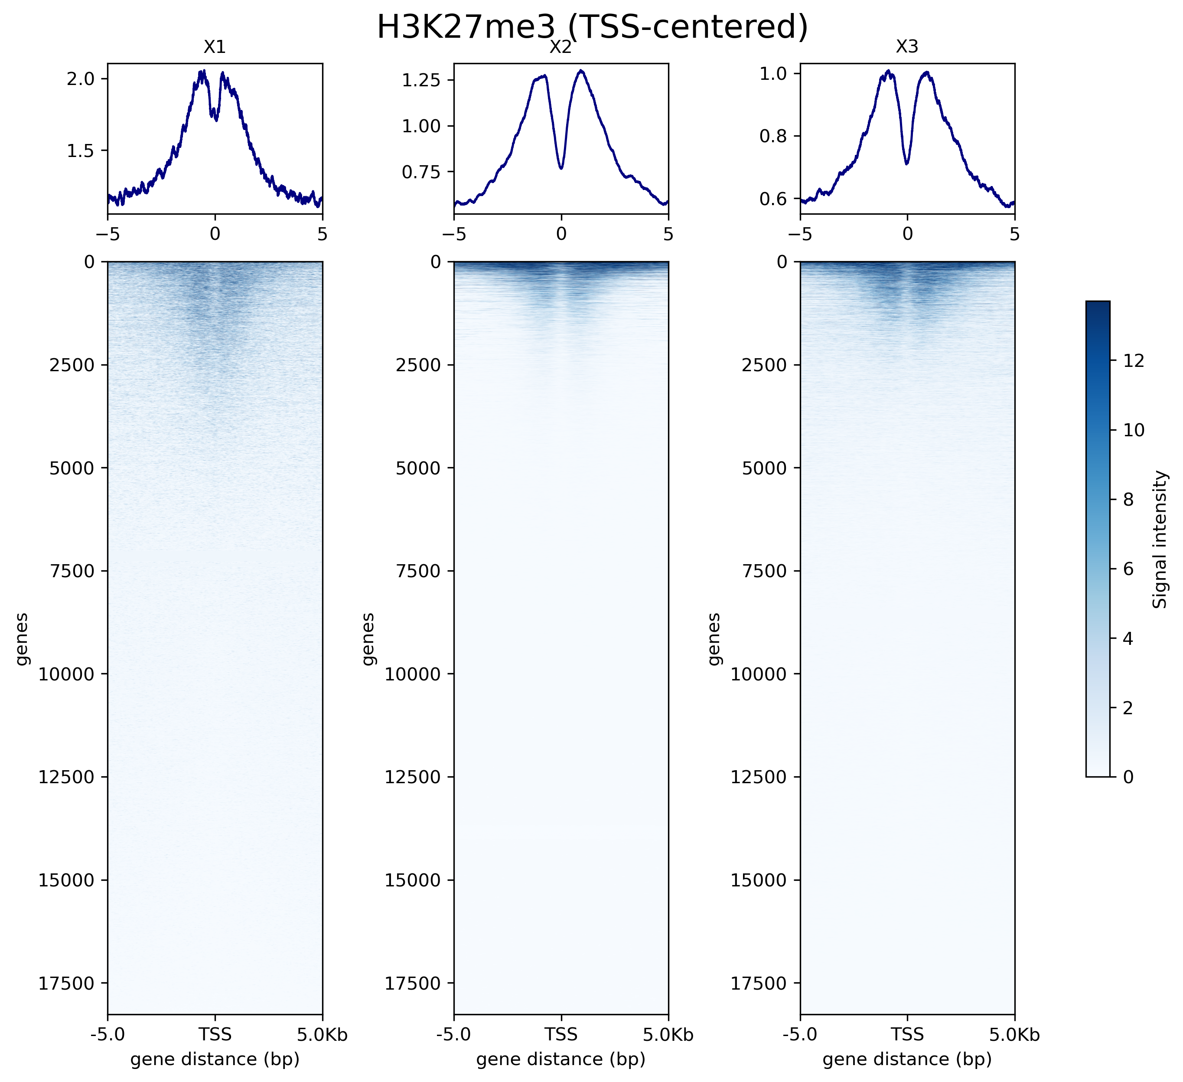
EDA – Chromatin Landscape
Chromatin signal scales differ across cell lines, indicating potential batch effects.
Apply transformations (e.g., log1p, per-track z-scoring, or quantile normalization) to reduce batch effects and improve generalization.

Slide 12
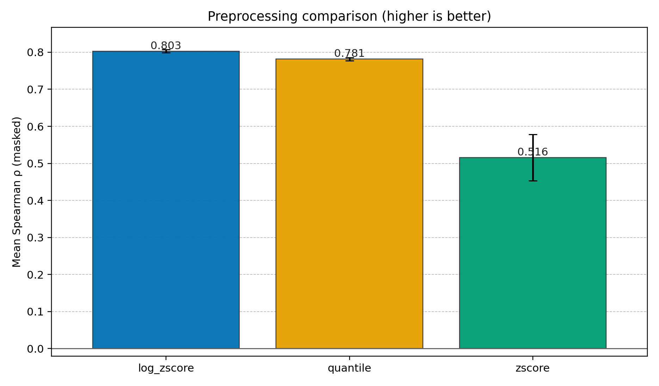
EDA – Chromatin Landscape
Chromatin signal scales differ across cell lines, indicating potential batch effects.
Apply transformations (e.g., log1p, per-track z-scoring, or quantile normalization) to reduce batch effects and improve generalization.
log1p transform - > z-score

Slide 13
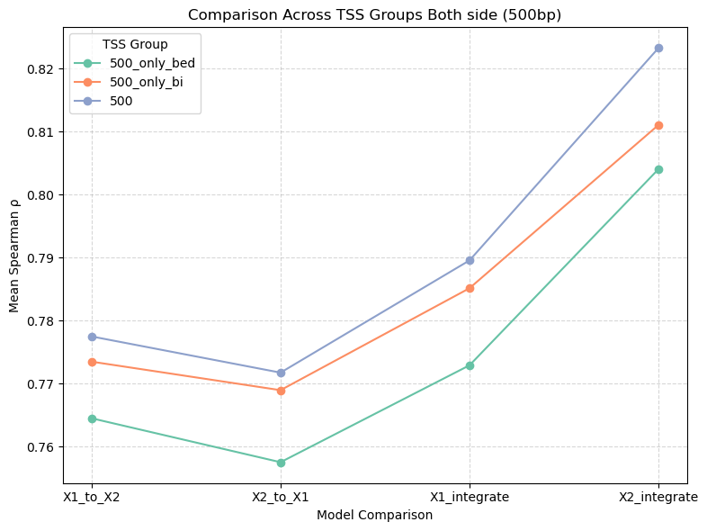
EDA – BigWig vs. BED
A BigWig file is a continuous signal track that stores a value per genomic position.
A BED file lists genomic regions with the mean signal value.
Both > BigWig > BED

Slide 14

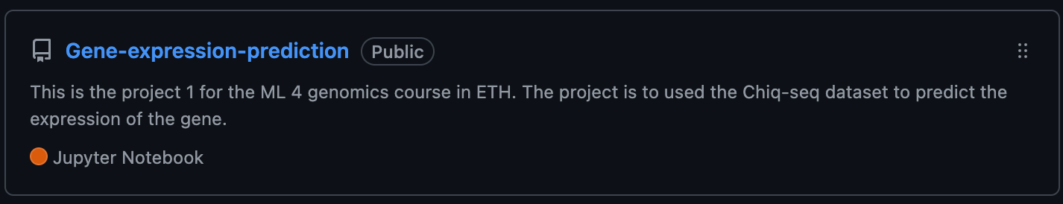
Features Engineer
BigWig & BED features: signal_sum, signal_mean, signal_std, signal_min, signal_max, signal_diff etc.

Slide 15
Model selection
Our data are tabular, and chromatin-derived features can exhibit non-linear interactions.
I used LightGBM for both binary classification and regression because it
efficiently captures non-linearities and feature interactions,
trains fast and scales well,
is more interpretable than deep nets (feature importance/SHAP), and
handles heterogeneous features and missing values with minimal preprocessing.

Slide 16
The Training Strategy
This task is about cross-chromosome and cross-cell lines prediction!
Cell line
Chromosome

Slide 17
The Training Strategy - Cell line
Pooled training (mix all cell lines):
Train/validate on the combined dataset from all cell lines.
Within–cell line:
Train and validate on the same cell line (no cross-line mixing).
Cross–cell line:
Train on one cell line and validate on a different cell line.
Pooled training: Captures the most general, cross–cell line patterns.
Within–cell-line training: Emphasizes cell line–specific patterns.

Slide 18
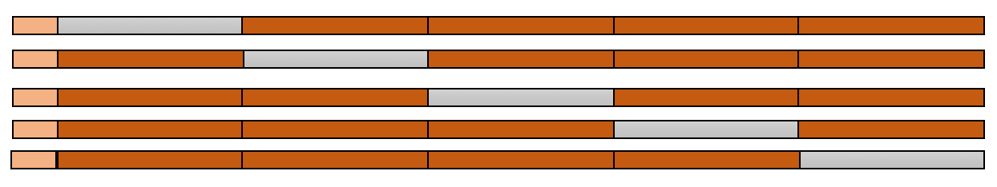
The Training Strategy - Chromosome
leave-one-chromosome-out (LOCO). For each held-out chromosome, perform k-fold CV on the remaining chromosomes for both binary classification and regression.
Test chr
Val chrs
Train chrs
x21 For each chr
x2 For both models

Slide 19
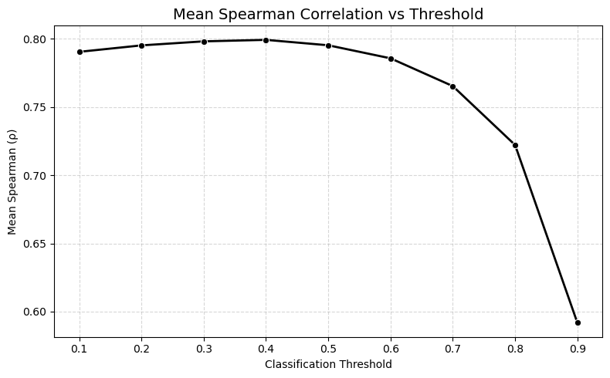
Binary Threshold selection

Slide 20
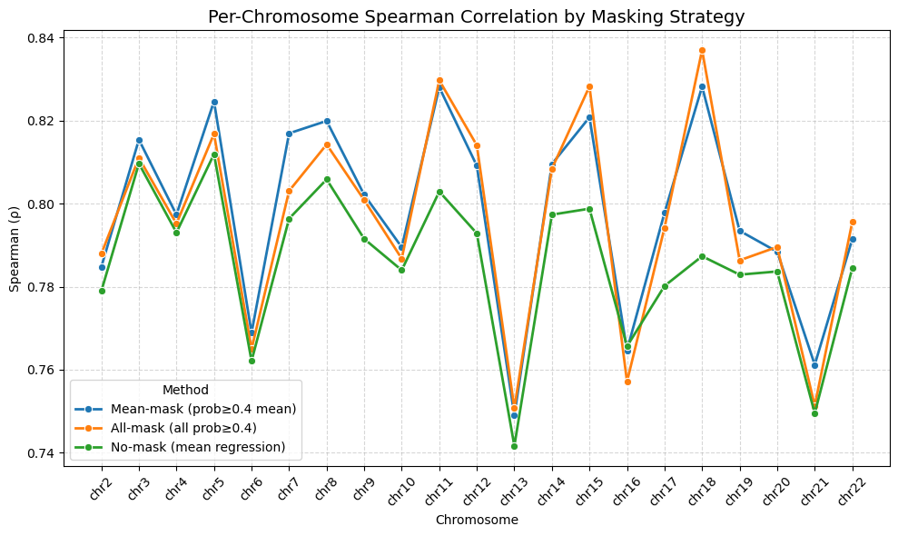
Binary Strategy selection

Slide 21
Prediction stacking
Final predictions are stacked across the three setups.
X1+X2 pooled: mix X1+X2 for train/val
X1-only: train/val on X1
X2-only: train/val on X2

Slide 22
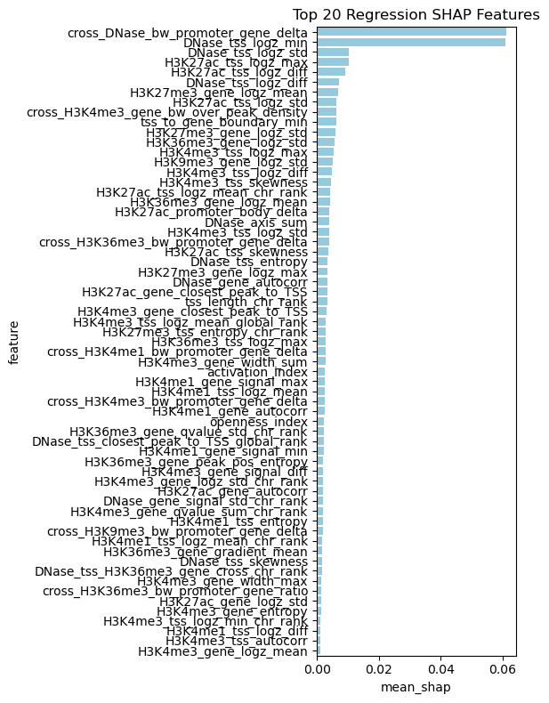
Result Interpretation
Chromatin accessibility is a crucial factor to predict the gene expression.

Slide 23
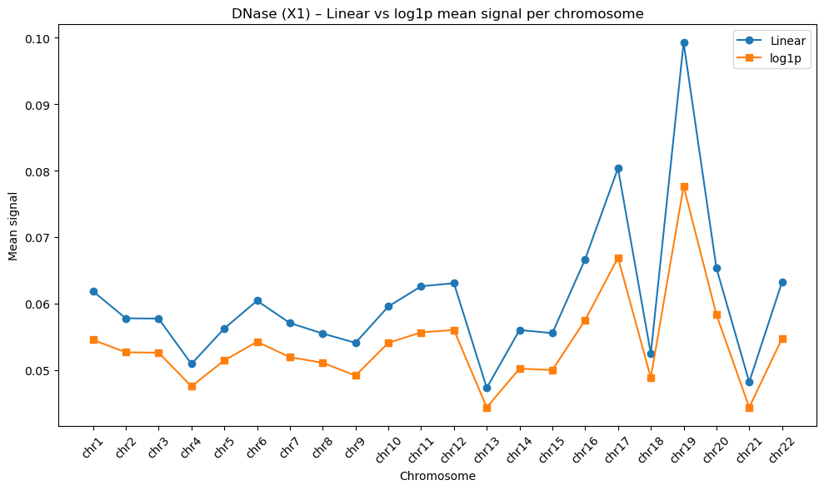
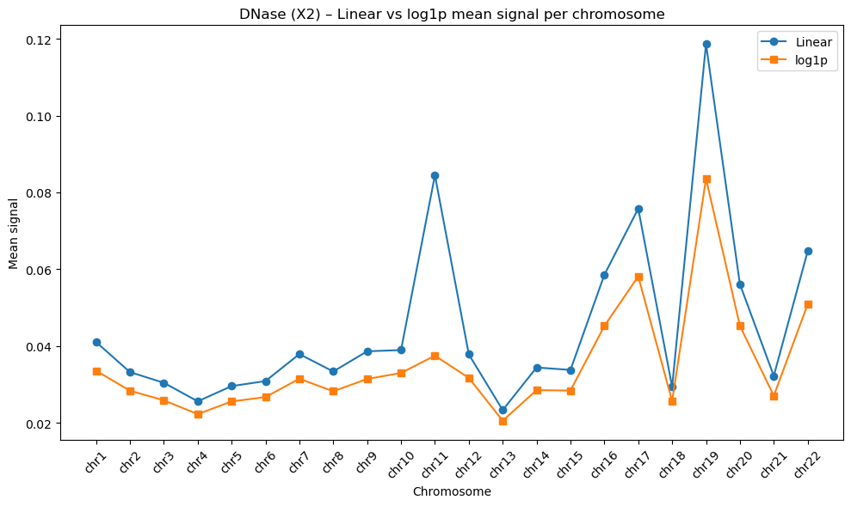
Question for you
Why log1p and z-score have the best performance?

Slide 24
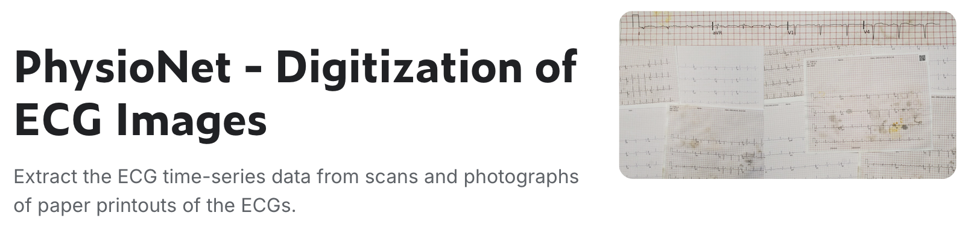

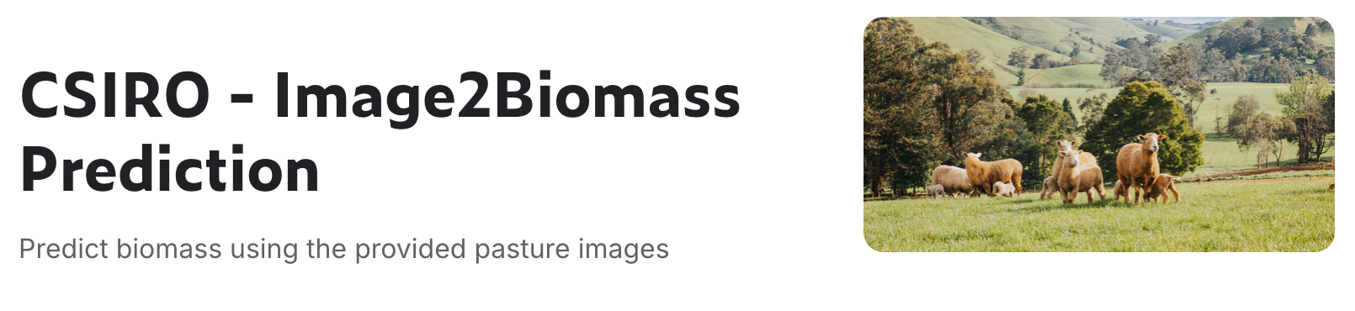
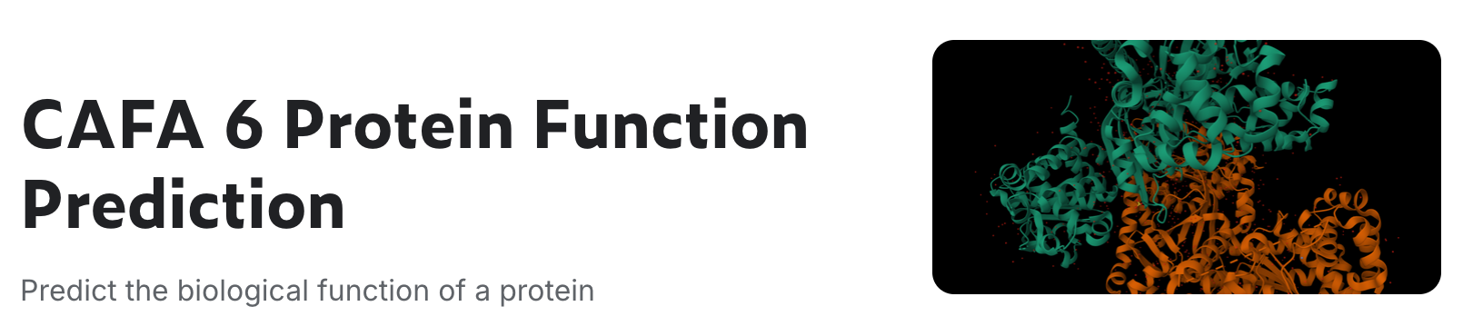
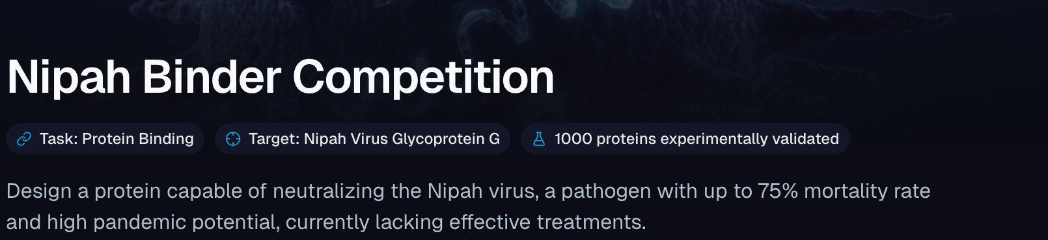
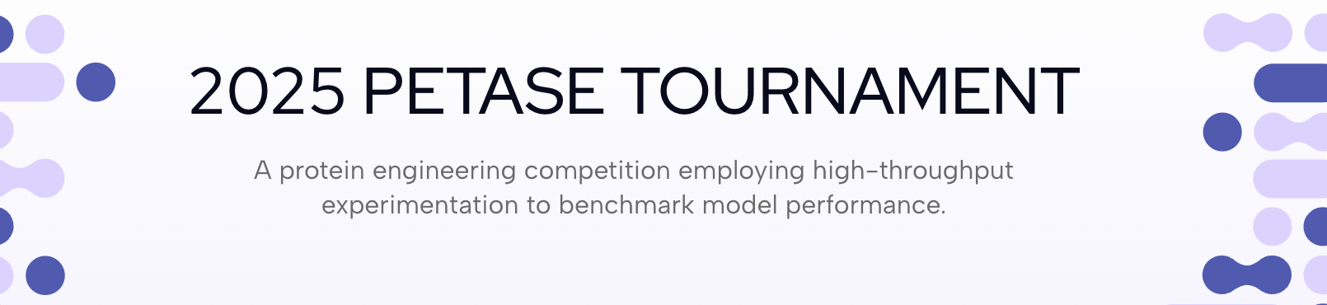

Competitions
dingyang.wang@uzh.ch

