Slide 1

ChatXPT
Stream to Engage, Viewer with Agency
An AI stream director that turns gameplay context, audience energy, and streamer style into safe sidequests viewers choose in real time.
Kevin Yong (Team Lead)
Joel Yap | Fred | Lim Jia Yin | Phua Jun Kai
REPO LENS README.md | docs/PRODUCT_BRIEF.md
01
Notes:
Open on the product promise: ChatXPT adds structured viewer agency to streams without replacing Twitch or OBS.
[Sources]
- local: README.md
- local: docs/PRODUCT_BRIEF.md
- local visual: twitch-upload-assets/ui-snapshots/studio-viewport-generated.png

Slide 2
The struggle of small streamers
OVERVIEW
A 2024-2025 regional Twitch audit shows why emerging creators need stronger participation mechanics, not simply more hours online.
75.23%
90%
-27.4%
creator attrition
audience concentration
average audience
Creators present in the earlier cohort but absent in the later period.
Share of audience attention held by the top 20% in the audited ecosystem.
Decline among creators active in both periods: 17.67 to 12.83 viewers.
Small streamers fail to capture audience due to high barriers of entry:
Limited algorithmic discoverability
Complex production tools
Constant manual engagement
Repetitive content
Competition from established creators
Better gameplay alone is not enough.
Smaller streamers need repeatable moments that reveal personality and give viewers a reason to participate.
Evidence: Padilla, 2025 OSF preprint. Regional audit; not a global Twitch estimate.
REPO LENS docs/research/PRODUCT-VALIDATION.md | docs/PRODUCT_BRIEF.md
02
Notes:
Use the figures as evidence of pressure and concentration, not as a universal Twitch statistic. The product opportunity is repeatable participation for emerging creators.
[Sources]
- https://doi.org/10.31235/osf.io/gef2q_v1
- local: docs/research/PRODUCT-VALIDATION.md

Slide 3
Engagement Difficulties
OVERVIEW
Livestream chat creates lots of messages but little structured participation.
Turning reactions into engaging content is inconvenient and mentally tiring because the streamer must read, interpret, moderate, invent, and operate controls while still playing.
This makes today's engagement is manual, shallow, and tiring to sustain
CHAT
MANUAL WORK
STREAMER FATIGUE
>
>
Fast chat is noisy. Quiet chat provides too little signal.
Read, interpret, moderate, invent a poll, and operate controls while playing.
Gameplay is interrupted and engagement becomes inconsistent or repetitive.
Viewers comment, but rarely influence the next playable moment.
Generic polls ignore game state, audience mood, and streamer boundaries.
Existing polls and chat tools are generic and are disconnected from game state
Manual management of viewer engagement while playing is a challenge
Audience ideas get buried
Content becomes repetitive
Smaller creators lose chances to build loyal communities.
Problem statement: poor engagement plus manual conversion creates streamer burden.
REPO LENS docs/PRODUCT_BRIEF.md | docs/research/PRODUCT-VALIDATION.md
03
Notes:
State the problem plainly: existing chat is expressive but operationally weak. The streamer carries the cost of turning it into content.
[Sources]
- local: docs/PRODUCT_BRIEF.md
- local: docs/research/PRODUCT-VALIDATION.md

Slide 4
ChatXPT removes the manual burden, one step at a time
OVERVIEW
PROBLEM
PROPOSED SOLUTION
01
Noisy or weak chat signals
>
Separate gameplay, audience, and streamer-profile inputs become one usable context.
02
Streamer must invent engagement
>
AI-ready intelligence produces exactly three distinct, vote-ready sidequests.
03
Manual prompts can be unsafe or disruptive
>
Deterministic rules enforce safety, feasibility, timing, diversity, and veto boundaries.
04
Viewer input disappears into chat
>
Twitch voting selects a winner; OBS shows it; progress and outcome return to the session.
Observe > understand > propose three > validate > vote > activate > resolve > learn
Solution mapping: each product mechanism resolves a stated burden from slide 3.
REPO LENS src/core/ | src/ai/ | src/quest-engine/ | src/viewer/
04
Notes:
Walk left to right. ChatXPT does not add another manual poll; it automates context assembly and option creation while keeping deterministic safety and streamer authority.
[Sources]
- local: docs/PRODUCT_BRIEF.md
- local: docs/ARCHITECTURE.md
- local: src/core/
- local: src/ai/
- local: src/quest-engine/
- local: src/viewer/

Slide 5
The MVP proves one complete path inside a larger product
OVERVIEW
FULL CHATXPT
TWITCH-FIRST MVP
Cross-platform AI stream director
What we prove now
Persistent streamer and viewer profiles
Multi-game intelligence and calibration
Engagement analytics and adaptive timing
Platform adapters and cross-stream history
ChatXPT Studio + Twitch viewer surface
OBS Browser Source overlay
Gameplay, chat, and profile context
Exactly-three algorithmic candidates
Deterministic safety, voting, and lifecycle
DEFERRED, NOT DISGUISED
Non-Twitch adapters, public SDK/API, billing, monetary rewards, official telemetry partnerships, production-scale moderation, and public Extension review.
Scope evidence: implemented Twitch-first surfaces plus explicitly deferred expansion.
REPO LENS AGENTS.md | docs/PRODUCT_BRIEF.md | docs/DECISIONS.md
05
Notes:
This slide prevents scope confusion. ChatXPT is platform-neutral by architecture, but Twitch is the only supported platform in the MVP.
[Sources]
- local: AGENTS.md
- local: docs/PRODUCT_BRIEF.md
- local: docs/DECISIONS.md

Slide 6
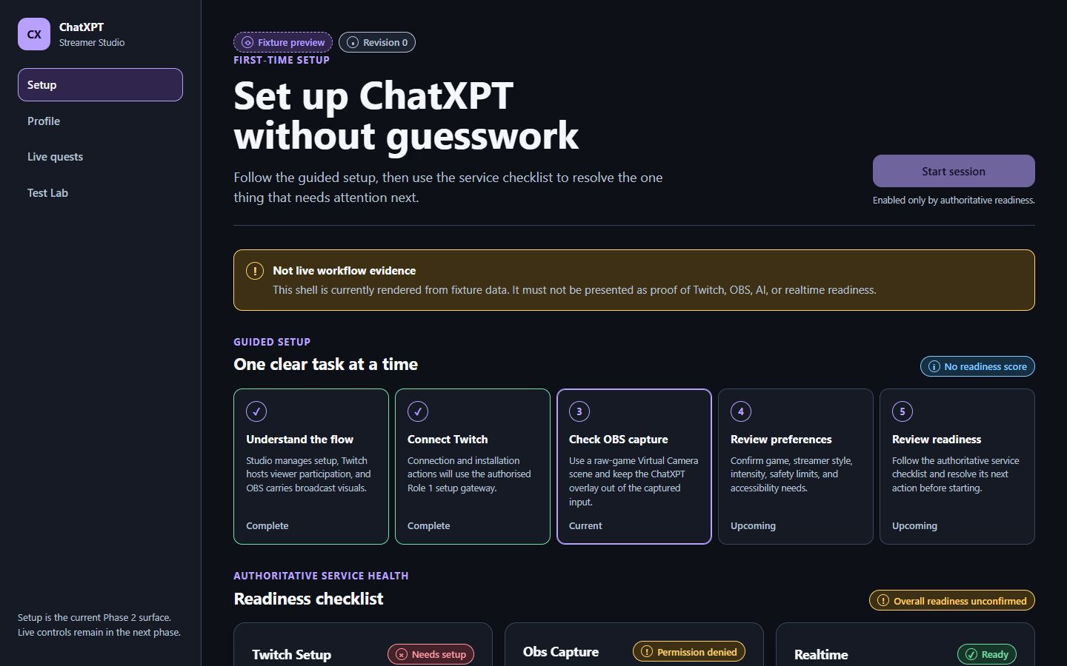
Twitch gives the MVP an interactive home without replacing OBS
USERS
Twitch supports panel, overlay, and video-component Extensions. ChatXPT can put voting beside the live video while OBS remains the broadcast tool.
01
First setup
Connect Twitch, select the capture source, add one ChatXPT Browser Source to the OBS scene, and save preferences.
02
Every later stream
Open the same OBS scene. Existing sources remain; ChatXPT observes and automation can open a vote when the chosen trigger is met.
ONE-TIME SETUP > OBS REMEMBERS THE SCENE > RETURNING STREAMS START FASTER
Evidence: Twitch supports Extension viewer surfaces; setup screenshot is local product evidence.
REPO LENS src/integrations/twitch/ | src/integrations/obs/ | src/streamer/
06
Notes:
Explain the exact intended flow: configure OBS once, then reuse the same scene in future streams. ChatXPT does not host or replace the video stream.
[Sources]
- https://dev.twitch.tv/docs/extensions/
- local: src/integrations/twitch/
- local: src/integrations/obs/
- local visual: changes/role-4/evidence/r4-p03/setup-desktop.png

Slide 7
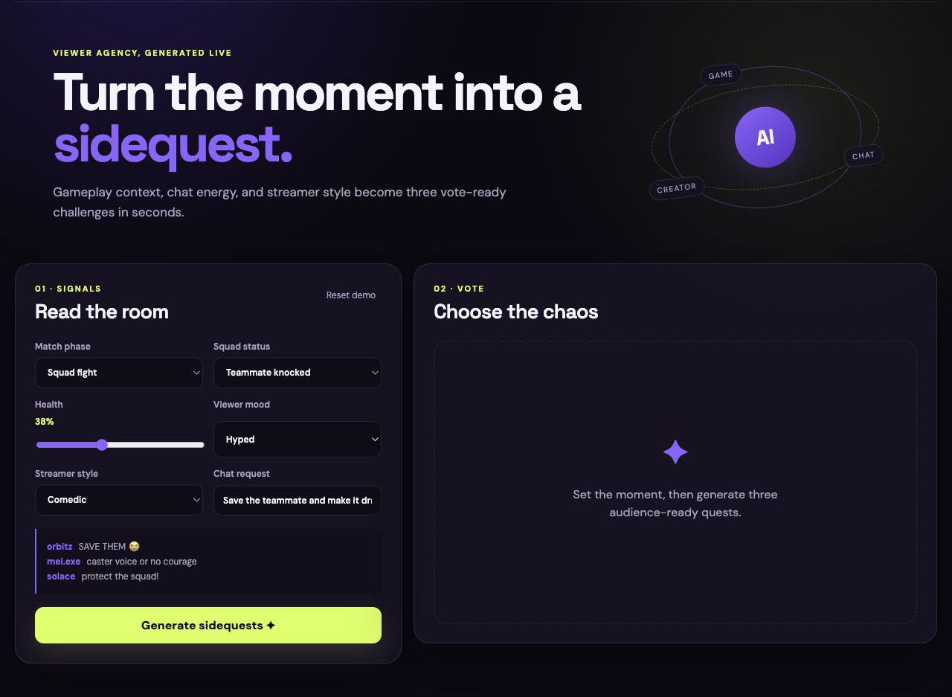
Streamers choose how much the system automates
USERS
AUTOMATIC
Set the trigger once.
Keep playing.
ChatXPT assesses silently, generates three quests, opens the viewer vote, and sends the winning quest to the overlay.
MANUAL
Review before viewers see it.
Analysis and generation still happen, but the streamer approves, rejects, or delays the vote.
Always available: emergency pause | skip/cancel/result | intensity | connection health | current context
Control principle: automation reduces work; it never removes streamer veto or safety authority.
REPO LENS src/streamer/ | src/core/application/ | docs/DECISIONS.md
07
Notes:
Automatic and manual modes solve different creator comfort levels. The safety rules remain identical in both modes.
[Sources]
- local: src/streamer/
- local: src/core/application/
- local: docs/DECISIONS.md
- local visual: twitch-upload-assets/ui-snapshots/studio-control-room.png

Slide 8
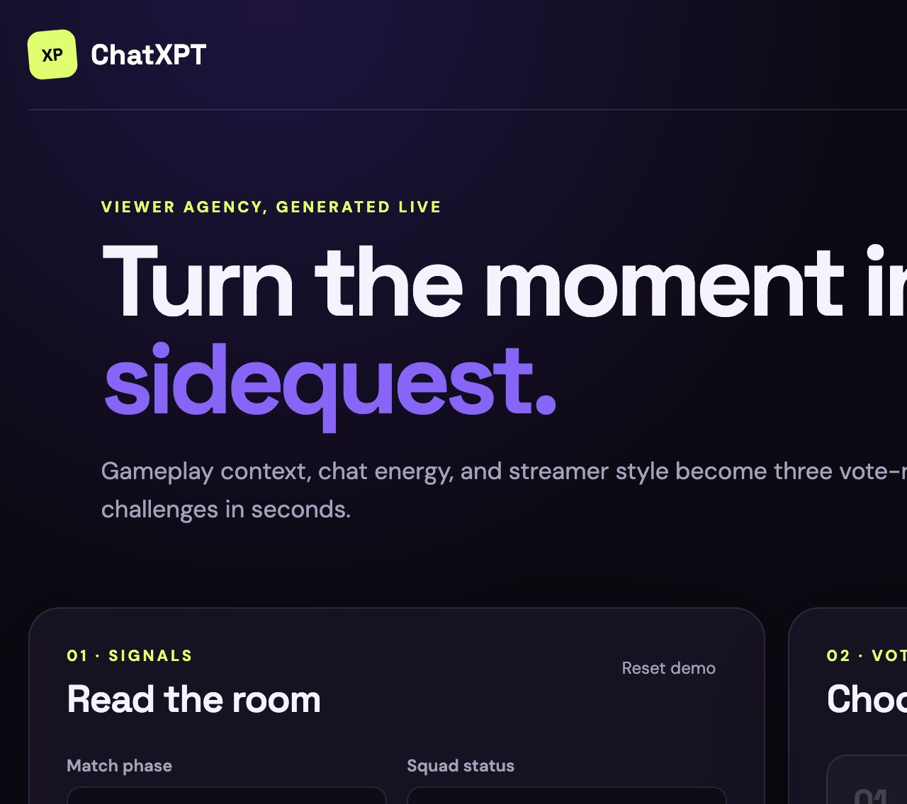
Customise once; keep the streamer's personality in the loop
USERS
SAVED CREATOR INPUT
Game context
title/category, capability, phase
Performance style
tone, comedy, intensity, creativity
Boundaries
forbidden types, safety, accessibility
Intervention
automatic/manual, trigger, vote duration
Rewards
points, hype, result handling
ChatXPT should amplify the creator, not replace them.
Current MVP: Studio exposes the control model; authenticated profile persistence requires final integration proof.
REPO LENS src/streamer/ | src/core/contracts/ | src/quest-engine/
08
Notes:
The creator profile is a first-class input, separate from game and audience signals. Persistent storage is described as intended product behaviour until deployment evidence exists.
[Sources]
- local: src/streamer/
- local: src/core/contracts/
- local: src/quest-engine/
- local visual: twitch-upload-assets/ui-snapshots/studio-generated-quests-working.png

Slide 9
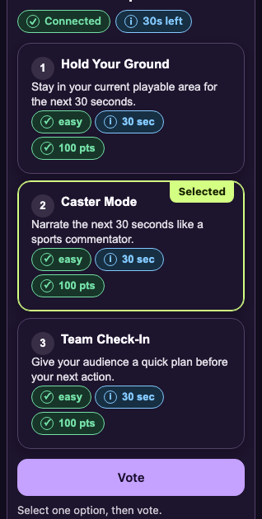
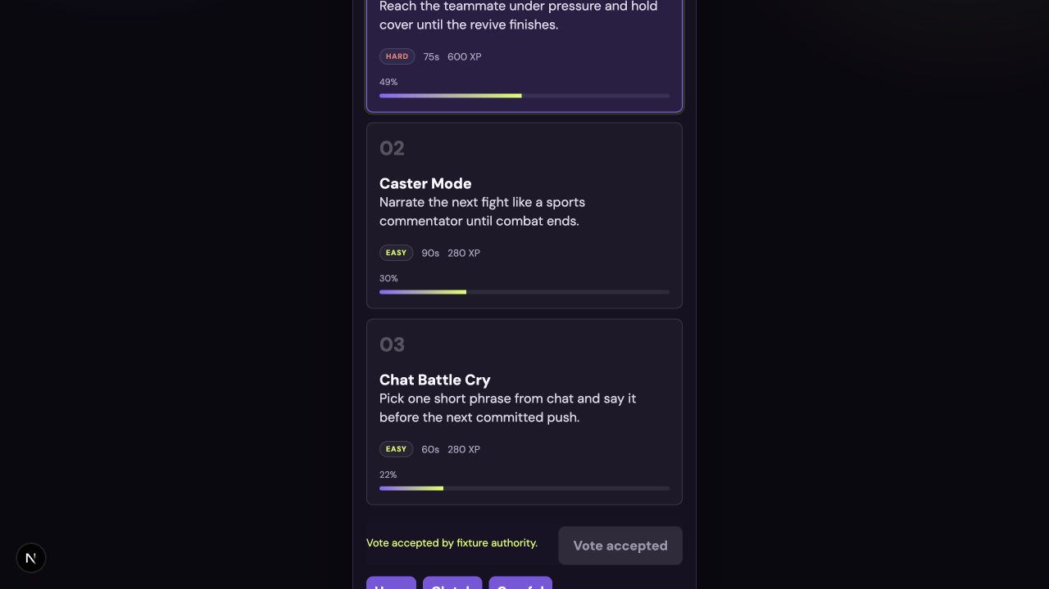
Viewer agency turns watching into a shared decision
USERS
Research on 2,227 Twitch users found that social interaction and sense of community help explain engagement, with stronger social motivations among viewers who preferred smaller channels.
The MVP therefore measures accepted-vote participation first. Belonging, retention, and return behaviour remain hypotheses to test, not claimed outcomes.
SEE THREE
>
VOTE
>
ACKNOWLEDGE
>
WATCH RESULT
Primary KPI
Viewer participation rate
Research: Hilvert-Bruce et al., 2018; participation-at-scale study. Compact surface is fixture-only.
REPO LENS src/viewer/ | src/realtime/ | docs/DECISIONS.md
09
Notes:
The viewer never has to leave Twitch for the primary experience. Make the evidence boundary explicit: the compact screenshot is fixture-rendered, while the interaction design is implemented.
[Sources]
- https://doi.org/10.1016/j.chb.2018.02.013
- https://arxiv.org/abs/2012.00215
- local: src/viewer/
- local: docs/evidence/manifest.json
- local visual: docs/evidence/artifacts/2026-08-09-role-5-twitch-compact-voting-fixture-only.png
- local visual: twitch-upload-assets/ui-snapshots/role5-twitch-extension-vote-accepted.png

Slide 10
One interaction creates value across the livestream ecosystem
USERS
STREAMER
VIEWER
PLATFORM
Turn a quiet or intense moment into a structured challenge without stopping to invent one.
Influence the next moment without leaving Twitch or creating a separate account.
Add differentiated, on-platform interactivity around existing live video.
Measure setup time, control burden, veto rate, completion.
Measure participation, vote completion, reconnect, reactions.
Evaluate watch, follow, and support outcomes later.
RESEARCH-BACKED HYPOTHESIS
Live viewing can strengthen presence and connection; activated engagement is associated with virtual gifting. ChatXPT must still measure its own uplift before claiming retention or earnings impact.
Evidence: Duani, Barasch & Ward, 2026; Chokpaisan et al., 2026. No guaranteed uplift claim.
REPO LENS docs/DECISIONS.md | docs/evidence/manifest.json | src/viewer/
10
Notes:
This is the business-value bridge. Research supports the direction, while ChatXPT's own effect remains a testable hypothesis with explicit product metrics.
[Sources]
- https://doi.org/10.1177/00222429261421488
- https://doi.org/10.1186/s40359-026-04813-x
- local: docs/DECISIONS.md
- local: docs/evidence/manifest.json

Slide 11
OBS intelligence creates honest, confidence-scored AI context
MECHANISM
THREE INPUTS STAY DISTINCT
OBS FRAMES
AUDIENCE
STREAMER PROFILE
>
AI CONTEXT
motion, activity, quiet, transitions, bounded OCR
chat energy, humour, boredom, requests, moderation
style, intensity, boundaries, game capability
timestamped observations with confidence and provenance
IMPLEMENTATION DECISIONS
01
Universal signals first
02
Calibrate only what is reliable
03
Protect trust and privacy
Broad activity and transition signals work across genres before game-specific HUD facts.
Selective OCR runs on bounded named regions; unsupported health, kill, score, or phase stays unknown.
Raw frames are ephemeral, carry provenance, and exclude the ChatXPT overlay to avoid recursive analysis.
AI assists context inference; uncertainty is a product state, not a reason to fabricate game facts.
Technical decisions: D-028, D-029, D-033, D-049, D-054.
REPO LENS src/extraction/ | src/ai/ | src/integrations/obs/ | docs/DECISIONS.md
11
Notes:
This is where AI begins: reliable visual and audience features are assembled into confidence-scored context. The system reports unknown rather than guessing unsupported facts.
[Sources]
- local: src/extraction/
- local: src/ai/
- local: src/integrations/obs/
- local: docs/DECISIONS.md (D-028, D-029, D-033, D-049, D-054)

Slide 12
The candidate layer is AI-ready and credential-free today
MECHANISM
MODEL-READY CONTEXT
Gameplay snapshot
Audience signal
CONTEXT ASSEMBLY
ALGORITHMIC INTELLIGENCE
>
capability-aware, structured, timestamped, privacy-bounded
>
genre-aware generation using real context; no external API key
Streamer profile
Recent quests
Restrictions
EXACTLY THREE CANDIDATES
01
Mechanical
02
Social
03
Comedic
clear in-game constraint
audience-shaped performance
personality-forward challenge
Judged MVP: credential-free algorithmic generator. External model provider not configured under D-055.
REPO LENS src/ai/ | src/lib/mock-engine.ts | src/app/api/sidequests/route.ts
12
Notes:
Be precise about AI. The architecture is model-ready and the intelligence work is contextual, but the judged candidate path is the no-credential algorithmic generator. Any future model remains server-side and fallback-safe.
[Sources]
- local: src/ai/
- local: src/lib/mock-engine.ts
- local: src/app/api/sidequests/route.ts
- local: docs/DECISIONS.md (D-055)

Slide 13
AI proposes; the deterministic quest engine decides
MECHANISM
UNTRUSTED INPUT
>
VALIDATE
>
REPLACE
>
EXACTLY THREE
AI or algorithmic candidate batch
schema, safety, legality, privacy, boundaries, capability
deterministic fallback fills invalid or missing options
clear, distinct, feasible, vote-ready quests
DETERMINISTIC LIFECYCLE
PROPOSED
>
VOTING
>
ACTIVE
>
SUCCESS / FAIL / CANCEL / SKIP / EXPIRE
>
COOLDOWN
Server time closes the 30-second vote. The engine resolves majority, ties, zero votes, points, hype, and allowed actions. Streamer auto/manual mode changes approval flow, never safety rules.
UIs display state. They do not calculate winners, rewards, or transitions.
Technical authority: pure deterministic engine; AI output is always validated before viewers or overlay.
REPO LENS src/quest-engine/ | src/quest-engine/validation.ts | src/core/contracts/
13
Notes:
This is the trust boundary. AI increases variety and contextual fit; the pure deterministic engine owns safety, exact-three assembly, voting resolution, and lifecycle transitions.
[Sources]
- local: src/quest-engine/
- local: src/quest-engine/validation.ts
- local: src/core/contracts/
- local: docs/DECISIONS.md (D-030, D-044, D-045, D-047)

Slide 14
One authoritative architecture keeps every surface consistent
MECHANISM
TWITCH + OBS
>
CORE
>
ROLE 2
>
ROLE 3
>
ROLE 1
>
SURFACES
platform adapters
normalised contracts
intelligence + candidates
deterministic engine
orchestrate + persist
Studio / viewer / overlay
TECHNICAL RIGOUR
Versioned Zod contracts
Platform payloads and UI state stay outside neutral domain types.
Authoritative commands
Command IDs, permissions, expected revisions, idempotency, typed errors.
Consistent realtime
Server timestamps, atomic persistence before broadcast, reconnect snapshots.
Least privilege
Role-sanitised views, server-only secrets, read-only OBS output.
Integration evidence
Producer/consumer contract tests and explicit fixture/live labels.
Evidence posture: automated checks prove contracts; real Twitch/OBS is required for live golden-workflow claims.
REPO LENS docs/ARCHITECTURE.md | docs/build-plans/INTEGRATION-CONTRACT.md | tests/integration/
14
Notes:
Explain both the runtime path and the reliability controls. One orchestrator and one authoritative participation service keep Studio, viewers, and OBS on the same revision.
[Sources]
- local: docs/ARCHITECTURE.md
- local: docs/build-plans/INTEGRATION-CONTRACT.md
- local: src/core/
- local: tests/integration/
- local: docs/evidence/manifest.json

Slide 15
Future work: carry the stream director beyond one Twitch MVP
FUTURE
PROFILES + MEMORY
ANALYTICS + ADAPTATION
GAMES + PLATFORMS
Persistent streamer personalities, boundaries, game preferences, cross-stream memory, and privacy-safe viewer profiles.
Quest timing, vetoes, completions, audience response, engagement experiments, adaptive styles, and highlight prompts.
Calibration packs, official telemetry, evaluated AI providers, and adapters for YouTube, Discord, TikTok Live, Kick, and future APIs.
NEXT
SCALE
EXPAND
Prove persistent profiles and engagement analytics on the Twitch workflow.
Deepen game understanding and evaluate server-side AI against a recorded rubric.
Add platform adapters only after the complete Twitch path is proven.
Prove the interaction on Twitch. Carry the intelligence, safety, and participation engine everywhere streams already happen.
Roadmap only: non-Twitch adapters, richer analytics, profiles, telemetry, and external AI remain future work.
REPO LENS src/integrations/ | src/core/ | docs/ARCHITECTURE.md | docs/DECISIONS.md
15
Notes:
Close on disciplined expansion. The reusable asset is the platform-neutral intelligence, deterministic safety, and participation engine; Twitch is the proving ground.
[Sources]
- local: docs/PRODUCT_BRIEF.md
- local: docs/ARCHITECTURE.md
- local: docs/DECISIONS.md
- local: src/integrations/
- local: src/core/

