Slide 1

Prime Video
Data Analyst
by Dewi Neo

Slide 2
Table of Content
Total types shows in prime video
Total shows based on years
Shows top 10 genders in prime video
The highest total of shows by country

Slide 3
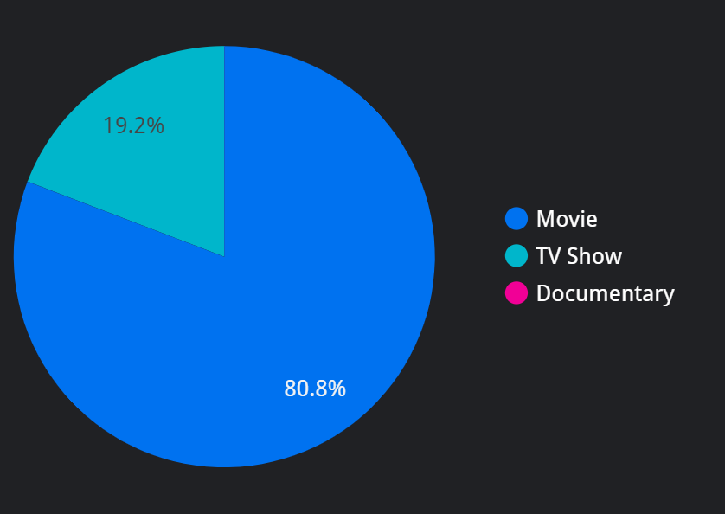
Percentage of show’s type
Show's Type
As we can see the pie chart on the side, All the shows in Prime Video has 3 types of shows. there is Movie who had the largest persentage 80,81%, and then TV Show has 19.18%, the last one is Documentary, it only had 0.01%
Type | Movie | TV Show | Documentary
Total | 80.81% | 19.18% | 0.01%

Slide 4
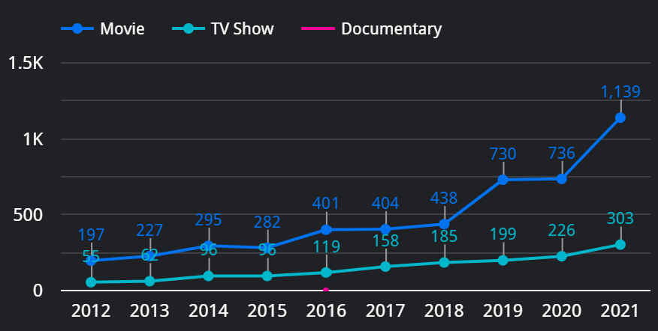
Shows at prime video by release year
Release Year
Prime Video provides shows from the release year in 1925 - current. From the chart line below, we can see the numbers of total shows are increasing as the year gets closer to the current year.
Shows that release years at 2018 in Prime Video provide 623 shows, at 2019 provide 929, 2020 provide 962, and 2021 provide 1442.

Slide 5
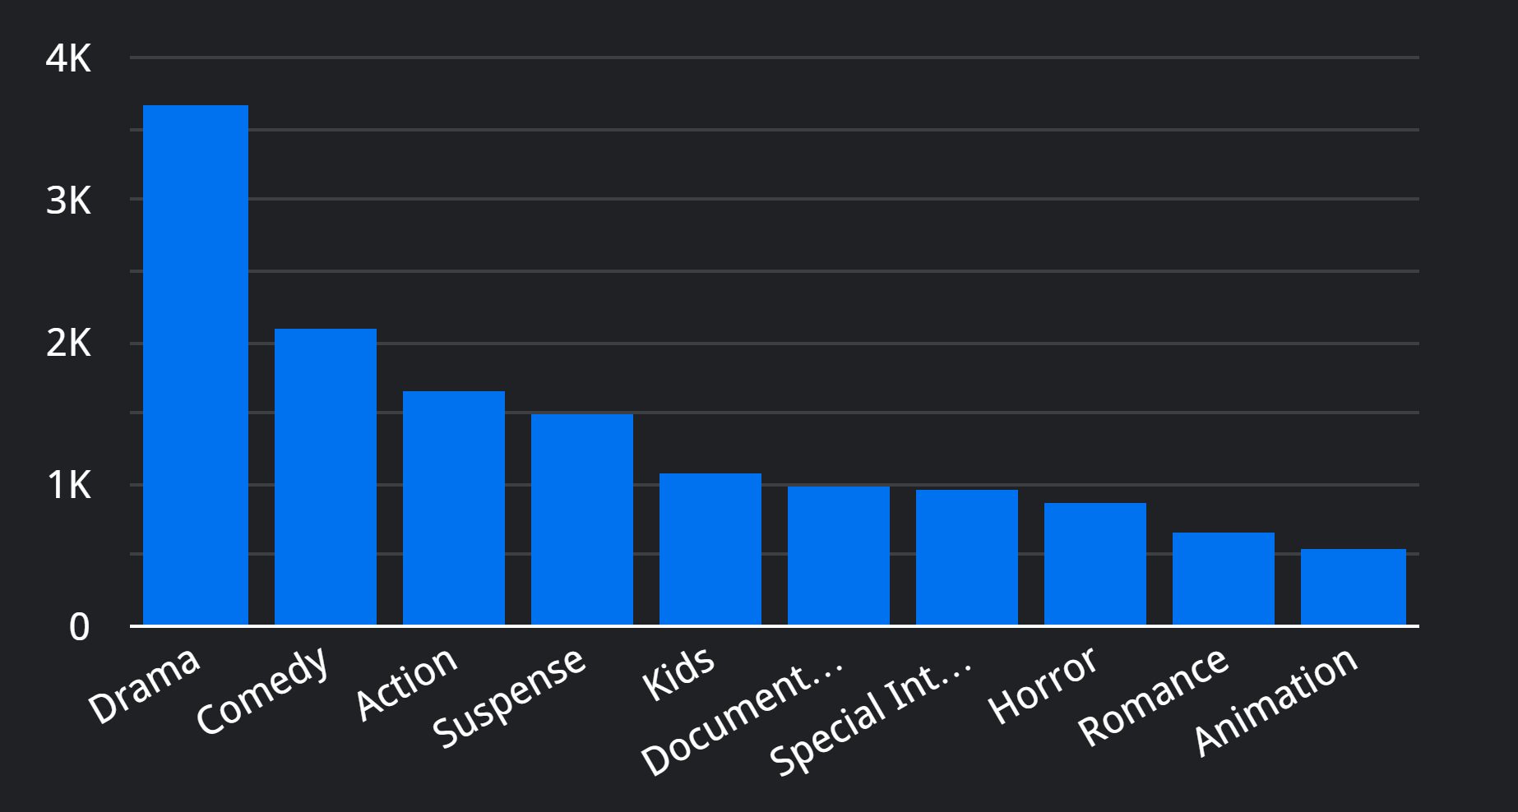
Top 10 Largest Genre in prime video
3687
In Prime Video has 10 Largest Genre of every show and every type. There are
Drama = 3687 shows
Comedy = 2099 shows
Action = 1657 shows
Suspense = 1501 shows
Kids = 1085 shows
Documentary = 993 shows
Special Interest = 980 shows
Horror = 875 shows
Romance = 674 shows
Animation = 547 shows
There are still many genre left, such as Fantasy, Adventure, Science Fiction, and other.
2099
1657
1501
1085
993
980
875
674
547
Genre | Drama | Comedy | Action | Suspense | Kids | Documentary | Special Interest | Horror | romance | Animation
Total | 3687 | 2099 | 1657 | 1501 | 1085 | 993 | 980 | 875 | 674 | 547

Slide 6
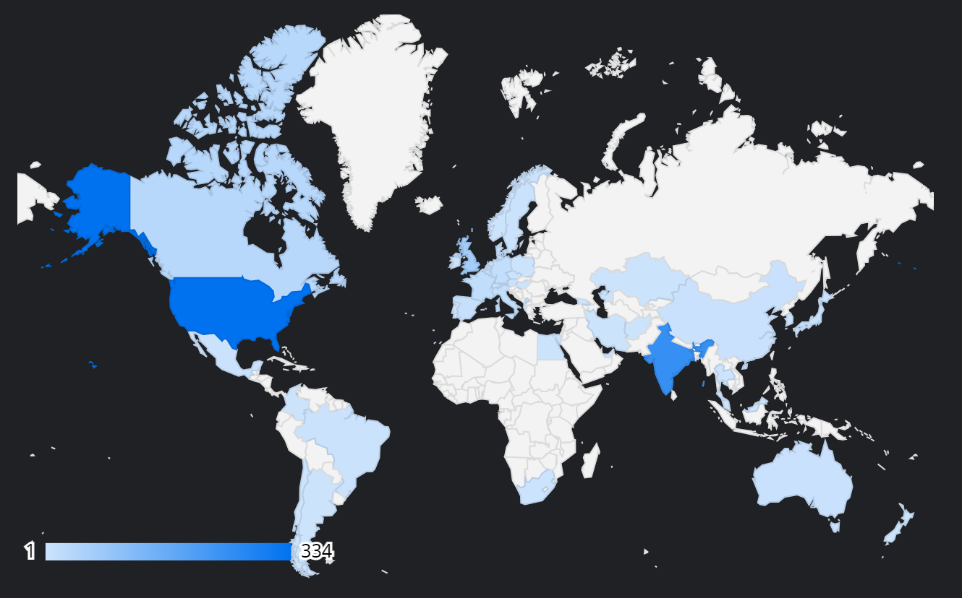
Shows at prime video by release year
Maps
The most shows in Prime Video based on country that we marked on the map. The thicker of the color, the more the shows from that county.
Top 2 of the country has the most show are
United State = 334 shows
India = 246 shows
334
246

Slide 8
THANK YOU
by Dewi Neo

