Slide 1

The Chapman Function and the Shape of the O₃ Profile
Callum Dewsnap
Department of Physics and Astronomy

Slide 2
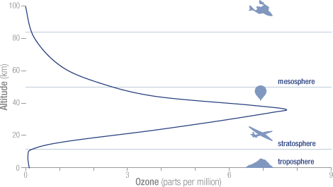
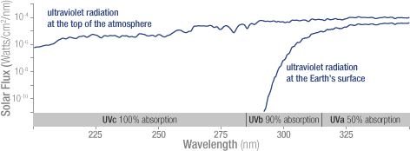
The Ozone Layer
90% of Ozone sits in the stratosphere
Concentration varies with altitude and peaks at roughly 32 kilometres
Absorbs majority of UV radiation from the Sun
Screens all UV-C radiation (100-280 nm) and most UV-B radiation (280-315 nm)
Without the ozone, the high energy UV radiation from the Sun would sterilize Earth’s surface
Credit: NASA Ozone Watch
1
Callum Dewsnap

Slide 3
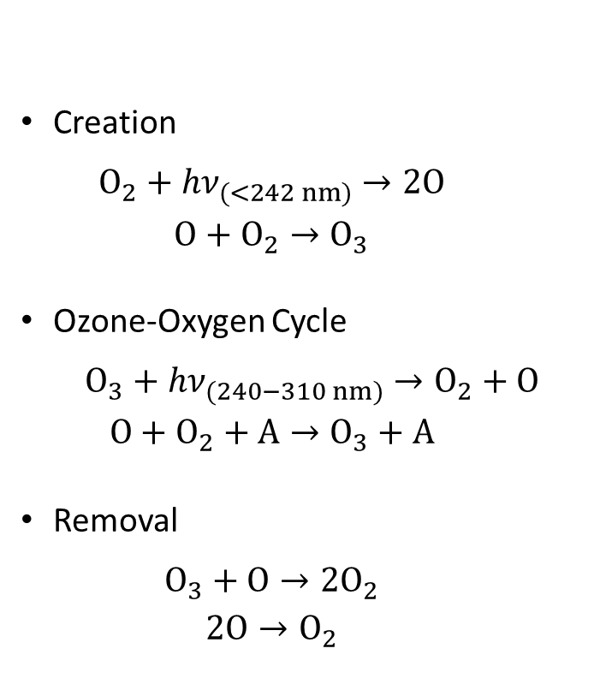
The Chapman Cycle
The work of Chapman¹ outlines the chemistry behind the regeneration of ozone in Earth’s stratosphere
Creation of ozone is driven by the photolyzing of oxygen molecules by high energy UV radiation
Thus, can model ozone by modelling the dissociative effect of stellar radiation on the atmosphere
Creation
$$O_{2}+hν_{(<242 nm)}→2O$$
$$O+O_{2}→O_{3}$$
Ozone-Oxygen Cycle
$$O_{3}+hν_{(240−310 nm)}→O_{2}+O$$
$$O+O_{2}+A→O_{3}+A$$
Removal
$$O_{3}+O→2O_{2}$$
$$2O→O_{2}$$
¹ Chapman, S. 1930. A theory of upper atmospheric ozone. Mem. Roy. Meteor. Soc.. 3. 103–125.
2
Callum Dewsnap

Slide 4
The Chapman Function
Chapman^{2,3} investigated this dissociative effect of radiation in an idealized atmosphere on a rotating earth
“A uniform beam of monochromatic radiation from a sun falls upon a rotating earth, the rate of rotation of the earth and the changing declination of the sun being the same as for the actual earth and sun; the radiation is absorbed (before reaching the ground) in an atmosphere of uniform composition, in which the density varies exponentially with height.”²
Solution gives the rate of dissociation/ionization at each point as a function of height, time of day, season of year, and latitude and is given in generalized terms
² S Chapman 1931 Proc. Phys. Soc. 43 26
³ S Chapman 1931 Proc. Phys. Soc. 43 483
3
Callum Dewsnap

Slide 5
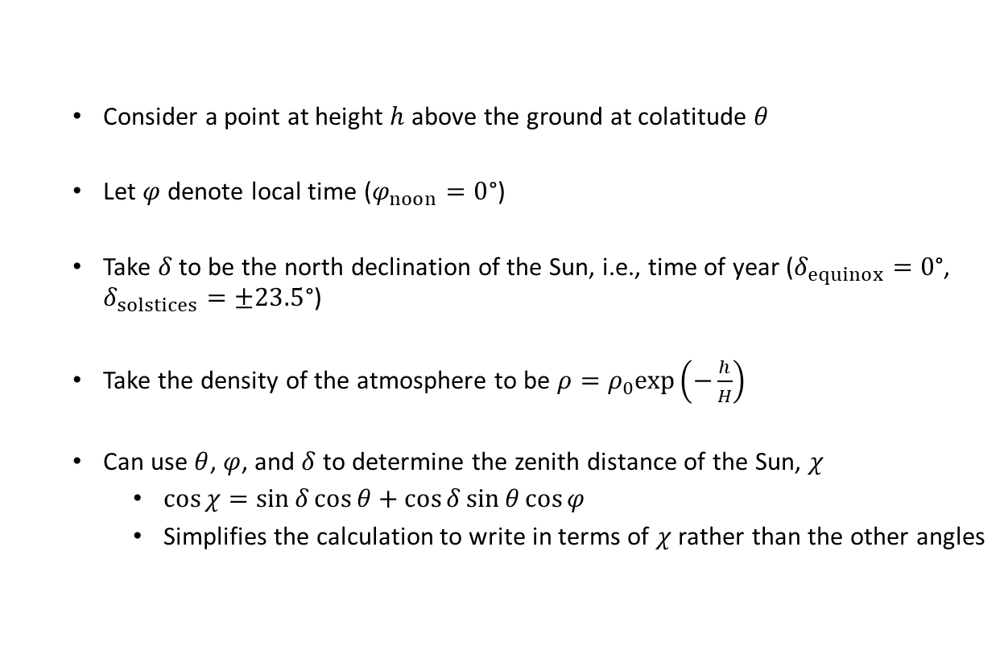
Independent Variables
Consider a point at height $h$ above the ground at colatitude $θ$
Let $φ$ denote local time ($φ_{noon}=0$°)
Take $δ$ to be the north declination of the Sun, i.e., time of year ($δ_{equinox}=0$°, $δ_{solstices}=±23.5$°)
Take the density of the atmosphere to be $ρ=ρ_{0}exp\left(−\frac{h}{H}\right)$
Can use $θ$, $φ$, and $δ$ to determine the zenith distance of the Sun, $χ$
$\cos{χ}=\sin{δ}\cos{θ}+\cos{δ}\sin{θ}\cos{φ}$
Simplifies the calculation to write in terms of $χ$ rather than the other angles
4
Callum Dewsnap

Slide 6
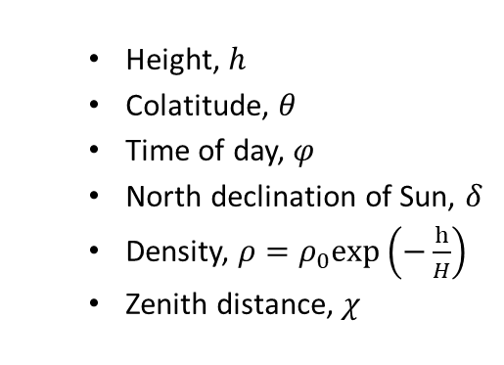



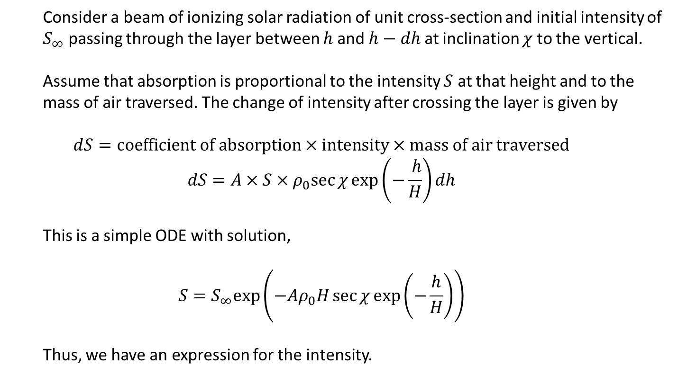
Deriving The Chapman Function
Height, $h$
Colatitude, $θ$
Time of day, $φ$
North declination of Sun, $δ$
Density, $ρ=ρ_{0}exp\left(−\frac{h}{H}\right)$
Zenith distance, $χ$
Consider a beam of ionizing solar radiation of unit cross-section and initial intensity of $S_{∞}$ passing through the layer between $h$ and $h−dh$ at inclination $χ$ to the vertical.
Assume that absorption is proportional to the intensity $S$ at that height and to the mass of air traversed. The change of intensity after crossing the layer is given by
$$dS=coefficient of absorption×intensity×mass of air traversed$$
$$dS=A×S×ρ_{0}sec{χ}exp\left(−\frac{ h}{H}\right)dh$$
This is a simple ODE with solution,
$$S=S_{∞}exp\left(−Aρ_{0}H\sec{χ}exp\left(−\frac{h}{H}\right)\right)$$
Thus, we have an expression for the intensity.
zenith
$$χ$$
$$h$$
$$h−dh$$
5
Callum Dewsnap

Slide 7
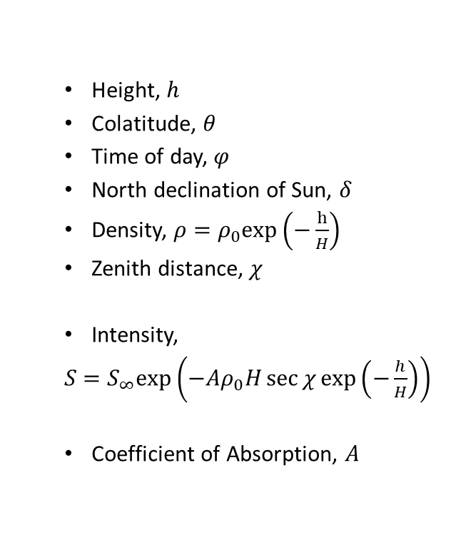
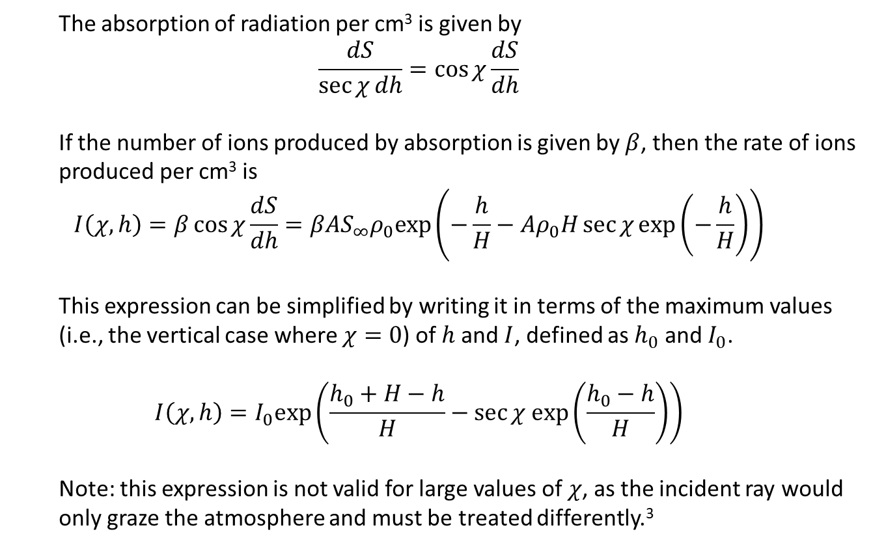
Deriving The Chapman Function
The absorption of radiation per cm³ is given by
$$\frac{dS}{\sec{χ}dh}=\cos{χ}\frac{dS}{dh}$$
If the number of ions produced by absorption is given by $β$, then the rate of ions produced per cm³ is
$$I\left(χ, h\right)=β\cos{χ}\frac{dS}{dh}=βAS_{∞}ρ_{0}exp\left(−\frac{h}{H}−Aρ_{0}H\sec{χ}exp\left(−\frac{h}{H}\right)\right)$$
This expression can be simplified by writing it in terms of the maximum values (i.e., the vertical case where $χ=0$) of $h$ and $I$, defined as $h_{0}$ and $I_{0}$.
$$I\left(χ, h\right)=I_{0}exp\left(\frac{h_{0}+H−h}{H}−\sec{χ exp\left(\frac{h_{0}−h}{H}\right)}\right)$$
Note: this expression is not valid for large values of $χ$, as the incident ray would only graze the atmosphere and must be treated differently.³
Height, $h$
Colatitude, $θ$
Time of day, $φ$
North declination of Sun, $δ$
Density, $ρ=ρ_{0}exp\left(−\frac{h}{H}\right)$
Zenith distance, $χ$
Intensity,
$S$ $=S_{∞}exp\left(−Aρ_{0}H\sec{χ}exp\left(−\frac{h}{H}\right)\right)$
Coefficient of Absorption, $A$
6
Callum Dewsnap

Slide 8
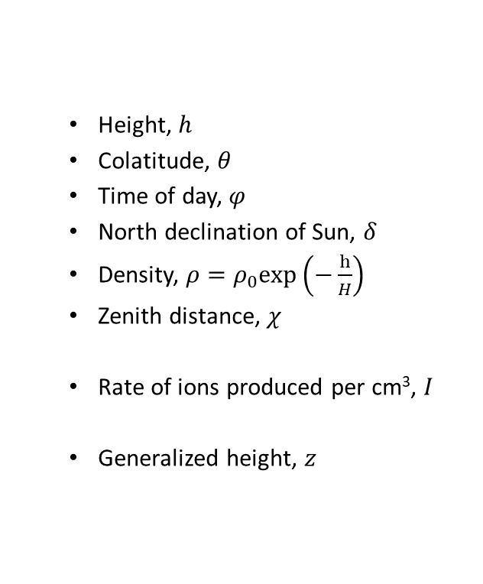
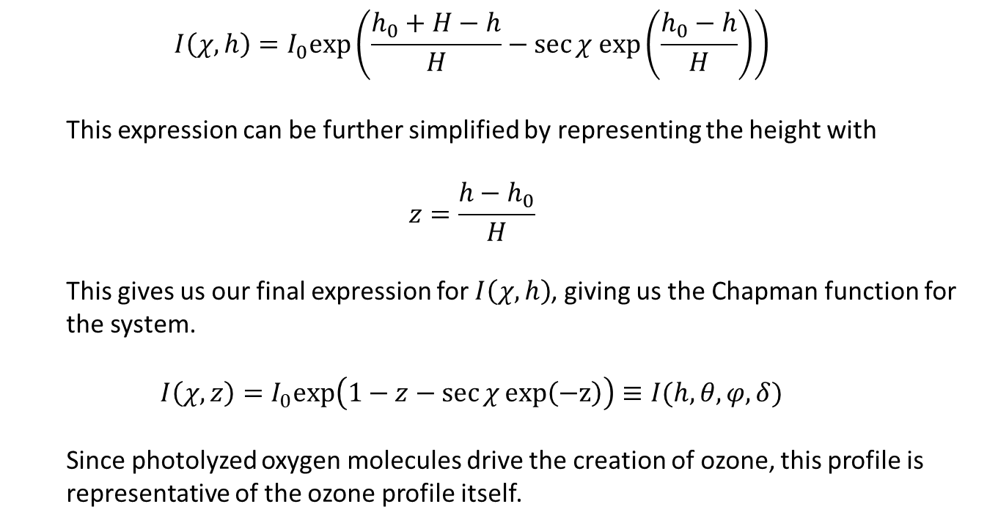
The Chapman Function
Height, $h$
Colatitude, $θ$
Time of day, $φ$
North declination of Sun, $δ$
Density, $ρ=ρ_{0}exp\left(−\frac{h}{H}\right)$
Zenith distance, $χ$
Rate of ions produced per cm³, $I$
Generalized height, $z$
$$I\left(χ, h\right)=I_{0}exp\left(\frac{h_{0}+H−h}{H}−\sec{χ exp\left(\frac{h_{0}−h}{H}\right)}\right)$$
This expression can be further simplified by representing the height with
$$z=\frac{h−h_{0}}{H}$$
This gives us our final expression for $I\left(χ,h\right)$, giving us the Chapman function for the system.
$$I\left(χ,z\right)=I_{0}exp\left(1−z−\sec{χ}exp\left(−z\right)\right)≡I(h,θ,φ,δ)$$
Since photolyzed oxygen molecules drive the creation of ozone, this profile is representative of the ozone profile itself.
7
Callum Dewsnap

Slide 9
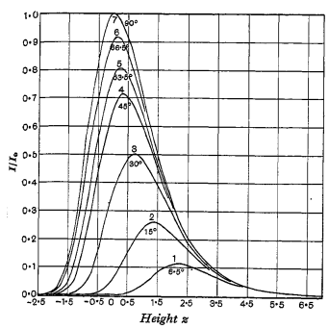
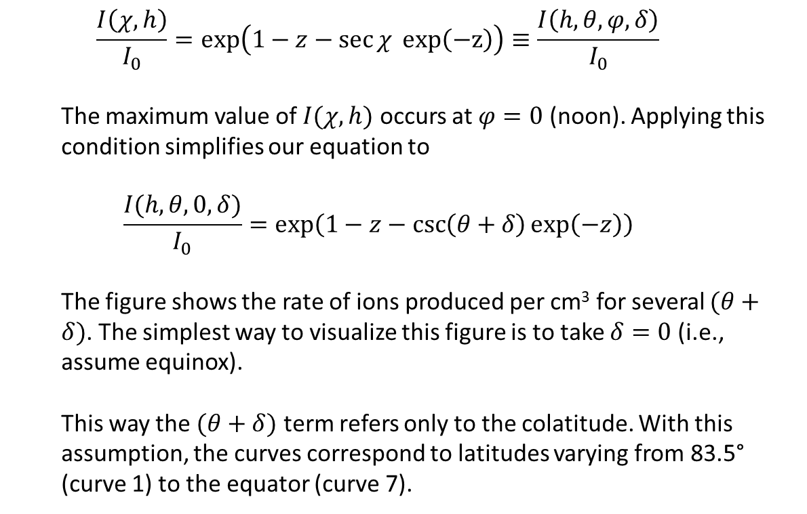
Noon Ion Production at Varying Heights
$$\frac{I\left(χ, h\right)}{I_{0}}=exp\left(1−z−\sec{χ} exp\left(−z\right)\right)≡\frac{I\left(h,θ,φ,δ\right)}{I_{0}}$$
The maximum value of $I(χ,h)$ occurs at $φ=0$ (noon). Applying this condition simplifies our equation to
$$\frac{I(h,θ,0,δ)}{I_{0}}=exp\left(1−z−\csc\left(θ+δ\right)\exp\left(−z\right)\right)$$
The figure shows the rate of ions produced per cm³ for several $(θ+δ)$. The simplest way to visualize this figure is to take $δ=0$ (i.e., assume equinox).
This way the $(θ+δ)$ term refers only to the colatitude. With this assumption, the curves correspond to latitudes varying from 83.5° (curve 1) to the equator (curve 7).
8
Callum Dewsnap

Slide 10
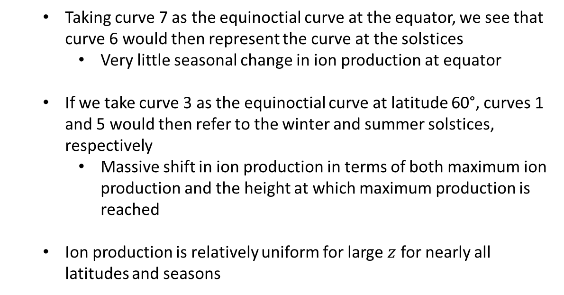
Noon Ion Production at Varying Heights
Taking curve 7 as the equinoctial curve at the equator, we see that curve 6 would then represent the curve at the solstices
Very little seasonal change in ion production at equator
If we take curve 3 as the equinoctial curve at latitude 60°, curves 1 and 5 would then refer to the winter and summer solstices, respectively
Massive shift in ion production in terms of both maximum ion production and the height at which maximum production is reached
Ion production is relatively uniform for large $z$ for nearly all latitudes and seasons
9
Callum Dewsnap

Slide 11
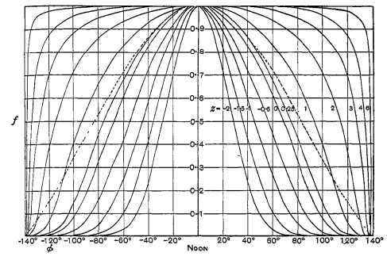
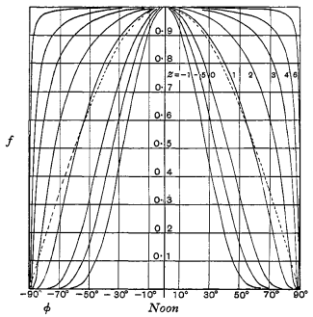
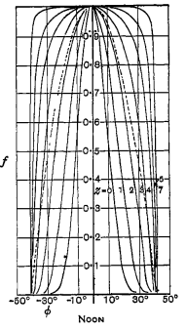

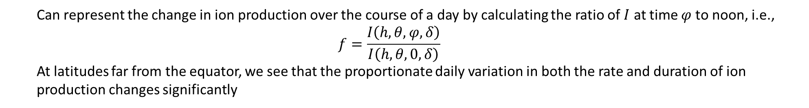
Ion Production at Varying Times
Can represent the change in ion production over the course of a day by calculating the ratio of $I$ at time $φ$ to noon, i.e.,
$$f=\frac{I\left(h,θ,φ,δ\right)}{I\left(h,θ,0,δ\right)}$$
At latitudes far from the equator, we see that the proportionate daily variation in both the rate and duration of ion production changes significantly
10
Callum Dewsnap

Slide 12
Thanks for listening, let me know if there are any questions!
11
Callum Dewsnap

