Slide 1
PADRE CONCEICAO COLLEGE OF ENGINEERING
CE634 · Data Mining and Data Warehousing
AT A GLANCE
Predictive Analysis of
2,800
Charging Records
EV Charging Demand
10
Dataset Attributes
& Grid Load Dynamics
0
Missing Values
Peak Load Risk Classification · Operational Clustering · Anomaly Detection
45.18%
RF Accuracy
Dewpearl Gonsalves · 23CE114
Shail Joshi · 23CE163
84
Flyson Dias · 23CE118
Anomalies Flagged
Academic Year 2025–2026 | May 2026
3
Operational Clusters
1 / 15

Slide 2
AGENDA
What We'll Cover Today
01
Dataset & Problem
05
Feature Importance
2,800 EV records · 10 features · peak load risk target
Top predictors of grid stress events
02
Preprocessing Pipeline
06
Clustering & Anomalies
Cleaning · Engineering · Encoding · Scaling
K-Means (k=3) · Isolation Forest (84 flagged events)
03
Similarity Analysis
07
Dashboard & Conclusions
Pearson correlation · Euclidean distance across city zones
Executive summary · Findings · Future work
04
Classification (RF)
Random Forest · SMOTE · 45.18% accuracy · 3-class
2 / 15

Slide 3
01 · DATASET
Dataset at a Glance
2,800
10
0
0
Charging Records
Dataset Attributes
Missing Values
Duplicate Records
FEATURE OVERVIEW
FEATURE
TYPE
DESCRIPTION
FEATURE
TYPE
DESCRIPTION
record_id
Integer
avg_charging_duration_min
Float
Session identifier (excluded from model)
Mean session duration (minutes)
date_time
DateTime
energy_dispensed_kwh
Float
Timestamp → hour_of_day, day_of_week
Total energy delivered (kWh)
city_zone
Categorical
grid_load_mw
Float
North / South / East / West / Central
Grid draw during session (MW)
station_type
Categorical
renewable_energy_percent
Float
Fast / Slow / Ultra-fast / Normal
% renewable energy used
vehicles_charged
Integer
peak_load_risk ★ TARGET
Categorical
No. of EVs per session
Low / Medium / High
3 / 15

Slide 4
02 · PREPROCESSING
8-Step Preprocessing Pipeline
Input: Raw CSV (2,800 × 10) → Output: Analysis-Ready Matrix (2,800 × 15)
1
2
3
4
5
6
7
8
Null Check
Duplicate Removal
Datetime Parsing
Feature Engineering
One-Hot Encoding
Target Mapping
StandardScaler
Drop record_id
→
→
→
→
→
→
→
Confirmed 0 missing values
0 duplicates found
Extracted temporal features
hour_of_day day_of_week
station_type, city_zone
Low→0, Med→1 High→2
Z-score normalize 5 features
Prevent data leakage
✓ Final Dataset: 2,800 rows × 15 features | record_id excluded | Target: peak_load_risk (ordinal)
4 / 15

Slide 5
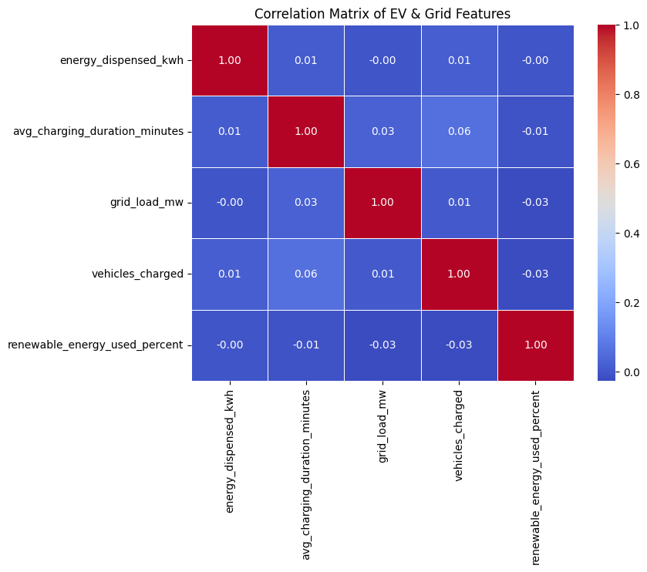
03 · SIMILARITY
Feature Correlation Analysis
Pearson Correlation Heatmap — Numerical Features
KEY INSIGHTS
Near-Zero Correlations
All Pearson coefficients fall close to 0 — features are largely independent.
Non-Linear Risk Drivers
Weak linear correlations suggest peak load risk emerges from complex, non-linear interactions.
Ensemble Justified
Absence of dominant predictors supports the use of Random Forest over linear models.
Feature Set Limitation
Limited predictive power indicates external features (weather, pricing) are needed.
5 / 15

Slide 6
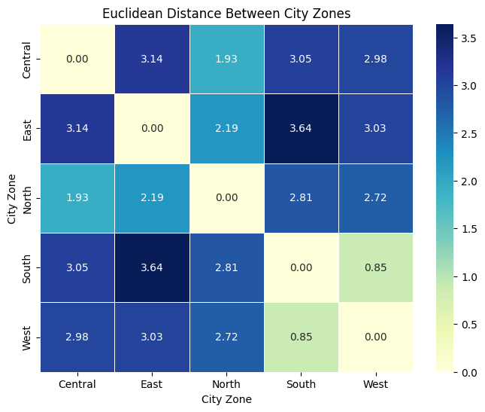
03 · DISSIMILARITY
Euclidean Distance Across City Zones
ZONE SIMILARITY MATRIX INSIGHTS
MOST SIMILAR
South ↔ West
Distance ≈ 0.85 | Comparable load profiles
MOST DISSIMILAR
East ↔ South
Distance ≈ 3.64 | Fundamentally different behaviour
💡 POLICY IMPLICATION
South-West strategies can be shared. East zone requires a distinct, tailored grid plan.
6 / 15

Slide 7
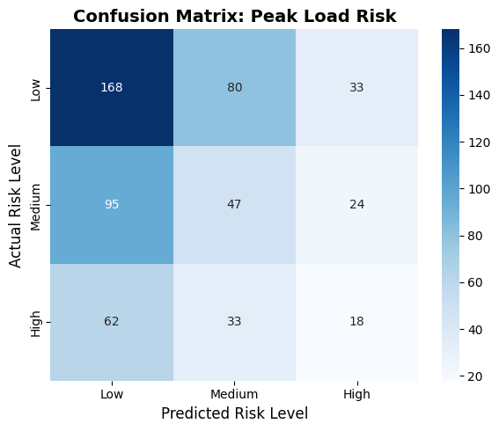
04 · CLASSIFICATION
Random Forest Classifier — Results
OVERALL ACCURACY
Low Risk
Medium Risk
High Risk
Weighted Avg
45.18%
F1 = 0.58
F1 = 0.33
F1 = 0.25
F1 = 0.44
P: 0.55 R: 0.62 N=281
P: 0.34 R: 0.33 N=166
P: 0.30 R: 0.21 N=113
P: 0.43 R: 0.45 N=560
with SMOTE rebalancing
METHODOLOGY
80/20 Split
SMOTE
Stratified train/test split preserving class proportions
Synthetic Minority Over-sampling on training set only
100 Trees
3-Class Target
RandomForestClassifier — n_estimators=100, default params
Low (0) · Medium (1) · High (2) — ordinal risk levels
INTERPRETATION
Moderate accuracy reflects inherent complexity of 3-class risk prediction with weak linear feature separability. High-risk miss-rate (F1 = 0.25) is the critical operational gap — SMOTE improved minority class recall but non-linear boundaries limit achievable accuracy.
Confusion Matrix — Random Forest
7 / 15

Slide 8
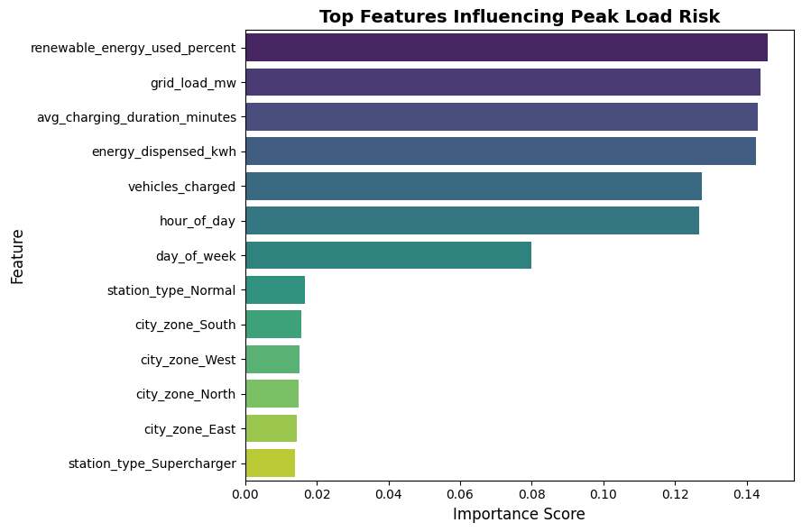
05 · FEATURE IMPORTANCE
What Drives Peak Load Risk?
KEY TAKEAWAYS
#1 Energy Dispensed (kWh)
Strongest predictor — total energy per session directly correlates with grid stress.
#2 Grid Load (MW)
Direct measure of instantaneous grid draw — naturally linked to risk level.
#3 Renewable Energy %
Moderates grid stress — higher renewable share reduces peak risk contribution.
#4 No Single Dominant Feature
Uniform distribution of scores confirms multifactorial risk — ensemble model is the right choice.
8 / 15

Slide 9
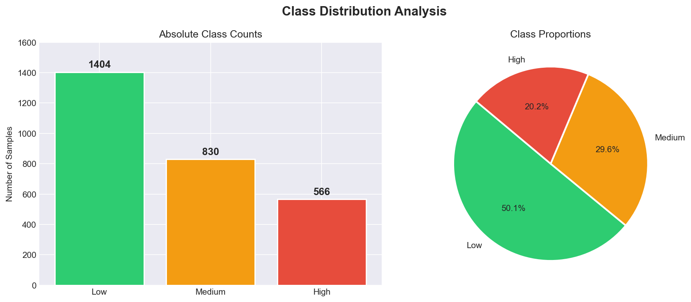
06 · CLASS DISTRIBUTION
Target Variable: Peak Load Risk Distribution
CLASS BREAKDOWN
50.1%
Low Risk (1,404 records)
Majority class · Most reliably classified (F1=0.58)
29.6%
Medium Risk (830 records)
Transitional class · Hardest to classify (F1=0.33)
20.2%
High Risk (566 records)
Minority class · Operationally critical (F1=0.25)
→ SMOTE applied on training set to address imbalance
9 / 15

Slide 10
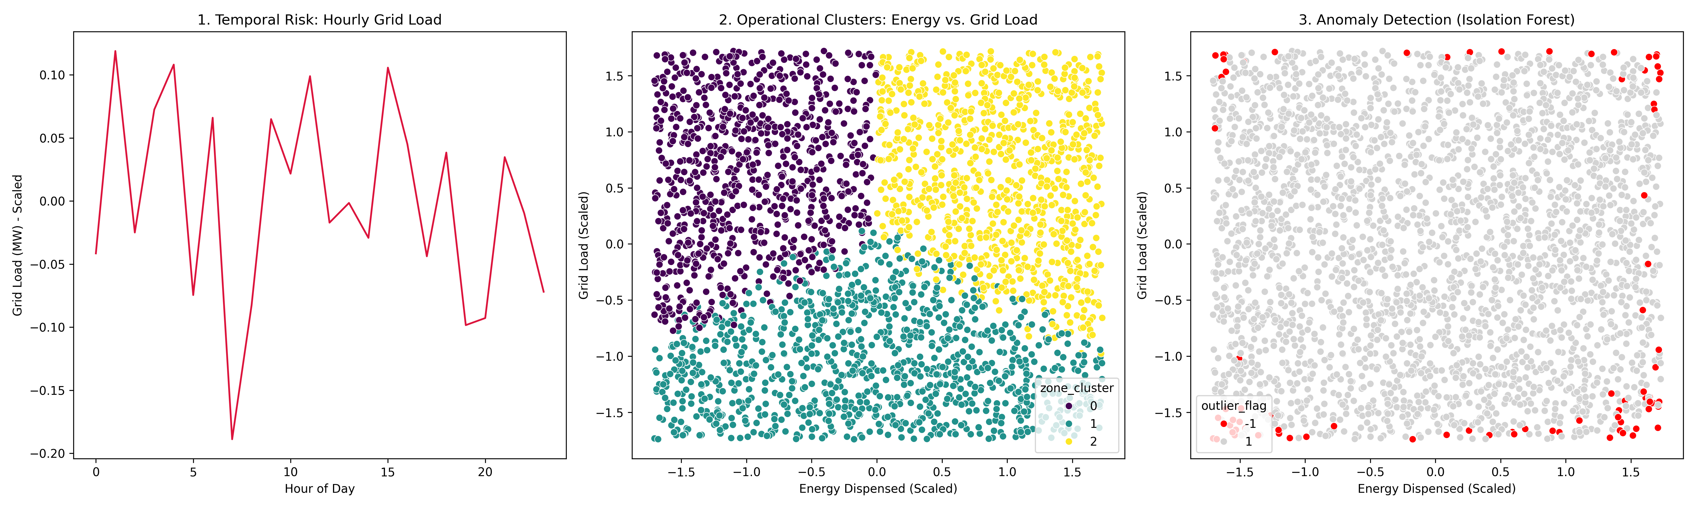
07 · CLUSTERING
K-Means Clustering — 3 Operational Profiles
Algorithm: K-Means | k = 3 | Features: energy_dispensed_kwh × grid_load_mw (scaled)
Cluster 0
Cluster 1
Cluster 2
Residential Overnight
Urban Fast Charger
Commercial Hub
Low energy · Low grid load Slow chargers · Extended duration
Moderate energy · Moderate load Mix of commuter & commercial users
High energy · High grid load Ultra-fast / multi-vehicle events
⬇ Minimal grid impact
↔ Standard grid operations
⬆ Highest grid stress
Cluster Scatter Plot (from Final Dashboard — Panel 2)
💡 Cluster-specific grid policies outperform uniform limits — tailor demand-response triggers to each operational archetype
10 / 15

Slide 11
08 · ANOMALY DETECTION
Isolation Forest — Anomaly Detection
Anomaly Overlay (from Dashboard — Panel 3: Red = Anomalies)
⚠ ANOMALIES FLAGGED
84
out of 2,800 sessions 3% contamination rate
2,716
84
Normal Sessions
Anomalous Sessions
POTENTIAL CAUSES
Hardware malfunction — erroneous power draw at specific stations
OPERATIONAL RESPONSE ACTIONS
→ Investigate flagged station records for hardware faults
Grid baseline stress — simultaneous large-scale charging events
→ Pre-position emergency battery buffer reserves
Sensor faults — data recording anomalies at station level
→ Implement real-time circuit breaker protocols for similar future events
11 / 15

Slide 12
09 · DASHBOARD
Three-Panel Executive Dashboard
Panel 1: Temporal Risk
Panel 2: K-Means Clusters
Panel 3: Anomaly Detection
Hourly grid load volatility
Operational zone segmentation
84 flagged events in red
12 / 15

Slide 13
10 · CONCLUSIONS
Key Findings & Takeaways
1
Clean Dataset
2
Weak Feature Correlations
3
RF Accuracy: 45.18%
2,800 records · 10 attributes · 0 missing values · 0 duplicates — no imputation needed
Pearson near-zero → non-linear risk drivers · Zone dissimilarity supports zone-specific grid policy
Moderate but informative · SMOTE improved minority recall · High-risk F1=0.25 is the critical gap
4
Multifactorial Risk
5
3 Operational Clusters
6
84 Anomalous Events
energy_kwh, grid_load_mw, renewable_% are top 3 predictors · No single dominant feature
K-Means: Residential · Urban Fast · Commercial Hub → cluster-specific demand-response policies
Isolation Forest (3% contamination) · Black-swan grid stress moments requiring investigation
13 / 15

Slide 14
11 · FUTURE WORK
Recommendations & Next Steps
→
External Feature Enrichment
→
Advanced Model Architecture
→
Dynamic Time-of-Use Pricing
Incorporate ambient temperature, baseline neighbourhood power consumption, and real-time electricity pricing to improve RF accuracy beyond 45%.
Explore Gradient Boosting (XGBoost/LightGBM), Neural Networks, and class-weight tuning as alternatives to SMOTE for imbalance.
Grid operators should implement cheaper off-peak rates to flatten the hourly demand curve and reduce infrastructure degradation.
→
Zone-Specific Forecasting
→
Real-Time Anomaly Monitoring
→
Dataset Expansion
Build separate predictive models per city zone — especially East zone which is operationally distinct from all others (max distance ≈ 3.64).
Deploy Isolation Forest as a live streaming pipeline to flag anomalous events in real-time and trigger automated circuit responses.
Merge with city-wide macroeconomic, weather, and grid telemetry datasets for a more generalisable model beyond synthetic Kaggle data.
14 / 15

Slide 15
Thank You
CE634 · Data Mining and Data Warehousing
Dewpearl Gonsalves · Shail Joshi · Flyson Dias
Padre Conceicao College of Engineering | Academic Year 2025–2026
2,800 Records
45.18% RF Accuracy
84 Anomalies
3 Clusters
Open for Questions

