Slide 1
ML Project
Dexin Wang & Guangyi Tao

Slide 2
IMDB DataSet
28 Nominal and Numerical Features
Predicted, Rating Score ( 2- 10)
5043 tuples , 1807 with “7”
Require at Least 37% accuracy

Slide 3
Algorithms
Stable Algorithms:
Linear SVM
Nearest Centroid Class (NCC)
Gaussian Native Bayes (GNB)
Unstable Algorithms:
Stochastic Gradient Descent (SGD)
Kernel Approximation (KA)
Forests of Randomized Trees( FRT)

Slide 4
Initial State
Algorithm | Accuracy | Training Time | Mean Error
Linear SVM | 0.03% | 16s | 2800.5
Stochastic Gradient Descent | 12.7%(Mean) (+/-10%) | 1.1s | 3553.1
Kernel Approximation | 18.7%(Mean) (+/-5%) | 3.1s | 5402.1
Nearest Centroid Classifier | 0% | 0.04s | 4113.7
Gaussian Naive Bayes | 5.3% | 0.07s | 2845.3
Forests of randomized trees | 29.6%(Mean) (+/-2%) | 0.07s | 2029.1

Slide 5
1. Remove Duplicated Tuples
Algorithm | Accuracy | Training Time | Mean Error
Linear SVM | 0.1% | 16s | 2656
Stochastic Gradient Descent | 14.8% | 1.3s | 8029.7
Kernel Approximation | 24.9% | 3.5s | 7806
Nearest Centroid Classifier | 0% | 0.05s | 3583.5
Gaussian Naive Bayes | 5.3% | 0.08s | 2977.5
Forests of randomized trees | 28.3% | 1.2s | 2251.4

Slide 6
2. Standard Score Normalization
Algorithm | Accuracy | Training Time | Mean Error
Linear SVM | 33.7% | 1.5s | 0.9
Stochastic Gradient Descent | 29.3% | 0.02s | 1.2
Kernel Approximation | 24.0% | 0.06s | 1.1
Nearest Centroid Classifier | 8.2% | 0.007s | 2.8
Gaussian Naive Bayes | 5.9% | 0.008s | 3.2
Forests of randomized trees | 36.1% | 0.12s | 1.0

Slide 7
3. Bag-of-Words
Algorithm | Accuracy | Training Time | Mean Error
Linear SVM | 36.5% | 10.5s | 0.9
Stochastic Gradient Descent | 33.2% | 17.4s | 0.9
Kernel Approximation | 23.6% | 0.05s | 1.4
Nearest Centroid Classifier | 11% | 10.7s | 2.5
Gaussian Naive Bayes | 25.5% | 14.8s | 1.4
Forests of randomized trees | 36.5% | 14s | 0.9

Slide 8
4.Remove Unnecessary Features
Algorithm | Accuracy | Training Time | Mean Error
Linear SVM | 36.5% | 3.9s | 0.9
Stochastic Gradient Descent | 38.4% | 5.07s | 1.0
Kernel Approximation | 32.1% | 0.05s | 1.4
Nearest Centroid Classifier | 11% | 3.1s | 2.5
Gaussian Naive Bayes | 25.5% | 3.4s | 1.4
Forests of randomized trees | 38% | 4.1s | 0.9

Slide 9
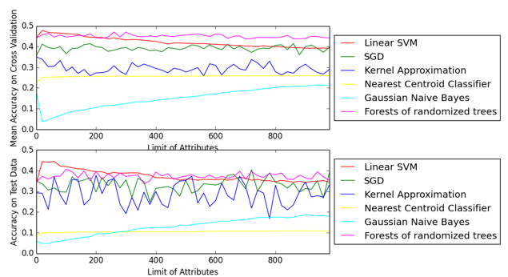
5. Checking Overfitting

Slide 10
5. Checking Overfitting
Algorithm | Accuracy | Training Time | Mean Error
Linear SVM | 42.1% | 1.4s | 0.8
Stochastic Gradient Descent | 26.5% | 0.04s | 0.9
Kernel Approximation | 27.4% | 0.05s | 1.2
Nearest Centroid Classifier | 10.2% | 0.02s | 2.7
Gaussian Naive Bayes | 4.3% | 0.02s | 3.5
Forests of randomized trees | 36.9% | 0.11s | 0.9

Slide 11
6.Update Parameters with Algorithms
Algorithm | Accuracy | Training Time | Mean Error
Linear SVM | 42.7% | 1.4s | 0.8
Stochastic Gradient Descent | 26.5% | 0.04s | 0.9
Kernel Approximation | 27.4% | 0.05s | 1.2
Nearest Centroid Classifier | 10.2% | 0.02s | 2.7
Gaussian Naive Bayes | 4.3% | 0.02s | 3.5
Forests of randomized trees | 36.9% | 0.11s | 0.9

Slide 12
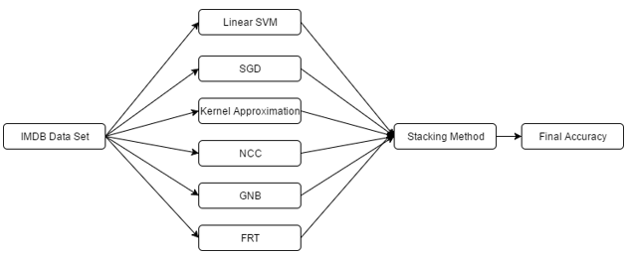
Staking Method <=43%

Slide 13
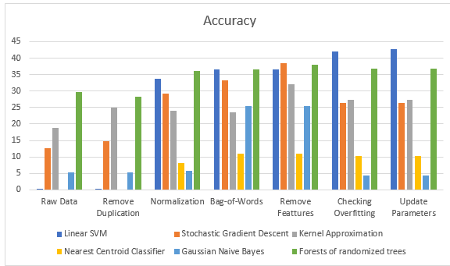
Accuracy

Slide 14
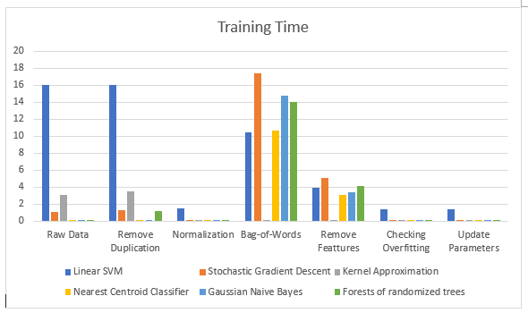
Training Time

Slide 15
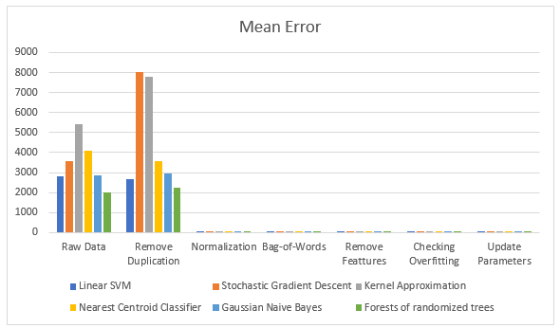
Mean Error

Slide 16
Q & A

