Slide 1
Computational Thinking
presented by Group 5

Slide 2
About the Team
Dex from Xi’an Jiaotong-Liverpool University
Jing from University of Electronic Science and Technology of China
Siqi from University of Electronic Science and Technology of China

Slide 3
New Insight on Big Data
Basic usage of R
Unleash the power of large size of file
Basic understanding of community detection
Several Algorithms to find MST and shortest path

Slide 4
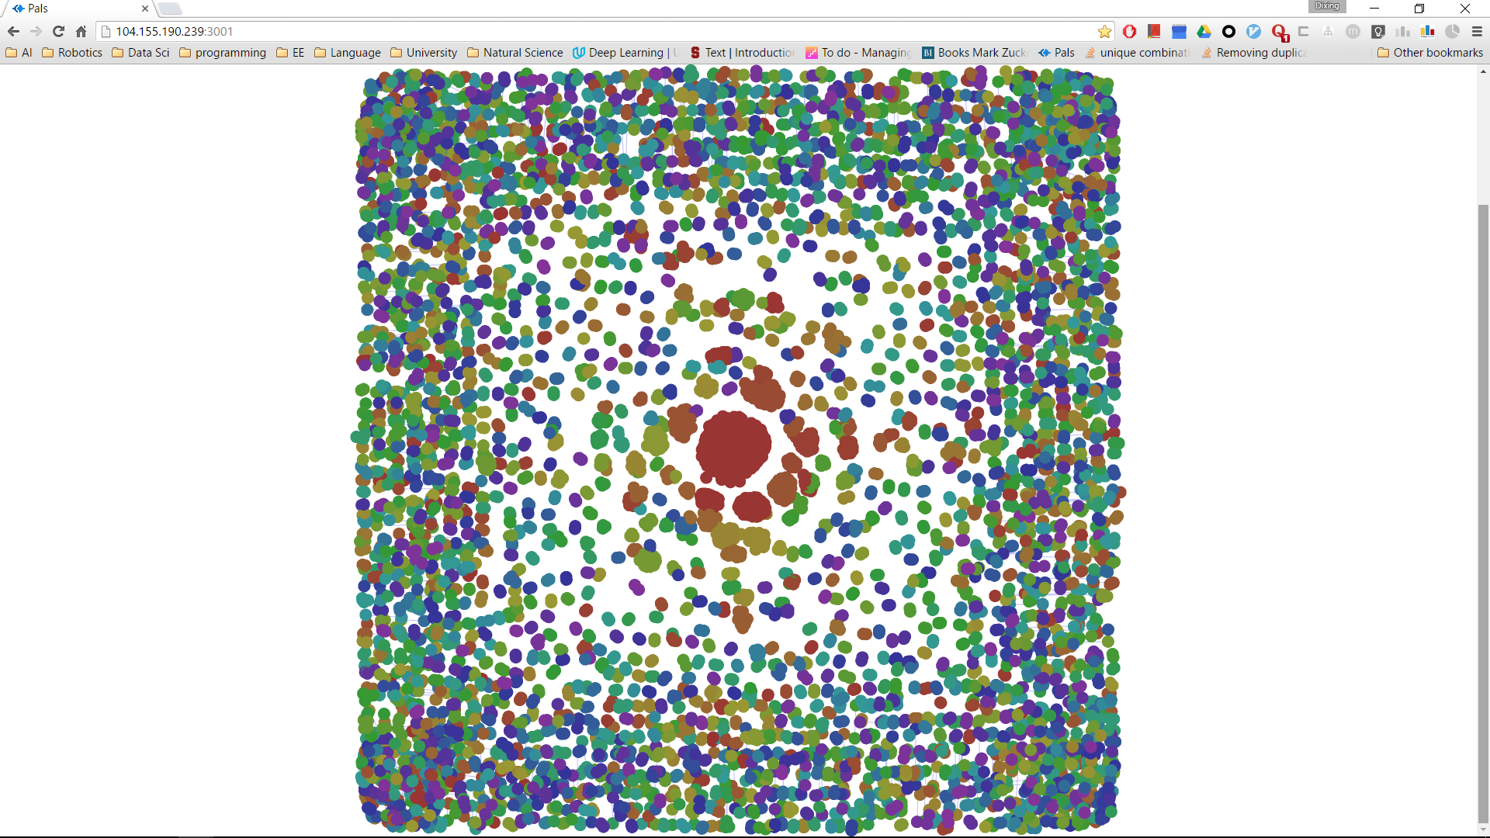
Visualisation for Assignment1
5000 pairs of nodes powered by pal system, provided by Dex

Slide 5
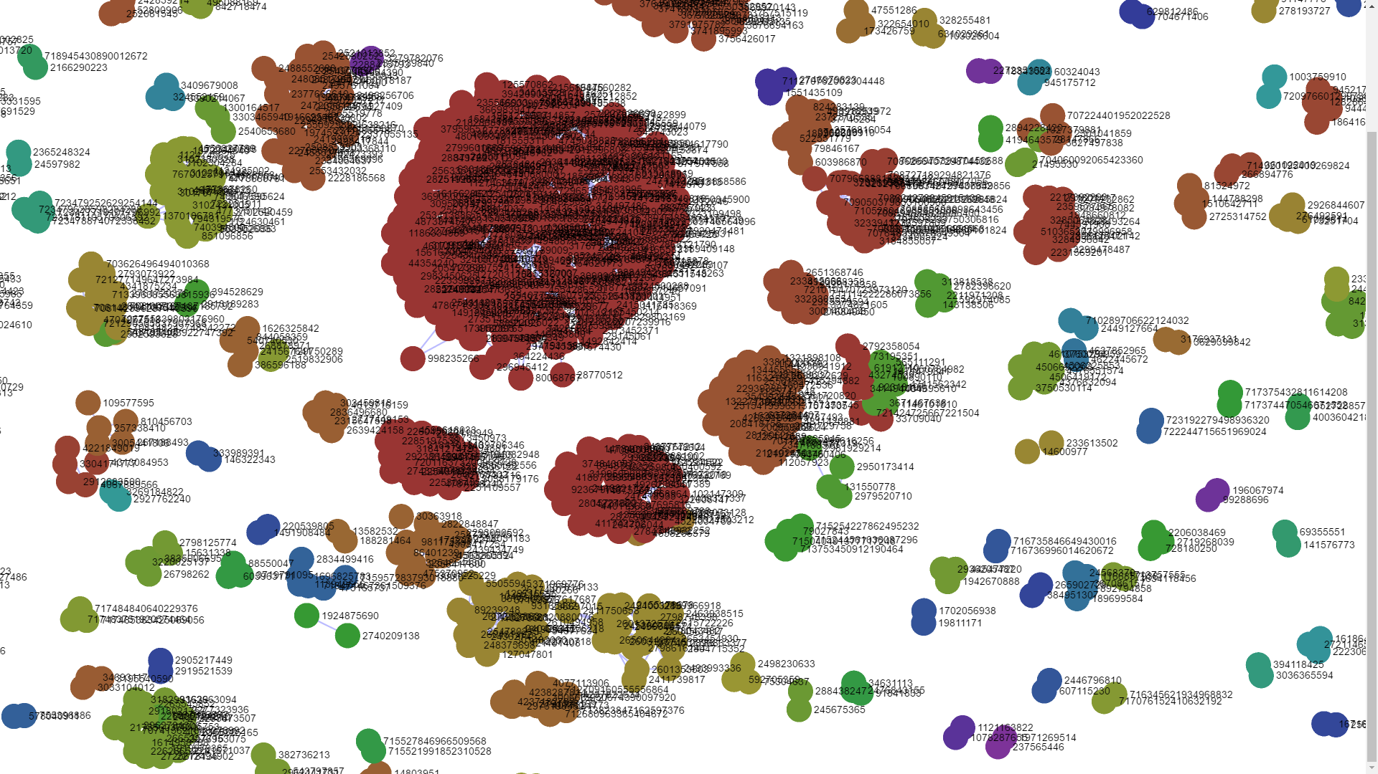
Visualisation for Assignment1
zoomed in and found out the communities of network graph

Slide 6
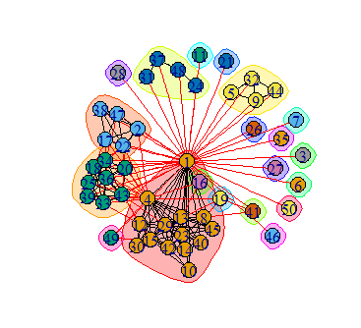
Visualization for G1.txt
clearly see the communities
with small dataset powered
by igraph

Slide 7
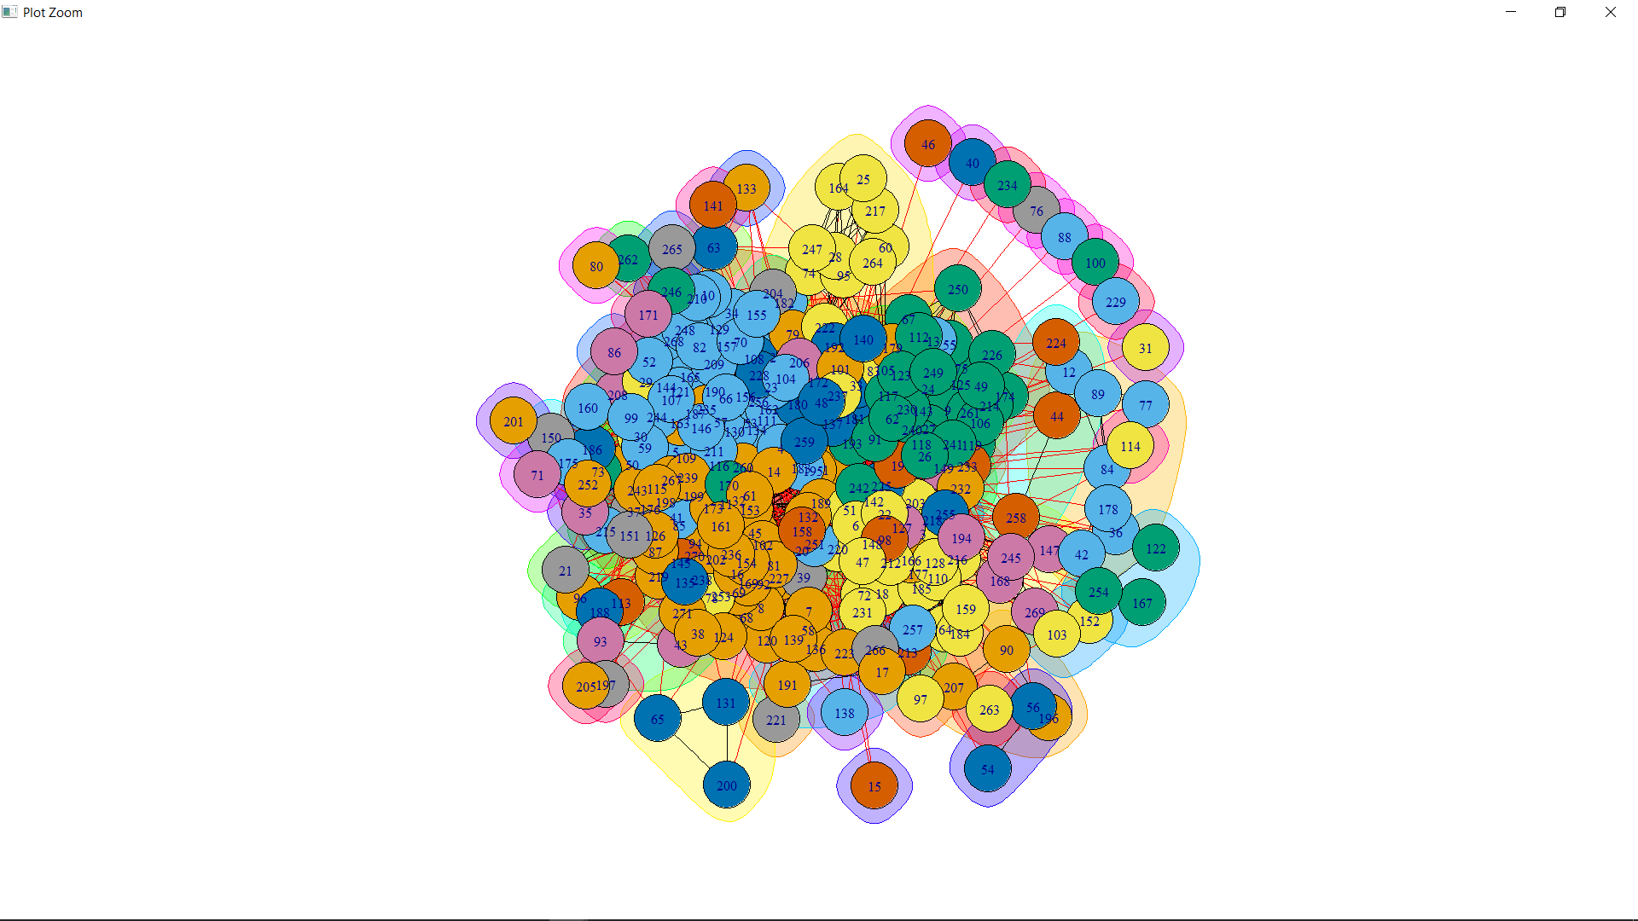
Visualization for G2.txt

Slide 8
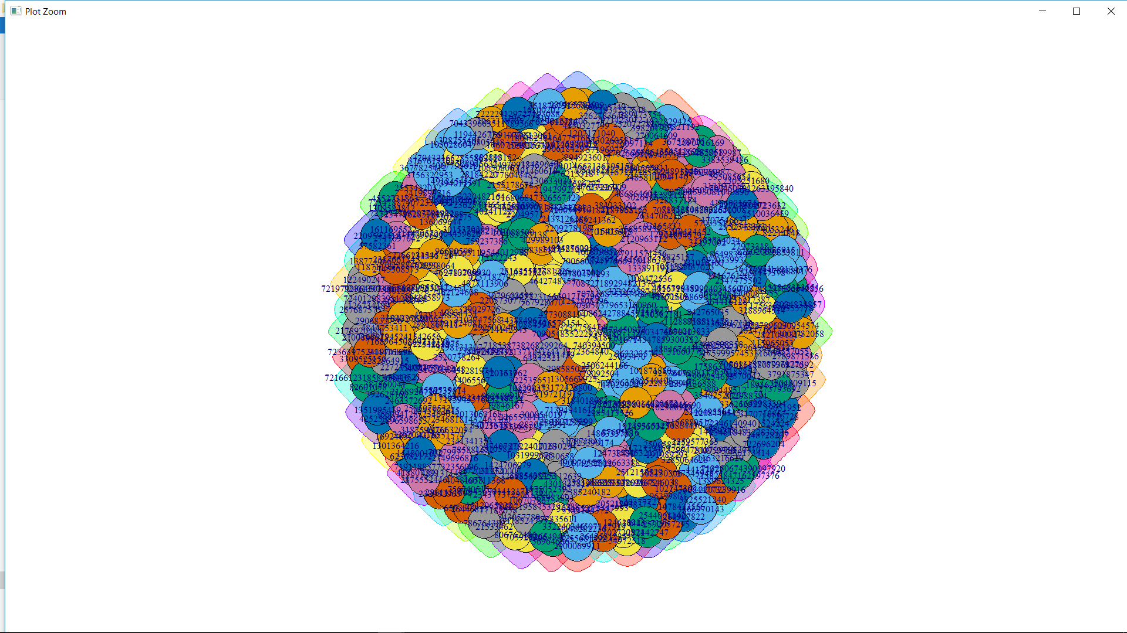
Visualization for G3.txt

