Slide 1

DITCH
DITCH
DITCH
STREAM ONCE. OWN EVERYWHERE.
A consumer-first live platform: free to watch, free to go live, everywhere at once — where viewers become the show.
LIVE

Slide 2
DITCH
What is Ditch?
DITCH is a consumer-first live platform: free for viewers and creators to start, with three interlocking layers competitors only built in pieces.
01
MULTI-STREAM GATEWAY
Go live once → Twitch, YouTube, TikTok, Kick. DITCH is the origin.
DITCH
02
INTERACTION HUB
Any viewer can step on screen, live, across every platform at once.
Stream Once. Own Everywhere.
The creator's live home base : a browser studio that makes distribution a solved problem and the audience part of the show.
03
PARTICIPATORY AD NETWORK
Brands sponsor a real human in the feed : one buy, every platform.
DITCH · CONFIDENTIAL
Stream Once. Own Everywhere.

Slide 3
DITCH
The Problem
Live streaming is fragmented — for creators, brands, and viewers.
✕
✕
✕
✕
Creators must choose
Brands pay 4×
Viewers are split
Ads get ignored
Platforms restrict cross-streaming. Pick one, leave audiences behind every stream.
Negotiate, run, measure and pay separately on every platform for one audience.
Five chat windows, no shared experience, no way for a viewer to matter.
Live ad spend is fragmented, hard to measure, and easy to skip.
$6.8B global live-streaming market by 2030, growing ~24% a year. The problem compounds every year it goes unsolved.
DITCH · CONFIDENTIAL
Stream Once. Own Everywhere.

Slide 4
DITCH
The Solution
Go live once. Reach everywhere. Make the viewer part of the content.
01
02
03
Multi-Stream Gateway
Interaction Hub
Participatory Ad Network
One source, pushed to Twitch, YouTube, TikTok, Kick and more simultaneously.
Viewers from any platform enter your channel and become on-screen participants.
Brands sponsor participant slots : a real person, live across every platform.
DITCH is the RTMP origin (the same category as an encoder like OBS), so you stream everywhere from one place.
They appear live in the broadcast and go back out across every destination at once. The viewer becomes the show.
Baked into the feed at the source: not a banner, not a pre-roll, far harder to skip or ad-block.
DITCH · CONFIDENTIAL
Stream Once. Own Everywhere.

Slide 5
DITCH
How it works and why it's defensible
01
→
02
→
03
Go live on DITCH
DITCH fans out
A viewer joins live
Browser studio — camera, mic, scenes, screen share. No download, no encoder.
The composite stream is pushed to every platform over RTMP, from one origin.
Click → allow camera → on screen across every platform in under 60 seconds.
THE MOAT
We control the composite origin. YouTube can't put a Twitch viewer on screen. Twitch can't put a TikTok viewer on screen. DITCH puts both on both, simultaneously. You can't replicate that from inside one platform's ecosystem. The architecture is the moat.
DITCH · CONFIDENTIAL
Stream Once. Own Everywhere.

Slide 6
DITCH
A large core market with upside on top
TAM
SAM
SOM
$6.8B
$4–5B
€7–8M
by 2030 · ~24% CAGR
growing double-digits
ARR · Year-3 target
Global live-streaming market
Creator multi-stream tools + live ad inventory
200K–500K mid-tier multi-platform creators
Adjacent upside (not summed): creator economy ~$185B and influencer marketing ~$32B (2025) sit next to the core market — we didn't add them in.
Beachhead: Europe-first, Rome-based. 1% of the beachhead at €39/mo ≈ €1M ARR, all before a single brand dollar.
DITCH · CONFIDENTIAL
Stream Once. Own Everywhere.

Slide 7
DITCH
The Competition
Proven category — but the full stack isn't built yet.
Product
Multi-stream distribution
Cross-platform viewer participation
Participatory ad layer
DITCH
Yes
Yes
Yes — live
Restream
Yes
No
No
StreamYard
Yes
Guests only
No
Twitch / YouTube Live
Single platform
No
Single-platform
OBS + plugins
With setup
No
No
Restream: 10M+ streamers. StreamYard: 12M+ creators, $250M exit to Hopin. Neither makes viewers cross-platform participants, and neither built an ad layer: that intersection is DITCH.
DITCH · CONFIDENTIAL
Stream Once. Own Everywhere.

Slide 8
DITCH
Free to join. Three ways to monetize.
01
02
03
Consumers · free
Creators · B2C
Brands · B2B
Watch and go live free, on any platform.
Free creators upgrade for more reach and tools.
Sponsor a real participant, live on every platform.
Free to join
Tips on screen
Premium unlocks
Free €0 · Pro €39
Studio €99
Ad take-rate 60 / 40
Influencer mktg ~$32B
ILLUSTRATIVE ARR
~€0.3M Year 1
→
~€1.8–2.0M Year 2
→
~€7–8M Year 3
DITCH · CONFIDENTIAL
Stream Once. Own Everywhere.

Slide 9
DITCH
BUSINESS MODEL
Consumer-first: free fuels paid
Free consumers are the engine. Monetization layers on top — B2C, then B2B.
CONSUMERS FREE · PRIMARY
Anyone watches and goes live free.
CREATORS B2C
A slice upgrade to paid plans: Free → Pro €39 → Studio €99.
BRANDS B2B
Audience scale unlocks the ad network.
Consumer-first by design — free usage feeds B2C, then B2B. The audience acquires itself.
DITCH · CONFIDENTIAL
Stream Once. Own Everywhere.

Slide 10
DITCH
Roadmap to 2030
Targets, not guarantees.
2026
2027–28
2029
2030
Foundation
Ad format
Media layer
World Cup
Product tight. First creators on the gateway. SaaS revenue. Startcup Lazio — European entry.
Brand pilots; ad format proven at mid-scale. Path to 100K+ creators. First media/sports deals.
Media companies on DITCH. Sports rights a primary use case. Network effects compounding.
Hosted across three continents. DITCH as a broadcast layer; sponsored slots at the center.
DITCH · CONFIDENTIAL
Stream Once. Own Everywhere.

Slide 11
DITCH
2030.
The broadcast layer for the biggest live moment on earth.
The 2030 World Cup spans three continents — Morocco, Portugal and Spain as principal hosts, with centenary opening matches in Uruguay, Argentina and Paraguay. Among the most-watched live events on the planet.
CazéTV proved it
A media company already draws record live football audiences on YouTube. That's exactly who DITCH is built for — across every platform at once.
A media company streaming through DITCH — one match, simultaneously on Twitch, YouTube, TikTok and Kick. The sponsored participant slot is one brand, in front of hundreds of millions of live viewers, on every platform, through a single purchase.
Not a moonshot — the destination, if the foundation is built in 2026.

Slide 12
DITCH
The Ask
USE OF FUNDS
RAISING
€500K
Engineering & reliability
45%
Creator go-to-market
25%
DITCH Ads pilot
15%
Seed round
Ops & runway
15%
~18 months runway to Series-A readiness.
HOW WE'LL RAISE IT
WHAT IT GETS US
SAFE round · angel investors · grants & competitions (Startcup Lazio, Lazio Innova, EU) · early SaaS revenue to extend runway.
500+ paying creators · DITCH Ads pilot live · €1.5–2M ARR trajectory → Series-A ready.
Indicative — to be set with the founding team.
DITCH · CONFIDENTIAL
Stream Once. Own Everywhere.

Slide 13
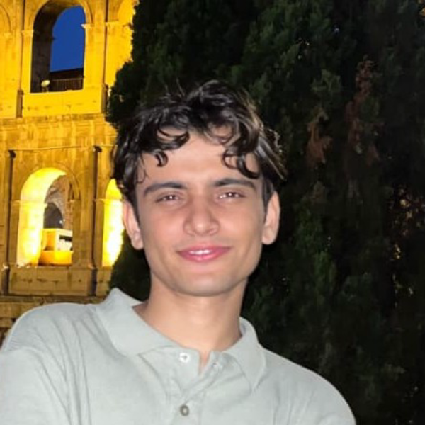
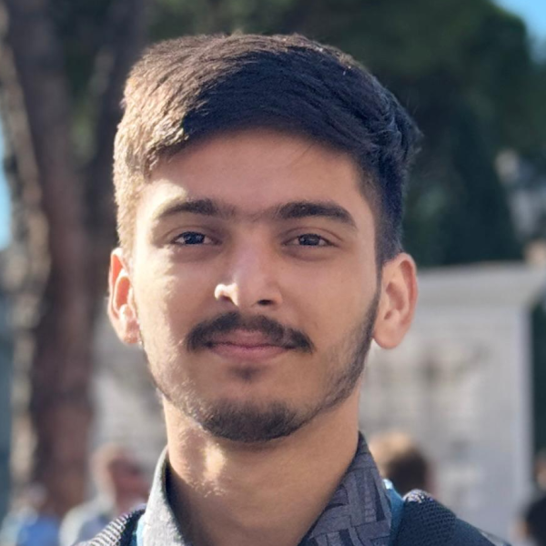
DITCH
Built by people who shipped it
Both founders study B.Sc. Engineering Sciences at the University of Rome Tor Vergata and DITCH is already live in production.
CORE TEAM
Sandesh Chapagain
Gambhir Sharma
Founder & CEO
Cofunder & CTO
Full-stack & infrastructure. Built DITCH's relay, compositor and realtime backend.
Front-end, product design & technical architecture and owns the studio & viewer UX.
ADVISORS WE'RE BUILDING AROUND (TARGET)
Media-tech
Creator economy
Ad-tech
broadcaster / streaming exec
MCN or talent-agency operator
programmatic / live ad networks
DITCH · CONFIDENTIAL
Stream Once. Own Everywhere.

Slide 14
DITCH
DITCH
DITCH
DITCH
Stream once. Bring every viewer into the picture. Turn presence into the ad unit.
STREAM ONCE. OWN EVERYWHERE.
● LIVE NOW — [ sendmailtodex@gmail.com ] · [ ditchlive.app ]

