Slide 1
OVERTIME PORTAL
User Manual
Live screenshots from http://localhost/overtime
Employee · Approver · Admin functions
Personas: Coquia Joshua Mari · Hernandez Dexmel Mico · Abuan Christopher
Overtime Portal · User Manual
1 / 20

Slide 2
INTRODUCTION
What this application does
• Employees submit overtime (date, group, location, project hours, remarks) and track status in Your History.
• Approvers review assigned requests, approve or reject (single or bulk), and can Submit Member Request on behalf of employees (auto-approved).
• Admins configure group approvers (L1–L4), manage app admins, and review activity logs.
• There is no separate Overtime login screen — identity comes from the shared portal session (Daily Report).
Screenshots in this manual were taken from the running local application with real database accounts.
Overtime Portal · User Manual
2 / 20

Slide 3
GETTING STARTED
Sign-in and navigation
1. Sign in through the Daily Report / company portal so the session cookie is set.
2. Open http://localhost/overtime (lands on Request).
3. Use the left sidebar: Request · Approve (approvers only) · Admin (admins only).
4. Header tools show your greeting and a Light/Dark theme toggle.
5. Daily Report in the sidebar footer returns to the parent portal.
Overtime Portal · User Manual
3 / 20

Slide 4
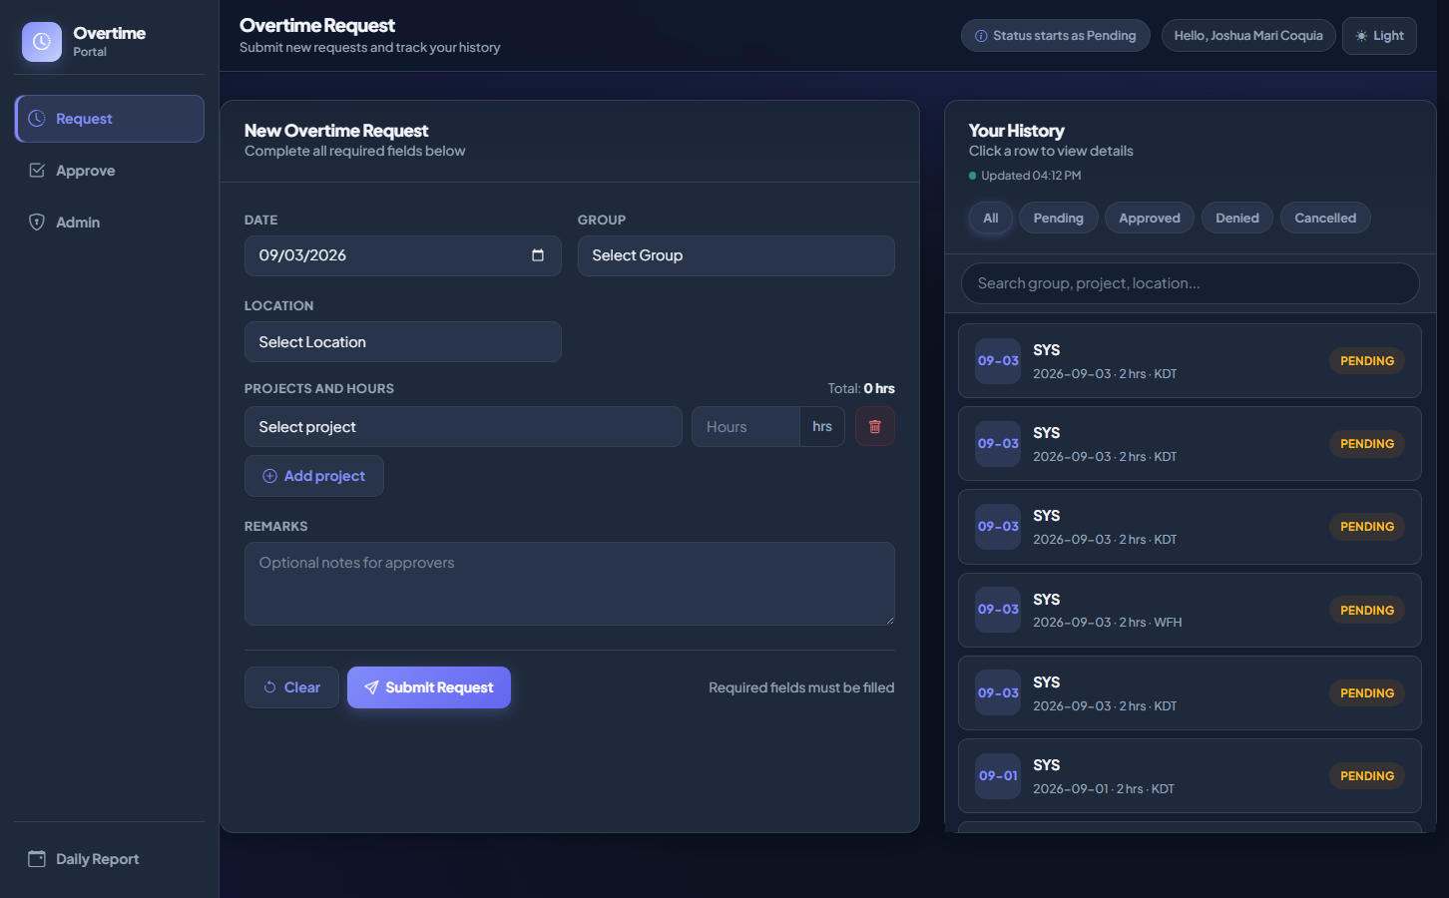
Request — Home
Signed in as Coquia Joshua Mari
How to use
1. Open /overtime/request/
2. Confirm your name in the header greeting
3. Left: New Overtime Request form
4. Right: Your History (live updates)
Overtime Portal · User Manual
4 / 20

Slide 5
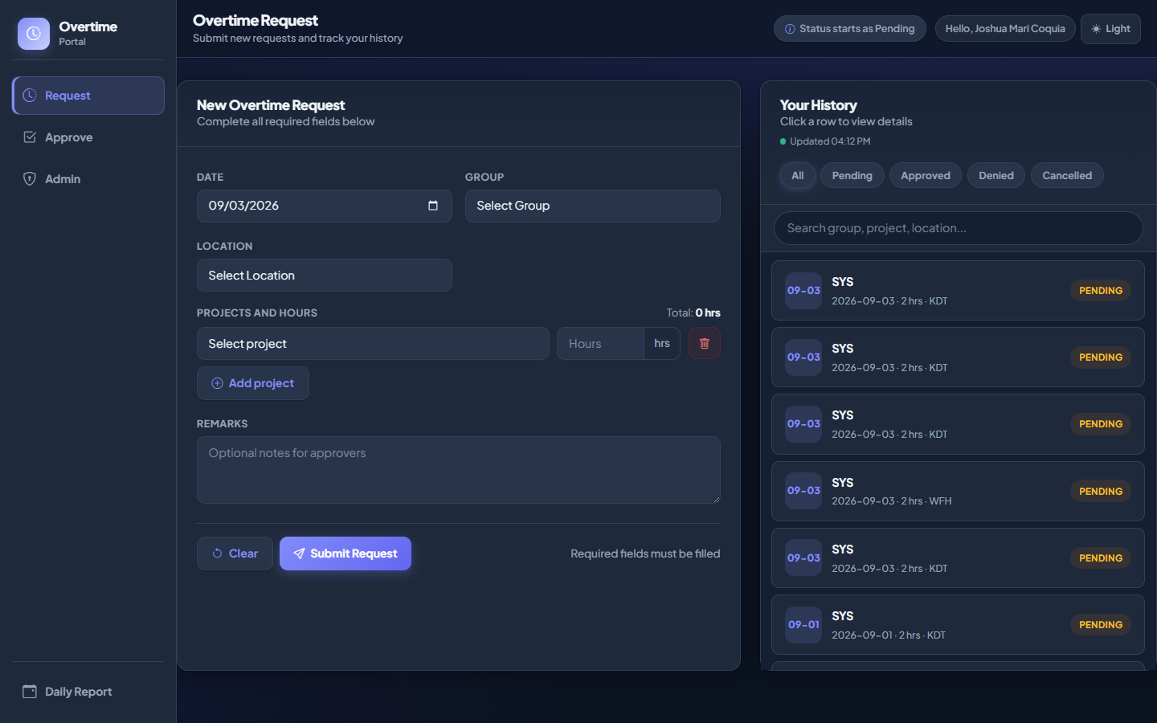
Request — New overtime form
Required fields and project allocations
How to use
1. Choose Date (allowed weekday)
2. Select Group — projects load
3. Select Location
4. Add project and enter hours
5. Optional remarks
6. Click Submit Request
Overtime Portal · User Manual
5 / 20

Slide 6

Request — Your History
Filters, search, and live refresh
How to use
1. Filter All / Pending / Approved / Denied / Cancelled
2. Search group, location, or remarks
3. Use date range / pager when shown
4. Click a row for details
Overtime Portal · User Manual
6 / 20

Slide 7
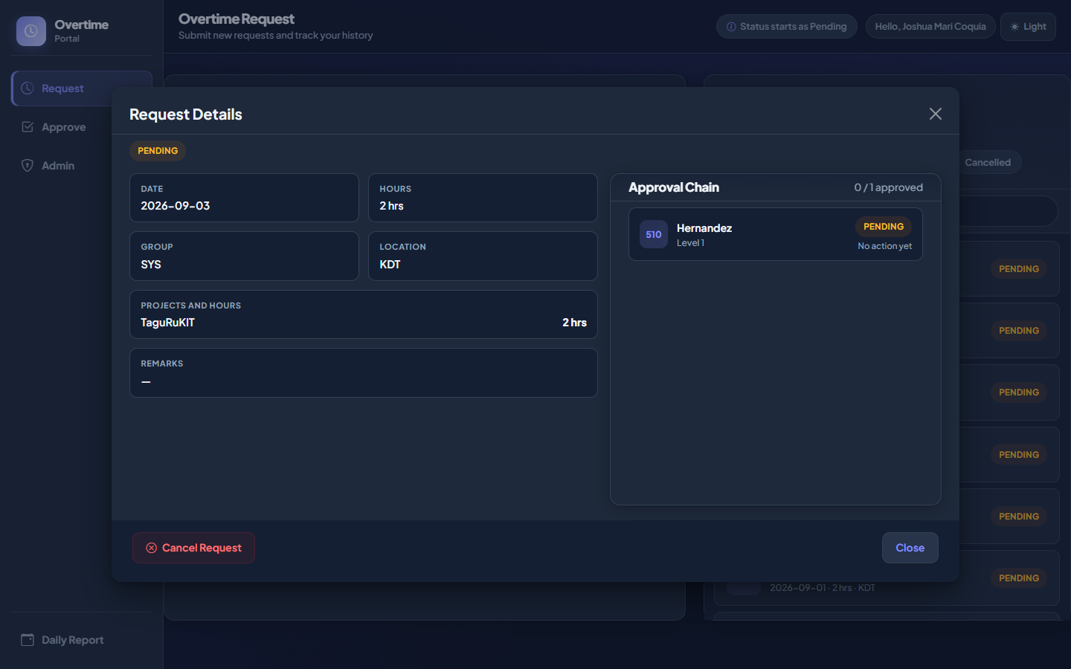
Request — Details modal
Status, projects, approvers, cancel
How to use
1. Review status and hours
2. Check project breakdown
3. See approver decisions
4. Cancel only while Pending
Overtime Portal · User Manual
7 / 20

Slide 8
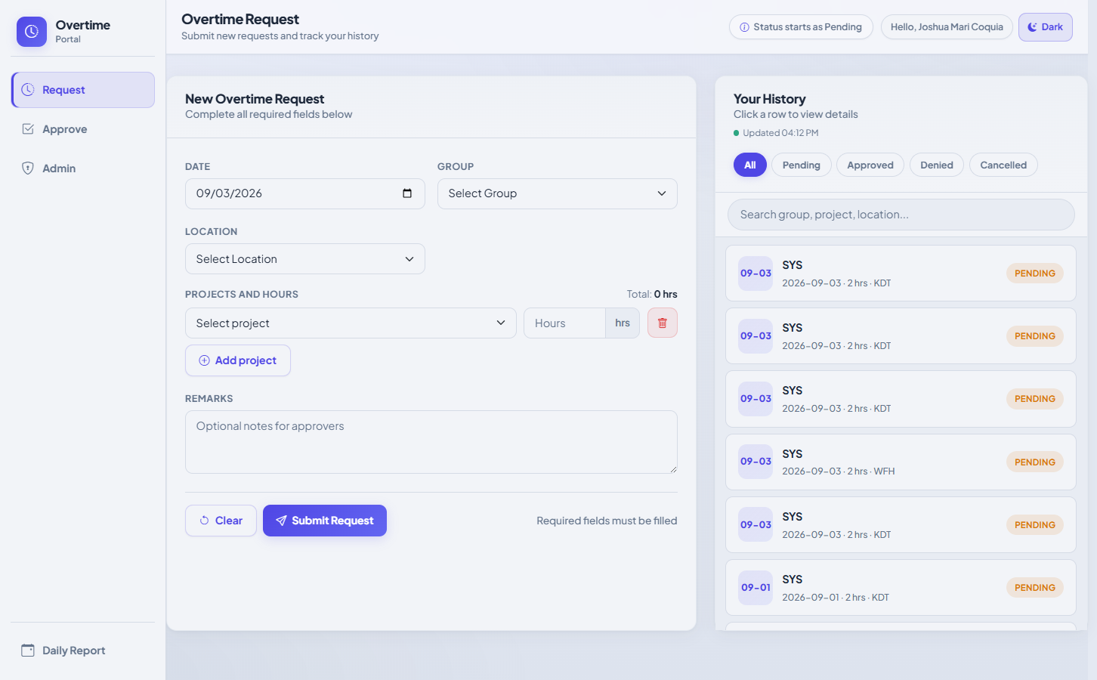
Request — Dark theme
Header theme toggle
How to use
1. Click Dark / Light in header tools
2. Preference is saved in the browser
Overtime Portal · User Manual
8 / 20

Slide 9
APPROVE MODULE
For designated approvers
Screenshots signed in as Hernandez Dexmel Mico.
• Open Approve from the sidebar (hidden if you are not an approver).
• Stats summarize Total Assigned, Awaiting Your Action, and You Already Acted.
• After the daily cutoff (default 15:00), employees cannot self-submit; approvers can still file on behalf.
Overtime Portal · User Manual
9 / 20

Slide 10
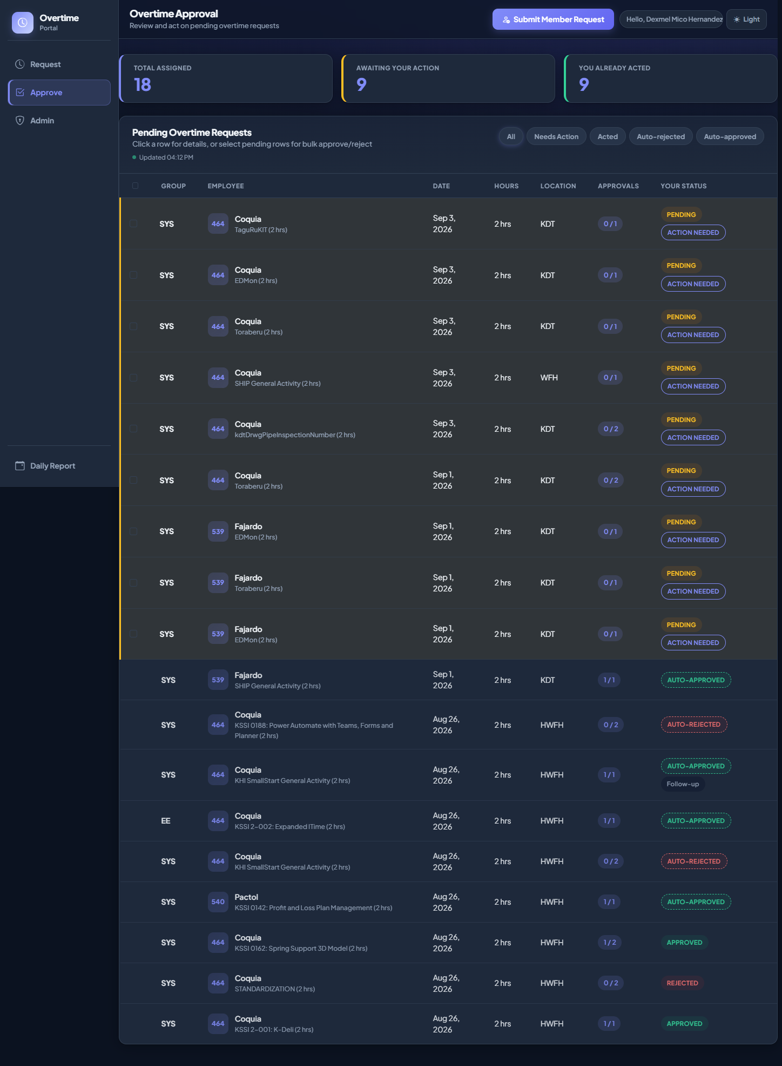
Approve — Home
Queue and statistics
How to use
1. Open /overtime/approve/
2. Review the three stat cards
3. Scan the request table
4. Use Submit Member Request when filing for someone
Overtime Portal · User Manual
10 / 20

Slide 11
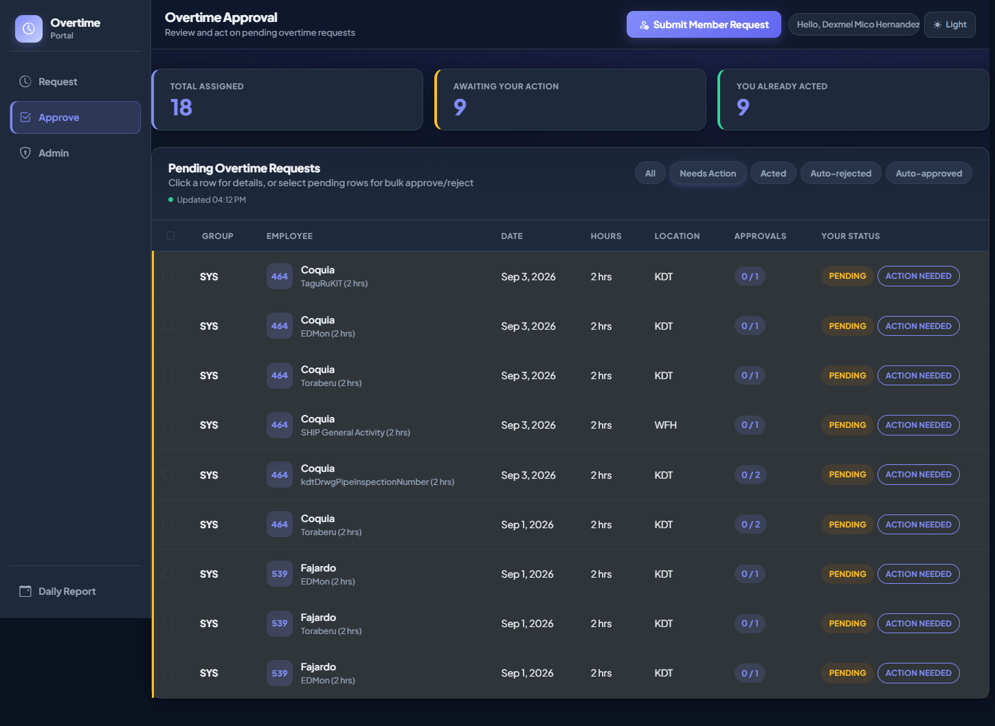
Approve — Needs Action
Items waiting for your decision
How to use
1. Click Needs Action
2. Select pending rows for bulk Approve/Reject
3. Or click a row to open details
Overtime Portal · User Manual
11 / 20

Slide 12
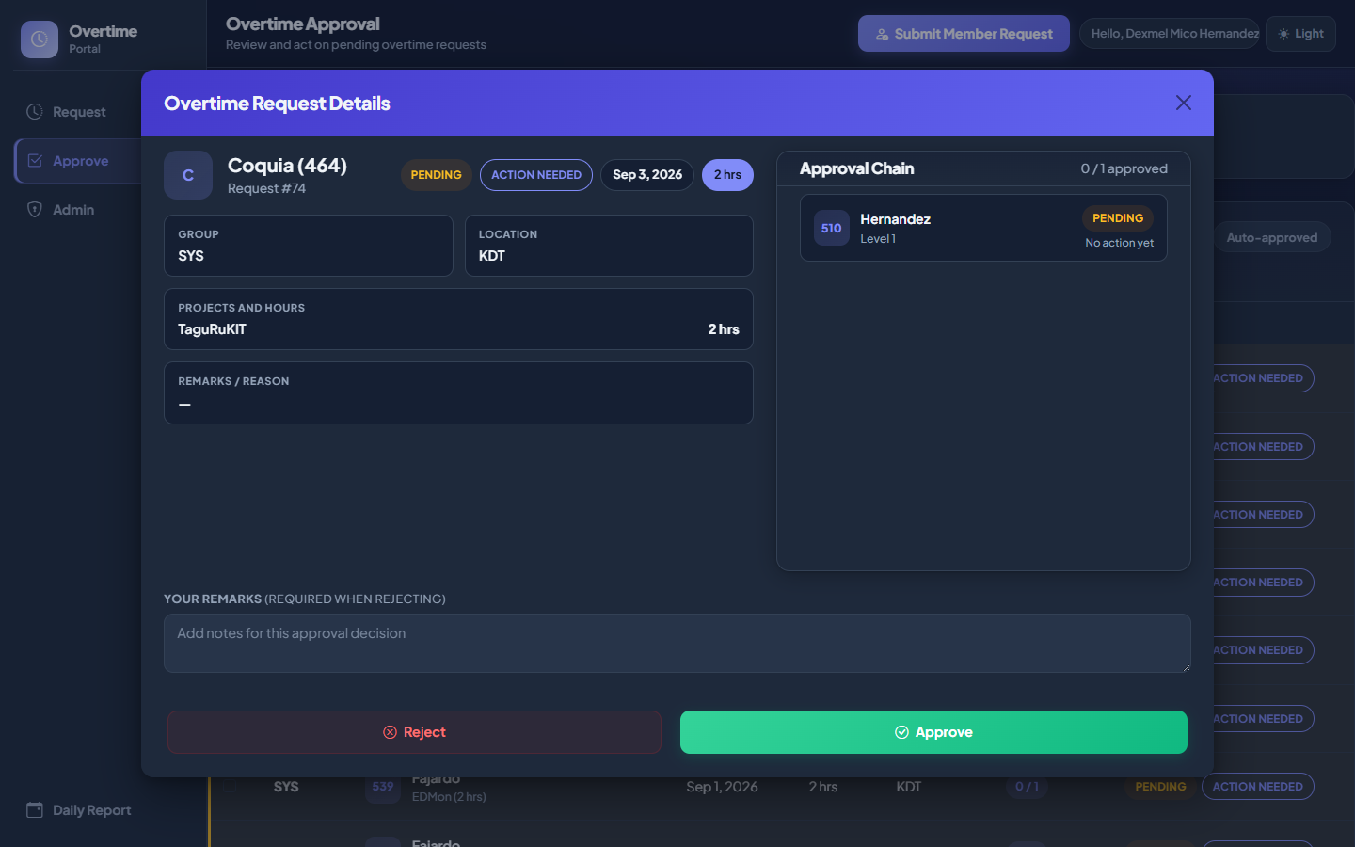
Approve — Request details
Single approve / reject
How to use
1. Review employee, date, hours, projects
2. Enter remarks if rejecting
3. Click Approve or Reject
4. L4 finalizes immediately; others wait for cutoff job
Overtime Portal · User Manual
12 / 20

Slide 13
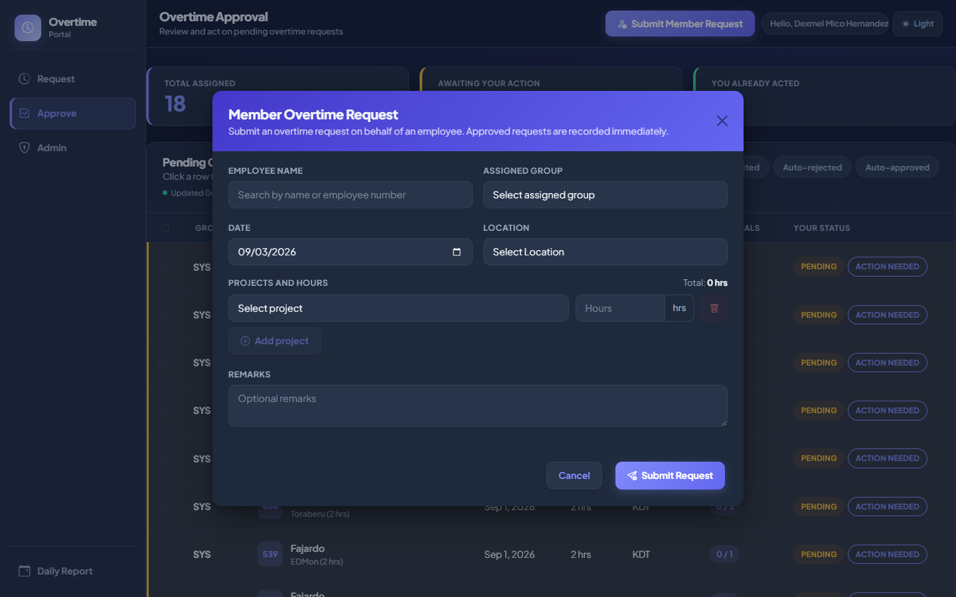
Approve — Submit Member Request
On-behalf filing (auto-approved)
How to use
1. Click Submit Member Request
2. Search and select the employee
3. Fill date, group, location, projects
4. Submit — auto-approved for the member
Overtime Portal · User Manual
13 / 20

Slide 14
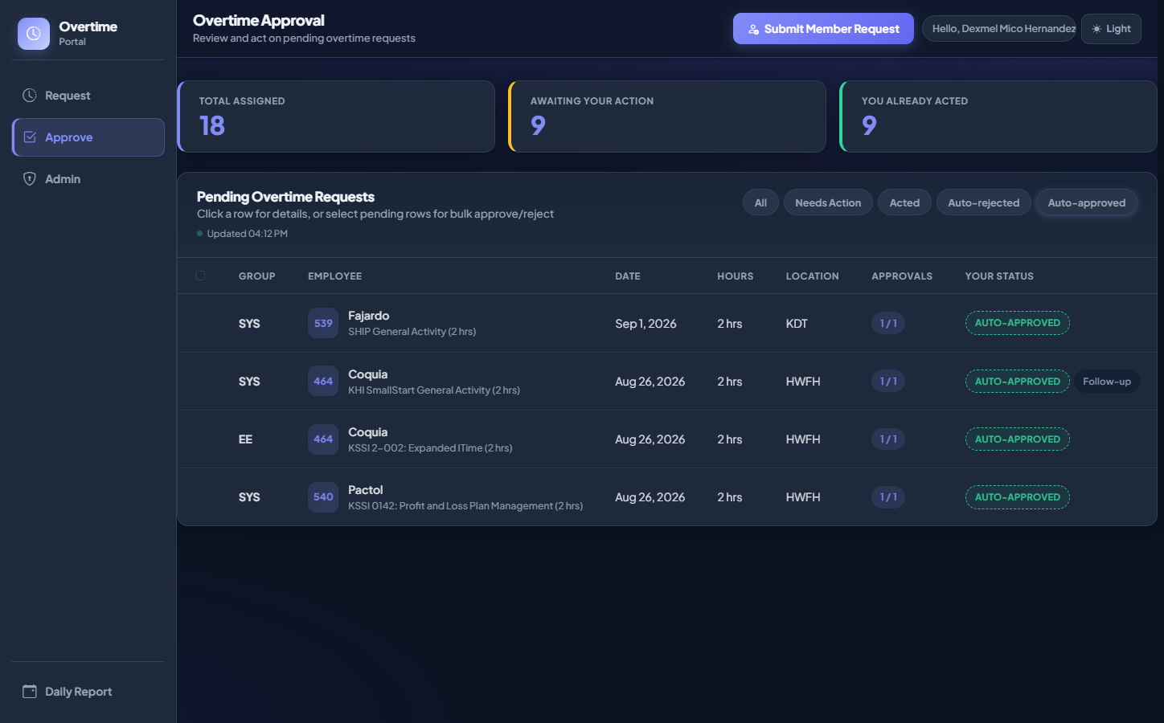
Approve — Auto-approved
On-behalf and related outcomes
How to use
1. Open Auto-approved filter
2. Confirm on-behalf submissions
3. Use Auto-rejected + Re-submit as approved for follow-ups when available
Overtime Portal · User Manual
14 / 20

Slide 15
ADMIN MODULE
For application administrators
Screenshots signed in as Abuan Christopher.
• Group Approvers — who receives OT for each group at levels L1–L4
• Admins — who may open this Admin area
• Activity Logs — audit trail of portal actions
Overtime Portal · User Manual
15 / 20

Slide 16
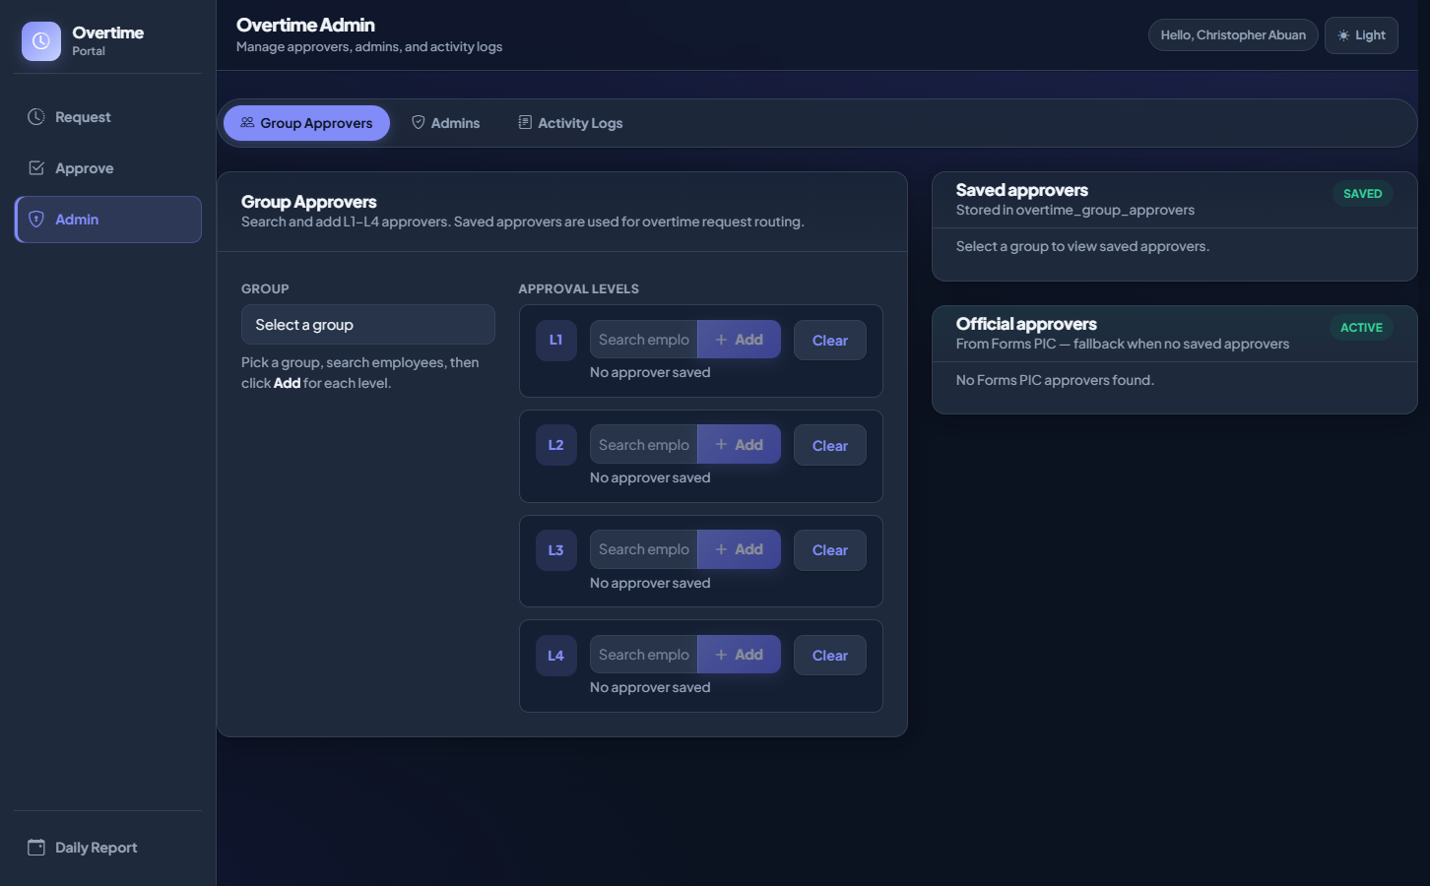
Admin — Group Approvers
Configure L1–L4 routing
How to use
1. Open /overtime/admin/
2. Select a group
3. Search employees and Add per level
4. Saved approvers drive OT routing
Overtime Portal · User Manual
16 / 20

Slide 17
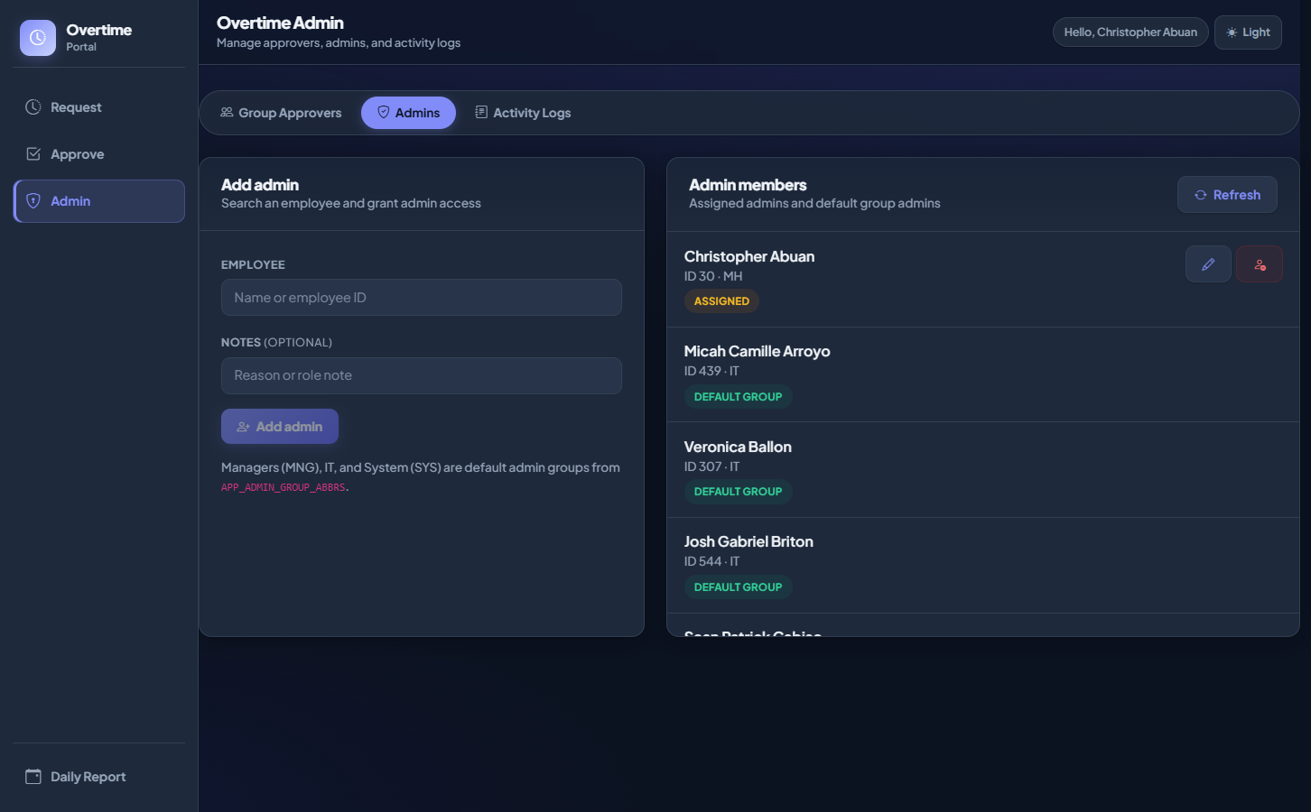
Admin — Admins
Grant or remove administrators
How to use
1. Open the Admins tab
2. Search and Add admin
3. Update or remove as needed
Overtime Portal · User Manual
17 / 20

Slide 18
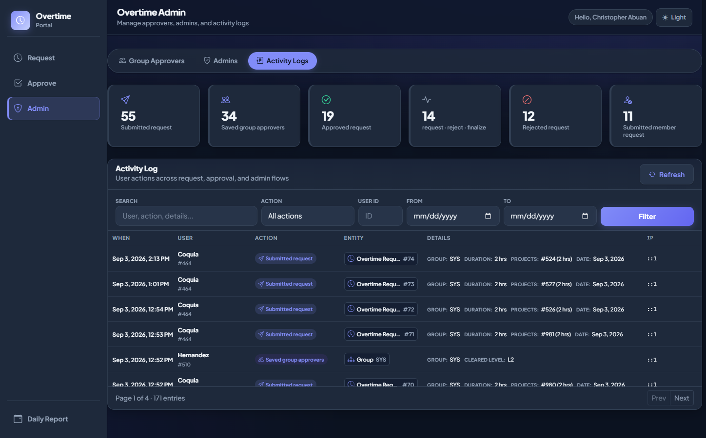
Admin — Activity Logs
Audit trail
How to use
1. Open Activity Logs
2. Filter results when controls are shown
3. Page with Prev / Next
Overtime Portal · User Manual
18 / 20

Slide 19

Access denied
Non-admin (Coquia Joshua Mari) opening Admin
How to use
1. Non-admins see a lock message
2. Ask an existing admin for access
3. Non-approvers are redirected away from Approve
Overtime Portal · User Manual
19 / 20

Slide 20
IMPORTANT RULES
Cutoff and identity
• Default cutoff time: 15:00 (configurable via APPROVAL_CUTOFF_TIME).
• After cutoff, the Request form locks for employees with an on-screen banner.
• Approvers can still Submit Member Request after cutoff.
• Pending items with no decision may be auto-rejected when the finalize job runs.
• Keep your Daily Report / portal session active — Overtime uses that identity.
Overtime Portal · User Manual
20 / 20

Slide 21
End of user manual
Questions? Walk the live UI: Request → Approve → Admin.
Overtime Portal · User Manual
21 / 20

