Slide 1
Change-point Detection
Algorithms for change-point detection (CPD), linear trend following trading system based on CPD.

Slide 2
What is Change-point Detection?
Identifying points where time series behavior changes
Change-points split time series into multiple segments
It is assumed that on each segment data exhibits identical properties
Different types of change can be identified (mean, variance, etc.)
For each type some numerical metric is being used (cost function)
Different scenarios: offline and online (real-time)

Slide 3
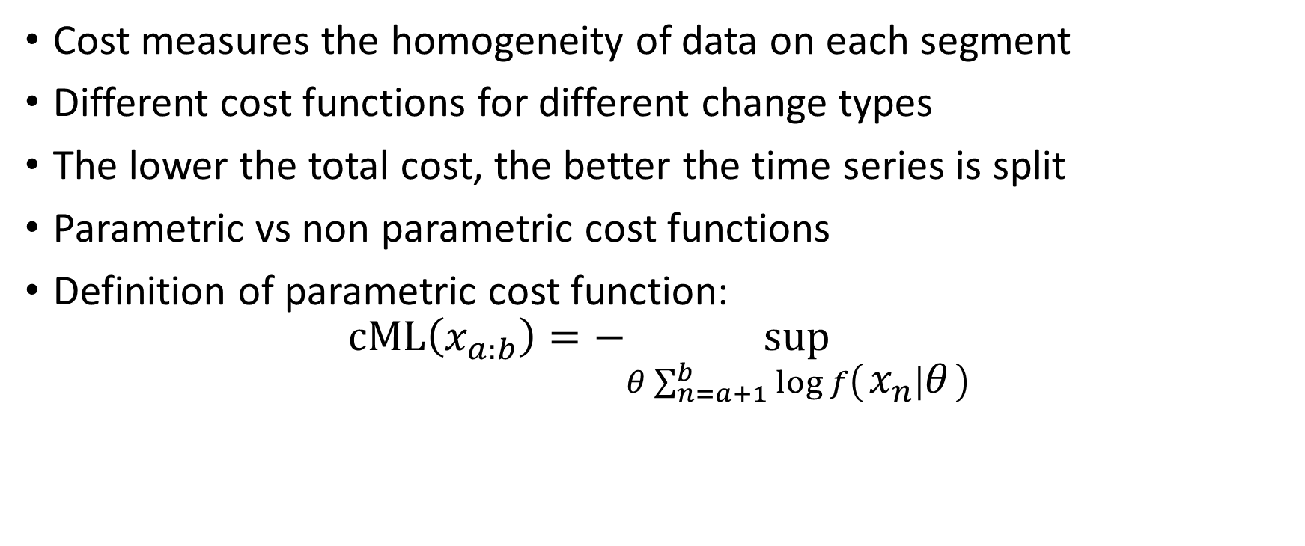
Cost Functions
Cost measures the homogeneity of data on each segment
Different cost functions for different change types
The lower the total cost, the better the time series is split
Parametric vs non parametric cost functions
Definition of parametric cost function:
$$cML\left(x_{a:b}\right)=−\sup_{θ\sum_{n=a+1}^{b}{\log{f\left(x_{n} ∣ θ\right)}}}$$

Slide 4
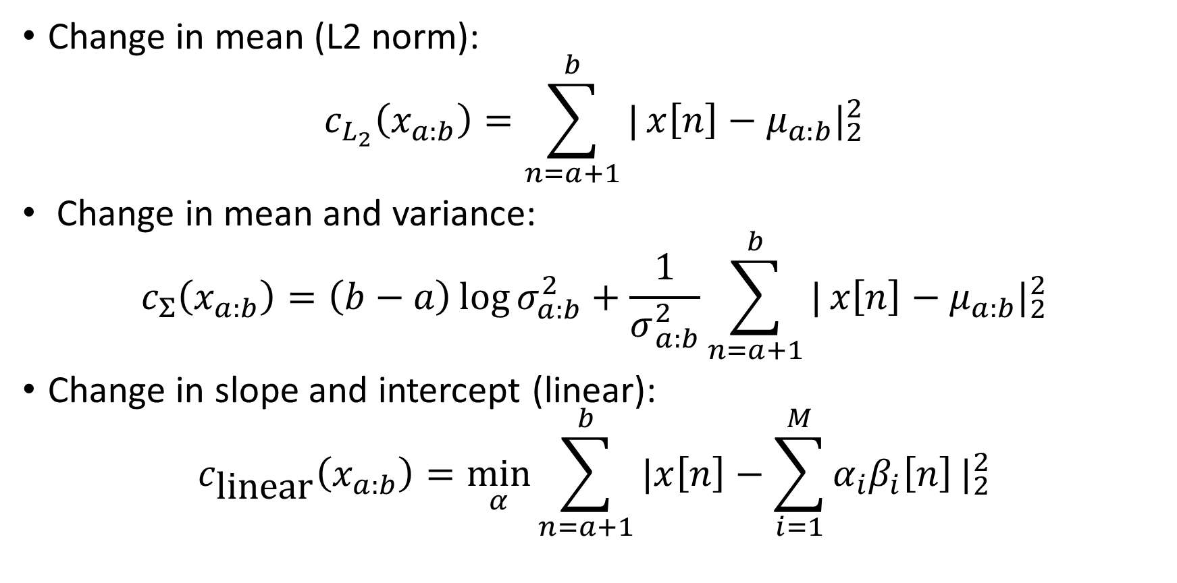
Types of Cost Functions
Change in mean (L2 norm):
$$c_{L_{2}}\left(x_{a:b}\right)=\sum_{n=a+1}^{b}{|}x\left[n\right]−μ_{a:b}|_{2}^{2}$$
Change in mean and variance:
$$c_{Σ}\left(x_{a:b}\right)=\left(b−a\right)\log{σ_{a:b}^{2}}+\frac{1}{σ_{a:b}^{2}}\sum_{n=a+1}^{b}{|}x\left[n\right]−μ_{a:b}|_{2}^{2}$$
Change in slope and intercept (linear):
$$c_{\text{linear}}\left(x_{a:b}\right)=\min_{α}{\sum_{n=a+1}^{b}{\left.|x\left[n\right]−\sum_{i=1}^{M}{α_{i}β_{i}\left[n\right]}\right.|_{2}^{2}}}$$

Slide 5
Cost Computers
For each segment its cost needs to be computed
Naive approach: iterate over each value in segment and make calculations
Efficient approach: most costs are based on properties which depend on simple sums or squared sums. Precomputing prefix sums over the whole time series can help calculate segment costs in O(1) time

Slide 6
Algorithms
There are many algorithms for CPD: CUSUM, Binary Segmentation, Optimal Partitioning, PELT, Bayesian CPD
Binary Segmentation (BinSeg): greedy selection of best point which splits segment into 2 smaller ones by minimizing cost. Relatively fast: O(nlogn) time complexity on average and O(n^2) in the worst case
Optimal Partitioning (Opt): using dynamic programming to make globally optimal splits. Slower than BinSeg, O(n^2) on average and in the worst case

Slide 7
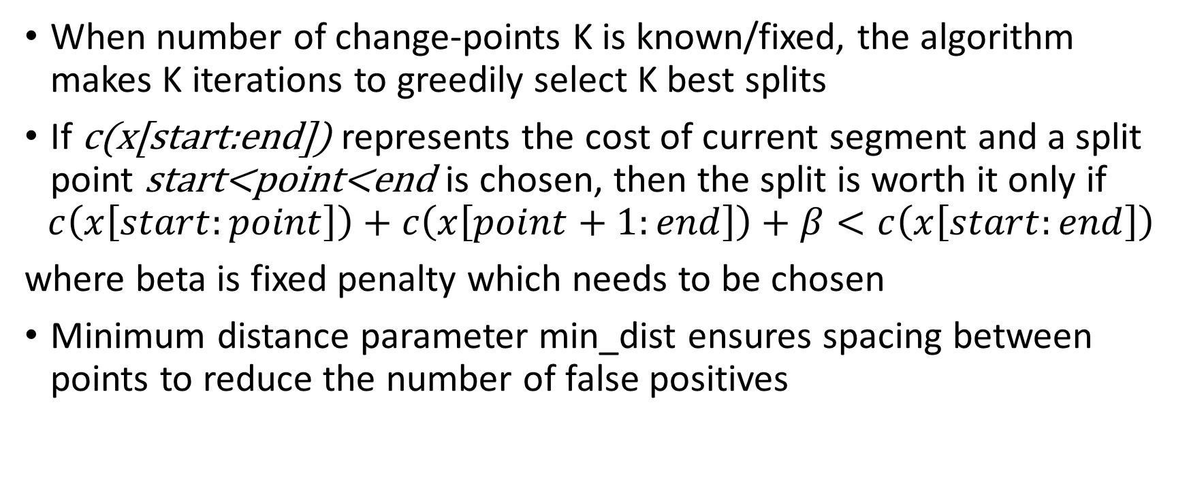
Binary Segmenation
When number of change-points K is known/fixed, the algorithm makes K iterations to greedily select K best splits
If c(x[start:end]) represents the cost of current segment and a split point start<point<end is chosen, then the split is worth it only if
$$c\left(x\left[start:point\right]\right)+c\left(x\left[point+1:end\right]\right)+β<c\left(x\left[start:end\right]\right)$$
where beta is fixed penalty which needs to be chosen
Minimum distance parameter min_dist ensures spacing between points to reduce the number of false positives

Slide 8
Binary Segmentation
Steps of the algorithm:
1. Get time series as input and initialize a cost computer.
2. Set a fixed penalty based on input time series.
3. Initialize a list of tuples which represents segments with value (0, N) where
N is the number of samples in time series.
4. While current gain is greater than penalty do
5. Iterate over all segments (tuples) in segments list and for each segment
calculate the best split which maximizes the gain
6. Pick the best gain out of all gains and if it is higher than penalty, make
a new split and update segments list. Also add new change-point to the
output list.
7. Return the sorted list of all found change-points.

Slide 9
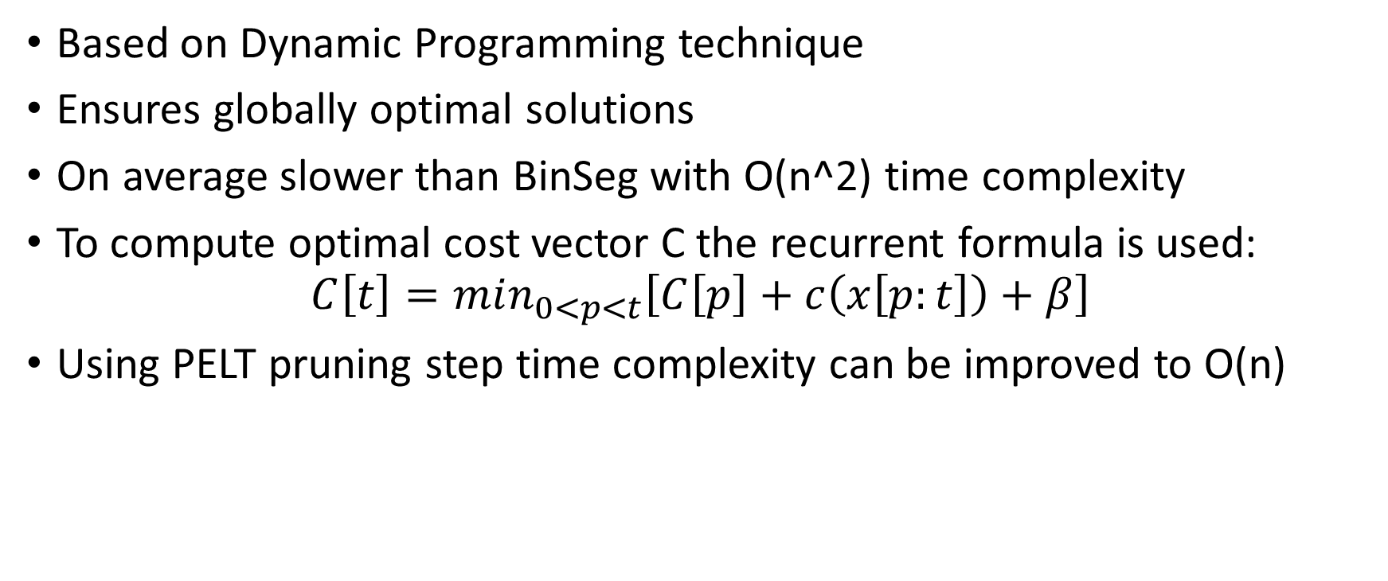
Optimal Partitioning
Based on Dynamic Programming technique
Ensures globally optimal solutions
On average slower than BinSeg with O(n^2) time complexity
To compute optimal cost vector C the recurrent formula is used:
$$C\left[t\right]=min_{0<p<t}\left[C\left[p\right]+c\left(x\left[p:t\right]\right)+β\right]$$
Using PELT pruning step time complexity can be improved to O(n)

Slide 10
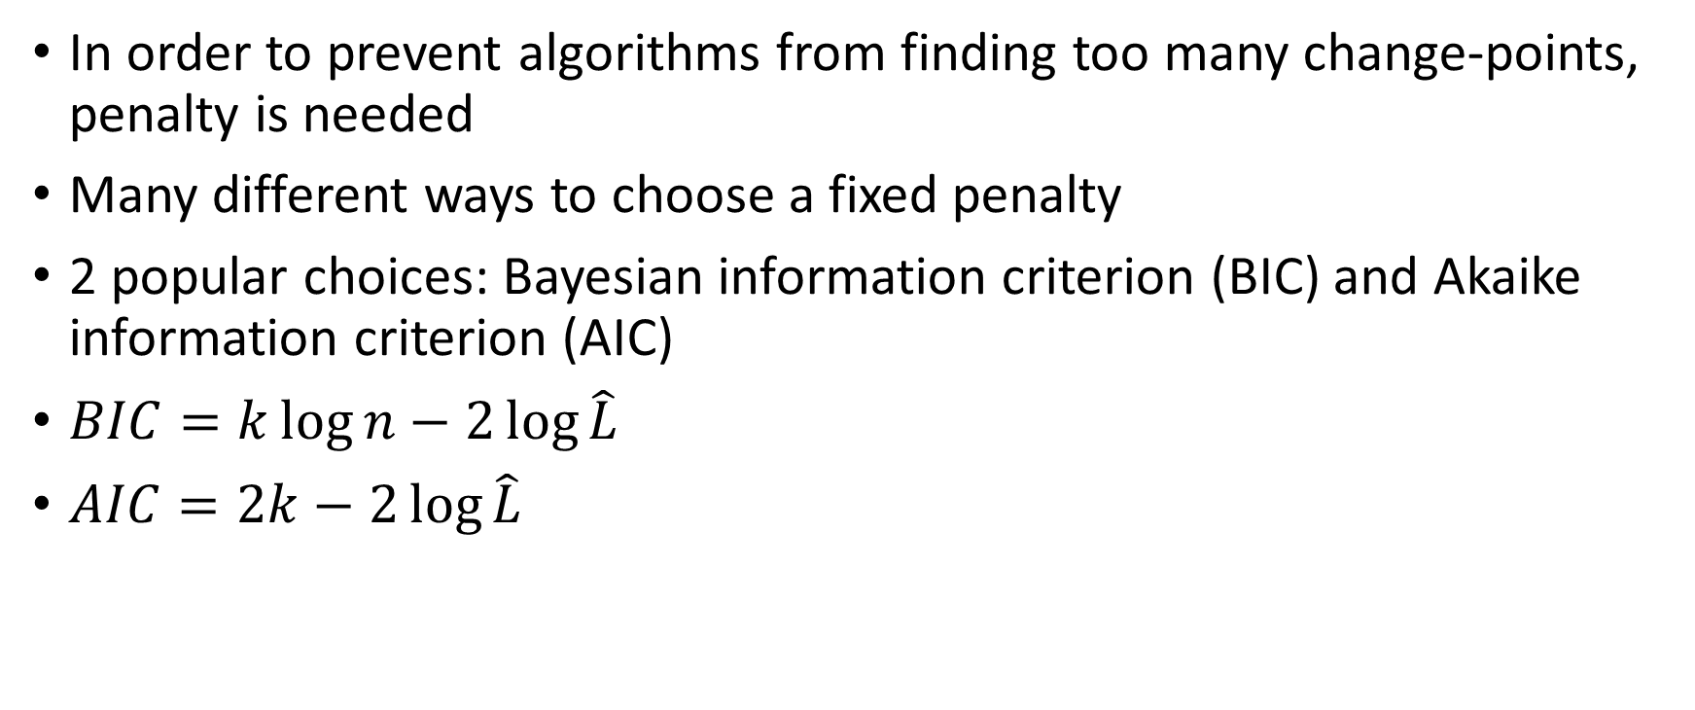
Penalty Choice
In order to prevent algorithms from finding too many change-points, penalty is needed
Many different ways to choose a fixed penalty
2 popular choices: Bayesian information criterion (BIC) and Akaike information criterion (AIC)
$BIC=k\log{n}−2\log{\hat{L}}$
$AIC=2k−2\log{\hat{L}}$

Slide 11
Online Wrapper
Previously mentioned algorithms were implemented to work with offline data
NaiveOnlineDetector is an online wrapper for offline algorithms
It receives cost type, algorithm type, minimum distance and horizon size as parameters
It keeps local buffer of time series values and updates them when new data arrives
Horizon size limits the size of the buffer to save memory and keep only fresh data

Slide 12
Testing results
In general, BinSeg algorithm is more susceptible to noise, detects more false positives than Opt
On stock market data both algorithms capture major trends, Opt better filters out noise
In online scenarios when minimum distance parameter is small, much noise is being captured. By increasing the value of min_dist parameter, the number of false positives drops and accuracy improves.
However, high minimum distance increases delay at which change-points are being detected, which can be critical in real-time scenarios

Slide 13
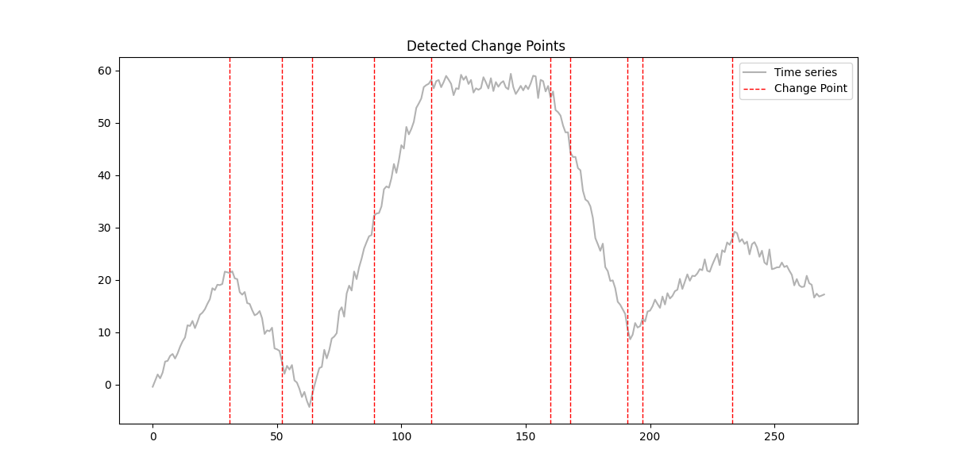
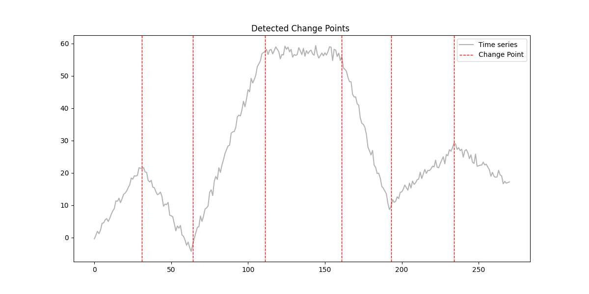
Slope change detection offline
BinSeg
Opt

Slide 14
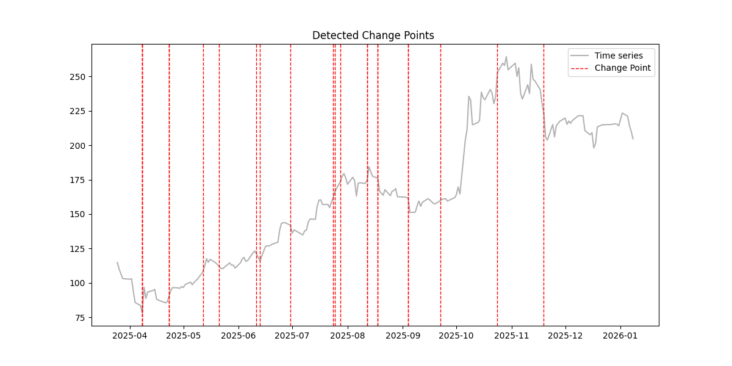
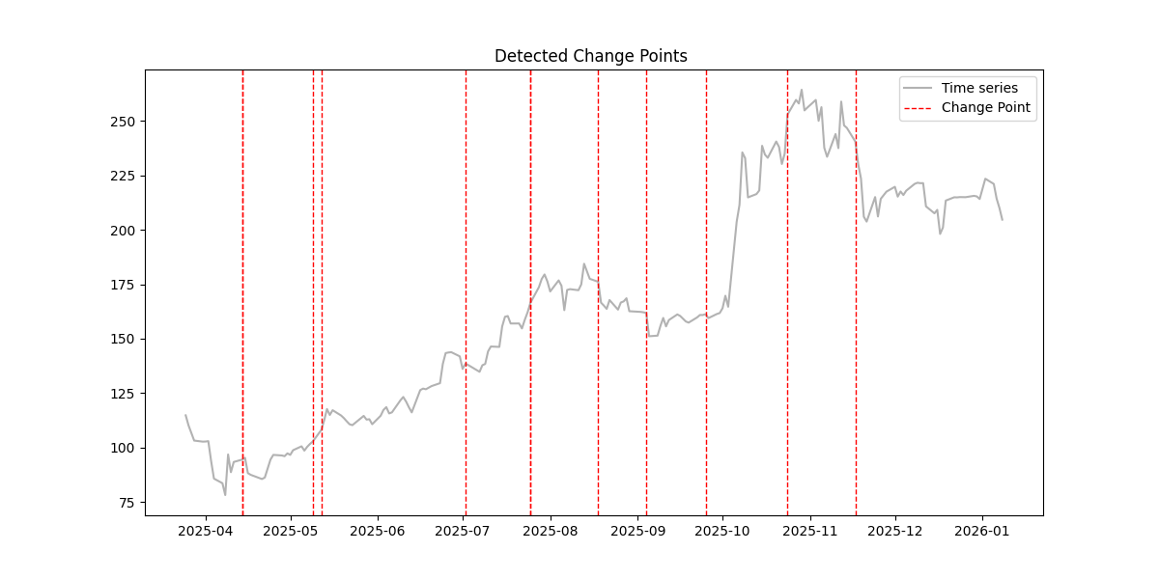
Slope change online stock prices
Opt with min_dist = 10
Opt with min_dist = 15
Higher minimum distance filters out more noise

Slide 15
Linear Trend Following Trading Strategy
CPD can be applied in finance and trading to detect when stock prices change behaviour
Based on CPD a trend following strategy can be built
When change-point is detected, buy or sell order can be executed based on the new trend. New trend should be strong enough compared to global trend
Skip trading during low volume periods of time
Adjust position size based on trend to noise ratio (mean returns over lookback period divided by standard deviation)

Slide 16
Trading Strategy Steps
Initialize online detector with linear cost type, Opt or BinSeg model type,
minimum distance and horizon size parameters.
2. For each new closing price data available, update the detector with it and find whether a new change-point has been detected.
3. If new change-point is detected, calculate the angle of the slope of linear regression line fitted to prices in range from detected
point to current moment. This angle represents an estimate of trend strength.
4. Update exponential moving average of trend and continue only if current trend is strong enough compared to average.
5. Calculate global trend using a fixed look-back period and continue trading only if local trend change is stronger than global trend.
6. Skip trade if it was a low volume day (compared to average volume from volume look-back window.
7. Set position size proportional to trend to noise ration (calculated as ratio of mean of daily returns to standard deviation of returns).
8. If trend is positive (angle > 0) then go long, else go short.

Slide 17
Strategy Performance
Strategy was backtested on SP500 data over different periods of time from 2014 to 2026 using yfinance data and backtesting.py library.
Mean sharpe ratio was used as performance criterion
Minimum distance parameter was adjusted based on volatility
Results were compared to simple Buy and Hold strategy
Over different periods from 2014 to 2020 the average Sharpe ratio of trend following strategy was 0.87 compared to 0.82 of buy and hold.

Slide 18
Conclusion
2 CPD algorithms were implemented and applied in trading
Both algorithms perform decently. BinSeg is computationally faster, O(nlogn) on average, but less accurate. Opt is slower, O(n^2), but finds globally optimal splits
Minimum distance parameter significantly influences detection results. Higher minimum distance filters out more noise, but detection delay increases.
Opt can be further improved by introducing PELT pruning to reach O(n) time complexity
NaiveOnlineDetector can, possibly, be further optimized
Trading strategy can be improved by adding more rules, using indicators and
scraping alternative data like news, earnings calls and market sentiment

Slide 19
Bibliography
[1] Ryan Prescott Adams and David J. C. MacKay. Bayesian online changepoint
detection. arXiv preprint arXiv:0710.3742, 2007. URL: https://arxiv.org/abs/0710.3742.
[2] Philip Bretz. Notes on bayesian changepoint detection, 2020. URL: https://math.ou.edu/~pbretz/Changepoint_Detection.pdf.
[3] GeeksforGeeks contributors. Residual sum of squares, 2024. URL: https://www.geeksforgeeks.org/maths/residual-sum-of-squares/.
[4] GeeksforGeeks contributors. Linear regression formula, 2025. URL: https://www.geeksforgeeks.org/maths/linear-regression-formula/.
[5] Pierre Granjon. The cusum algorithm: A short review, 2013. URL: https://hal.science/hal-00914697v1/document.
[6] Laurent Oudre. Lecture 5: Change-point and anomaly detection, 2023.
URL: https://www.laurentoudre.fr/ast/AST5.pdf.
[7] Giovanni Romano. Multiple change-point detection, 2025. URL:
https://www.lancaster.ac.uk/~romano/teaching/2425MATH337/3_multiple_changes.html.
[8] Eric W. Weisstein. Least squares fitting. URL: https://mathworld.wolfram.com/LeastSquaresFitting.html.
[9] Wikipedia contributors. Sharpe ratio. URL: https://en.wikipedia.org/wiki/Sharpe_ratio.
[10] Wikipedia contributors. Simple linear regression. URL: https://en.wikipedia.org/wiki/Simple_linear_regression.

