Slide 1
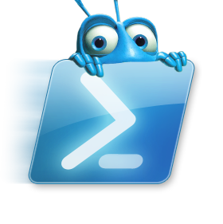

PSBUG – June 2016
Desired State Configuration and PowerCLI
Vinith Menon
My Blog - virtualize-automate.com
Twitter - @vinithmenon28

Slide 2
Welcome
Desired State Configuration
Microsoft’s declarative configuration technology, built on Windows PowerShell and introduced in Windows Management Framework 4.0.
Available for Windows 7, Windows Server 2008 R2, and later.
What we will cover
Intro to PowerCLI
How I Creating the Custom DSC Resource
Demo
Q&A

Slide 3
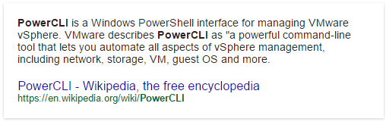
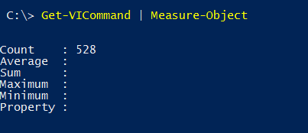
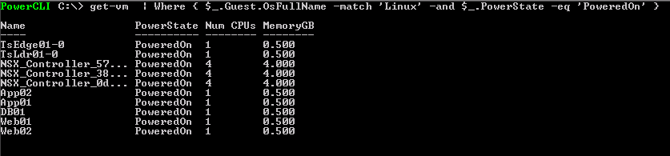
PowerCLI – Introduction
Build on PowerShell
Provides CLI management and automation capability for vSphere environments
Used extensively by vSphere customers in operations / engineering roles

Slide 4
What is DSC?
DSC was the “final destination” for PowerShell, this is as per a document written by Windows PowerShell inventor Jeffrey Snover, wherein he described his vision for changing administration in a Microsoft environment.
In some respects, DSC eliminates the need for some administrators to even learn Windows PowerShell.
GIF Image Describes DSC ☺
Pink – The Misconfigurations
Blue – Fixed by DSC

Slide 5
DSC Resource for PowerCLI
Please ask as we go!
Most of this session consists of live demonstration of main DSC technique used to create the custom resource, with a minimum of slides. Feel free to pop in with questions whenever you feel the urge.
The PowerCLI DSC Resource - check’s for snapshot configuration on a set of vm’s in a resource pool.
Based on the condition “Ensure = Present” / “Ensure = Absent” takes the appropriate actions of creating snapshots on the VM’s / removing all the existing snapshots.
Next we look at the Core components
Snapshots and ResourcePools
Notes:
The PowerCLI DSC Resource which i created check’s for configurations of snapshots on a set of vm’s in a resource pool, and based on the condition “Ensure = Present” / “Ensure = Absent” takes the appropriate actions of creating snapshots on the VM’s / removing all the existing snapshots.

Slide 6
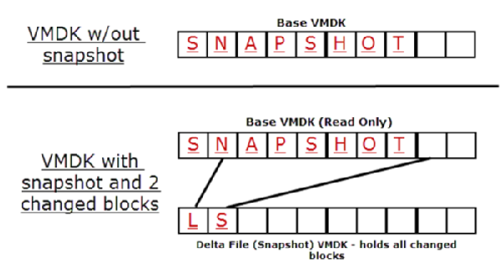
What's a Snapshot ?
Snapshots are one of the best features in vSphere.
Snapshots are the safety net built into the platform that allows you to easily revert to a previous known good state in the event that something happens in a VM.
Some environments run regularly scheduled snapshots. Some administrators use them only before changes are made in the environment.
Over a period of time, virtual machine snapshots grow to a point that they can exhaust all of the available disk space on a datastore.
Administrators can take multiple snapshots and each snapshot references a parent, which means that there is added overhead for IO since the system has to combine multiple files in order to find the correct data to return.
Notes:
The PowerCLI DSC Resource which i created check’s for configurations of snapshots on a set of vm’s in a resource pool, and based on the condition “Ensure = Present” / “Ensure = Absent” takes the appropriate actions of creating snapshots on the VM’s / removing all the existing snapshots.

Slide 7
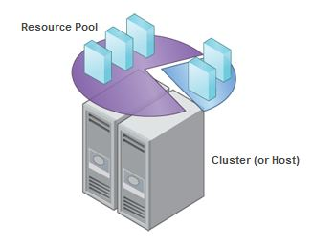
What's a ResourcePool ?
Resource pools allows to group together VM objects with similar performance requirements.
Resource pools allow a priority to be set to pools of compute, memory, and disk resources, so that when a resource contention occurs, the hypervisor can decide which VMs get access to resources first.
Notes:
The PowerCLI DSC Resource which i created check’s for configurations of snapshots on a set of vm’s in a resource pool, and based on the condition “Ensure = Present” / “Ensure = Absent” takes the appropriate actions of creating snapshots on the VM’s / removing all the existing snapshots.

Slide 8
DSC PowerCLI Architectural Overview
Configuration Script
PowerCLIConfig.ps1
Pushed
MOF Executed on Local Node
Compiled
Calls
LocalHost.mof
Snapshot DSC Resource Windows PowerShell module
Authoring
Deployment
Notes:
Basically it start from the configuration script, we compile it and create a mof file, the mof gets executed on the local node, after that based on the condition specified it will create / remove snapshots

Slide 9
Deployment Mode used - Push
Push – Mostly use it for testing
Use Start-DscConfiguration to copy MOF to target node(s). Node(s) evaluate configuration immediately and again every 15 minutes (by default).
Manual process. Non-core DSC resources must be manually deployed to nodes.
Pull - Better way and preferred in Production
Use push mode to enroll target node(s), configuring them with their pull server information. Target node(s) check the pull server every 30 minutes (default) and re-apply configuration.
MOF files must be copied to pull server, and must be accompanies by a checksum file.
DSC resources must be ZIPped and placed on pull server. Nodes will copy down any resources they are missing.

Slide 10
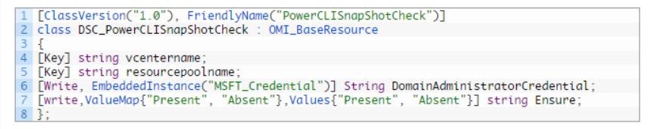
How the DSC Resource was created
Create the Schema.mof file
In an ISE editor or even a notepad, type in the below and create the MOF Files. The class consists of the properties which need to be passed as parameters to the resources. i my DSC resource i have the vcentername, the resourcepool name and also the DomainAdmin credentials to connect to the vcenter.
The type qualifier, [Key], on a property indicates that this property will uniquely identify the resource instance.
The [write] qualifier indicates that this property is optional when using the custom resource in a configuration script.
Values restricts the values that can be assigned to the property to the list of values defined in ValueMap.
Property called Ensure with values Present and Absent in your resource is recommended as a way to maintain a consistent style with built-in DSC resources.

Slide 11
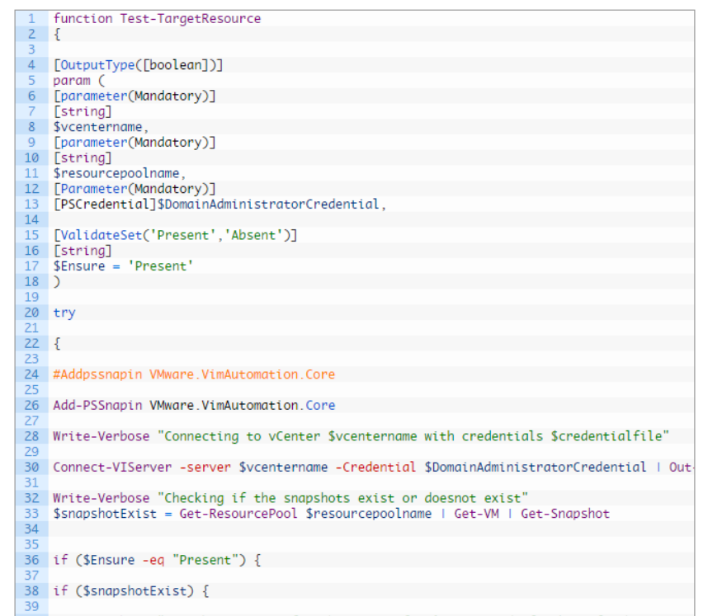
How the DSC Resource was created
Create the PowerShell Module – Does all the Heavy Lifting
Function Get-TargetResource {
}
Function Set-TargetResource {
}
Function Test-TargetResource {
}
Lets see the module!

Slide 12
Demo
Create Snapshots and Run with Ensure = “Absent”
This will remove if the snaps exist.
Create Snapshots and Run with Ensure = “Present”
This will check if the snaps exist, and create if not there.
Delete Snapshots and Run with Ensure = “Present”
This will create snaps for the VM.
Delete Snapshots and Run with Ensure = “Absent ”
???

Slide 13
Think About It
Configuration is Just a Text File!
If you’re configuring everything on your servers by means of DSC, then all of your configurations are just text files.
They’re searchable. Index-able. Human-readable.
Easily modified by tools! Imagine a GUI where you set up configurations, and it just writes out text files.
Easily modified by tools!!! Imagine a wizard that adds a new user… but really just modifies configuration scripts targeting your domain controllers, file servers, and whatever else. Configuring anything becomes a matter of modifying text files.

Slide 14
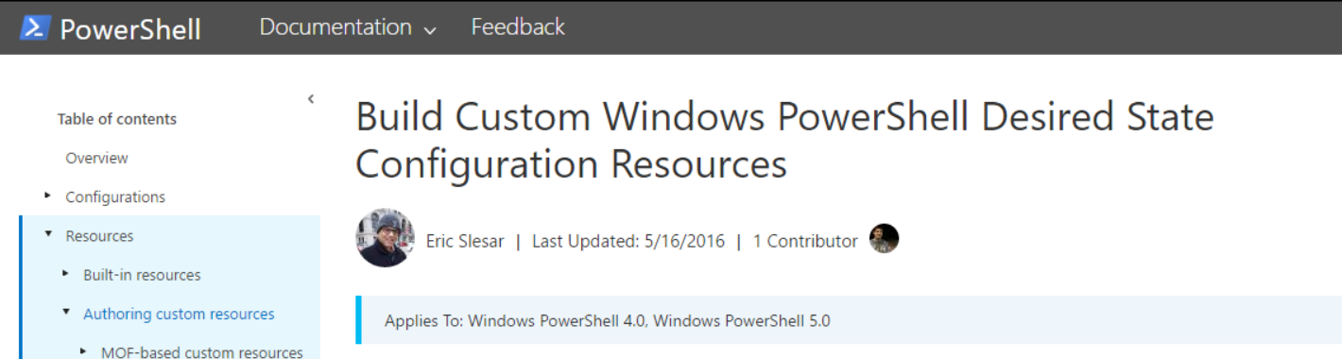
What About Resources?
They’re Script Modules
A DSC resource is just a Windows PowerShell script module (.psm1) that implements three pre-defined functions.
You deploy resources by file copy or via a pull server.
https://msdn.microsoft.com/en-us/powershell/dsc/authoringresource

Slide 15
DSC Resource Design
Module
DSC_PowerCLI
Resource
DSC_PowerCLISnapshotCheck
Resource
DSC_PowerCLIVMCheck

Slide 16
DSC Skills Stack
Basic
admin
Configuration Scripts
DSC Resources
Scripter
Scripter/
Dev
Windows PowerShell commands

Slide 17


Thank You
Contact Me
On Twitter @vinithmenon28
My Blog – Lots of PowerShell and Server Stuff – virtualize-automate.com

Slide 18
Q&A
Please ask Your Questions!

