Slide 1
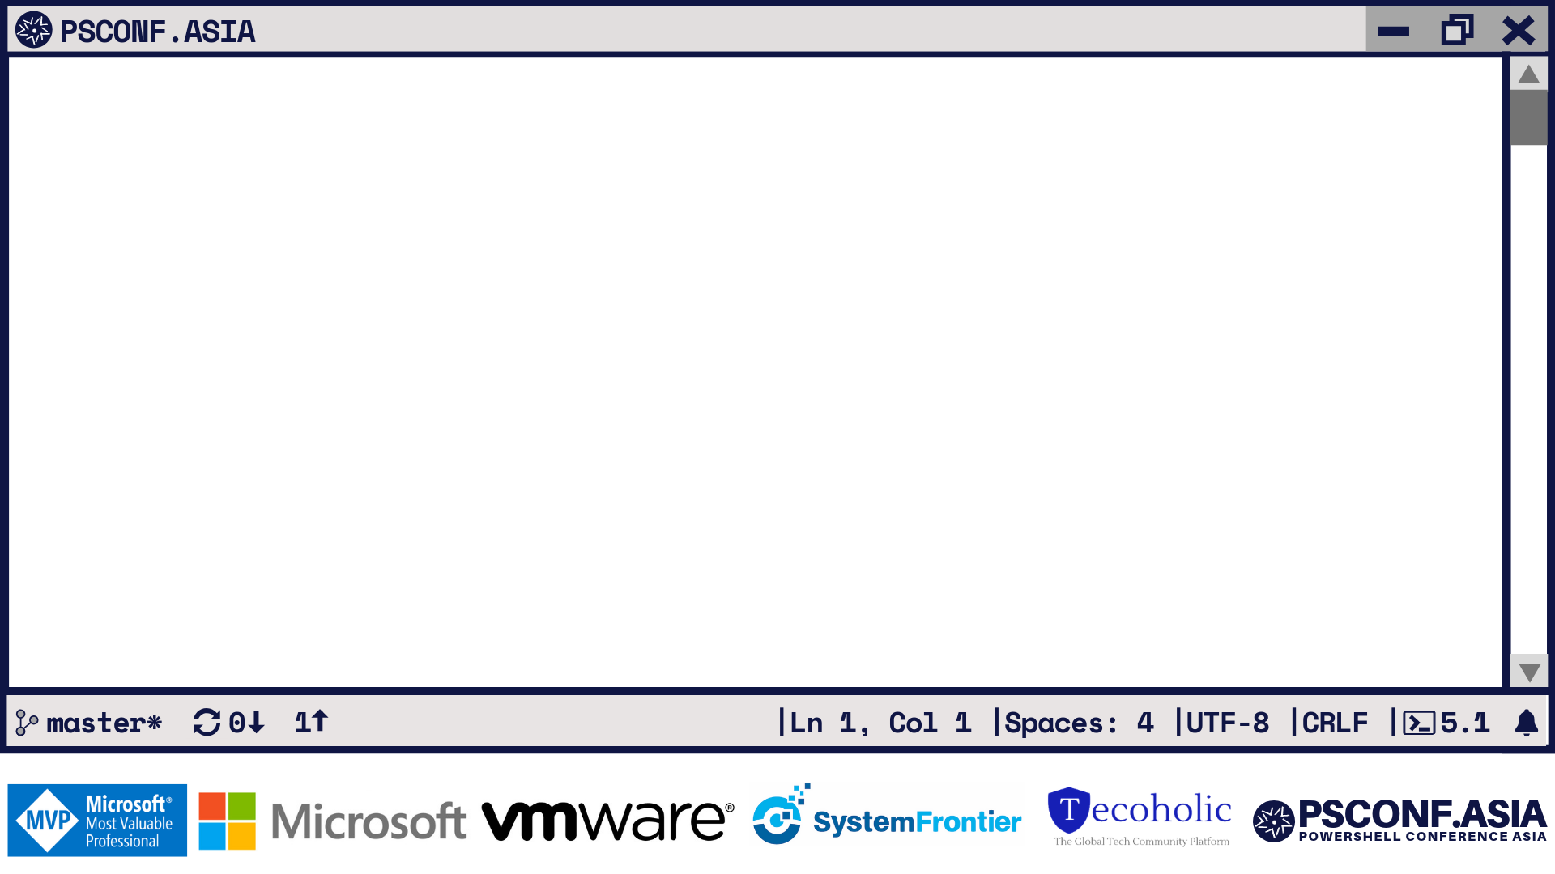
Power of the Console

Slide 2






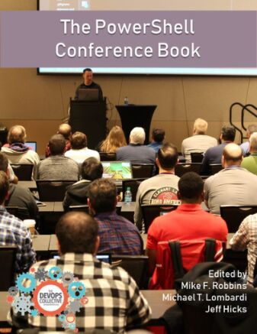





PS C: >_ whoami
TECH. WRITER FOR
BOOKS AUTHORED
CONTRIBUTING AUTHOR
PRATEEK SINGH
RIDICURIOUS.COM
/SINGHPRATEIK
/PRATEEKKUMARSINGH
/RIDICULOUSLYCURIOUS
LEANPUB.COM/B/BOOKS

Slide 3
PS C: >_ Get-Agenda
What is REST
Azure Cognitive APIs
Demo 1 - Working with PowerShell Cognitive Services Module
Demo 2 - Using Azure Cognitive and Twitter REST endpoints to build a customized dashboard with Polaris and PSHTML
@singhprateik

Slide 4
PS C: >_ Get-Agenda
What is REST
Azure Cognitive APIs - meaning of cognition
Demo 1 - Working with PowerShell Cognitive Services Module
Demo 2 - Using Azure Cognitive and Twitter REST endpoints to build a customized dashboard with Polaris and PSHTML

Slide 5
Demo-1
PowerShell + Azure Cognitive Service

Slide 6
But Before that!
A quick crash course on dependent modules

Slide 7
Demo-2
Live Twitter Dash Board

Slide 8







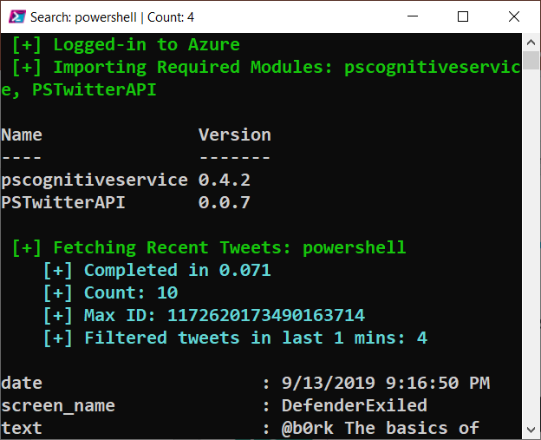


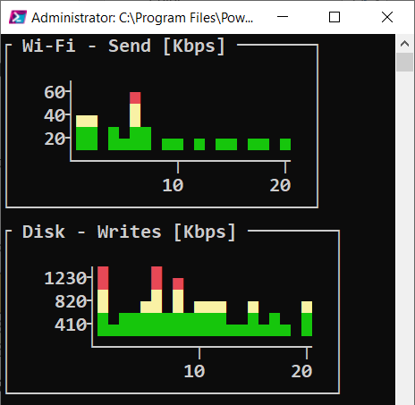

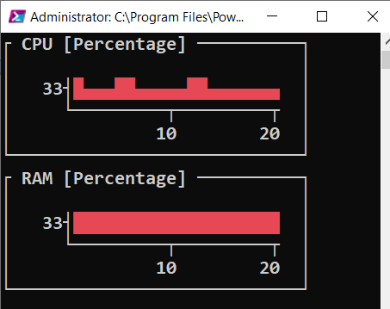
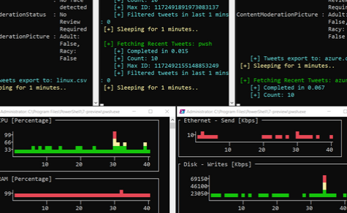

Image
Moderation
Text
Moderation
Sentiment Analysis
Twitter Search API
Computer
Vision
3
Invoke-RESTMethod
4
5
PSCognitiveService Module
KEYWORDS:
PowerShell, DevOps
KEYWORDS:
PowerShell, DevOps
Azure Cognitive Services
1
2
Start-Process pwsh
PSHTML Module
6
7
<HTML>
Monitoring & Control Console Grids
Polaris Web Server
Live Twitter Dash Board

Slide 9
