Slide 1
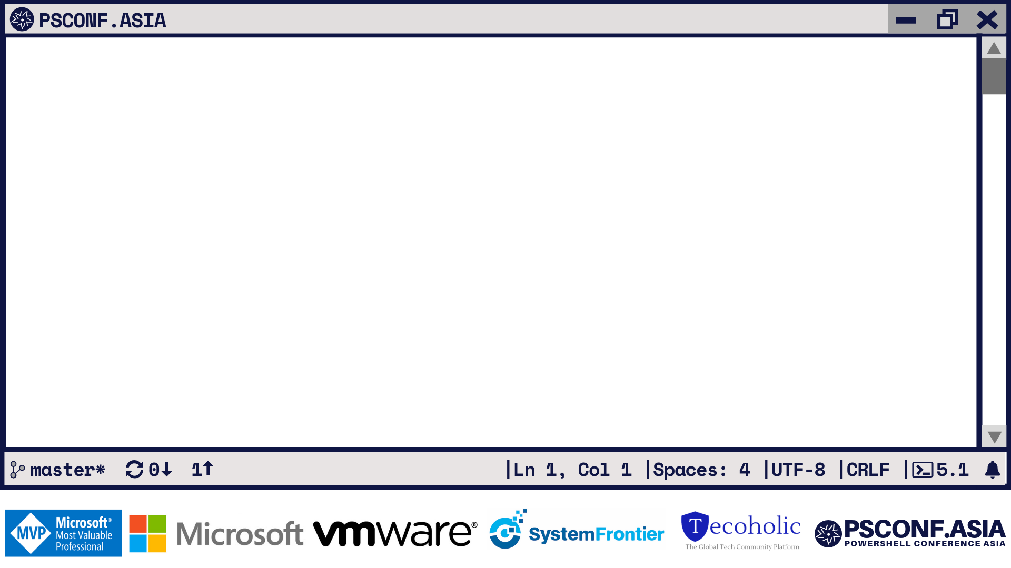
Visualize & Document Infrastructure with PowerShell

Slide 2












PS C: >_ whoami
TECH. WRITER FOR
BOOKS AUTHORED
CONTRIBUTING AUTHOR
PRATEEK SINGH
RIDICURIOUS.COM
/SINGHPRATEIK
/PRATEEKKUMARSINGH
/RIDICULOUSLYCURIOUS
LEANPUB.COM/B/BOOKS

Slide 3

““The purpose of visualization is insight, not pictures.”
Ben Shneiderman

Slide 4
PS C: >_ Get-Agenda
Basics of GraphViz and PSGraph Module
Simple use cases
Abstract Syntax Tree
Tree Size visualization
Network
Port Testing - Telnet
Reachability - Test-Connection
Active Directory
Org chart
AD Group membership
Hyper-V visualization
Azure Resource Group Topology diagram
Bonus Content
Trace Route
Email header analysis

Slide 5

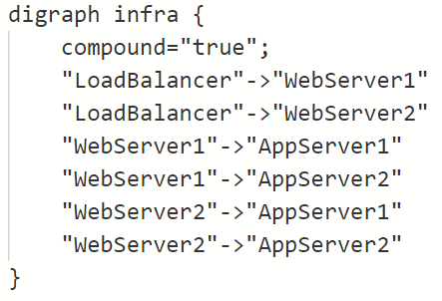
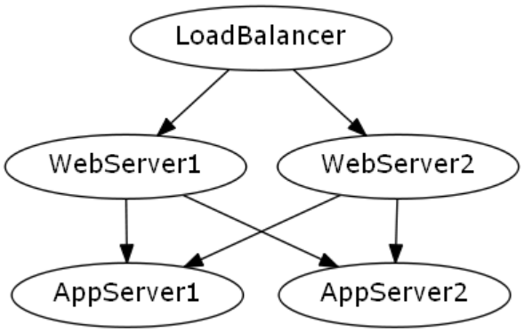

PS C: >_ GraphViz
Open source
Graph visualization software
Structural information to graphs
Simple text to automated diagrams
Applications in:
Software engineering
Database and Web Design
Networking and other domains
INPUT
OUTPUT
Graph Visualization Engine
DOT Language
PNG, SVG, JPEG, PDF

Slide 6

PS C: >_ PSGraph Module
Open sourced on Github https://github.com/KevinMarquette/PSGraph
Cross platform (Win, Linux and MacOS)
PowerShell based Graph visualization
Built upon GraphViz Engine
Implemented as a DSL or Domain Specific Language

Slide 7
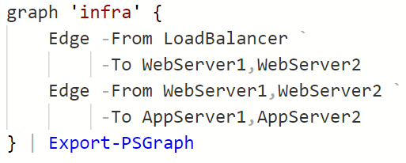
PS C: >_ PSGraph Module
DSL
(Domain Specific Language)
INPUT
OUTPUT
Graph Visualization Engine
PNG, SVG, JPEG, PDF
DOT Language

Slide 8

That’s fine but what’s so special !

Slide 9
“If your only tool is a hammer,
every problem looks like a nail.”
“If all you have is a hammer, everything looks like a nail.”
Abraham Maslow’s
The Psychology of Science, published in 1966.
Different problems require different solutions
Favorite Right tool for the right job

Slide 10



Manual
Time consuming
Planning Phase
Non-Techies
More Control
Automated
Maintainable
Live Infrastructure
Engineers & Devs
Asset while troubleshooting
+

Slide 11
PS C: >_ Start-Demo
“Talk is cheap. Show me the code.”
-Linus Torvalds

Slide 12


Slide 13
DEMO – 1 Getting Started with
PSGraph Module

Slide 14
DEMO – 2 Advance Use cases

Slide 15
PS C: >_ Get-Resource
Official Website of GraphViz
https://www.graphviz.org/
Use cases, API’s and Language Bindings https://github.com/CodeFreezr/awesome-graphviz
PSGraph Documentation
https://psgraph.readthedocs.io

Slide 16
