Slide 1
Demo-1
PowerShell + Azure Cognitive Service

Slide 2
Demo-2
Live Twitter Dash Board

Slide 3
But Before that!
A quick crash course on dependent modules

Slide 4










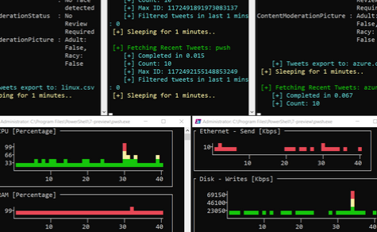


Twitter Search API
Computer
Vision
Image
Moderation
Text
Moderation
Sentiment Analysis
3
Invoke-RESTMethod
4
5
PSCognitiveService Module
KEYWORDS:
PowerShell, DevOps
Azure Cognitive Services
KEYWORDS:
PowerShell, DevOps
1
2
Start-Process pwsh
PSHTML Module
6
7
Monitoring & Control Console Grids
Polaris Web Server
Live Twitter Dash Board

