Slide 1
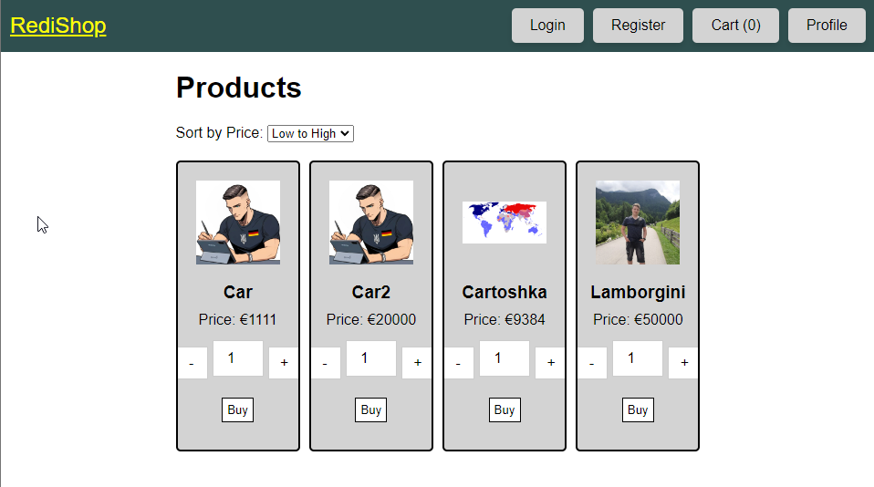

RediShop
The project is about creating an online store using API, SQL, HTML, CSS, and JavaScript.
Notes:
Welcome to my presentation. My project is about creating an online store. I used API, SQL, HTML, CSS, and JavaScript. The store has registration and login, a user profile, and a page to add and show products.

Slide 2
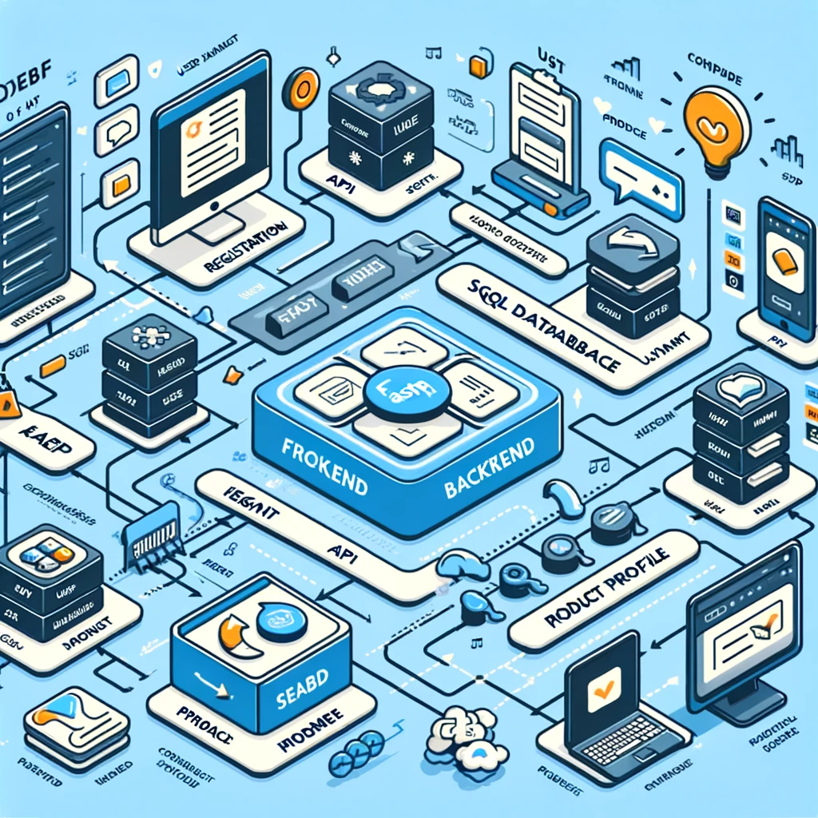
Purpose of the Presentation
To show the development process, technologies used, challenges faced, and future improvements.
Notes:
The purpose of this presentation is to show how I made the project. I will talk about the technologies I used, the problems I had, and the improvements I plan to make.

Slide 3
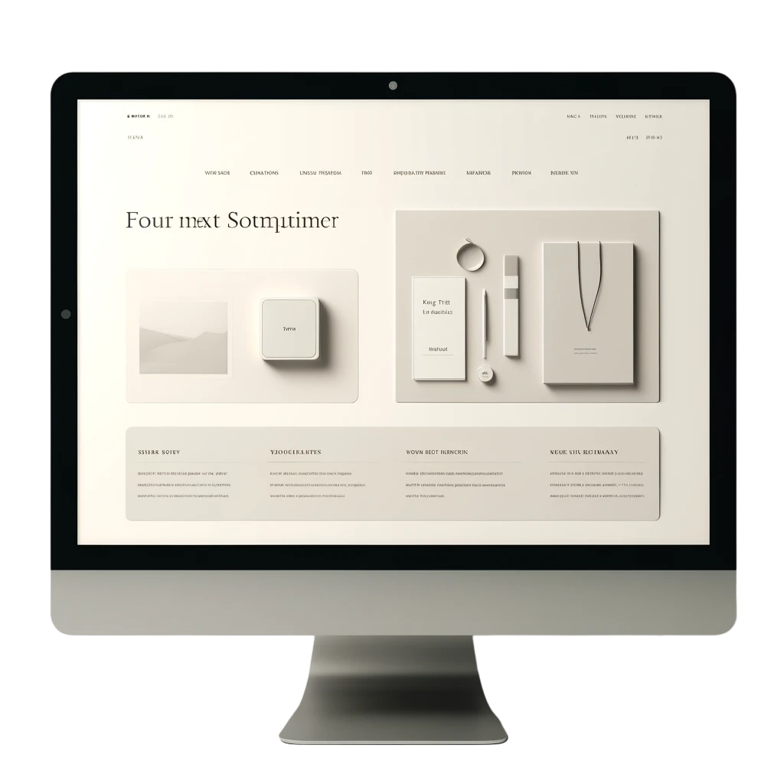
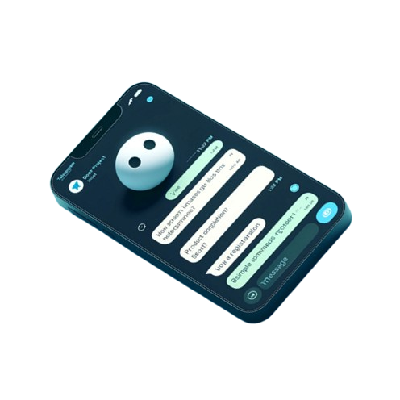

Why This Project?
To apply my knowledge practically and
help a friend start a business.
Notes:
I chose this project to use my knowledge and help a friend start a business. First, I made a Telegram bot. Later, I decided to make a full website.

Slide 4
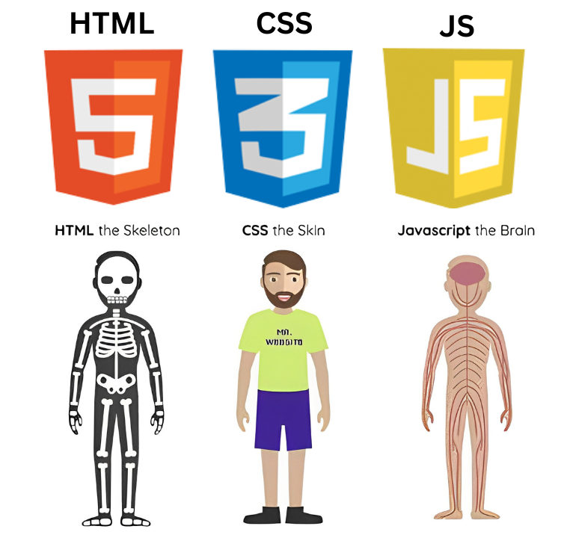


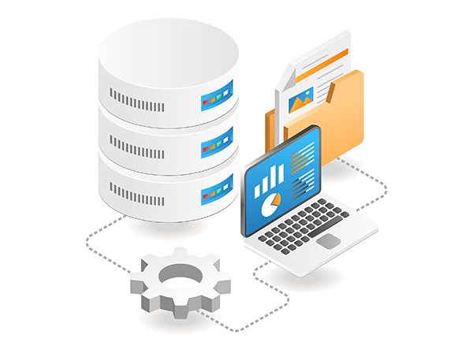
Development Stages
Started with requirements analysis, then backend with FastAPI, database setup with SQLAlchemy, and frontend with HTML, CSS, and JavaScript.
Notes:
I started with requirements analysis. Then, I developed the backend using Python and FastAPI. I set up the database with SQLAlchemy. Finally, I built the frontend with HTML, CSS, and JavaScript.

Slide 5
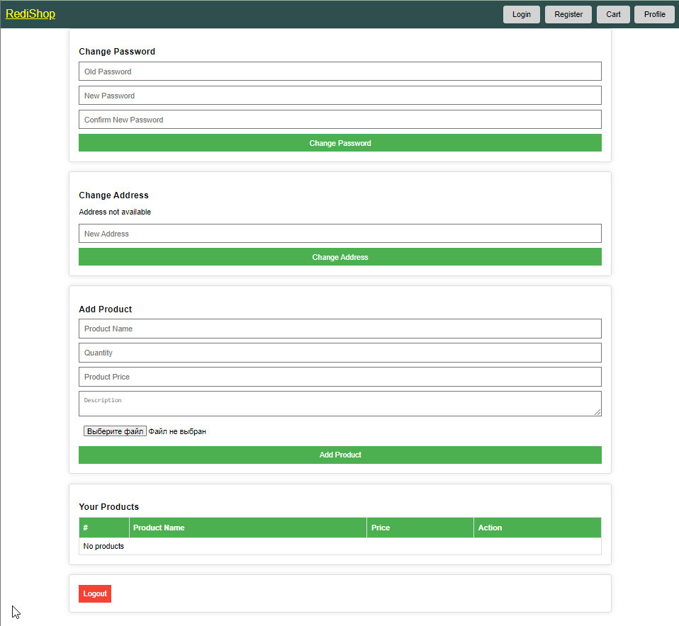
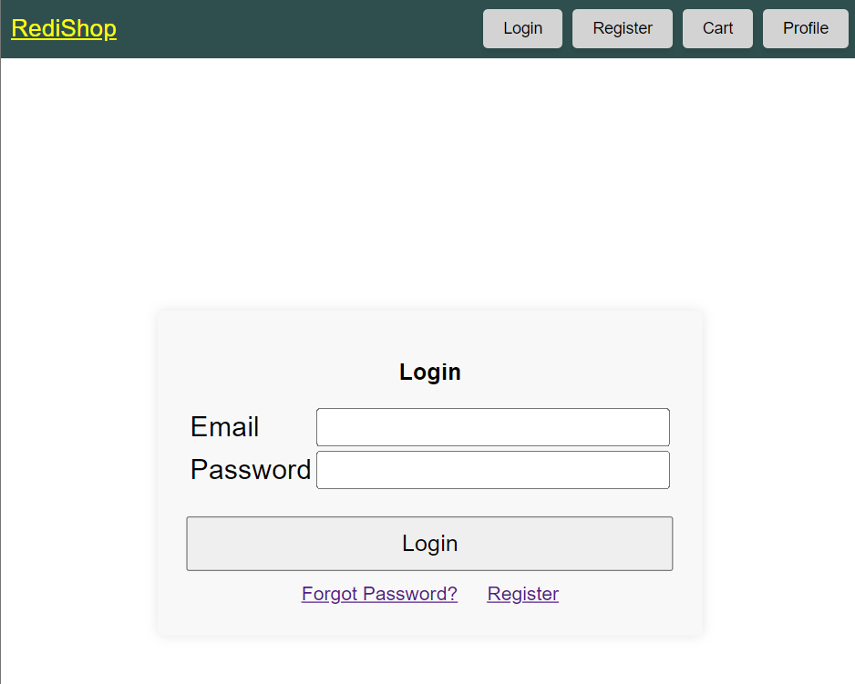
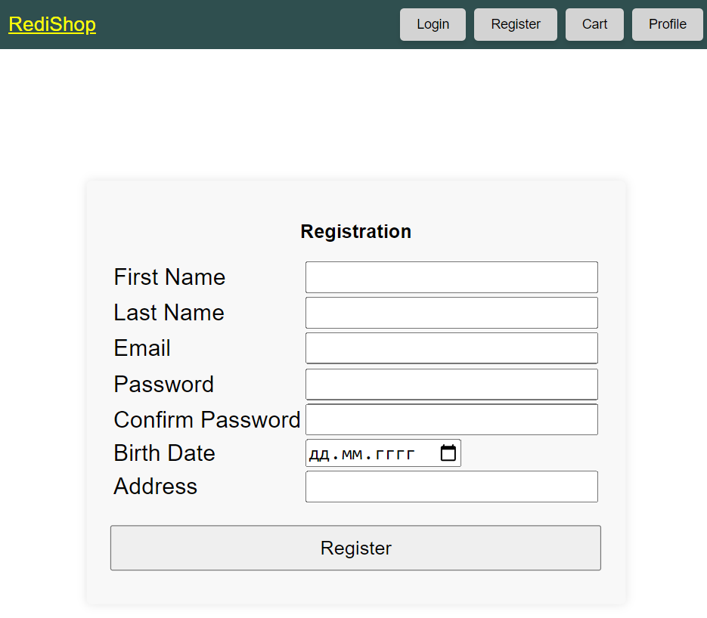
Website Appearance
Modern interface with user registration, login, profile management, and product addition.
Notes:
The website has a modern and easy-to-use interface. Users can register, log in, manage their profiles, and add products. The main page shows all the products.

Slide 6
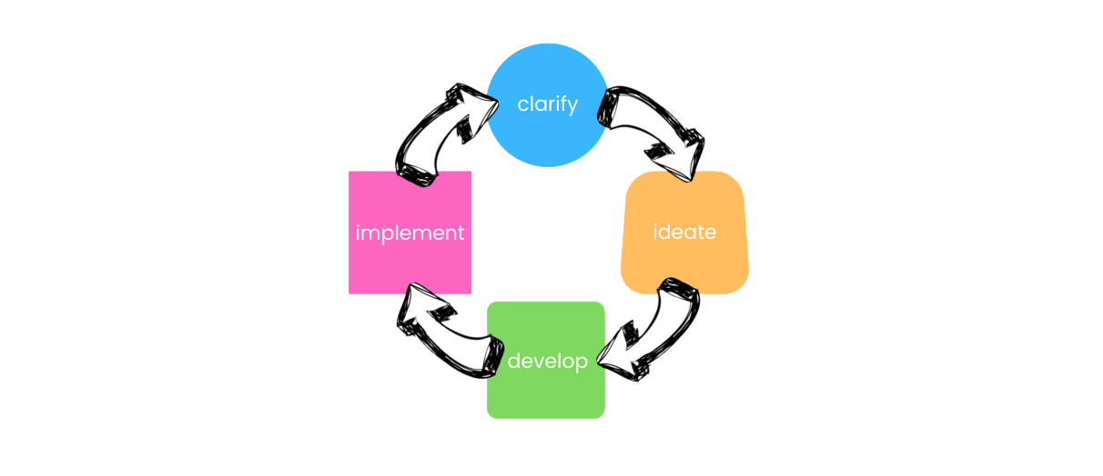
Problems and Solutions
Configuration issues were resolved through consultation and time.
Notes:
I had some problems with the configuration that stopped the site from working. I solved these problems by asking for help and taking time to fix them. This taught me the importance of patience and getting help when needed.

Slide 7

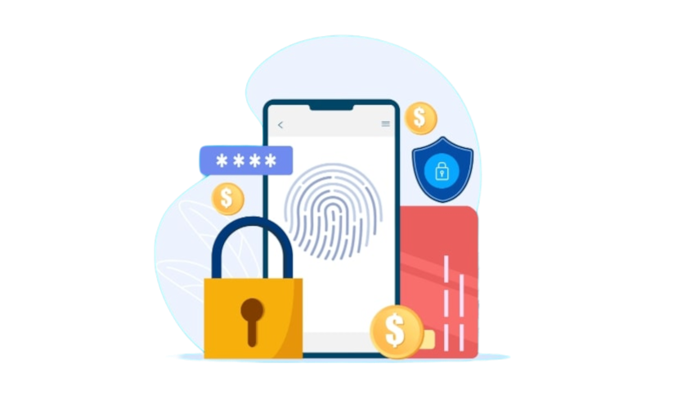
Future Improvements
Plan to deploy on Amazon using Lambda, with scalability and enhanced security.
Notes:
In the future, I plan to put the site on Amazon using Lambda and free database services. This will make the project almost free to run. The site can grow bigger with these plans. I will also add more security to stop attacks like SQL injection.

Slide 8



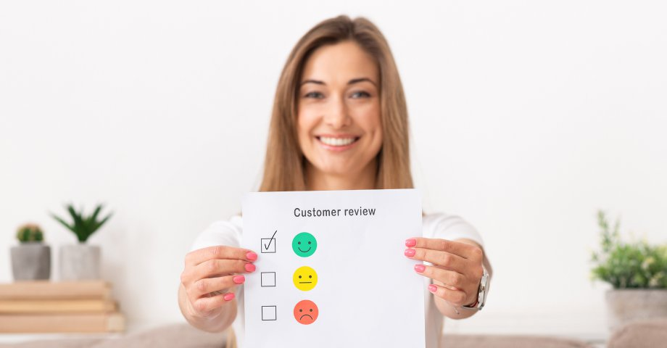
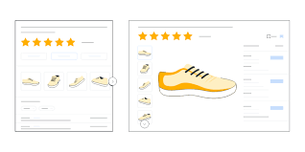
Summary
Adding user reviews, product ratings, advanced search filters, and payment integration.
Notes:
I will add new features like user reviews, product ratings, advanced search filters, and payment systems. I will also make the site work better on mobile devices.

Slide 9
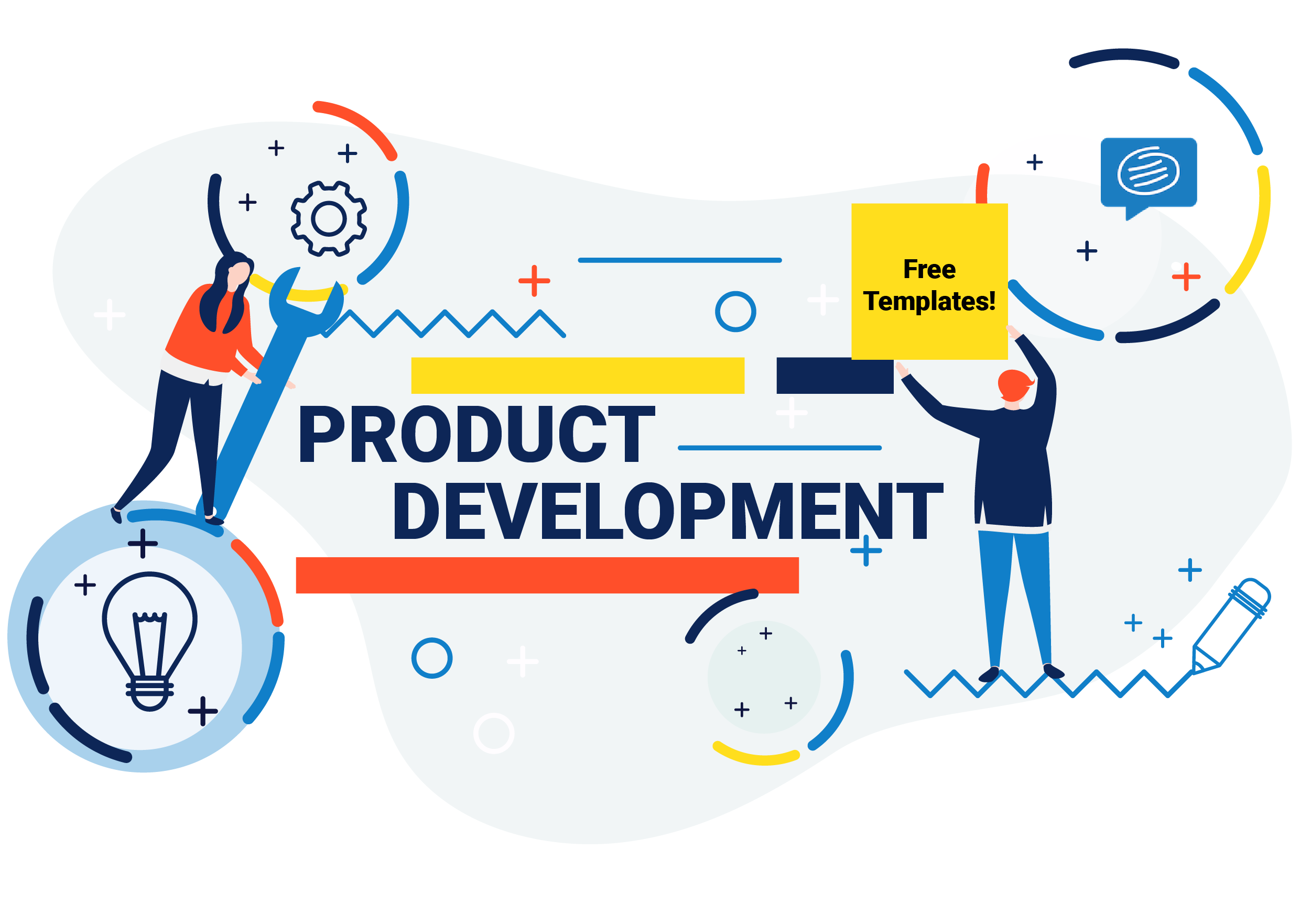
Conclusion
The project demonstrates applying knowledge to create a real product with plans for further development.
Notes:
This project shows how I used my knowledge to make a real product. It was a challenging but rewarding journey. I plan to keep improving the project and add new features to make it better for users.

Slide 10
Questions and Answers
Ready to answer questions about technical details, technologies used, and future plans.
Handzii Vladyslav
Notes:
Now, I am ready to answer any questions you have about the project, the technologies I used, and my future plans. Please feel free to ask anything. Thank you for listening.

