Slide 1

LINEAR AND LOGISTIC REGRESSION
PROJECT 3: OTHER REGRESSIONS
Yifei Zhang
jialu XU

Slide 2
Overview of the Data
Kommun: Municipality number and name
County: County number and name
Part: Part of Sweden: 1 = Götaland; 2 = Svealand; 3 = Norrland
Coastal: Coastal = any sea area within its borders: 0 = Inland; 1 = Coastal
Builton: Area covered in buldings, roads, etc (= not nature), (hectares / 1000 inhabitants)
Children: 0–14 year olds (percentage)
Seniors : 65+ year olds (percentage)
Higheds: At least 3 years of post-secondary education (percentage)
Income: Median yearly income (1000 SEK)
BRP: Gross Regional Product per capita (1000 SEK)

Slide 3
Overview of the Data
Cars: Number of passenger cars / 1000 inhabitants
Urban: Proportion of the population that lives in urban areas (percentage)
Transit: Proportion of the population that lives within 400 meters of a bus stop or other
public: Transportation (percentage).
Apartments: Proportion of the apartments that are in apartment buildings (percentage).
Fertility: Total fertility rate. Number of births per woman.
Persperhh: Average number of persons per household.
Population
Cars_nbr: The number of personal cars

Slide 4
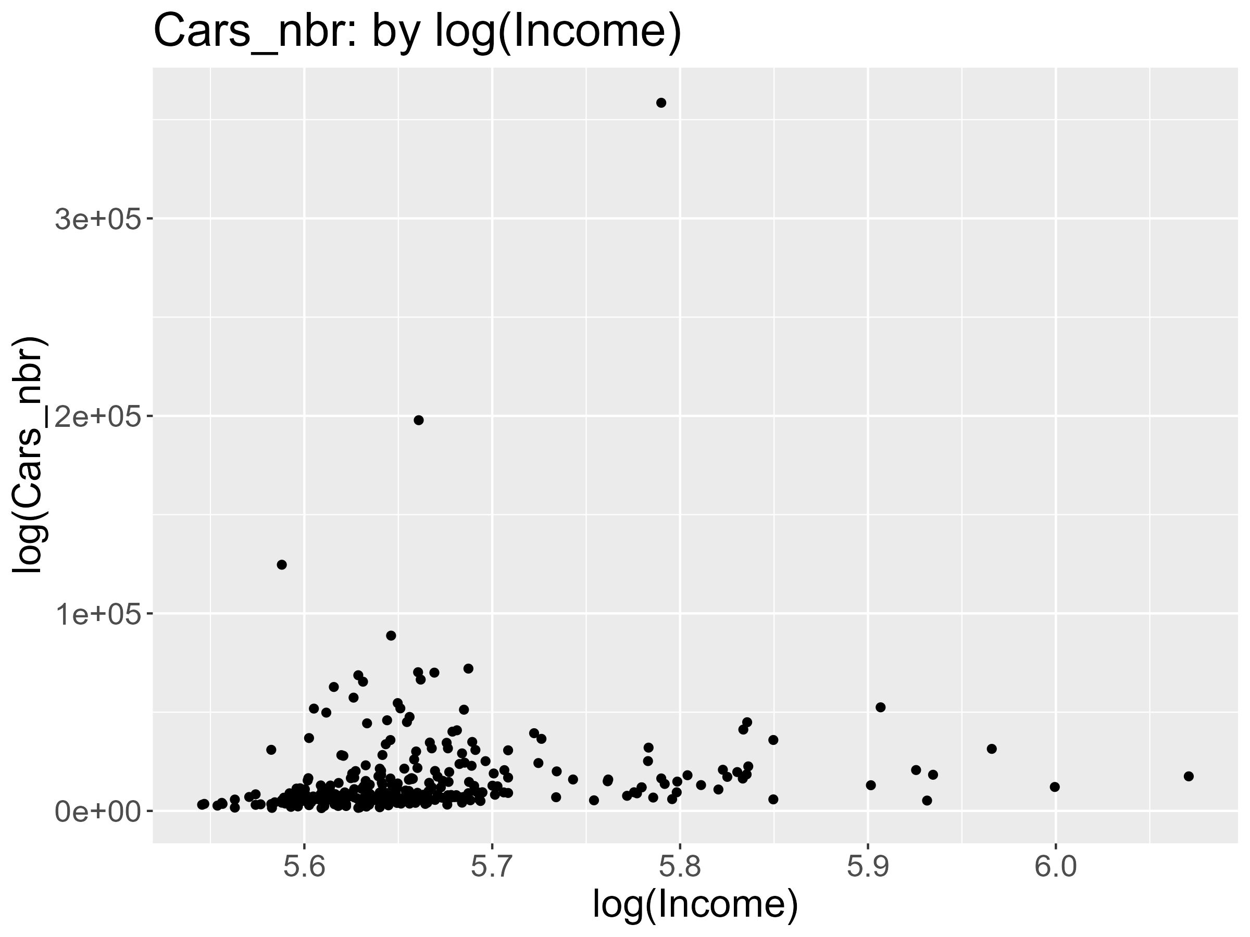
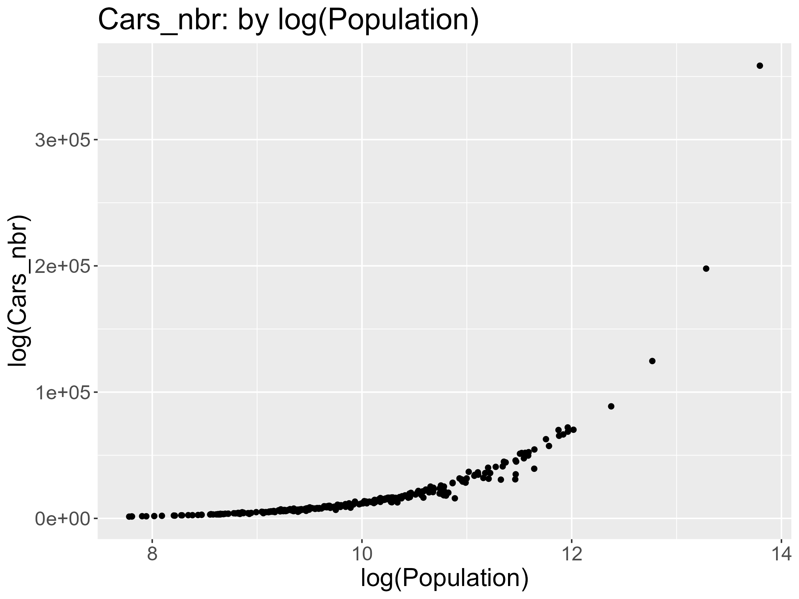
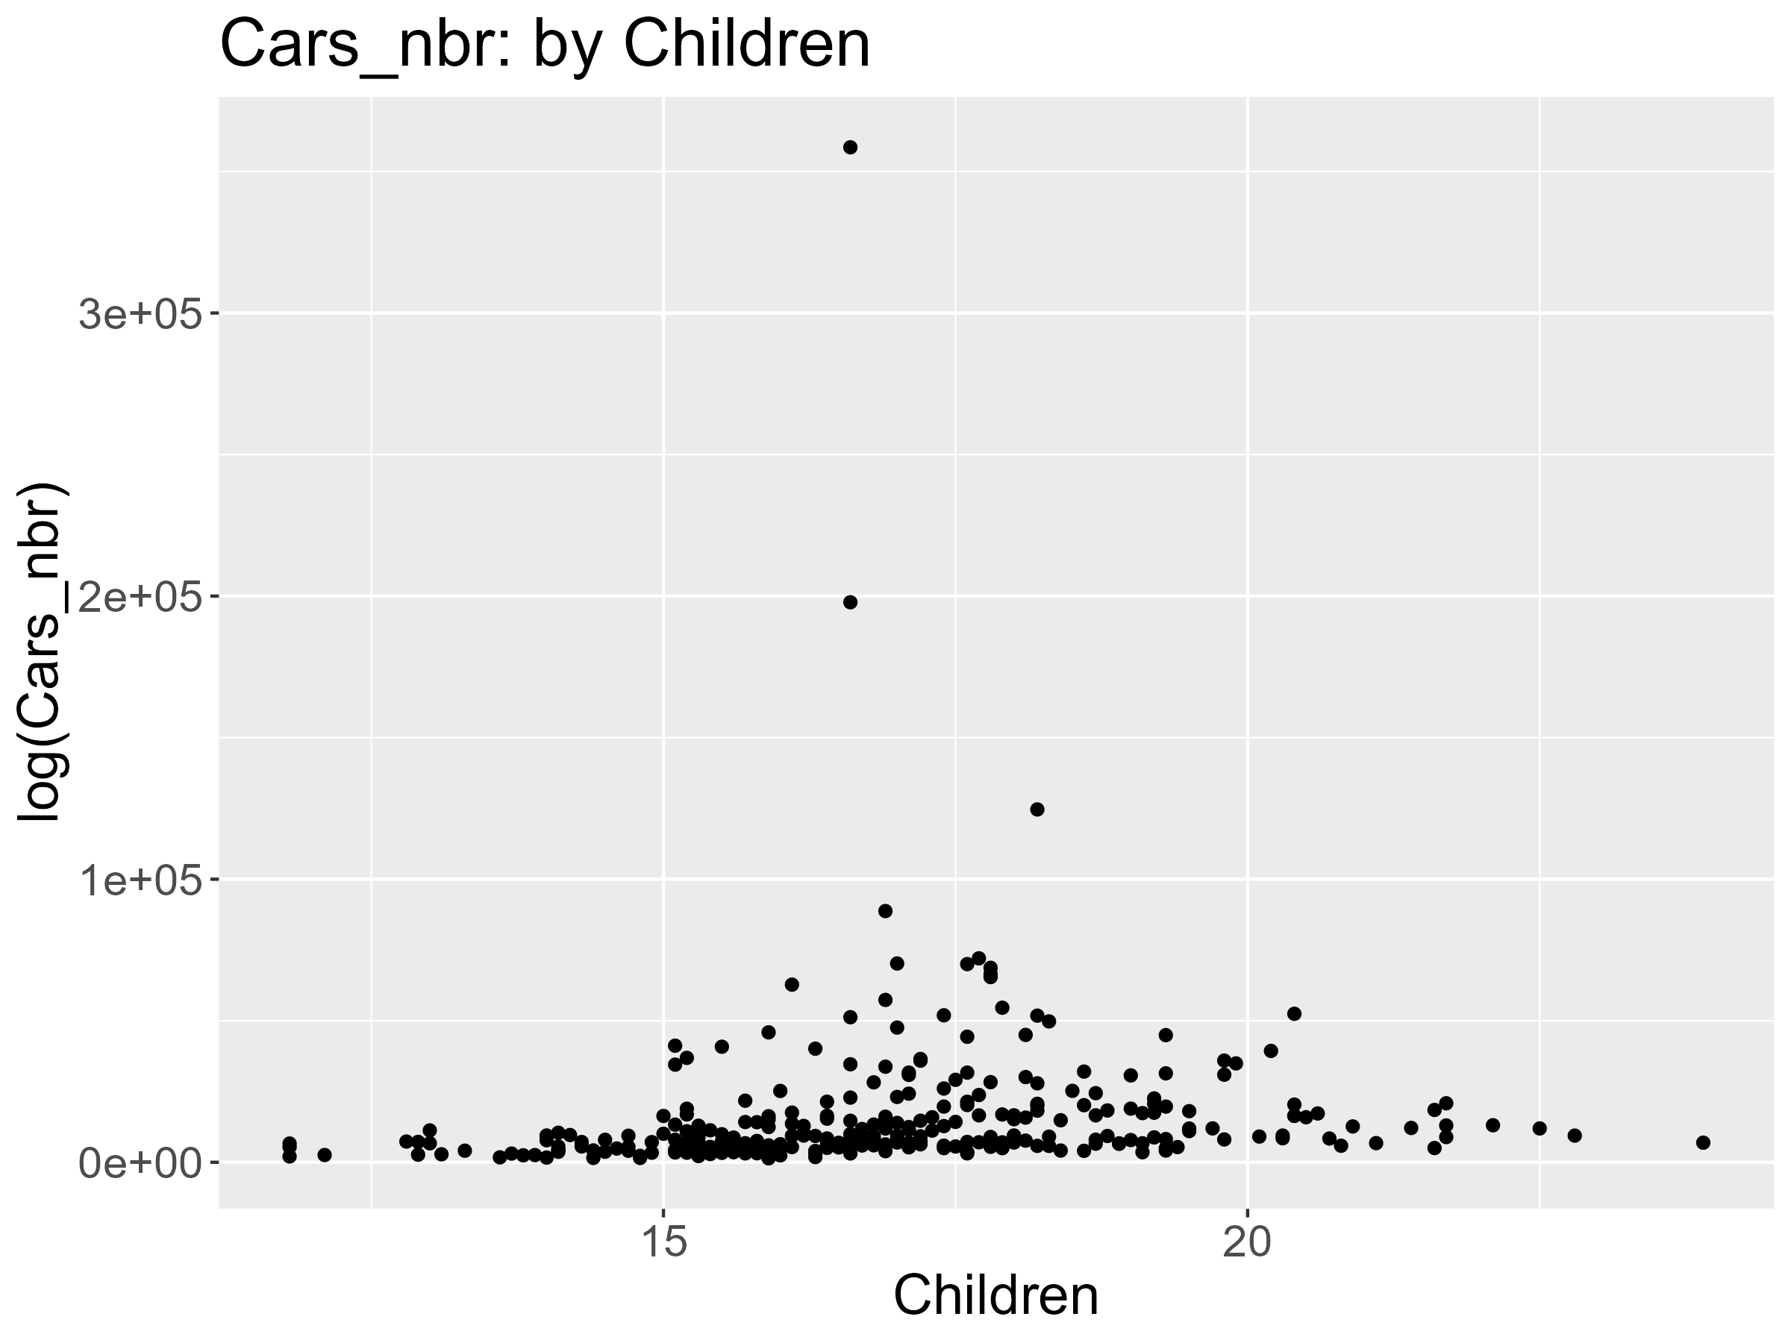
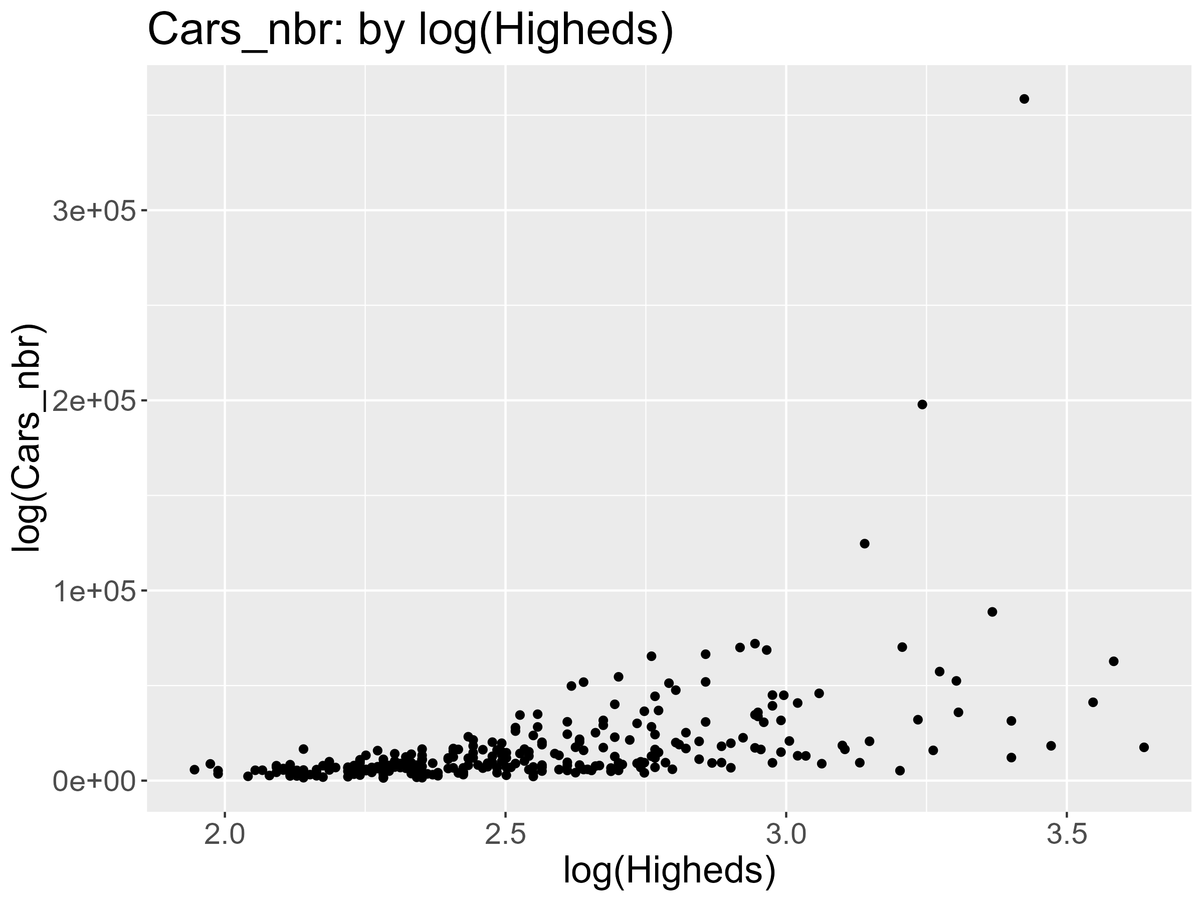
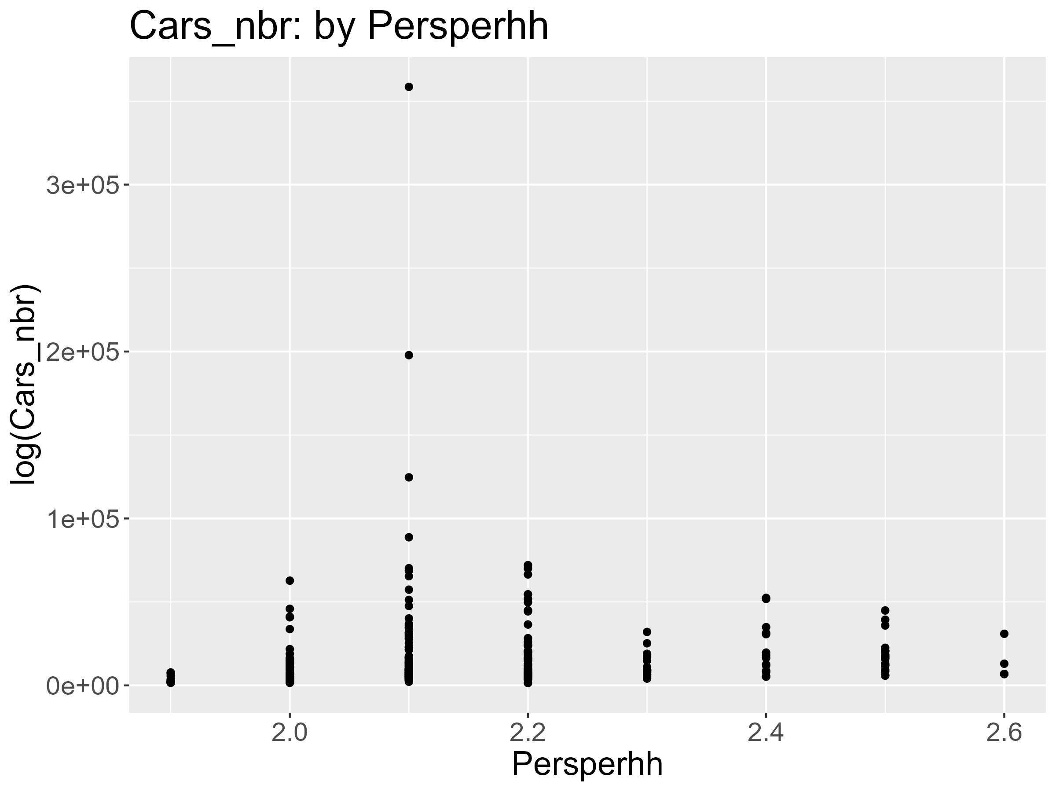
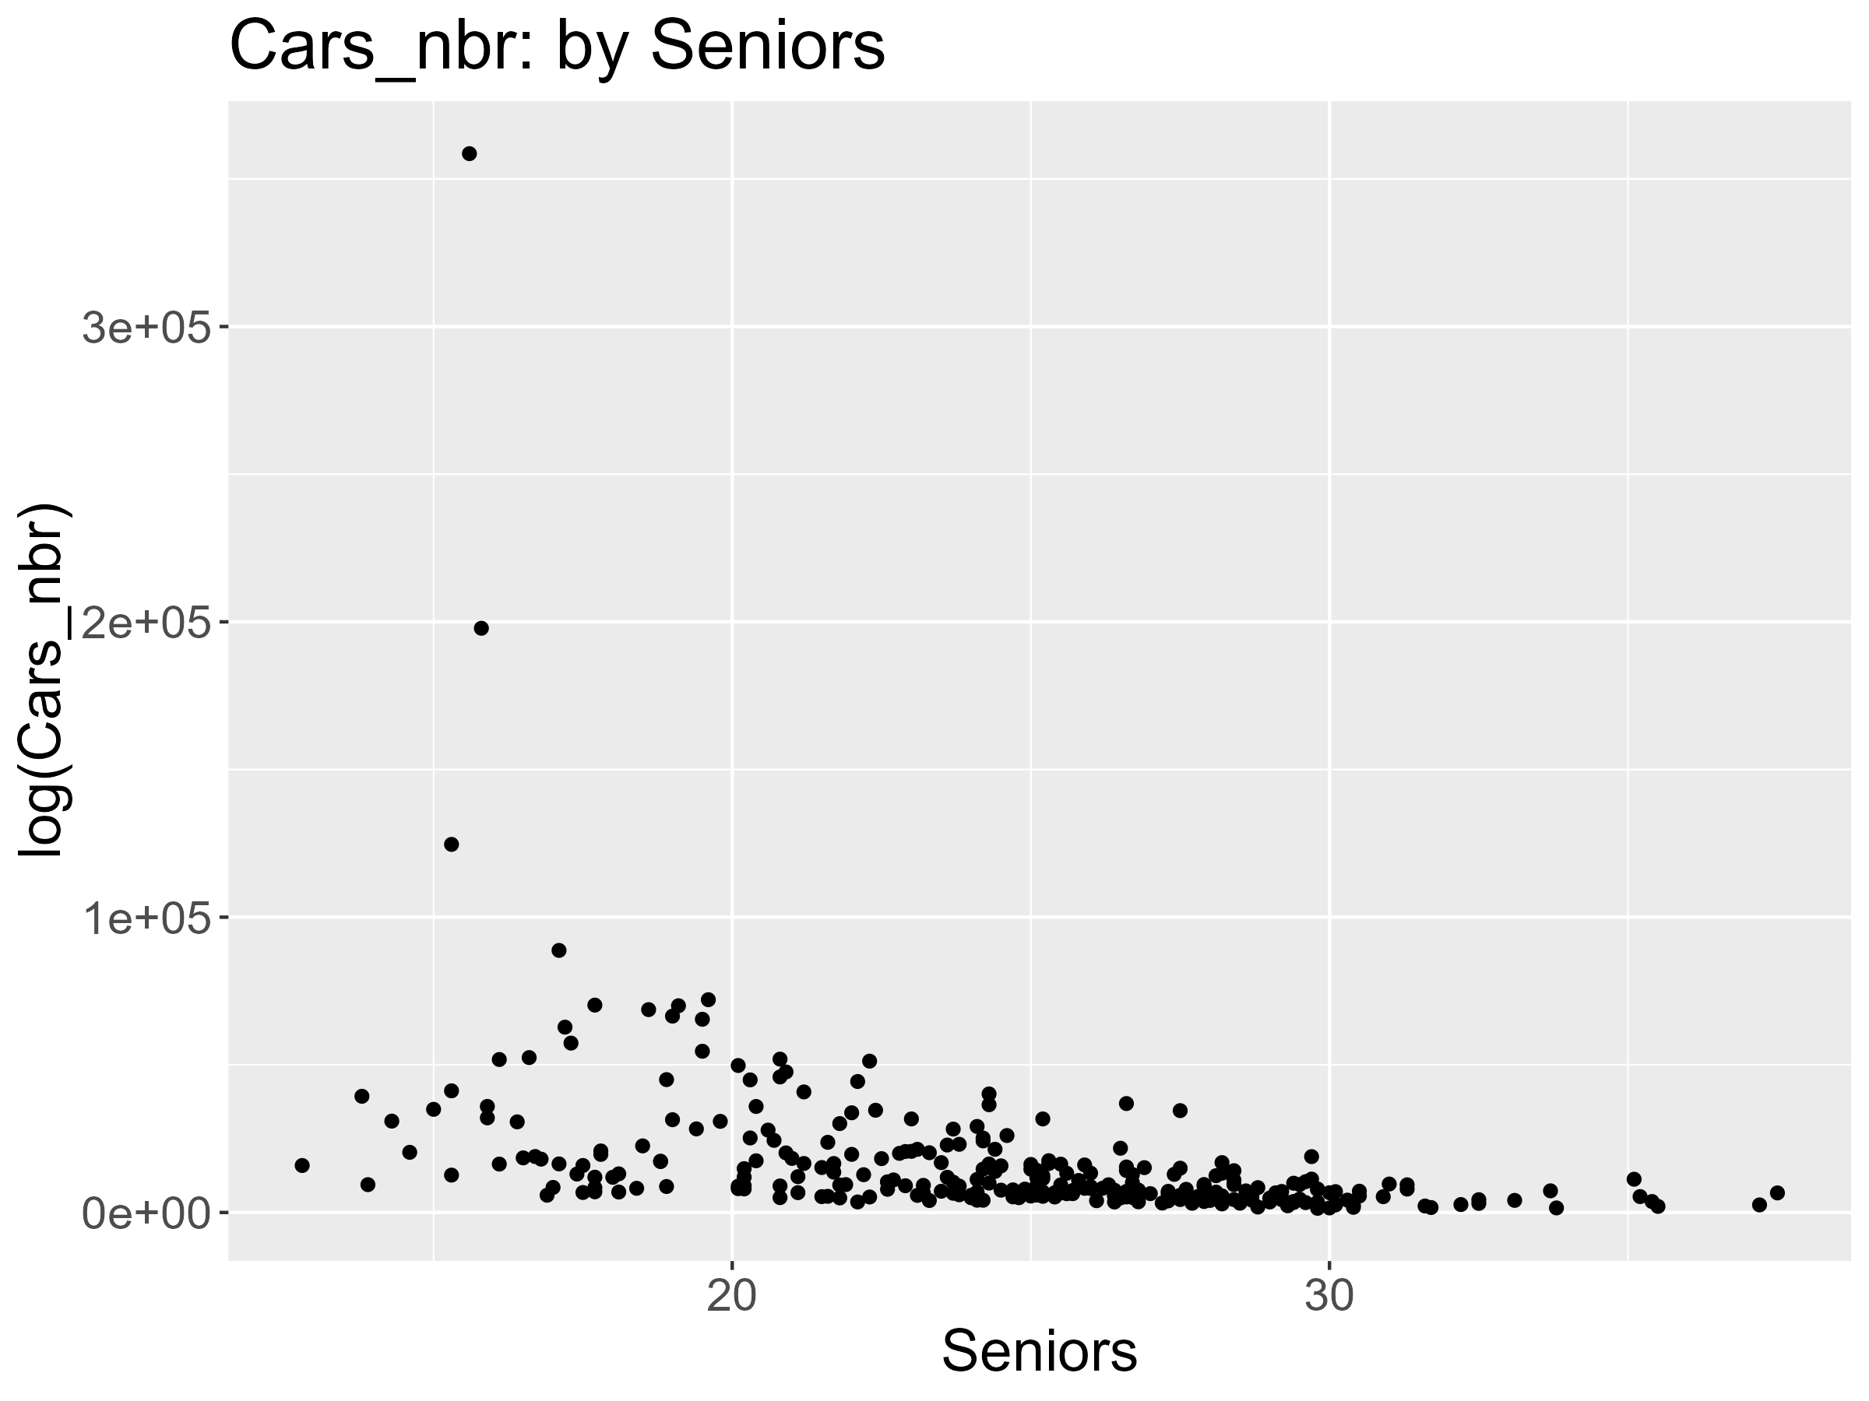
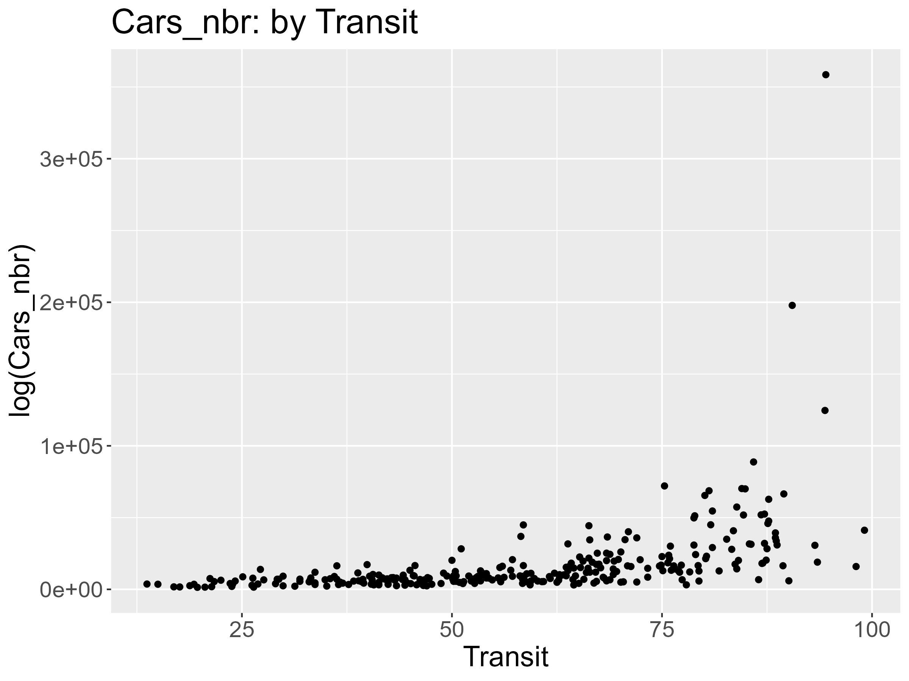
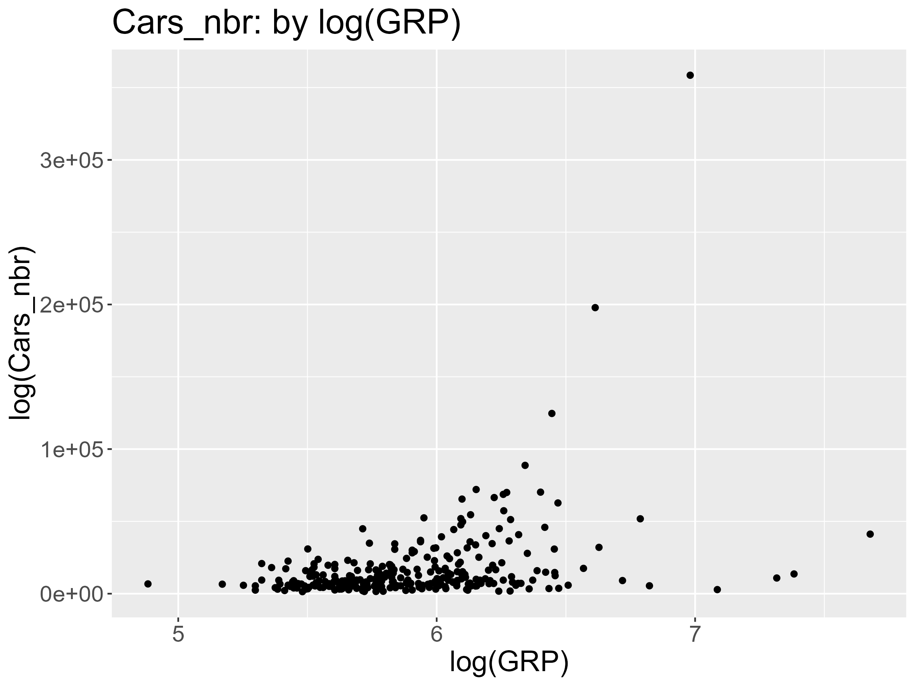
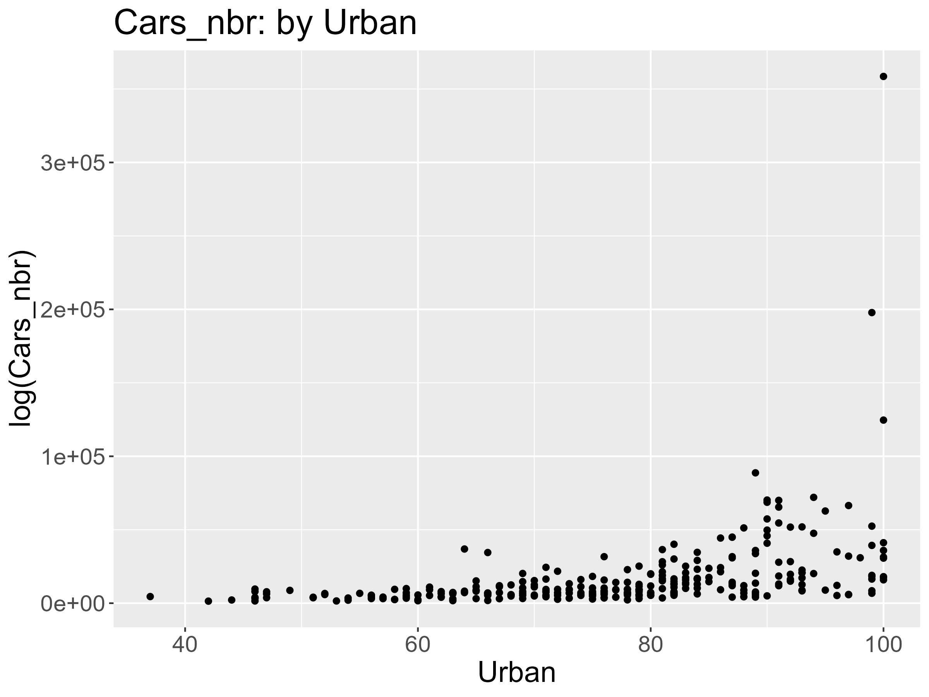
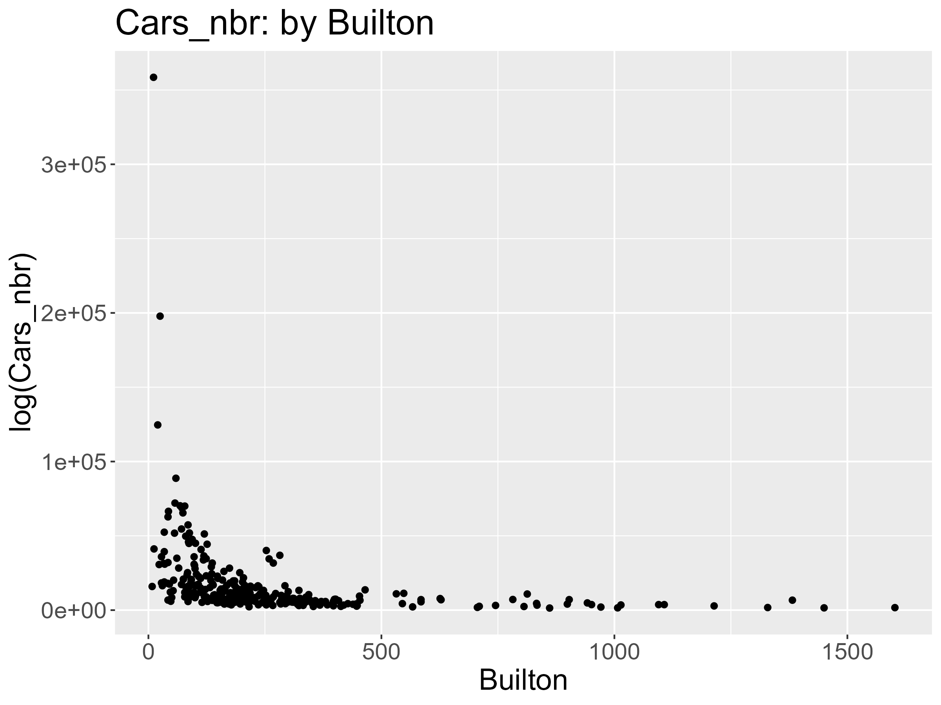
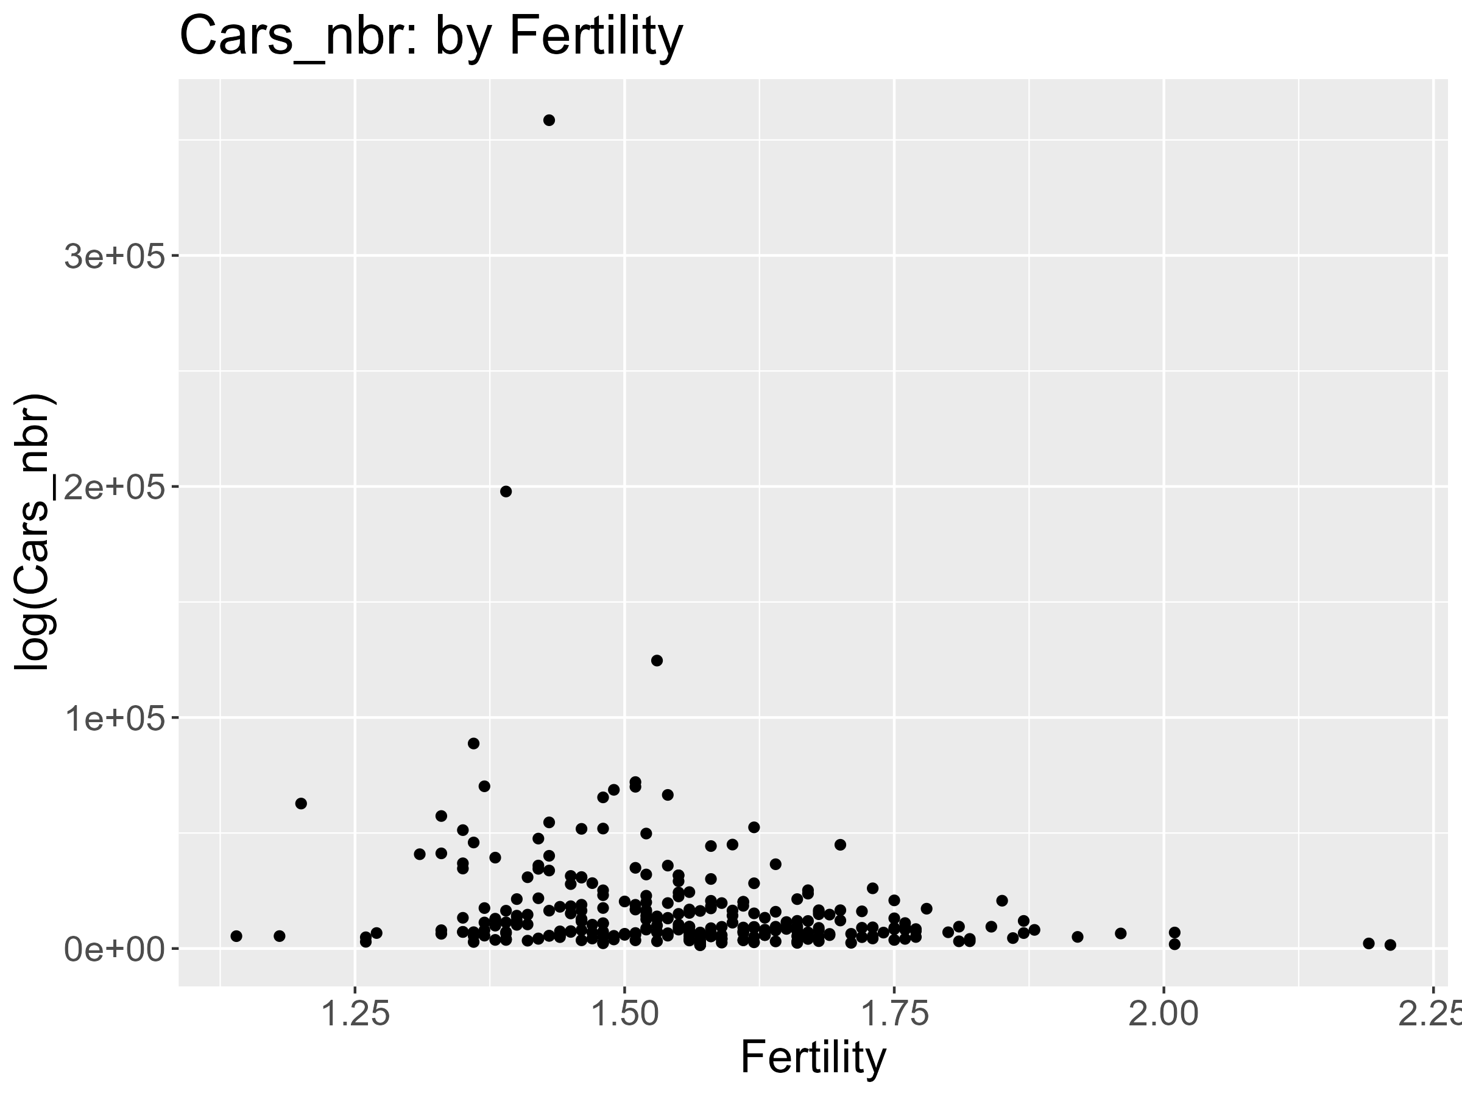
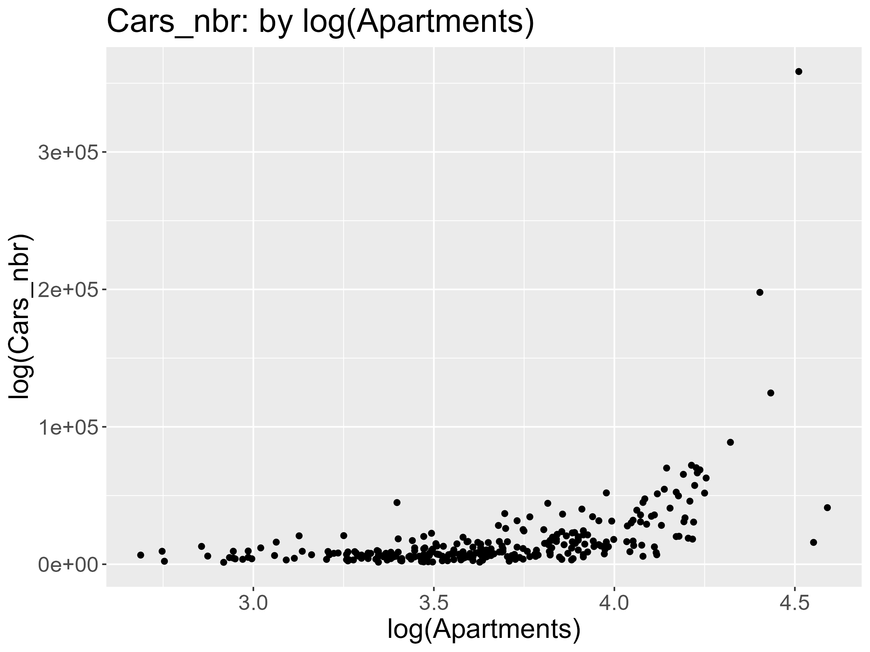

Slide 5
Data Preprocessing
Fertility Missing Values Completion
New parts division
"Gotaland" | Coastal == "Yes"
"Svealand" & Coastal == "No"
"Norrland" & Coastal == "No"

Slide 6

End slide. Logotype only.

