Slide 1
THEME 25 · PORTFOLIO / RESOURCE ALLOCATION OPTIMIZER
Quantum-Assisted
Loan-Portfolio Allocator
A calibrated default-risk model sets the coefficients of a QUBO. QAOA allocates a fixed capital budget across the loan book.
Team ASTITWA · Tanishq Aryan · 29 August 2026
Notes:
One sentence: a bank has more creditworthy applicants than capital. Choosing which subset to fund under a fixed budget is a 0-1 knapsack -- NP-hard, natively binary, and exactly the shape QAOA was built for.

Slide 2
THE QUESTION A JUDGE ASKS FIRST
Why quantum belongs here at all
0-1 knapsack, not curve fitting
The scope we were given
1
Choosing which loans to fund under a capital budget is weakly NP-hard, natively binary, natively quadratic. Its ground state IS the answer.
Small qubit counts, simulator only.
One quantum module, well-scoped.
So we stayed at 10-16 qubits and measured exactly where the method stops working.
We claim no advantage at this scale. Guerreschi & Matsuura (Sci. Rep. 9:6903, 2019) put the crossover at hundreds of qubits.
A real Ising Hamiltonian
2
14 qubits, ~100 Pauli terms, transpiled depth 78, 182 two-qubit gates. We can point at a ZZ term and name the two applicants it couples.
Not a quantum kernel on PCA features
3
The 14 tabular-classifier themes ask you to project data into Hilbert space and hope. Here the mapping is derived, not assumed.
Notes:
Expect 'why quantum?' and answer before it is asked. Optimisation and chemistry have principled answers; quantum kernels on small tabular data mostly do not.

Slide 3
ARCHITECTURE
The AI feeds the quantum module — in series
Most hybrid projects run the two halves in parallel: a classifier, then a quantum classifier doing the same job. Two demos bolted together. Remove our AI model and there is no optimisation problem left to solve.
Taiwan card data
Calibrated GBM
Expected value
QUBO
QAOA
30,000 accounts
UCI, 2005
P(default) per account
AUC 0.780
EV = P(repay)·interest
− P(default)·LGD·principal
max Σ EV·x − λ·gap(x)²
s.t. Σ units·x ≤ budget
Ising Hamiltonian
14 qubits, measured
→
→
→
→
CLASSICAL — the AI model
QUANTUM — the one module
The modelling choice that makes it work
The budget is an inequality, so the converter adds integer slack — 10 decision variables + 4 slack bits = 14 qubits. Discretising capital into coarse units is the single lever controlling qubit count. The fairness term is a squared penalty, so it costs ZERO extra qubits and is what makes the objective genuinely quadratic rather than a linear knapsack in a QUBO costume.
Notes:
Say the word 'series'. Judges notice architecture.

Slide 4
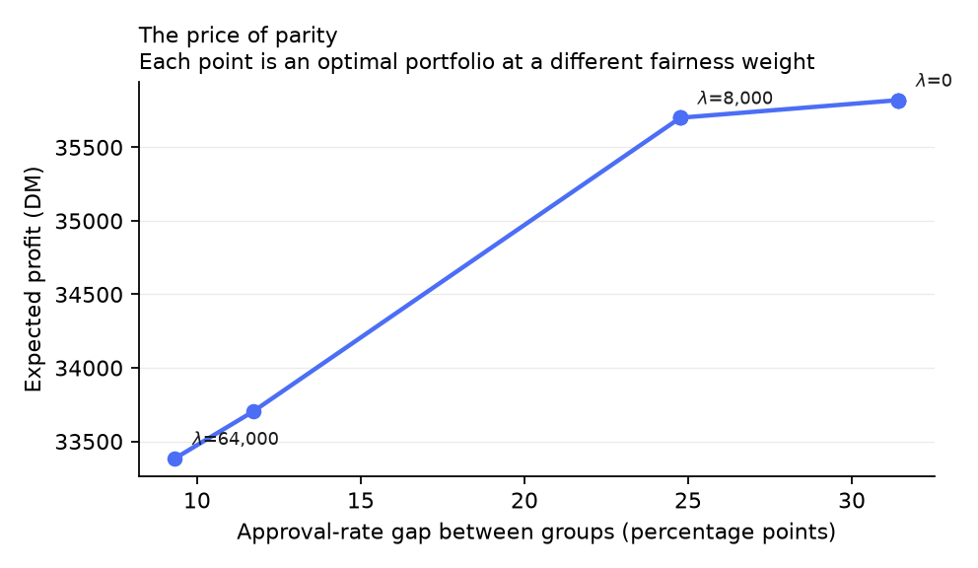
THE LIVE DEMO
Diversification and fairness as constraints
Move two sliders. That is the whole demo.
Capital budget → the funded loan book re-optimises live, qubit count updates with it.
Fairness weight → approval-rate gap closes from 0.28 to 0.03, and we can price it.
Parity enters as a squared penalty on the objective: zero extra qubits, and it couples applicants of opposite groups in the Hamiltonian.
0.28 → 0.03
≈10%
Approval-rate gap
Of profit, the price of parity
We do not claim the model is fair. We claim we can put parity in the objective and tell you what it costs -- about 4% of profit.
Notes:
This is the money shot. Toggle diversification and fairness live and let the numbers move. If asked why age rather than sex: sex is not recoverable from this dataset -- male singles and female non-singles share code A92, and A95 has zero rows here. Groemping (2019) documents the coding errors.

Slide 5
DELIVERABLE 4 · QUANTUM VS CLASSICAL
We are reporting a negative result
125×
0.9789
0.9986
67%
Slower than exact search
QAOA approx ratio (24 runs)
Greedy heuristic — better
Hit exact optimum (QAOA p=2)
vs greedy 88%
QAOA is right more often, and wrong more expensively.
It reaches the exact optimum 67% of the time against the heuristic's 88%, but its worst run is 0.9083 against greedy's 0.9889. That tail drags the pooled mean below greedy. For a bank allocating real capital, the heuristic's predictability is worth more than the extra exact hits — the opposite of what a hit-rate-only table would have told you.
Every solver attacks the SAME QUBO on the SAME instances — this compares optimisers, not two different classifiers. Classical baseline is exhaustive enumeration (the true optimum) plus the greedy value-per-capital rule, not a strawman.
This result is trustworthy precisely because it did not come out the way we wanted.
Notes:
Lead with the loss. A fabricated quantum win does not survive the first follow-up question.

Slide 6
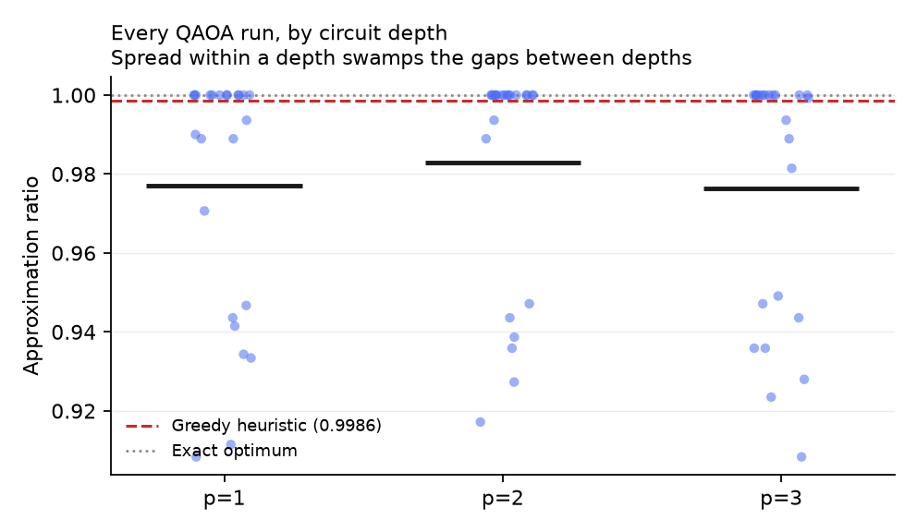
WHAT NOBODY ELSE WILL HAVE MEASURED
The depth ranking does not survive its own noise floor
We nearly published noise.
Our first benchmark used one QAOA seed per cell and ranked p=2 clearly best. Re-running the same code with different transpilation ranked p=2 clearly worst. Same instances, same solver.
0.0211
0.0036
Spread WITHIN one cell
Spread BETWEEN depths
So we stopped naming a best depth.
Within-cell noise exceeds the between-depth differences, so no depth is meaningfully best at this scale. The benchmark now runs 3 QAOA seeds per (instance, depth) — 24 runs per depth instead of 8.
Notes:
Anyone showing a single-seed depth ranking is reporting noise. We were, until we checked.

Slide 7
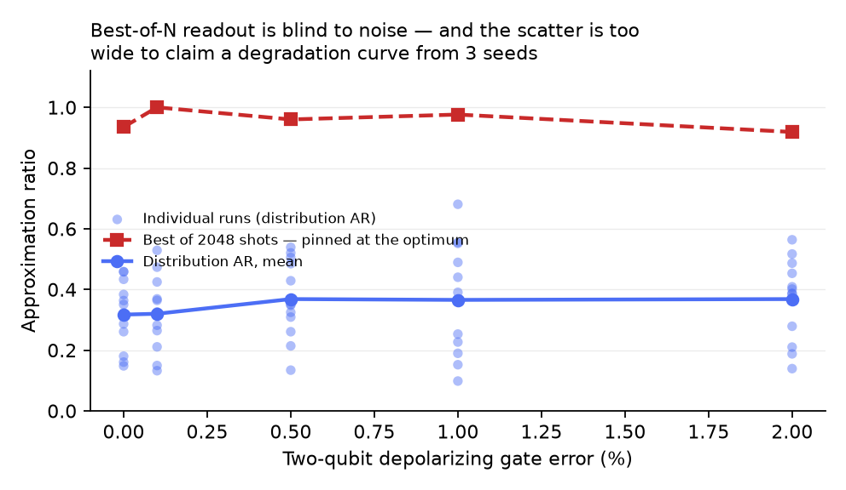
WE MEASURED, AND CANNOT SAY
Would this survive on real hardware?
Our sweep cannot tell you -- and that is the finding.
The scatter within one error level across seeds is several times larger than the spread between levels, so there is no degradation curve we are entitled to draw. Worse: our 3-seed pilot estimated ~8 seeds would settle it. At 12 seeds the scatter came out 2.5x larger than the pilot thought, and the requirement jumped to ~104. The power calculation was itself under-powered.
5×
104
Scatter exceeds the trend
Seeds/level needed to resolve it
~8 h of simulation
So we report the sweep as inconclusive. Drawing a tidy curve through five noisy points would have looked better and been unsupported.
Notes:
Two retractions live on this slide. First: an early table showed noise making QAOA better, which is impossible -- the metric was wrong, and we fixed it. Second: at 3 seeds best-of-N looked provably noise-blind, and at 12 seeds that claim did not survive, so we removed it. Say both out loud; it is the strongest evidence that the rest of our numbers are trustworthy.

Slide 8
WHAT WE ACTUALLY BUILT
A correct end-to-end mapping, and an honest map of its limits
Deliverable 1
Deliverable 2
Calibrated GBM on 30,000 real accounts, AUC 0.78. Beats logistic regression here -- reversed on small data.
One quantum module: QAOA on the portfolio QUBO. 14 qubits, simulator, no hardware queue.
Deliverable 3
Deliverable 4
Streamlit demo the jury drives: budget and fairness sliders, live re-optimisation.
One A4 page, every number generated from measured CSVs. Nothing typed by hand.
We claim no quantum advantage at 14 qubits. We claim a mapping that is correct, a benchmark that is honest, and a measurement of exactly where the method stops being simulable.
Notes:
Close on scope. The rubric rewards Feasibility and being well-scoped -- staying inside the boundary deliberately is the answer, not an apology.

