Slide 1
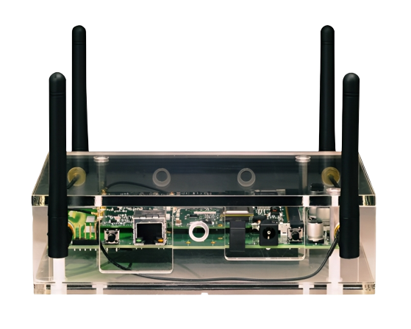
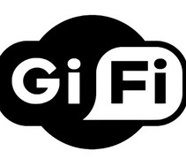
GI-fI
Technology
NEXT GENERATION WIRELESS TECHNOLOGY
GUIDENCE BY:
Asst. Pro. Jagruti Joshi
PRESENT BY:
Jemin H. Nagoria
EXAM NO. 0978
C.B. COMPUTER COLLEGE

Slide 2

01
Of 17
COnTEnTS
INTRODUCTION NETWORK EVOLUTION WHAT IS GI-FI?
HISTORY OF GI-FI WHY GI-FI IS USED
COMPARISON BETWEEN WI-FI, BLUETOOTH AND GI-FI TECHNOLOGIES USED
WORKING PRINCIPLE USED IN GI-FI FREQUENCY OF OPERATION ARCHITECTURE OF GI-FI
FEATURES OF GI-FI
GI-FI ACCESS DEVICES APPLICATIONS CONCLUSION REFERENCES
C.B. COMPUTER COLLEGE

Slide 3

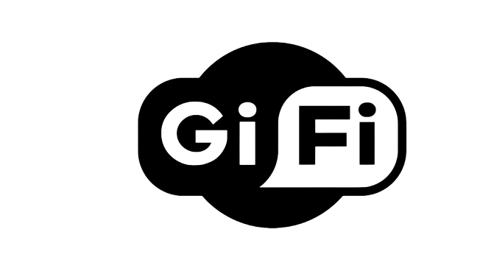
02
Of 177
INTRODUCTION
GI-FI or Gigabit Wireless is the world's first transceiver
integrated on a single chip in which a small antenna used and both transmitter- receiver are integrated on a single chip which is fabricated using the complementary metal oxide semiconductor (CMOS) process.
Researchers at Melbourne University have come up with a wireless technology which promises high-speed short-range data
transfers with a speed of up to 5Gbps meters. The new wireless technology is
within a radius of 10 named as GI-FI and
operates on the 60GHz frequency band, which is currently mostly unused.
The best part about this new technology is its cost effectiveness and power. consumption, it consumes only 2 watts of power for its operation with antenna (1mm)) included and the development of GI-FI chip costs approximately $10(Rs 380) to manufacture.
C.B. COMPUTER COLLEGE

Slide 4
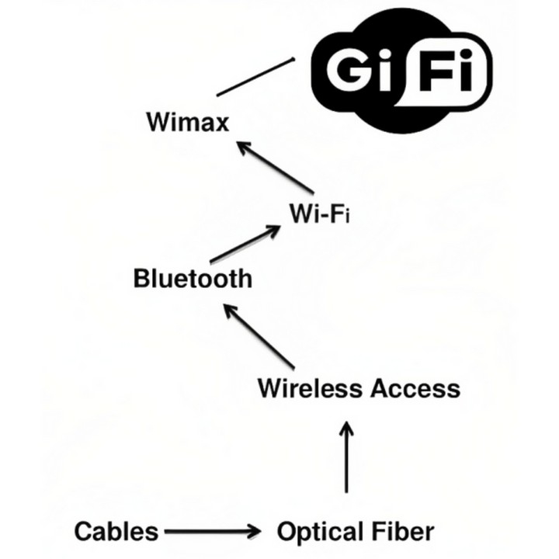
03
Of 17
NETWORK EVOLUTION
Bluetooth constantly scans for signals, searching for new devices to connect with, but using energy in the process. Check your device's settings and turn Bluetooth off when you're not using it. To
overcome such disadvantages bluetooth gifi came into picture.
of wifi It will
and surely
enable the future for information management. Gi-Fi allows the transfer of audio and video data upto 5gigabits per second. It was developed by NICTA (National Information & Technology Research center in Melbourne, Australia. The above figure shows the Gi-Fi Technology.
evolution of Gi-Fi(Gigabits wireless). Initially there were wired media used such as cables and optical fibers. But as evolution took place wireless media came into picture. Now everyone is using Wi-Fi. Recently the research has started regarding Gi-Fi.
C.B. COMPUTER COLLEGE

Slide 5

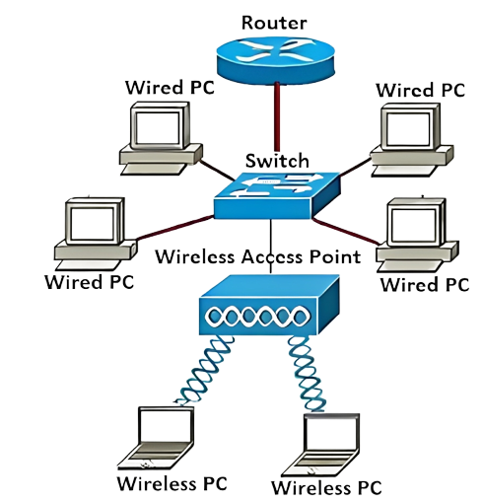
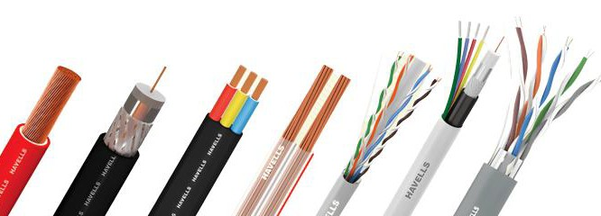
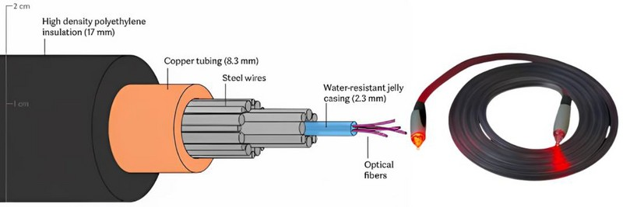
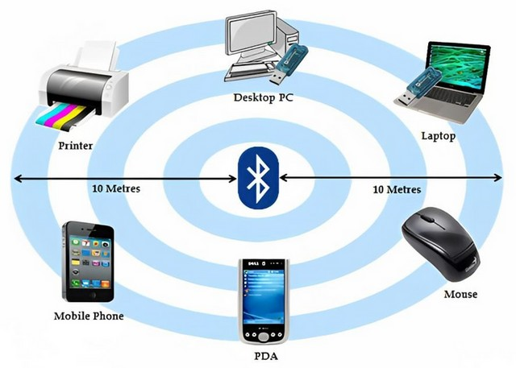
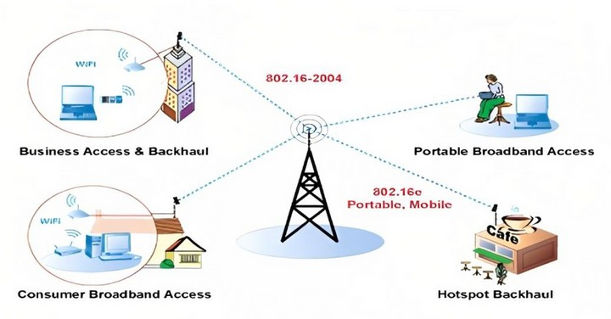
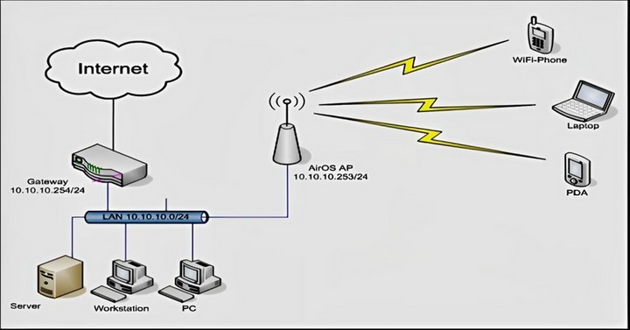
04
Of 17
WHAT ARE CABLES ?
WHAT IS OPTICAL FIBER?
WIRELESS ACCESS
Worldwide Interoperability for Microwave Access
Wireless Fidelity
WHAT IS BLUETOOTH ?
WHAT IS WI-MAX?
WHAT IS WI-FI?
C.B. PATEL COMPUTER COLLEGE

Slide 6
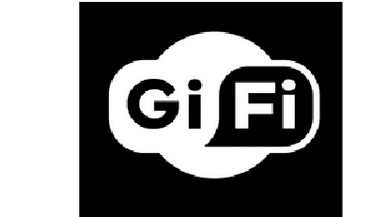

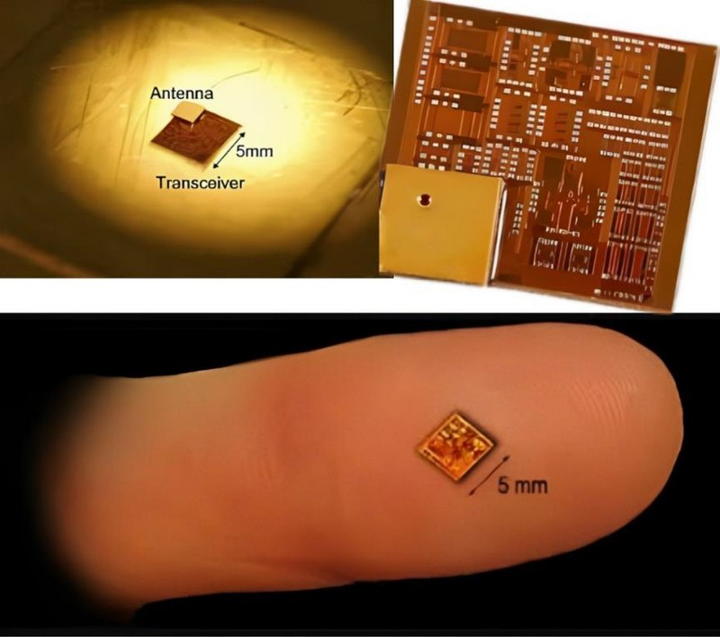
05
of 17
WHAT IS GI-FI?
Gi-Fi is the technology that uses extremely high frequency of 60GHz for the transmission of data.
The process of mixing and signal filtering enhances the strength of the signal, with
minimal losses in the medium.
Just like Bluetooth, this technology
uses This
short-range wireless communication.
feature computes with the contemporary wireless communication technologies.
These researchers at Melbourne University attained a data transfer rate of 5Gbps using the wireless chip.
This technology range of 10m, technology.
also operates within a just like he Bluetooth
C.B. PATEL COMPUTER COLLEGE

Slide 7
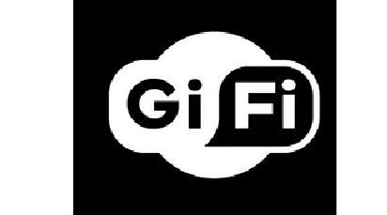
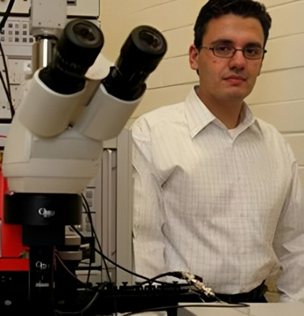
06
of 17
HISTORY OF GI-FI
It was developed at the National Information and Communication Technology Research Center in Melbourne, Australia.
It can have a span of 10 meter.
Professor Stan Skafidis of Melbourne University
C.B. PATEL COMPUTER COLLEGE

Slide 8


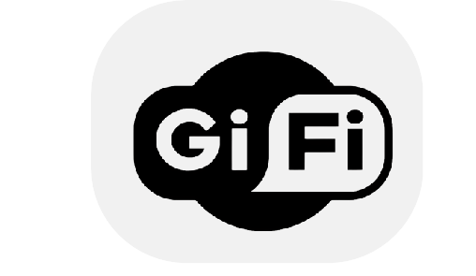
07
of 17
C.B. PATEL COMPUTER COLLEGE
WHY GI-FI ?
The reason for pushing into Gi-Fi
technology is because of
Slow Rate
High Power Consumption
low range of frequency operations of earlier technologies.
i.e. Bluetooth and Wi-Fi, see the
comparisons and features of those two technologies.

Slide 9
08
COMPARISON BETWEEN
Of 17
BLUETOOTH, WI-FI & GI-FI
COLLEGE
COMPUTER
C.B.

Slide 10

09
Of 17
TECHNOLOGIES USED
This mm Wave WPAN will operate in the new and clear band including 57-64 GHz unlicensed band defined by FCC 47 CFR 15.255. The millimeter wave WPAN will allow high coexistence (close physical spacing) with all other microwave systems in the 802.15 family of WPANS. Two Technologies that help realise GWLAN are...
1. MUlTIPlE InPUT MUlTIPlE OUTPUT (MIMO)
2. SySTEm-On-A-PAcKAgE (SOP)
MIMO wireless is an emerging cost-effective
Recent development of materials and
technology that offers substantial leverages in making 1Gbps wireless links a reality. We can, in principle, meet the 1 Gbps data rate
processes in the packaging area makes it possible to bring the concept of SOP into the RF world to meet the stringent needs in the wireless communication area.
requirement if the product of (measured in Hz) and spectral
bandwidth efficiency
Wireless devices implementing complex
(measured in bps/Hz) equals 10^9.
The performance improvements resulting
from the use of MIMO systems are due to...
Array gain
Diversity gain
Spatial Multiplexing Gain
Interference Reduction
functionality require a large amount of
circuitry and consequently, require a large conventional package or MCM real estate.
SOP goes one step Module (MCM) by performances and functionalities.
beyond Multi Chip
enhancing
adding
overall more
C.B. PATEL COMPUTER COLLEGE

Slide 11
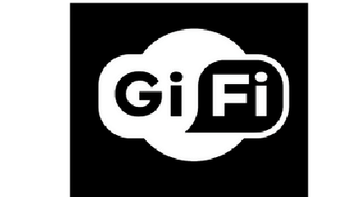
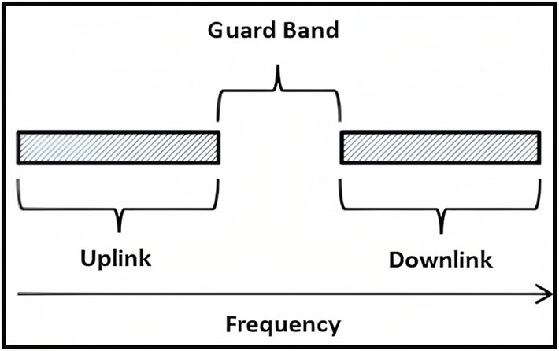
10
of 17
WORKING PRINCIPLE USED IN GI-FI
In this we will use time division duplex for both transmission and receiving. Here data files are converted from IF range to RF60Ghz range by using 2 mixers and we will fed this to a power amplifier, which feeds millimeter wave antennas.
TIME-DIVISION DUPLEX
Time-Division Duplex (TDD) is the application of time-division multiplexing to separate outward and return signals. It emulates full duplex communication over a half-duplex communication link. Time division duplex has a strong advantage in the case where the asymmetry of the uplink and downlink data speed is variable. As uplink traffic increases, more channel capacity can dynamically be allocated to that, and as it shrinks it can be taken away.
C.B. PATEL COMPUTER COLLEGE

Slide 12
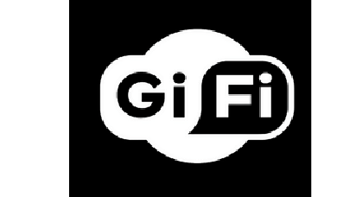
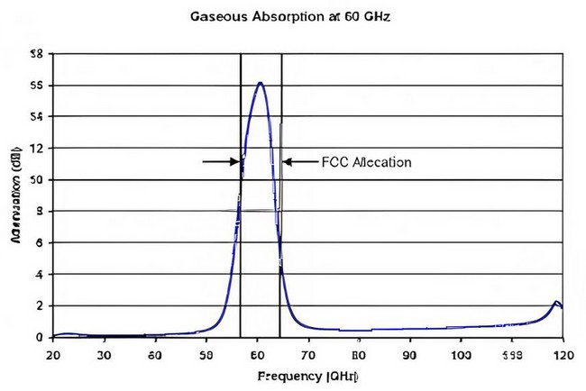
11
of 17
FREQUENCY OF OPERATION
will use millimeter wave antenna which will at 60GHz frequency which is unlined band
Here we operate
Because of this band we are achieving high data rates
energy propagation in the 60GHz band has unique characteristics that make
possible many other immunity to co-channel
benefits such as excellent
interference, high security, and frequency reuse.
UlTRA-wIDE BAnD fREqUEncy USAgE
UWB, a technology with high bit rate, high security, and faster data transmission. It is a zero-carrier technique with low coverage area. So, we have low power consumption. These features are Ultra-Wideband is a technology for transmitting information spread over a large bandwidth (>500 MHz) that should be able to share spectrum with other users. Regulatory settings of FCC are intended to provide an efficient use of scarce radio bandwidth while enabling both high data rate personal-area network (PAN) wireless connectivity and longer- range, low data rate applications as well as radar and imaging systems.
C.B. PATEL COMPUTER COLLEGE

Slide 13
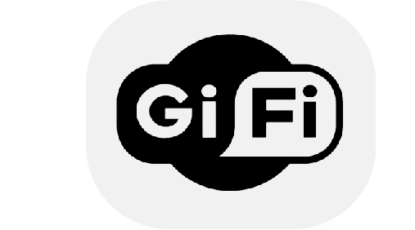
12
of 17
ARCHITECTURE OF GI-FI
The core components of a Gi-Fi system is the subscriber
station which available to several access points.
It supports standard of
IEEE 802.15.3C
pan network
devices
supports used for
millimetre-wave wireless communication among computer
(including
telephones and personal digital assistants) close to one person.
An 802.15.3C based system often uses small antenna at the subscriber station. The antenna is mounted on the roof. It supports line of sight operation.
It is the world's first transceiver integrated on a single chip that operates at 60GHz on the CMOS (Complementary Metal Oxide Semiconductor) process.
C.B. COMPUTER COLLEGE

Slide 14
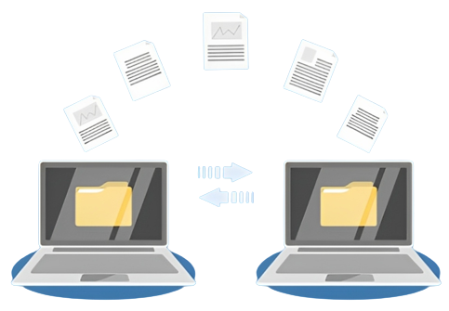
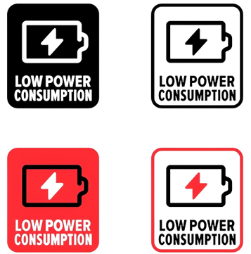

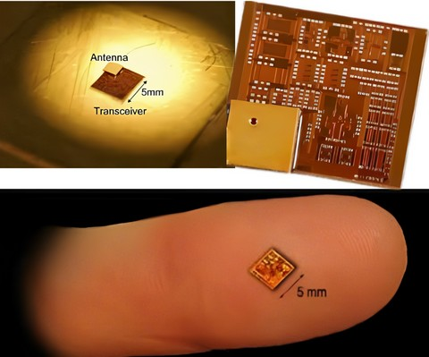
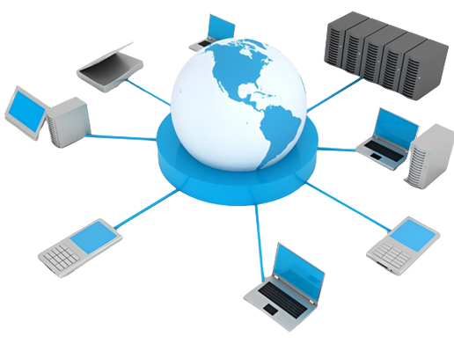

13
of 17
FEATURES OF GI-FI
HIGH SPEED OF DATA TRANSFER
LOW POWER CONSUMPTION
HIGH SECURITY
COST-EFFECTIVE
SMALL SIZE
QUICK DEPLOYMENT
C.B. PATEL COMPUTER COLLEGE

Slide 15
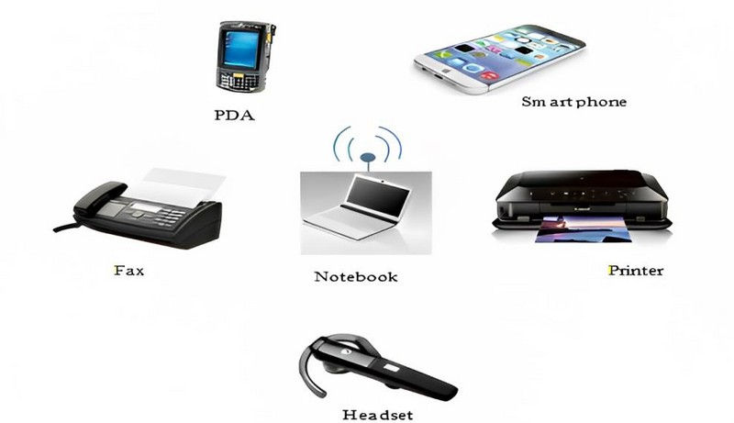
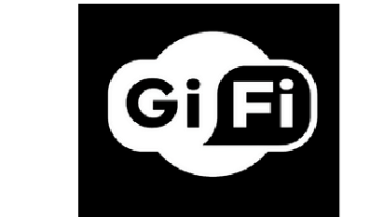
14
of 17
GI-FI ACCESS DEVICES
LAN access points
Cellular phones
PDAs
Wireless Printers
Notebooks
Faxing machines
Headsets
Electronic Devices
Etc.,
C.B. PATEL COMPUTER COLLEGE

Slide 16

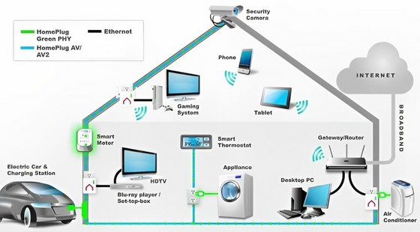
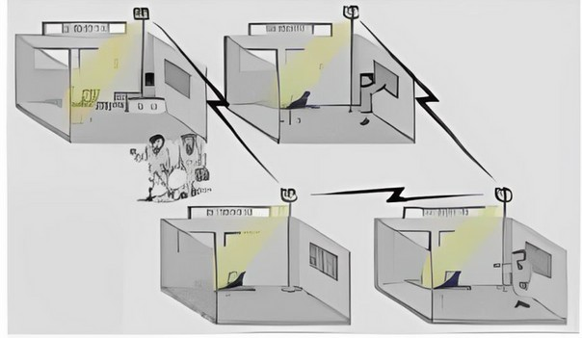
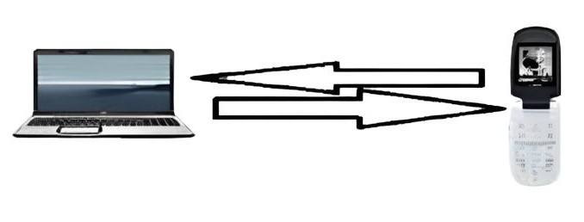
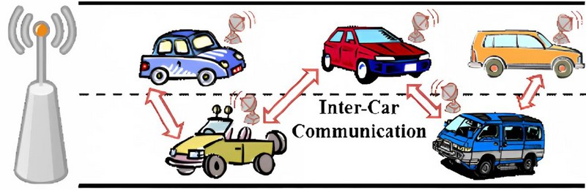
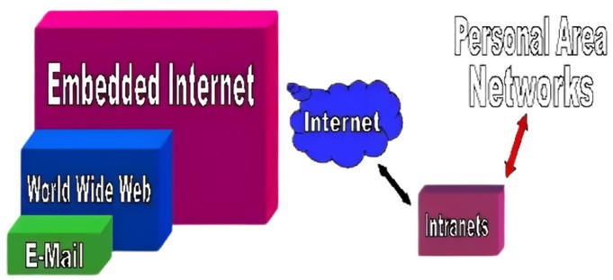
15
Of 17
C.B. PATEL COMPUTER COLLEGE
APPLICATIONS
1. HOUSE HOLD APPLIANCES
3. VIDEO INFORMATION TRANSFER
2.OFFICE APPLIANCES
By using present technologies video swapping takes hour of time, whereas by this we can transfer at a speed of Gbps.
It makes the wireless home and office of the future.
As it transfers data at high
speeds that made work very easy.
4. INTER-VEHICLE COMMUNICATION SYSTEM
5. MEDIA ACCESS CONTROL
(MAC) & IMAGING AND OTHERS
This technology can be effectively used in the inter-vehicle communication system.
Media access control determines how to transmit data between two computer terminals.

Slide 17
16
Of 17
C.B. PATEL COMPUTER COLLEGE
CONCLUSION
gI-fI technOlOgy
Within five years, we expect Gi-Fi to be the dominant technology for wireless networking. By that time, it will be fully mobile, as well as providing low-cost, high broadband access, with very high speed large files swapped within seconds which will develop wireless home and office of future.
If the success of Wi-Fi and the imminent wide usage of Wi-Max is any indication, Gi-Fi potentially can bring wireless broadband to the enterprise in an entirely new way.

Slide 18
17
Of 17
C.B. PATEL COMPUTER COLLEGE
REFERENCES
www.wikipedia.com
www.ieee.org
www.yuvaengineers.com
www.seminarprojects.com
www.sensable.com
www.technologyreview.com
www.google.com
www.studymafia.org
gI-fI technOlOgy

Slide 19

Thank yOu
PROVIDE BY:
Nagoria Jemin Hemantkumar
EXAM NO.:
0978
GUIDE BY:
Asst. Pro. Jagruti Joshi
ACADEMIC YEAR:
2022-2023
C.B. PATEL COMPUTER COLLEGE

