Slide 1

Final Project
Online Shop
By Deyan Tranev and Sergey Slavov

Slide 2
Application Purpose
An online book store with an extensive catalogue of fantasy, horror, romance and the classics…
Convenient Search feature – browse by title, favorite author or genre
Shopping cart functionality

Slide 3
Technologies used
Spring MVC Framework
Maven build automation
Tomcat
JSP
JSTL
SHA-256 Password hashing
MySQL Database
REST Service

Slide 4
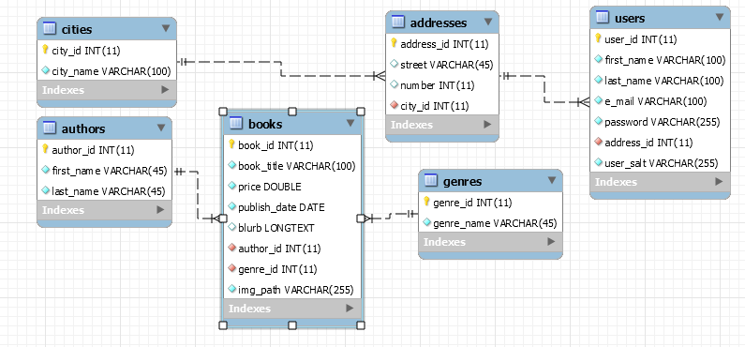
Architecture

Slide 5
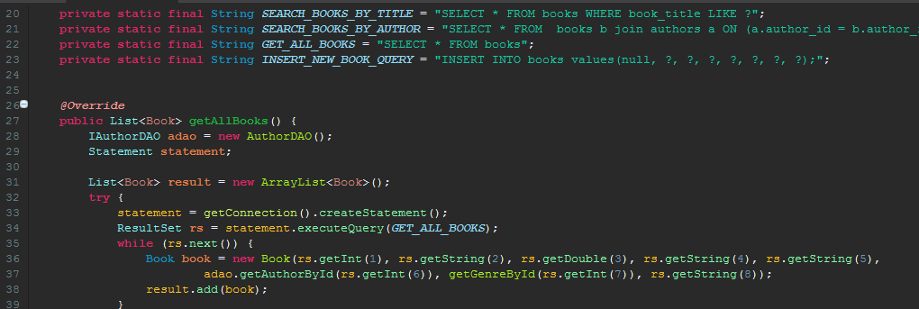
Demo

Slide 6
Expansion Plans
Offer More Products
Allow users to add products for sale
Implement a rating system
Allow users to post reviews

Slide 7


