Slide 1
概率编程
Probabilistic Programming
调研结果与简介
—2018,10,26 唐珑涛

Slide 2
“概率编程系统：用编程语言表达的概率推理系统。”
–www.epubit.com/selfpublish/article/848
以下内容来自上述网站

Slide 3
每个概率推理系统都使用某种表示语言表达其概率模型。表示语言有许多种，如贝叶斯网络（置信网络）和隐含马尔科夫模型。
语言所能表示的一组模型称作语言的表达能力。对于实际应用，你肯定希望表达能力尽可能强。
简单地说，概率编程系统是以编程语言作为表示语言的概率推理系统。我所说的编程语言是指具有编程语言所有预期特征（如变量、丰富的数据类型、控制流、函数等）的语言。正如你将要看到的，概率编程语言可以表达极其广泛的概率模型，超越传统的概率推理框架。概率编程语言有极强的表达能力。

Slide 4
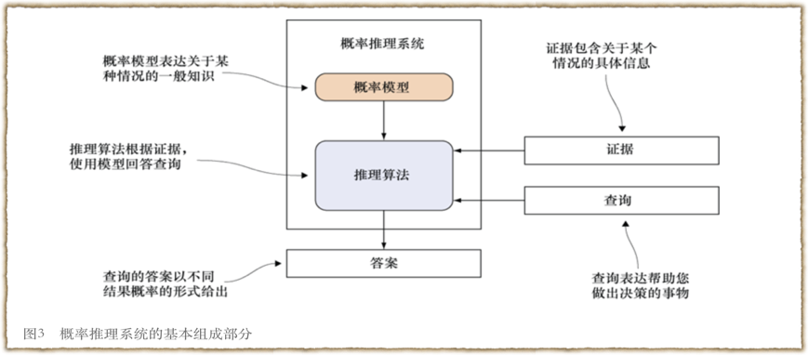
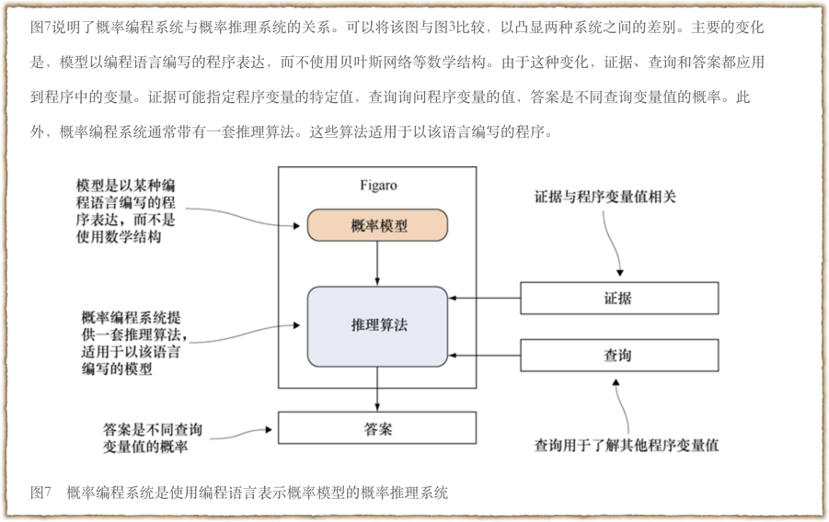

Slide 5
但是，编程语言如何成为概率建模语言？如何将概率模型表示为程序？我将在这里提出回答这一问题的一些线索，将更深入的讨论放在稍后的章节，那时你已经对概率程序有所了解。
编程语言的核心思路之一是执行。你执行一个程序以产生输出。概率程序也类似，但是它可以有许多执行路径，每个路径产生不同的输出。在程序中随机选择执行路径，每个随机的选择有许多可能的结果，程序编码每种结果的概率。因此，概率程序可以视为随机执行以产生输出的一个程序。

Slide 6
概率编程的魔法在于，它还可以用于各类概率推理。概率编程不仅可用于预测未来，还可以推断导致特定结果的事实；你可以“展开”程序，发现结果的根源，还可以在某种情况下应用程序，从结果中学习，在未来使用学习到的信息做出更好的决策。可以使用概率编程做出所有通过概率思想得到的决策。

Slide 7
太理论了？来点实的！

Slide 8
“Introducing our first hammer: PyMC3”
–https://docs.pymc.io
以下内容来自上述网站

Slide 9
Purpose
PyMC3 is a probabilistic programming package for Python that allows users to fit Bayesian models using a variety of numerical methods, most notably Markov chain Monte Carlo (MCMC) and variational inference (VI).
Its flexibility and extensibility make it applicable to a large suite of problems. Along with core model specification and fitting functionality, PyMC3 includes functionality for summarizing output and for model diagnostics.

Slide 10
Features
PyMC3 strives to make Bayesian modeling as simple and painless as possible, allowing users to focus on their scientific problem, rather than on the methods used to solve it. Here is a partial list of its features:

Slide 11
Features
Modern methods for fitting Bayesian models, including MCMC and VI.
Includes a large suite of well-documented statistical distributions.
Uses Theano as the computational backend, allowing for fast expression evaluation, automatic gradient calculation, and GPU computing.
Built-in support for Gaussian process modeling.
Model summarization and plotting.
Model checking and convergence detection.
Extensible: easily incorporates custom step methods and unusual probability distributions.
Bayesian models can be embedded in larger programs, and results can be analyzed with the full power of Python.

Slide 12
一个简单的例子
请移步：https://docs.pymc.io/notebooks/getting_started.html#A-Motivating-Example:-Linear-Regression

Slide 13
Discussion
Probabilistic programming is an emerging paradigm in statistical learning, of which Bayesian modeling is an important sub-discipline. The signature characteristics of probabilistic programming–specifying variables as probability distributions and conditioning variables on other variables and on observations–makes it a powerful tool for building models in a variety of settings, and over a range of model complexity. Accompanying the rise of probabilistic programming has been a burst of innovation in fitting methods for Bayesian models that represent notable improvement over existing MCMC methods. Yet, despite this expansion, there are few software packages available that have kept pace with the methodological innovation, and still fewer that allow non-expert users to implement models.

Slide 14
translating…
Provide by Google
校正ing…
by 我

Slide 15
Discussion
概率规划是统计学习中的一种新兴范式，其中贝叶斯建模是一个重要的子学科。
概率编程的重要特征是：声明的变量是建立在其他变量和观测结果上的概率分布或条件变量（conditioning variables）。这种特征使其成为在各种设置和模型复杂度范围内构建模型的强大工具
随着概率规划的兴起，贝叶斯模型拟合方法的创新突破，代表了对现有MCMC方法的显着改进。然而，尽管有这种扩展，却很少有软件包能够跟上方法创新的步伐，很少能让非专业人士也能够轻易实现模型。

Slide 16
Discussion
PyMC3的开发是一项持续的工作，并计划在未来版本中使用多种功能。最值得注意的是，变分推理技术通常比MCMC采样更有效，但代价是普遍性。然而，最近，已经开发了黑盒变分推理算法，例如自动微分变分推理（ADVI; Kucukelbir等，2017）。该算法计划添加到PyMC3。作为开源科学计算工具包，我们鼓励研究人员为贝叶斯模型开发新的拟合算法，以便在PyMC3中提供参考实现。由于采样器可以用纯Python代码编写，因此可以通常实现它们以使它们在任意PyMC3模型上工作，从而为作者提供更多的用户来使用它们的方法。

Slide 17
I find some books！

Slide 18
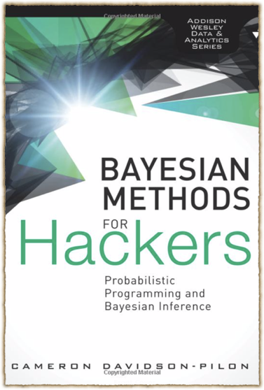
Bayesian Methods for Hackers: Probabilistic Programming and Bayesian Inference

Slide 19
“如果我们最终要进行贝叶斯推断，那么一方面我们可以采用数学的分析来实现这一目的，而另一方面，由于计算能力的上升，我们已经可以通过概率编程来完成这一任务。后一种方法更加轻松，因为其避免了复杂的数学推导。”
–来自书的前言

Slide 20
“掌握核心科技。”
–格力
MCMC
马尔可夫链蒙特卡罗

Slide 21
Summary
概率编程系统
PyMC3
Bayesian Methods for Hackers: Probabilistic Programming and Bayesian Inference

Slide 22
概率编程
Probabilistic Programming
工作汇报
—2018,11,8 唐珑涛

Slide 23
PART ONE

Slide 24
进一步了解PyMC
随机型变量
分布形式
决定型变量
算数表达式
封装函数
lambda表达式(lambda演算)

Slide 25
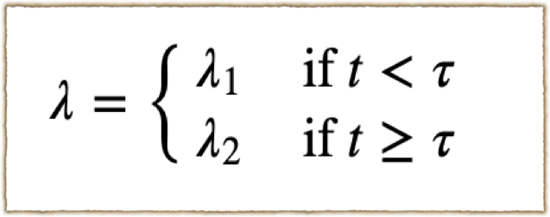
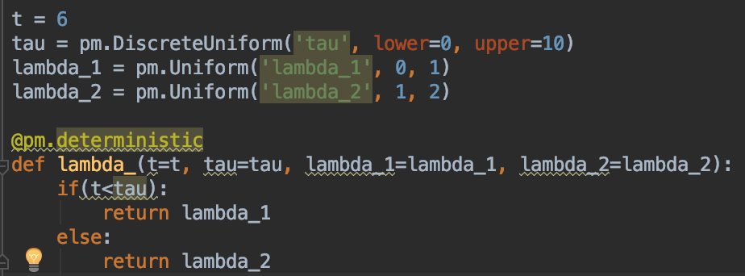

Slide 26
添加观测值
获得后验，以采样形式表现
mcmc = pm.MCMC(model)
mcmc.sample(40000, 10000)

Slide 27

如何获取样本
alpha
tua
Lamba1
Lamba2
Lamba1
Obs

Slide 28
MY SOLUTION
alpha
tua
Lamba1
Lamba2
Lamba1
Obs

Slide 29
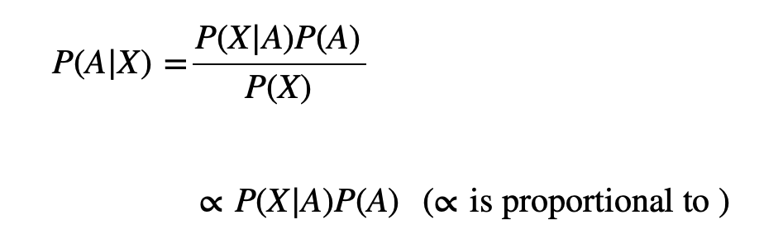
alpha
tua
Lamba1
Lamba2
Lamba1
Obs

Slide 30
“Suppose, however, that it is impractical to sample directly from p(z) but that we can evaluate p(z) easily for any given value of z. ”

Slide 31
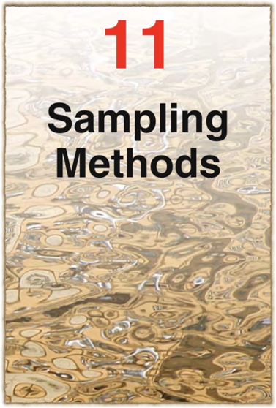
Pattern Recognition and Machine Learning.2013.英文版 第十一章

Slide 32
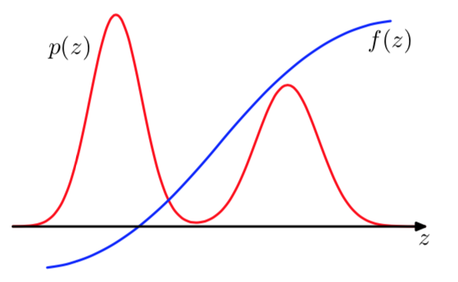
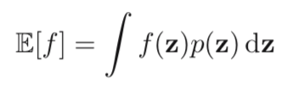
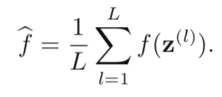
为什么我们要采样

Slide 33
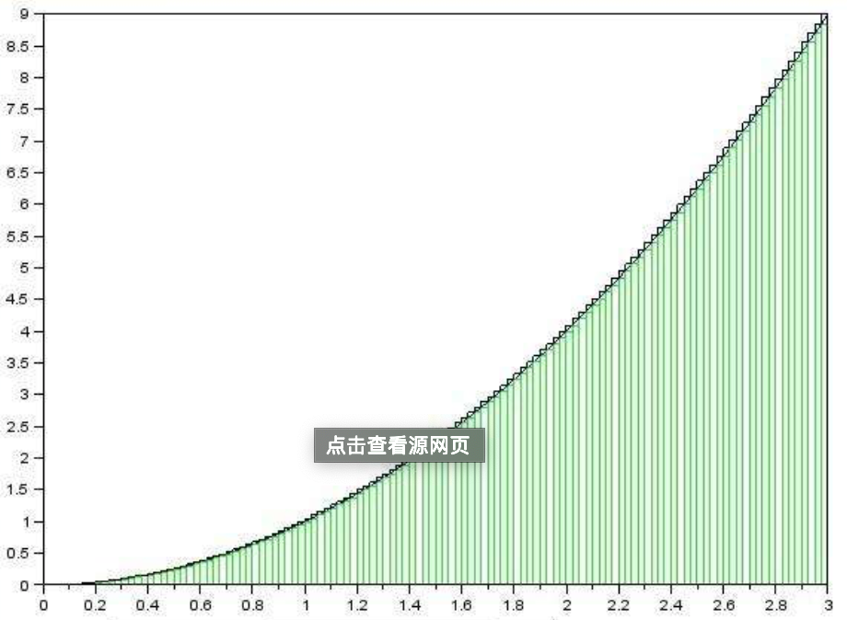
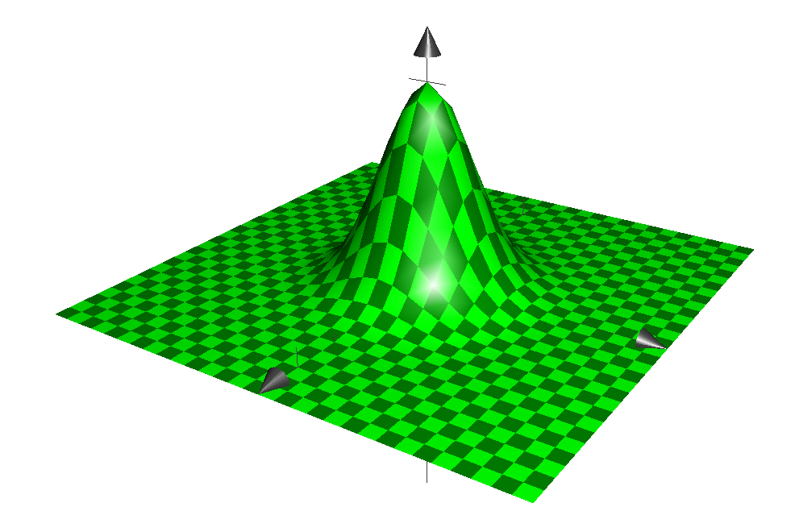

Slide 34
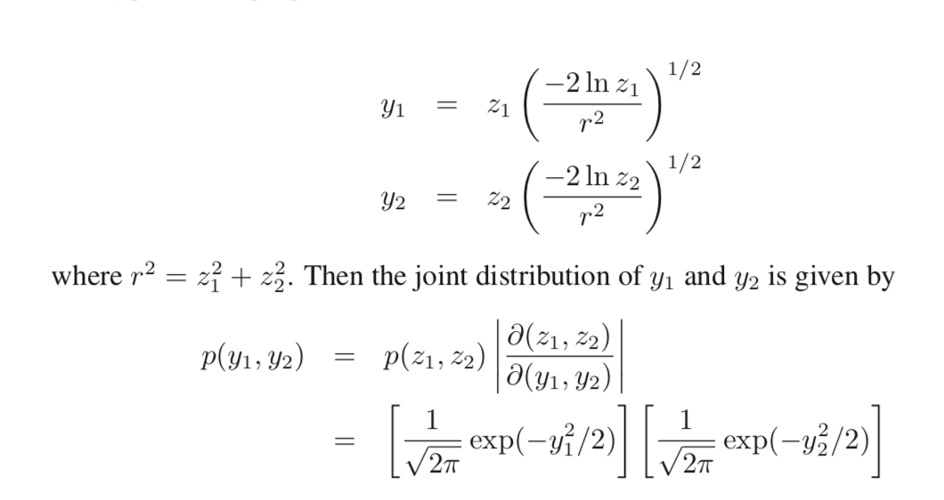
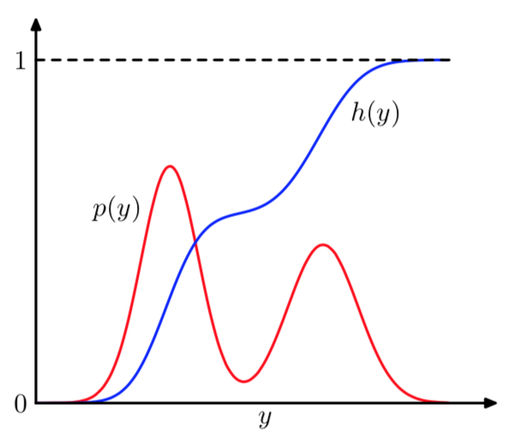
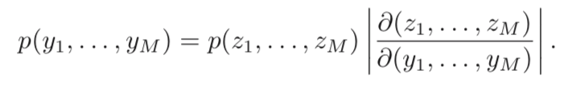
Standard distributions
均匀分布
同余方程组生成伪随机数
一些可以表示出累计分布函数的分布

Slide 35
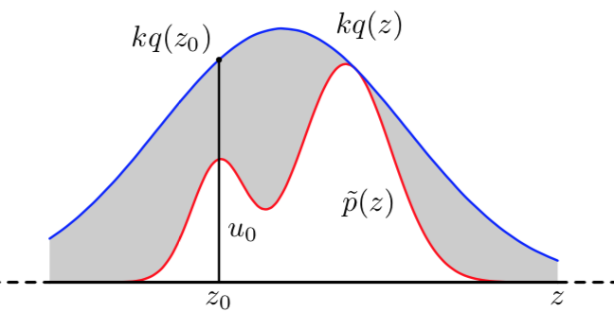
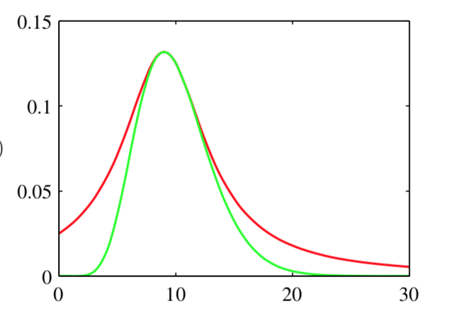
Rejection sampling
Although rejection can be a useful technique in one or two dimensions it is unsuited to problems of high dimensionality

Slide 36
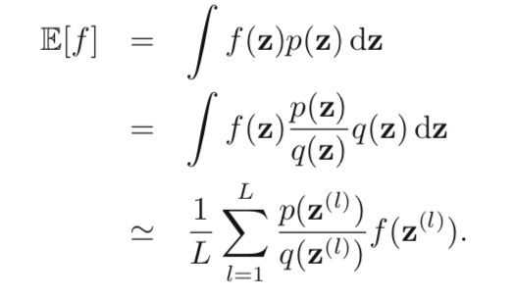
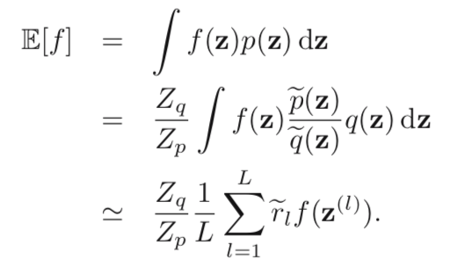
Importance sampling

Slide 37
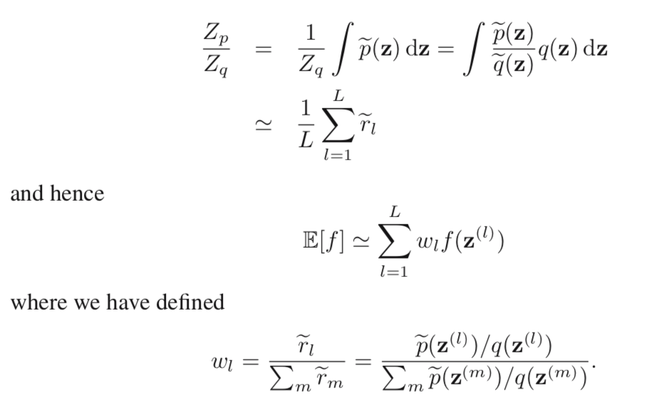
Importance sampling

Slide 38
Markov Chain Monte Carlo
Markov chain Monte Carlo methods have their origins in physics (Metropolis and Ulam, 1949), and it was only towards the end of the 1980s that they started to have a significant impact in the field of statistics.

Slide 39
Markov Chain Monte Carlo
This time, however, we maintain a record of the current state z(τ), and the proposal distribution q(z | z(τ)) depends on this current state, and so the sequence of samples z(1), z(2), . . . forms a Markov chain.

Slide 40
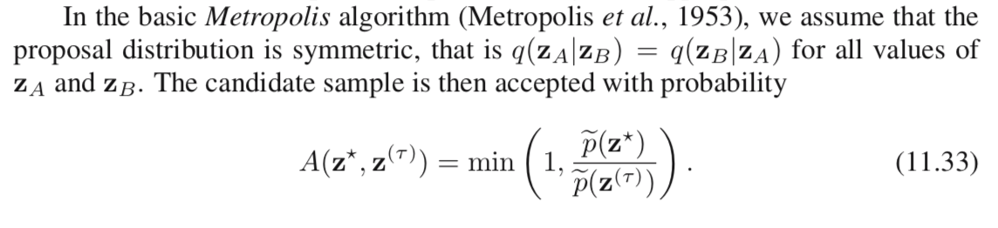
Markov Chain Monte Carlo

Slide 41

Markov Chain Monte Carlo
目标是使我们的马尔可夫链的平稳状态收敛到我们需要的分布p上去

Slide 42
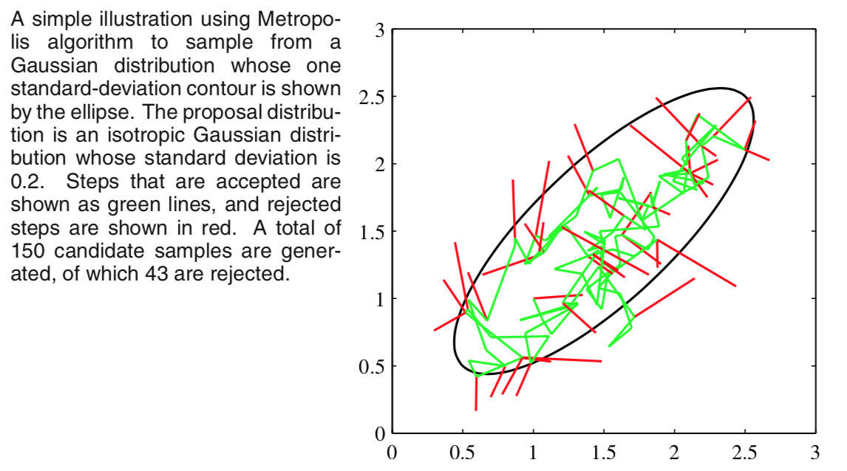
Markov Chain Monte Carlo

Slide 43
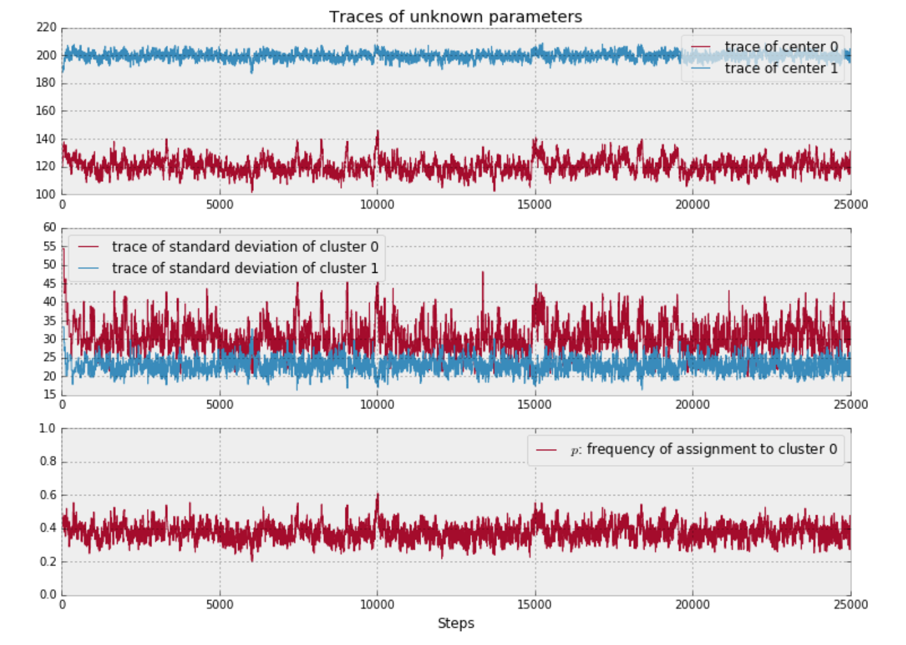
Markov Chain Monte Carlo

Slide 44
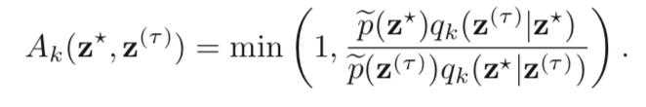
Markov Chain Monte Carlo
除了MCMC，还有另外一些可以寻找后验分布的方法。比如拉普拉斯近似法，就是一种用简单函数来对后验进行近似的方法。还有更高级的变分贝叶斯法。
话虽如此，我有个朋友总MCMC方法烂，烂透了。对于PyMC使用的具有别样风味的MCMC算法，他的评价只有一个字：烂。
– Bayesian Methods for Hackers: Probabilistic Programming and Bayesian Inference

