Slide 1

AI – POWERED EYE TRACKER SYSTEM FOR ASD PREDICTION
DEEKSHITH NAIK 4SO22CD016
SANATH 4SO22CD044
SRIJAN S SHETTY 4SO22CD052
SUDHANVA PATIL 4SO22CD055

Slide 2
Introduction:
Autism Spectrum Disorder (ASD) is a complex neurodevelopmental condition affecting approximately one in 100 children globally, characterized by persistent deficits in social communication, restricted interests, and repetitive behaviors. Early diagnosis is critical for improving social, cognitive, and adaptive outcomes, as evidence-based interventions yield maximum benefit when initiated before age three.
Current diagnostic assessments, such as the Autism Diagnostic Observation Schedule (ADOS-2) and Diagnostic and Statistical Manual of Mental Disorders (DSM-V) criteria, rely on qualitative evaluations, clinician observations, and extended behavioral assessments that are inherently subjective, time-consuming, and dependent on specialist availability. These limitations result in diagnostic delays, particularly in resource-constrained settings, narrowing the window for early intervention.

Slide 3
Why Eye-tracking :
Low-Cost, Hardware-Independent Screening The setup works with nearly any budget webcam, so there’s no need for expensive tools or tricky installations.
Objective, Quantifiable Behavioral Measurement Looking at how often focus changes, size of eye motions, blinking speed, or ability to follow objects gives doctors clearer clues.
Early Detection and Timely Intervention Faster detection happens with solid predictions, so toddlers get checked quickly because smart actions begin at once.
Real-Time Analysis and Immediate Feedback The system runs videos at 30 frames per second, displaying real-time motion while flagging dangerous situations.

Slide 4
Key Features
Gaze Data Collection: Real-time webcam-based eye tracking via MediaPipe FaceMesh.
Behavioural Metric Extraction: Fixations, saccades, blink frequency, pursuit gain, gaze variability.
ASD Risk Prediction: Calibrated ensemble ML model (Low / Borderline / High risk).
Real-time HUD: Live gaze overlays during screening.

Slide 5
Key Features
Report Generation: Summaries, metrics, risk score, visual analysis.
Data Logging: CSV/JSON session archive.
Performance: Stable at 24–30 FPS.
Scalability: Large session support.
Security: Encrypted logs, access control.

Slide 6
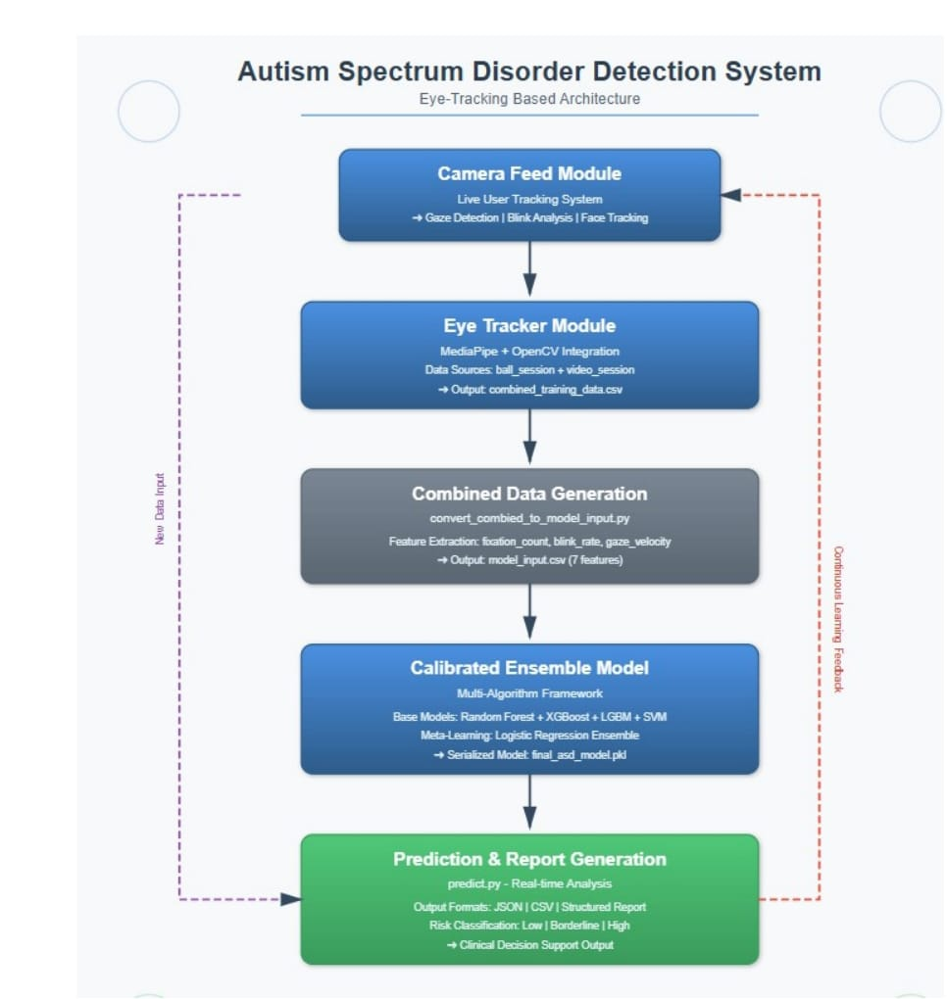
System Architecture

Slide 7
Here’s a brief explanation of the flow:
illustrates the high-level architecture of the proposed system. The pipeline begins at the user-facing interface, which orchestrates screening sessions, invokes the gaze-tracking backend, and displays real-time overlays and final ASD risk summaries. The backend stack processes video frames to extract eye-region landmarks and compute gaze trajectories, which are then transformed into behavioral features. An ensemble of calibrated machine-learning models operates on these features to generate probabilistic risk scores, which are rendered as interpretable categories and detailed.

Slide 8
Development Tools and Technologies
Technologies
Infrastructure, Data, and Auditing Layer: Local/Cloud encrypted storage, Session metadata, features, predictions, Complete audit logs for reproducibility.
Machine Learning and Behavioural Analysis: Layer Ensemble classifier (RF, XGB, SVM, LGBM, Calibration (Platt scaling / isotonic), Behavioural discriminant analysis, Metrics: Accuracy, F1, AUC, Brier score.
Security and Privacy Layer: No raw video stored by default, Role-based access, Encryption of metrics and reports, Alignment with child data privacy requirements.
Frontend (User Interface)
Technology stack: React.js, HTML, CSS, JavaScript.
Backend
Technology stack: Python, FastAPI/Flask, MediaPipe, OpenCV.

Slide 9
Implementation:
Real-time webcam-based gaze tracking using MediaPipe FaceMesh.
Behavioural feature extraction (fixations, saccades, blinks, smooth pursuit metrics)
Ensemble machine-learning model for ASD risk classification.
Python backend with FastAPI/Flask for orchestrating the processing pipeline.
Frontend user interface for rendering live visualizations and results .
Automated report generation in PDF/CSV/JSON formats.

Slide 10
User Interface Development:
The frontend is implemented using React.js with a minimalistic, distraction-free layout designed for real-time tracking tasks.
Key features include:
• Live video preview with gaze overlays.
• Fixation cross, pursuit target, and saccade stimuli presentation.
• Session progress and status indicators.
• Real-time metrics such as blink count, fixation time, and gaze direction.
• Final ASD risk scoring display with interpretation.
Stimuli Rendering Module:
This module renders dynamically controlled tasks including:
• Central fixation targets, Horizontal/vertical smooth pursuit paths.
• Randomized saccade jumping points.
• Social and non-social video stimuli.

Slide 11
Backend Implementation:
The backend is implemented in Python using FastAPI/Flask. It manages request handling, real-time landmark extraction, and ML inference.
Backend Modules
Frame Receiver: Accepts frames streamed from frontend, Gaze Tracking Engine: Extracts landmarks using MediaPipe FaceMesh, Behavioural Feature Extractor: Computes fixations, saccades, blinks, pursuit gain, Model Inference Engine: Runs ensemble classifier on extracted features and Report Generator: Produces structured output artifacts.
Behavioural Feature Extraction:
The behavioural features computed by the system are essential for differentiating ASD and non-ASD patterns. The feature pipeline includes:
• Fixation Metrics: Count, mean duration, stability.
• Saccadic Metrics: Frequency, amplitude, velocity.
• Blink Metrics: Blink count, blink intervals, blink irregularities.
• Smooth Pursuit Metrics: Tracking accuracy, pursuit gain, lag error.
• Gaze Variability Metrics: Gaze dispersion, jitter, cluster spread.

Slide 12
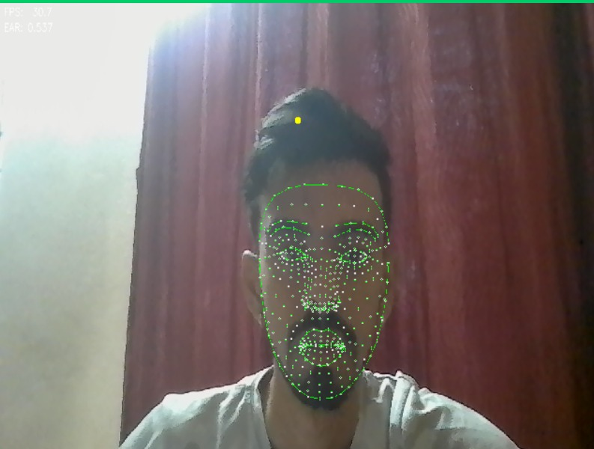
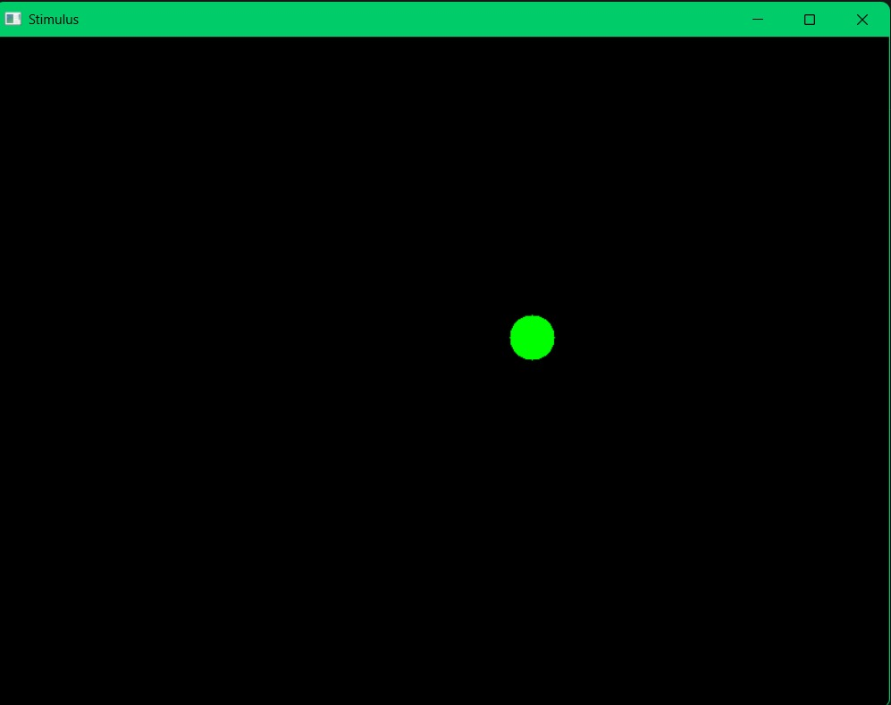
RESULTS

Slide 13
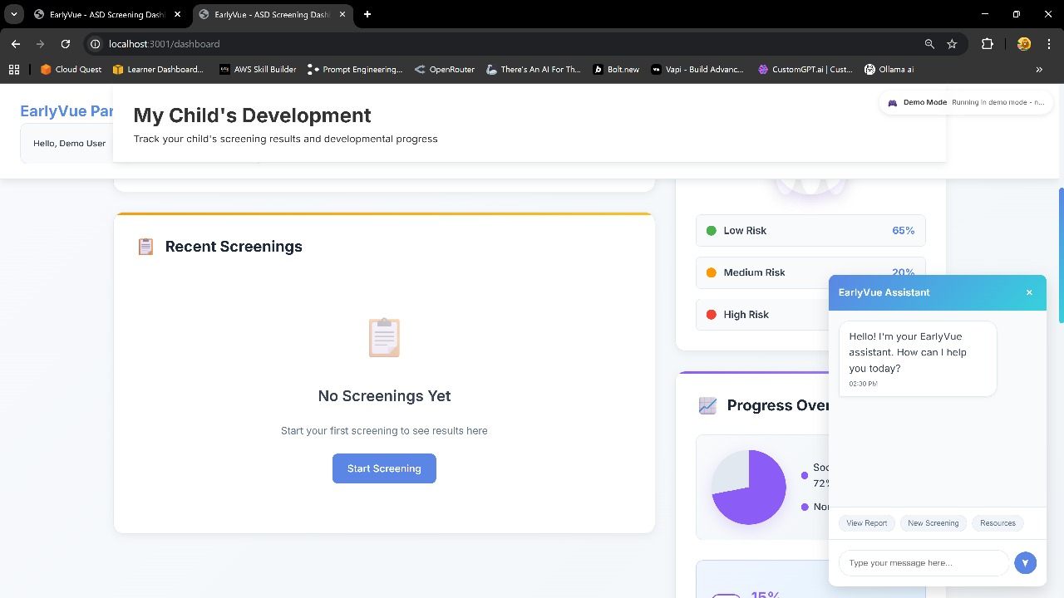
RESULTS

Slide 14
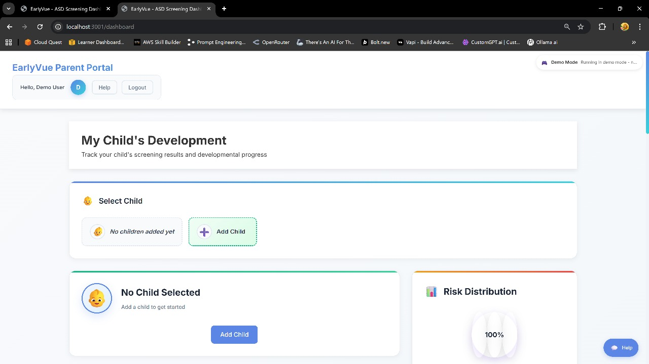
RESULTS

Slide 15
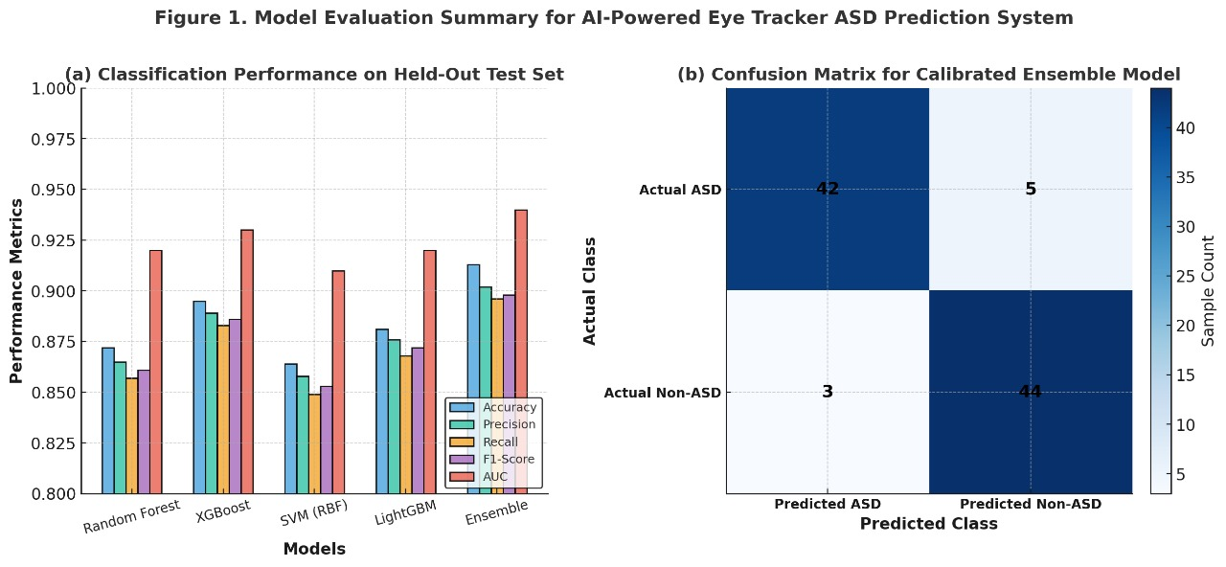
RESULTS

Slide 16
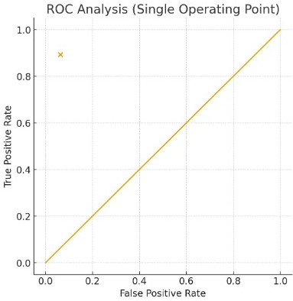
RESULTS

Slide 17
Application:
This project presented a complete, AI-powered eye-tracking system designed to support early-stage screening of Autism Spectrum Disorder (ASD) using accessible, webcam-based technology.
Designed for clinics, schools, and home settings, it combines real-time processing, accessible hardware, and structured reporting. Looking at how often focus changes, size of eye motions, blinking speed, or ability to follow objects gives doctors clearer clues, Research constantly ties these actions to ASD.
The system runs videos at 30 frames per second, displaying real-time motion while flagging dangerous situations which helps teachers or healthcare workers catch events instantly – skipping slow playback check.
Auto data collection works well with regular check-ups on features, cutting 4 down hands-on work – great for research, student wellness drives, or trial runs in clinics

Slide 18
Future Enhancements
• Deep Learning–Based Gaze Models: Incorporate transformer or CNN-based gaze-estimation models to improve accuracy under challenging environments.
• Multimodal Behavioural Signals: Integrate voice patterns, gesture recognition, and micro-expressions to support multimodal ASD analysis.
• Adaptive Testing Protocols: Develop dynamic stimuli that adapt to user behaviour in real time to improve engagement and reduce noisy samples.
• Cross-Device Calibration: Implement automated calibration methods for different webcams and screen resolutions.
• Clinical Validation Studies: Conduct large-scale hospital trials and cross cultural studies to assess generalizability and long- term reliability.

Slide 19
THANK YOU

