Slide 1
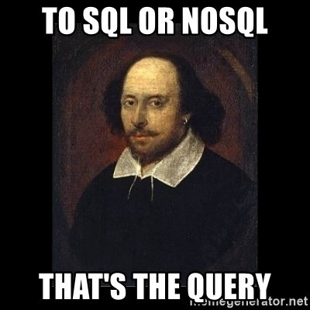
NoSQL

Slide 2
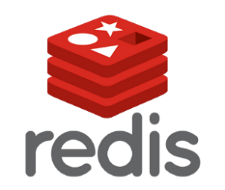



Key-value stores
Graph databases
Wide-column stores
Document databases

Slide 3
Key-value stores
Used for cache
User session data
Really fast to query
Really simple structure
Key
Value
Key
Value
Key
Value

Slide 4
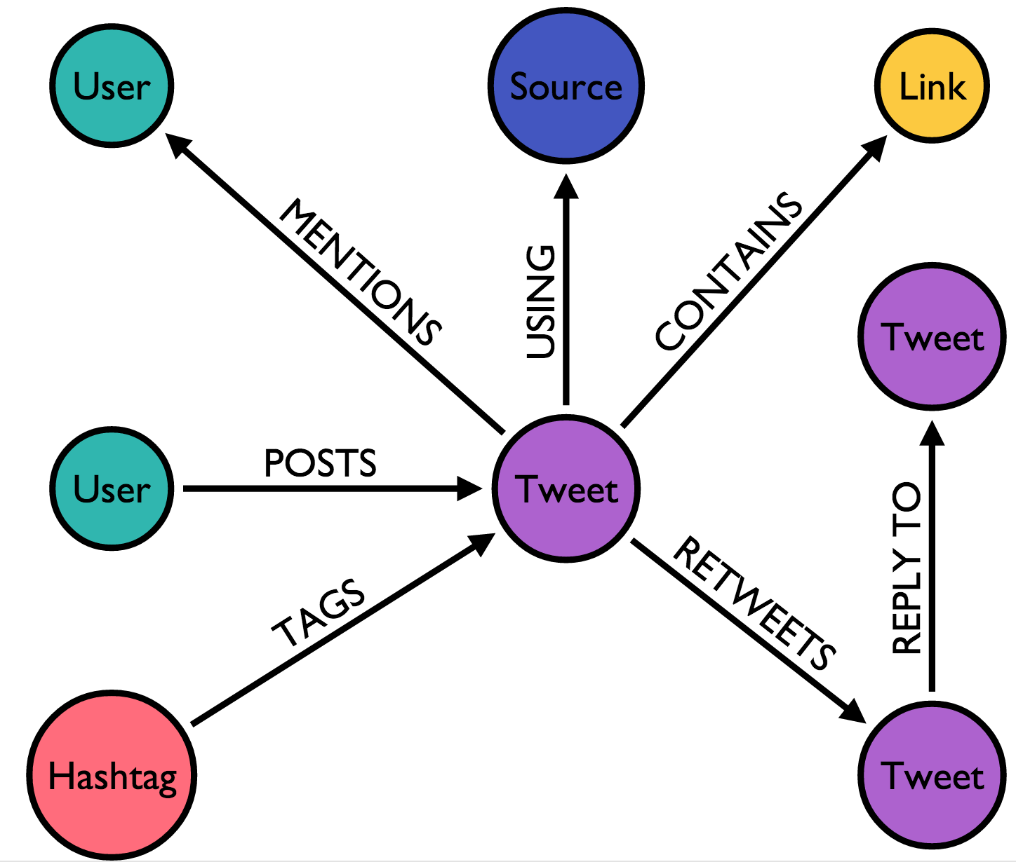
Graph databases
Based on graphs (nodes)
Allows for complex relationships (Edges)
https://neo4j.com/blog/oscon-twitter-graph/

Slide 5
Wide-column stores
Two keys allowing for fast queries
Allow for huge amounts of information
Used in Big Data and IoT among other things
Modeling data is a little complex
Column Key
Column Key
Column Key
Row Key
Column Value
Column Value
Column Value

Slide 6
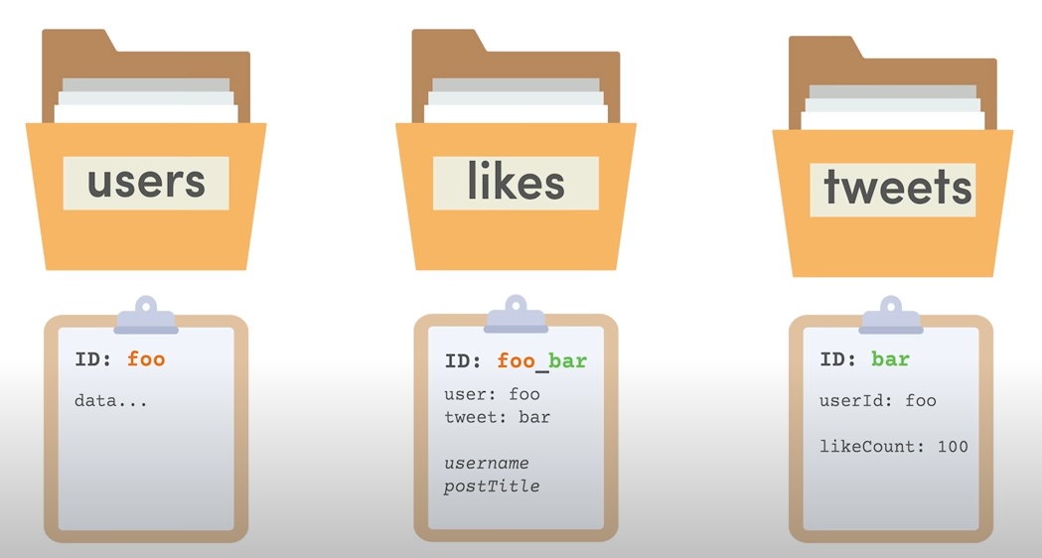
Document databases
Flexible Schema
Simple JSON Like Structure
https://youtu.be/jm66TSlVtcc

Slide 7
 | Use Case | Examples
Key-value store | Ideal for quick access data such as cache or session information | Redis, Memcached
Graph database | Good for complex relationships and better performance than relational databases | Neo4J, JanusGraph
Wide-column store | High performance and highly scalable with quick queries but complex modeling | Cassandra, HBase
Document database | Good for modeling real life entities and general purpose | MongoDB, Couchbase

Slide 8


Slide 9
MongoDB’s document data model naturally supports JSON and its expressive query language is simple for developers to learn and use. Functionality such as automatic failover, horizontal scaling, and the ability to assign data to a location are built-in.
https://www.mongodb.com/

Slide 10
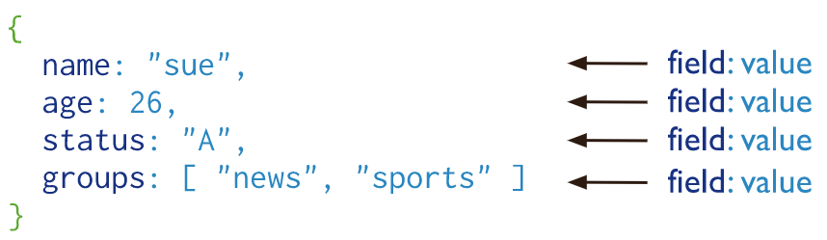
MongoDB stores data records as BSON documents. BSON is a binary representation of JSON documents, though it contains more data types than JSON.
https://docs.mongodb.com/manual/core/document/

Slide 11
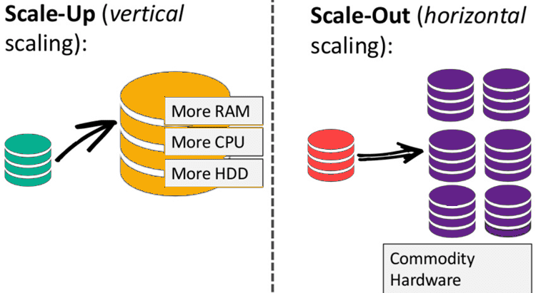
Horizontal Scalability
Part of the core functionality with Sharding (Fragmenting Data)
https://hevodata.com/learn/mongodb-vs-sql-comprehensive-analysis/

Slide 12
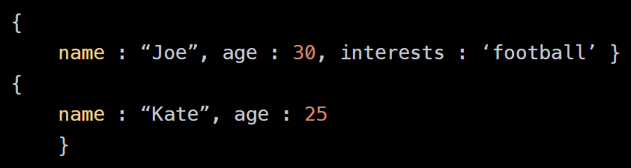
Schemaless
https://www.mongodb.com/unstructured-data/schemaless

Slide 13
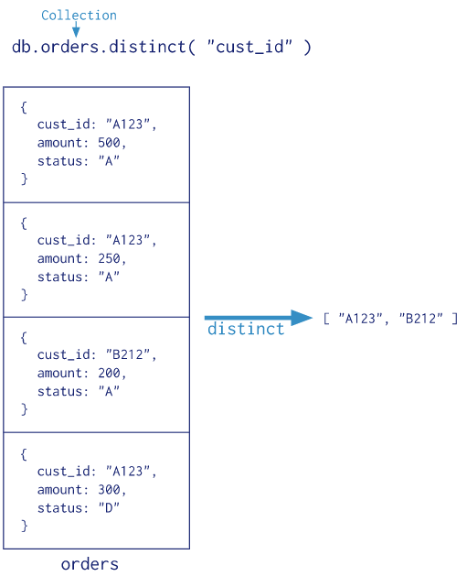
Queries
Although there are no joins, there are queries, indices and aggregations that allow for data extraction.
https://docs.mongodb.com/manual/aggregation/

Slide 14
Queries
Although there are no joins, there are queries, indices and aggregations that allow for data extraction.
https://docs.mongodb.com/manual/aggregation/

Slide 15
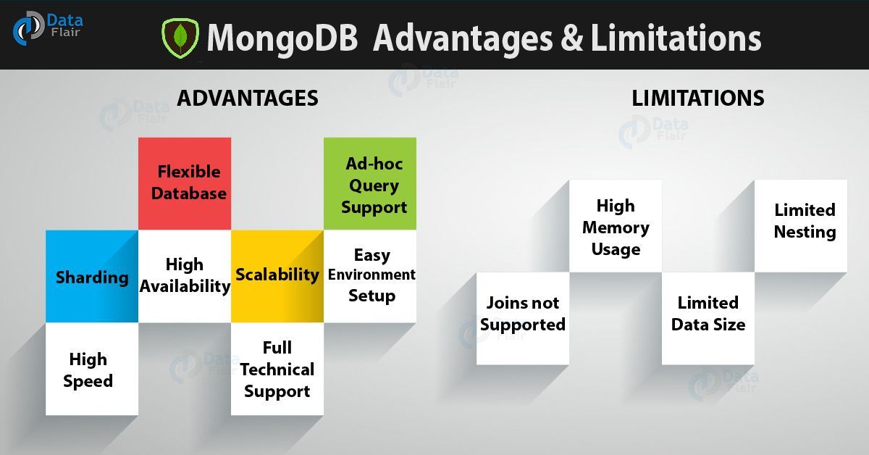
Overall
https://data-flair.training/blogs/advantages-of-mongodb/

Slide 16
Bibliography
https://www.mongodb.com/
https://neo4j.com/blog/oscon-twitter-graph/
https://hevodata.com/learn/mongodb-vs-sql-comprehensive-analysis/
https://data-flair.training/blogs/advantages-of-mongodb/

