Slide 1
Overview
Project Aim and Obejective
Breakdown of the project analysis using spreasheet
Introduction to other visualization tools
Tableau, Python, Sql and Databases
Data Lifecyle
Project: Analysis report on Energy Demand in Australia
Client: AusEnergy
Presented by: Chiedozie Umeoduagu
Comapany: Datascope
Position: Junior Data Analyst
Date: 20th June 2023

Slide 2


Aim
The Aim of this presentation is to understand the energy demand over time in Australia and how to manage the supply of energy efficiently.
Objectives
What demand looks like over time?
What extreme demand looks like and under what conditions?
How KPI’s like weather, holiday, school days and non-school days affect demand.

Slide 3
What are these tools?
Tableau
Python
SQL & Databases
Without data, you’re just another person with an opinion

Slide 4
Tableau
Tableau Desktop is a data visualization software where analysts and business users can explore their data and build reports and dashboards that can be shared out across the organization.
Who uses Tableau Tableau is mostly used by Data Analysts and business professionals.
What’s its importance in the Data World Tableau is used by organizations and individuals to make meaningful decisions based on the interpretation of data, it achieves this by adding value to the data, creating visual information, and drawing insights that drive actions.

Slide 5
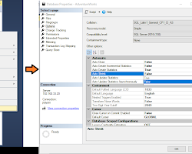
Databases and SQL Databases are structured data warehouse that stores data in columns or fields, rows, and records in an organized matter. SQL stands for Structured Query Language; it is a programming language used to interact with and manipulate databases. Who uses SQL? SQL is mainly used by Data Analysts, Software developers, and Database Administrators . What is SQL used For and why? SQL databases are designed to handle large datasets efficiently. it is used to store data, retrieve data, and delete data from a database.

Slide 6

Python
What is Python? Python is an object-oriented programming language used for a variety of tasks, including data analysis, scripting, web design, and machine learning. Python has a large set of libraries to implement a wide variety of tasks. These libraries include Numpy, pandas, startsmodels and Scikits Learn. *an object-oriented programming language is a programming language that uses objects and classes to organize codes. Who Uses Python? Python is used by data scientists, web developers What is Python used for? Python is used for web development, Data analysis and machine learning, automation, software testing, and prototyping. Python provides easy integration and automation of task.

Slide 7
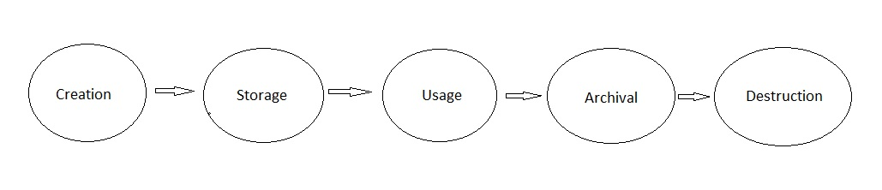
Data Lifecyle
Data lifecycle is the process of collecting, storing, and managing data, it can be divided into the following key phases
Creation: This is the process of collecting data from different sources
Storage This is the process of storing data in a safe and organized manner.
Usage: This is the process of making sure that the data is accurate, complete, and up-to-date

Slide 8
Archival: This is the process of copying data to an enviroment where it can be stored incase we need to use it again.
Disposal The process of deleting or archiving data that are no longer in use
How do spreadsheets fit into the Data Lifecycle
A spreadsheet is a common tool for Data collection, storing, Analysis, Visualization and managing data. It offers flexibility and convenience, but It lacked Database features, memory limitations, collaboration challenges and memory limitations. The downside of Spreadsheets is, it's not well suited for handling Large data sets effectively.
Areas the Data lifecycle was not analyzed in this project
The stages of the data lifecycle not analysed during the project were, Data archival, and disposal.
Dataspace can help in this area by providing professional services in data collection techniques, enhanced Database systems for storage, and data security.

Slide 9

Thank you!
I hope you find this presentation helpful. If you have any questions, please feel free to ask.

