Slide 1
ExpressCut
Developed by: Darrin Davis, Micaele Futsum, Michael Mfonyam, and Dennis Cothran
Purpose:
The purpose of this app is to allow independent barbers to create virtual appointment books so that their clients may easily request appointments. This app will have a social media aspect and will host the appointment books of other independent barbers who wish to deploy their appointments within the app.

Slide 2
ExpressCut
How Does It Work?
Barbers and potential customers will create new app accounts, in addition to the barber creating a Calendly account that will connect to the app. In addition to standard registration information barbers will have the opportunity to manage their schedules, communicate to customers in real time via text, create a profile that includes prices, specialties, any additional text and a virtual headshot portfolio. Customers will have the opportunity to search subscribed barbers, view their profiles and portfolios, make appointments, create favorite barbers, rate barbers and create routes to the barbers’ locations.

Slide 3
ExpressCut
Current State:
It is not fully functional at this juncture due to authentication and routing challenges but we will continue to work on it until it becomes a solid stable application as we will like to see this app go into real world production.

Slide 4
Pseudo Code

Slide 5
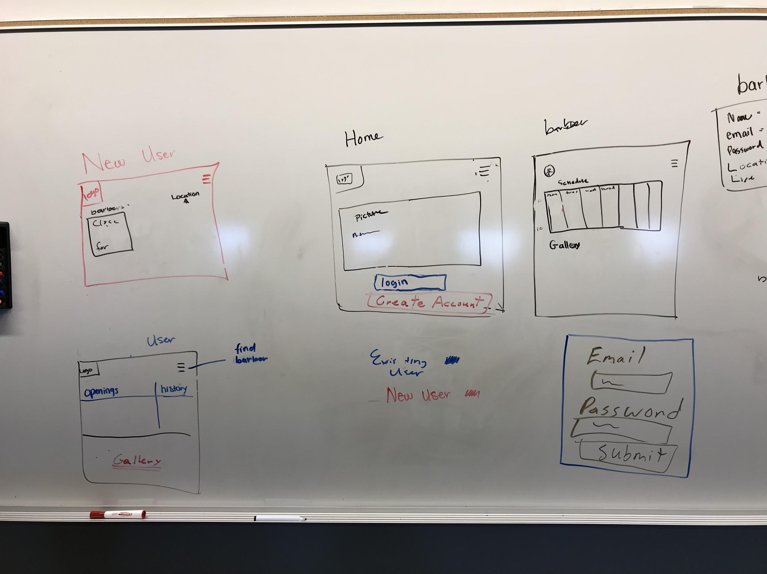

Slide 6
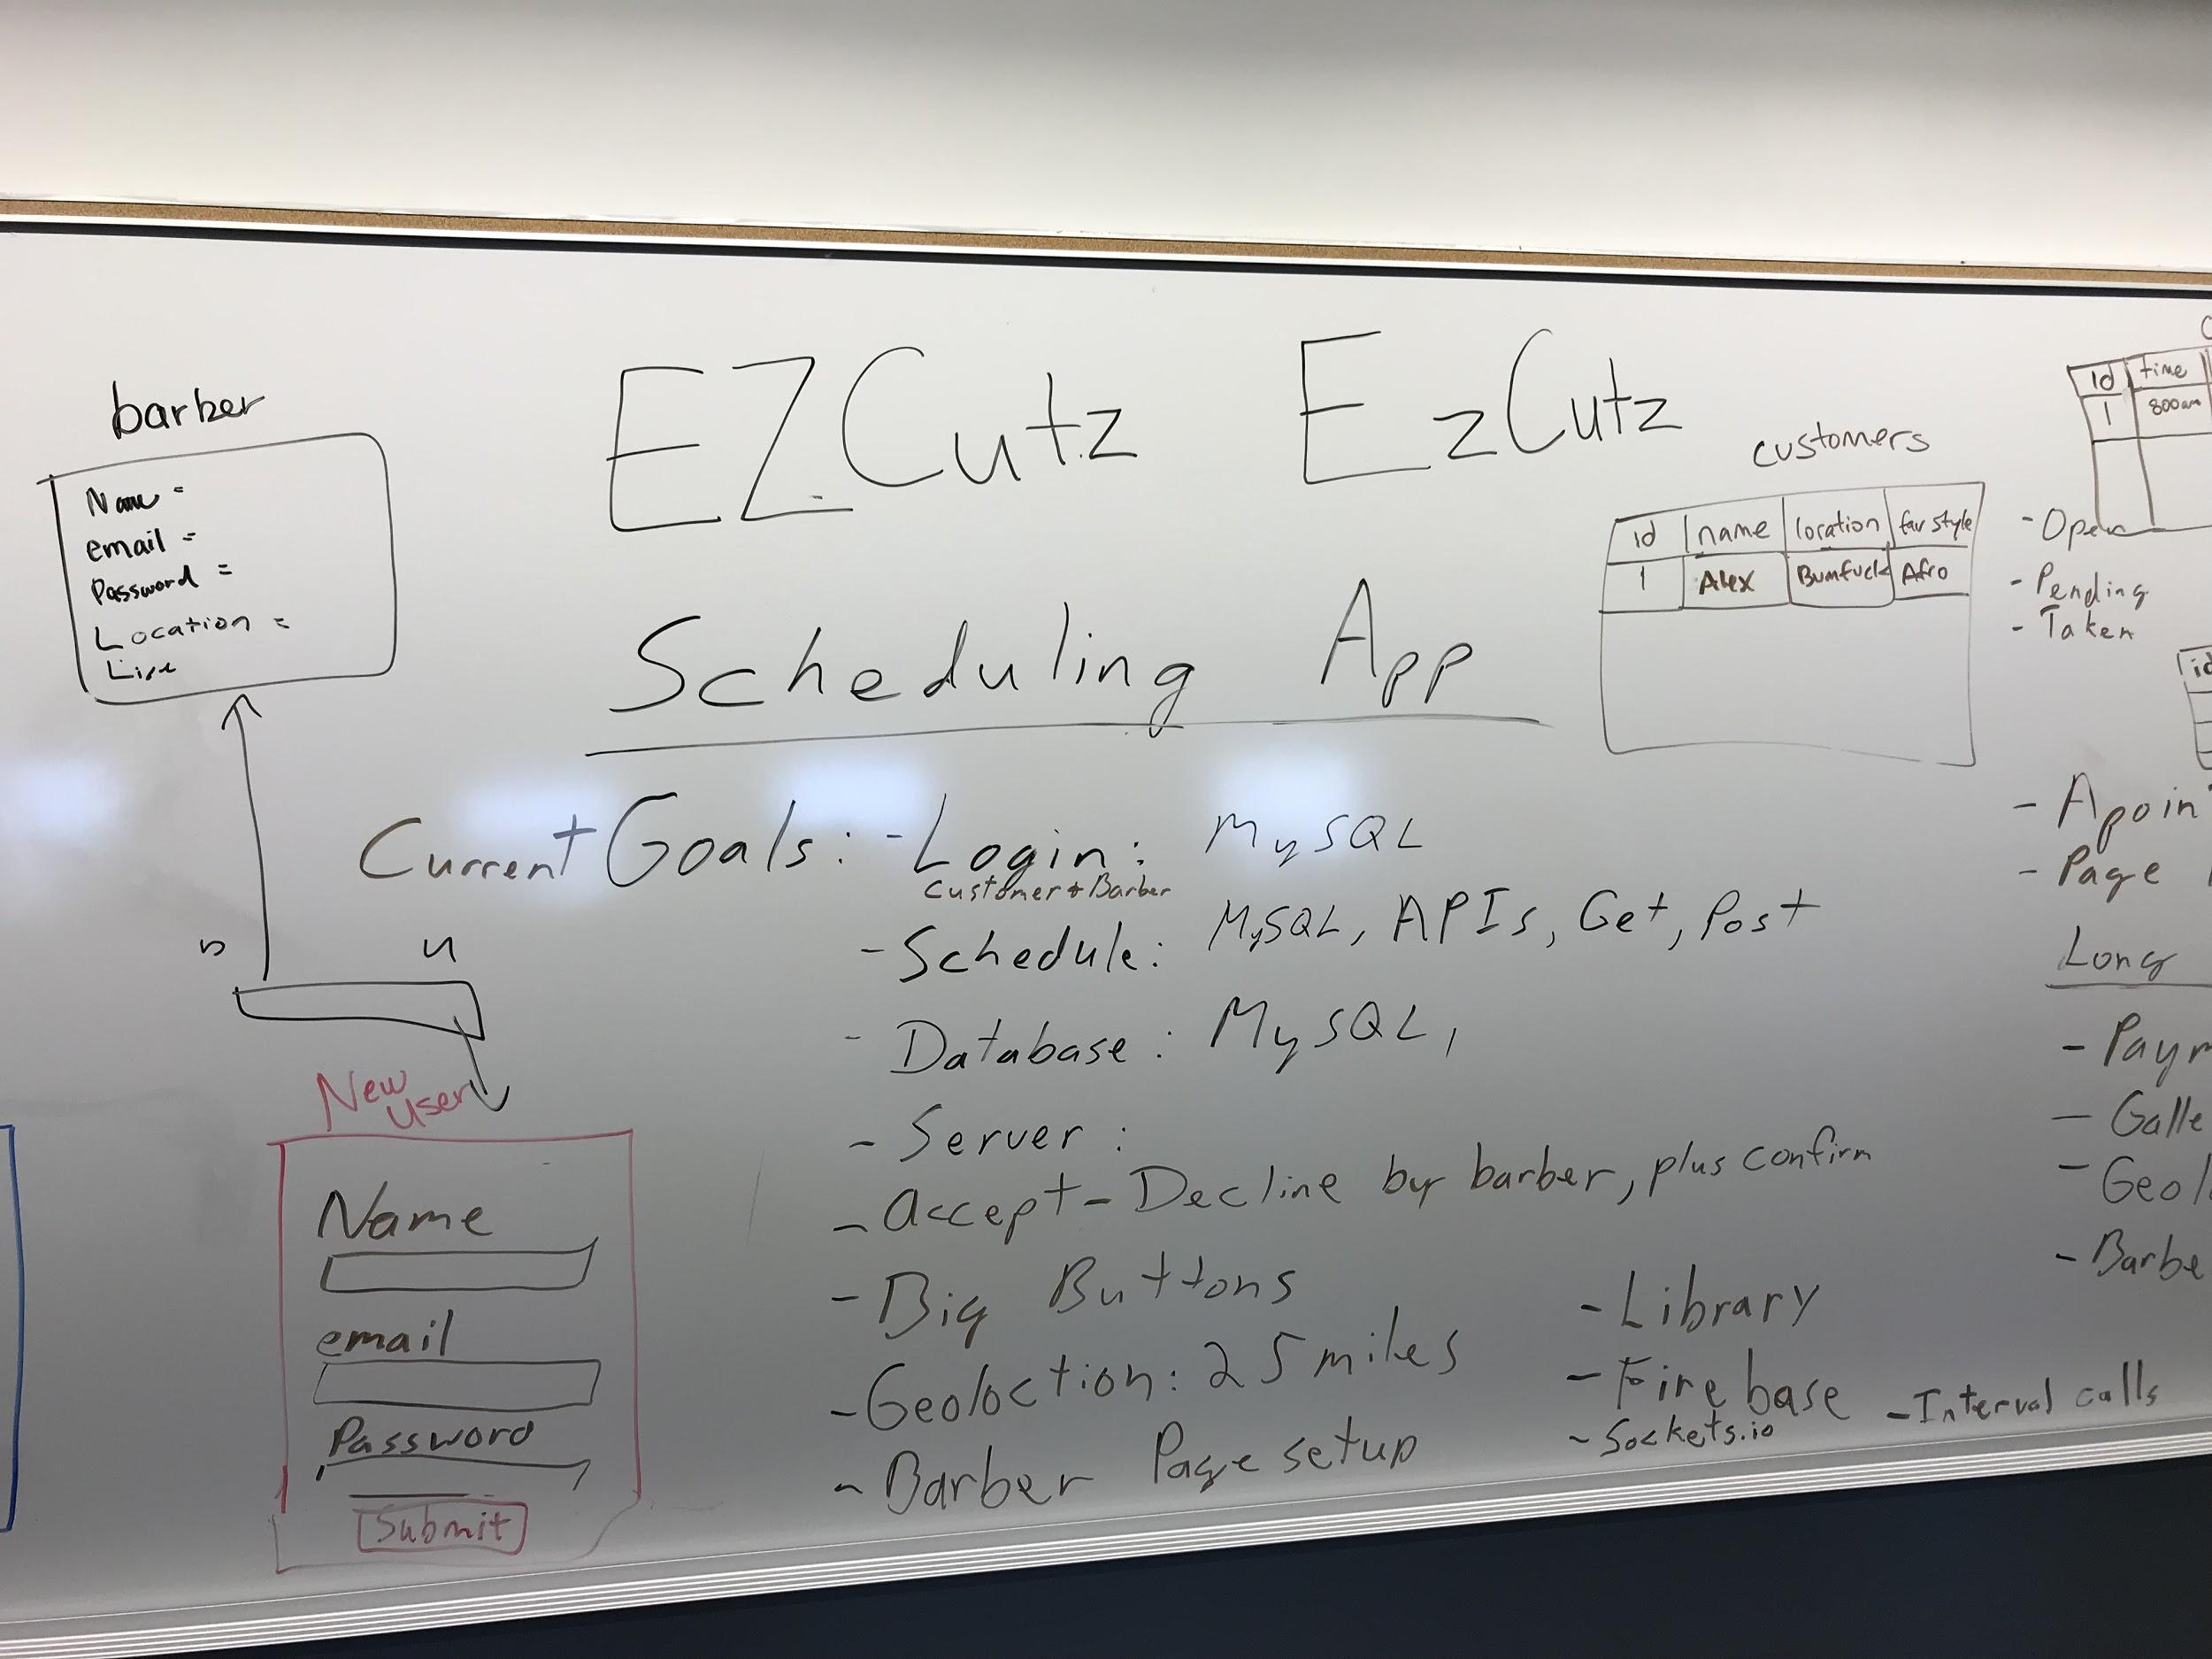

Slide 7
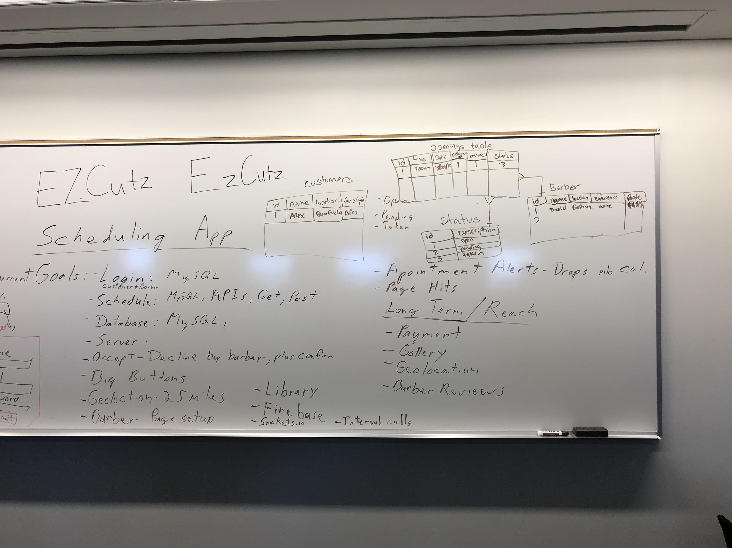

Slide 8
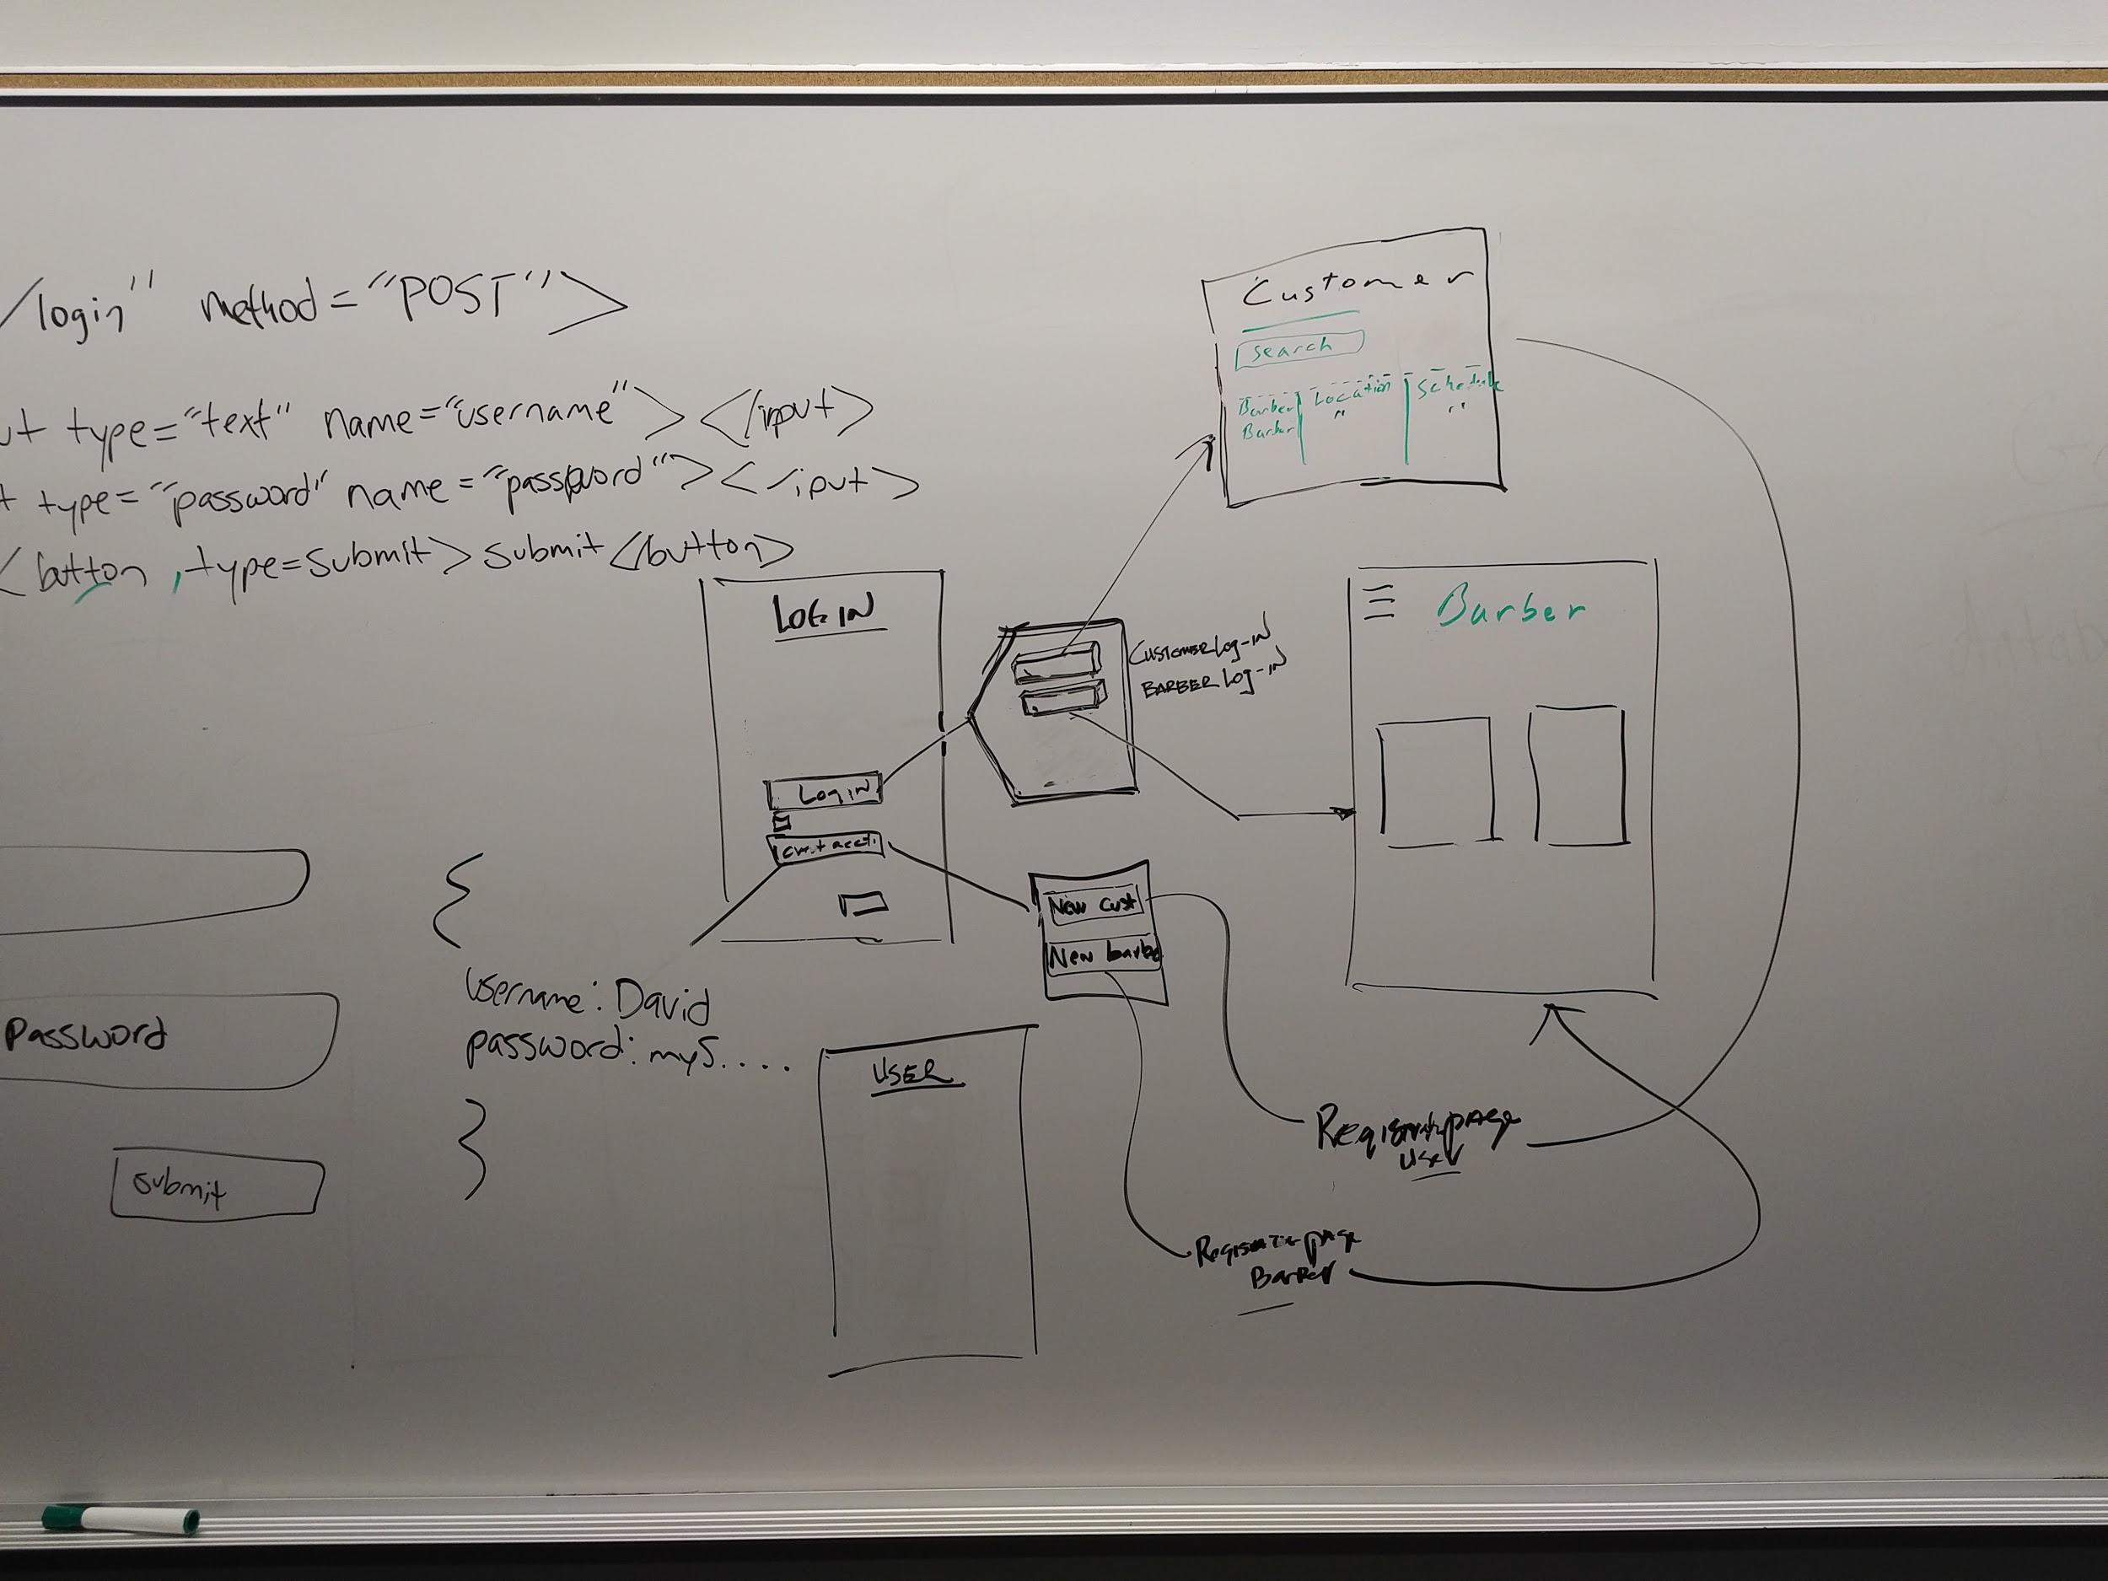

Slide 9
Technology
Geolocation(API)
Bootstrap
Calendy (API)
MySql
Node & Express
JavaScript

Slide 10
Features
Scaleable Site
Simple Coding
Big buttons

Slide 11
Challenges
Authentication with log-in
Dealing with the API Routes

Slide 12
Future Developments
Distance Location
Make it a mobile app
Customer Ratings
Favorites

