Slide 1

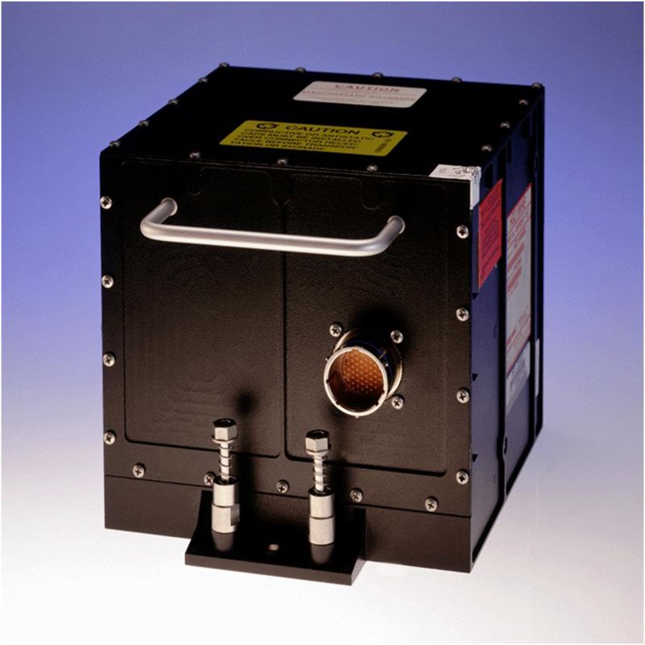
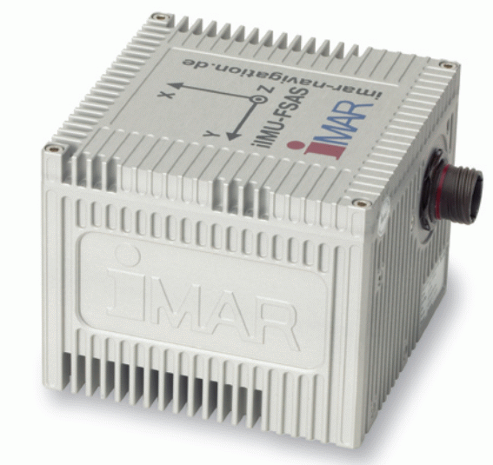
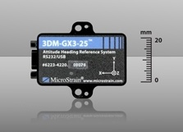
Nottingham
Geospatial
Institute
Ring Laser Gyros
£100k
0.003º/hr
1m after ~2 mins
100m after ~10 mins
Fibre optic gyros
£20k
1º/hr
1m after ~30s
100m after ~3 mins
MEMS
<£2k
360º/hr
1m after ~5s
100m after ~60s
MEMS
<£1
3600º/hr
1m after <5s
100m after <60s
Drift values are approximate and depend on many factors

Slide 2
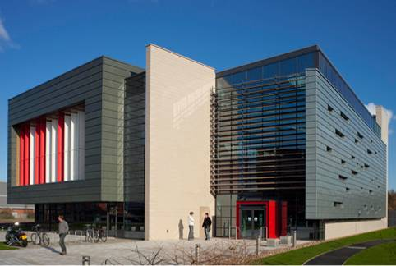
Contact Details
Nottingham
Geospatial
Institute

