Slide 1


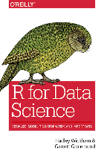



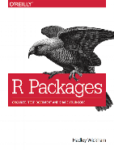




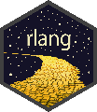
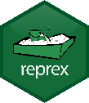



DfE Best Practice for R : : CHEAT SHEET
Software
Packages
Databases
Learning More
Write code in the RStudio IDE
Packages should be loaded in one place with successive calls to library()
Use {DBI} and {odbc} to connect to SQL
Use helper functions to create connections
Common data science tasks: use R for Data Science (2e)
Developing packages: use R Packages (2e)
Advanced programming: use Advanced R (2e)
Developing apps: use Mastering Shiny
Use git to version-control your code and analysis
Use the tidyverse for normal wrangling, plotting etc
connect_to_db <- function(db) {
DBI::dbConnect(
odbc::odbc(), Database = db,
# Hard-code common options here
)
}
(or)
Use GitHub / AZURE DevOps to collaborate with other people
Use tidymodels for modelling and machine learning
# Connect using the helper
con <- connect_to_db("DWH_PL")
Projects
Use {shiny}, {bslib} and {bs4Dash} for app development
Functions
WRITING FUNCTIONS: WORKFLOW
PROJECT CREATION
Write functions to reduce repetition or increase clarity
Write many small functions that call each other
Define functions in dedicated scripts with corresponding names
a <-
b <-
c <-
d <-
Repetitive, complex code; purpose clarified by comments
Create a new project in RStudio using File > New Project > New Directory
Do put projects in C:\Users\your-name\Documents
Don't put projects in C:\Users\your-name\OneDrive - Department for Education\Documents
Use r-lib packages like {rlang}, {cli} and {glue} for low-level programming
complex operation on a
complex operation on b
complex operation on c
GitHub stars are a good proxy for a package's quality. Not sure whether to use a package? If it has >200 stars on GitHub it's probably okay!
complex operation on d
<- function(x) {
}
Complex logic abstracted into functions
operate_on
NAMING CONVENTIONS
complex operation on x
PROJECT STRUCTURE
Getting Help
✓ Good (verb-like) | ✗ Bad (noun-like)
compute_totals() | totals_getter()
fit_model() | modeller_func()
import_datasets() | project_data()
Projects are folders containing a file with the extension .Rproj. Projects should be structured something like this:
a <- (a)
b <- (b)
c <- (c)
d <- (d)
Repetition reduced; clearer code; less need for comments
CREATE A REPREX
operate_on
A minimal, reproducible example should demonstrate the issue as simply as possible
Copy your example code and run reprex::reprex() to embed errors/messages/outputs as comments
Use your reprex in a question on Teams or Stackoverflow
operate_on
operate_on
my-project/
Tells Git which files it shouldn't track
operate_on
.gitignore
Styling
For other styling guidance, refer to the Tidyverse style guide
R/
Scripts in R/ should define functions for use elsewhere
NAMING THINGS
# Good (lower_snake_case everywhere):
add1 <- function(x) x + 1
first_letters <- letters[1:3]
iris_sample <- slice_sample(iris, n = 5)
# Bad (non-syntactic, not lower_snake_case):
`add 1` <- function(x) x + 1
FirstLetters <- letters[1:3]
iris.sample <- slice_sample(iris, n = 5)
01-import.R
Use lower_snake_case for most objects (functions, variables etc)
Title_Snake_Case may be used for column names
Use only syntactic names where possible (include only numbers, letters, underscores and periods, and don't start with a number)
02-tidy.R
print("Hello " + "world!")
#> Error in "Hello " + "world!": non-numeric argument to binary operator
SQL/
SQL, Python scripts etc should have dedicated folders too
costs.sql
names.sql
This reprex minimally demonstrates an error when attempting to use + for Python-style string concatenation
data/
keys.csv
A top-level R script may be used to run the whole project
ETIQUETTE WHEN ASKING QUESTIONS
WHITESPACE
run-all.R
Don't | Do
Post screenshots of your code | Use reprex::reprex() and paste your code as text
Include big files | Use dput() or tibble::tribble() to include a data sample
Ignore messages or warnings | Ensure your code only fails where you're expecting it to
Add spaces after commas and around operators like |>, %>%, +, -, *, /, = and <-
Indentation increases should always be by exactly 2 spaces
Add linebreaks when lines get longer than 80 characters.
When there are many arguments in a call, give each argument its own line (including the first one!)
# Good (lots of spaces, indents always by +2):
df <- iris |>
mutate(
Sepal.Area = Sepal.Width * Sepal.Length,
Petal.Area = Petal.Width * Petal.Length
)
# Bad (inconsistent spacing and indentation):
df<-iris |>
mutate(Sepal.Area=Sepal.Width*Sepal.Length,
Petal.Area=Petal.Width*Petal.Length)
my-project.Rproj
A .Rproj file makes this directory an RStudio project
README.md
Write the main facts about the project here
NB, usethis::use_description() + usethis::use_namespace() will
turn this structure into a package!
CC BY SA The DfE R Community • github.com/DfE-R-Community • Updated: 2023-03

Slide 2



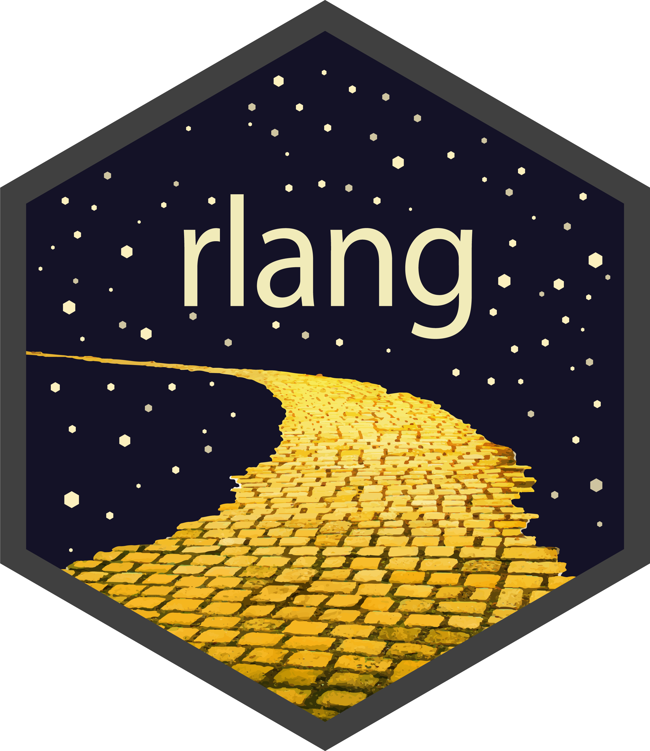

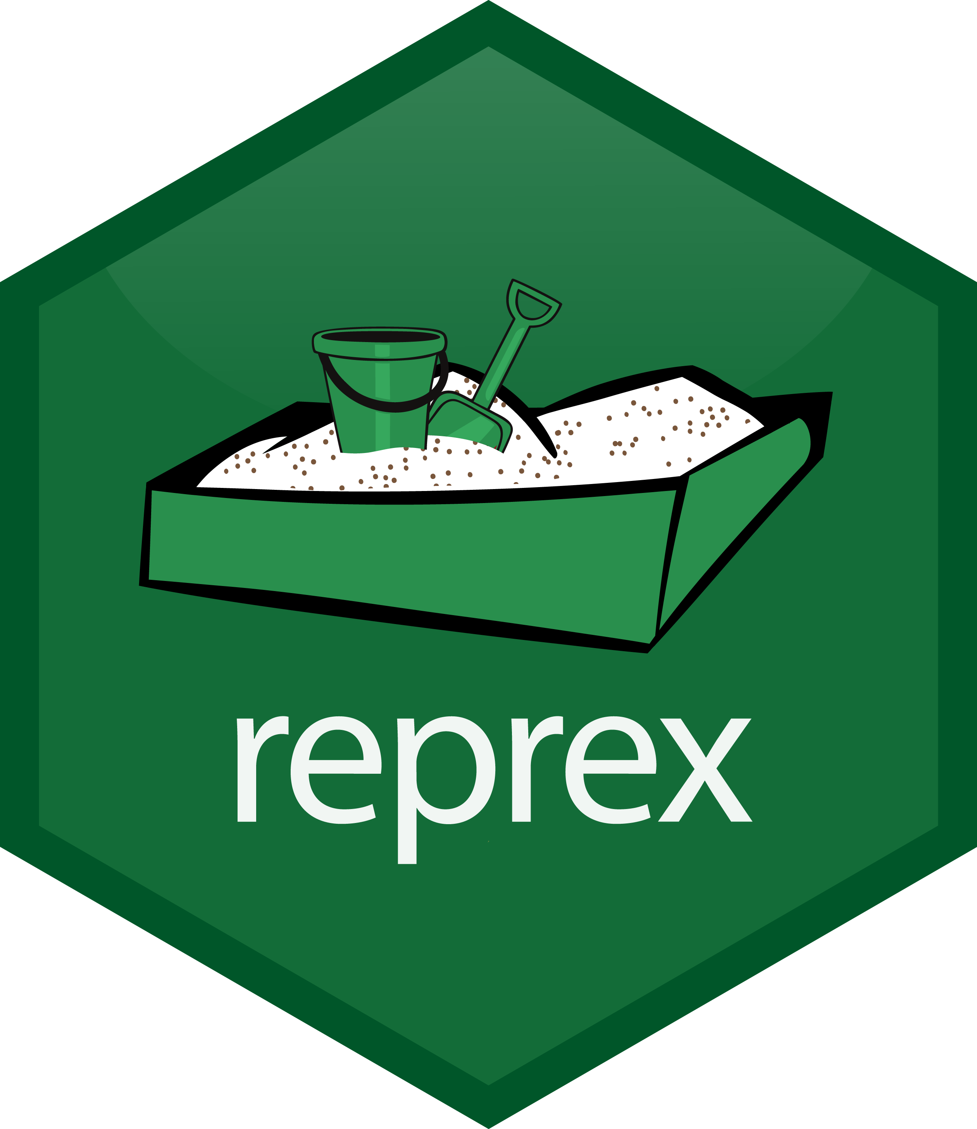
DfE Best Practice for R : : CHEAT SHEET
Software
Packages
Databases
Learning More
Write code in the RStudio IDE
Packages should be loaded in one place with successive calls to library()
Use {DBI} and {odbc} to connect to SQL
Use helper functions to create connections
Common data science tasks: use R for Data Science (2e)
Developing packages: use R Packages (2e)
Advanced programming: use Advanced R (2e)
Developing apps: use Mastering Shiny
Use git to version-control your code and analysis
Use the tidyverse for normal wrangling, plotting etc
connect_to_db <- function(db) {
DBI::dbConnect(
odbc::odbc(), Database = db,
# Hard-code common options here
)
}
(or)
Use GitHub / AZURE DevOps to collaborate with other people
Use tidymodels for modelling and machine learning
# Connect using the helper
con <- connect_to_db("DWH_PL")
Projects
Use {shiny}, {bslib} and {bs4Dash} for app development
Use r-lib packages like {rlang}, {cli} & {glue} for low-level programming
Functions
WRITING FUNCTIONS: WORKFLOW
PROJECT CREATION
Write functions to reduce repetition or increase clarity
Write many small functions that call each other
Define functions in dedicated scripts with corresponding names
a <-
b <-
c <-
d <-
Repetitive, complex code; purpose clarified by comments
Create a new project in RStudio using File > New Project > New Directory
Do put projects in C:\Users\your-name\Documents
Don't put projects in C:\Users\your-name\OneDrive - Department for Education\Documents
complex operation on a
Use {renv} in long-term projects to track dependency packages
complex operation on b
complex operation on c
GitHub stars are a good proxy for a package's quality. Not sure whether to use a package? If it has >200 stars on GitHub it's probably good!
complex operation on d
<- function(x) {
}
Complex logic abstracted into functions
operate_on
NAMING CONVENTIONS
complex operation on x
PROJECT STRUCTURE
Getting Help
✓ Good (verb-like) | ✗ Bad (noun-like)
compute_totals() | totals_getter()
fit_model() | modeller_func()
import_datasets() | project_data()
Projects are folders containing a file with the extension .Rproj. Projects should be structured something like this:
a <- (a)
b <- (b)
c <- (c)
d <- (d)
Repetition reduced; clearer code; less need for comments
CREATE A REPREX
operate_on
A minimal, reproducible example should demonstrate the issue as simply as possible
Copy your example code and run reprex::reprex() to embed errors/messages/outputs as comments
Use your reprex in a question on Teams or Stackoverflow
operate_on
operate_on
operate_on
my-project/
.gitignore tells git which files not to track
Styling
For other styling guidance, refer to the Tidyverse style guide
.gitignore
R/
Scripts in R/ should define functions for use elsewhere
NAMING THINGS
# Good (lower_snake_case everywhere):
add1 <- function(x) x + 1
first_letters <- letters[1:3]
iris_sample <- slice_sample(iris, n = 5)
# Bad (non-syntactic, not lower_snake_case):
`add 1` <- function(x) x + 1
FirstLetters <- letters[1:3]
iris.sample <- slice_sample(iris, n = 5)
01-import.R
Use lower_snake_case for most objects (functions, variables etc)
Title_Snake_Case may be used for column names
Use only syntactic names where possible (include only numbers, letters, underscores and periods, and don't start with a number)
02-tidy.R
Use SQL/, data/ etc for other file types
print("Hello " + "world!")
#> Error in "Hello " + "world!": non-numeric argument to binary operator
SQL/
costs.sql
Use a top-level R script to run everything
This reprex minimally demonstrates an error when attempting to use + for Python-style string concatenation
run-all.R
renv/
Records of package versions created using renv::init()
renv.lock
ETIQUETTE WHEN ASKING QUESTIONS
WHITESPACE
# Good (lots of spaces, indents always by +2):
df <- iris |>
mutate(
Sepal.Area = Sepal.Width * Sepal.Length,
Petal.Area = Petal.Width * Petal.Length
)
# Bad (inconsistent spacing and indentation):
df<-iris |>
mutate(Sepal.Area=Sepal.Width*Sepal.Length,
Petal.Area=Petal.Width*Petal.Length)
my-project.Rproj
A .Rproj file makes this directory an RStudio project
Don't | Do
Post screenshots of your code | Use reprex::reprex() and paste your code as text
Include big files | Use dput() or tibble::tribble() to include a data sample
Ignore messages or warnings | Ensure your code only fails where you're expecting it to
Add spaces after commas and around operators like |>, %>%, +, -, *, /, = and <-
Indentation increases should always be by exactly 2 spaces
Add linebreaks when lines get longer than 80 characters.
When there are many arguments in a call, give each argument its own line (including the first one!)
README.md
Write the main facts about the project here
NB, usethis::use_description() + usethis::use_namespace() will
turn this structure into a package!
CC BY SA The DfE R Community • github.com/DfE-R-Community • Updated: 2023-03

