Slide 1
Super Bowl Commercial: Impact of Brand Engagement & Stock Performance

Slide 2

Introduction
Investigate the impact of Super Bowl commercials on brand engagement and stock performance.
To examine if there is a relationship between the type of brand and the engagement metrics they garner during the Super Bowl ad time.
Uncover trends linking commercial types to viewership metrics through comprehensive data analysis.

Slide 3
Objective 1: Data Breakdown & Exploration
Determine if there is a correlation between the cost of Super Bowl commercial that a brand produces and the number of views it receives.
Analyze the dataset to identify top-viewed videos and least-viewed videos
Find if there was a correlation between cost vs viewers
Find the average commercial types and views it received.

Slide 4
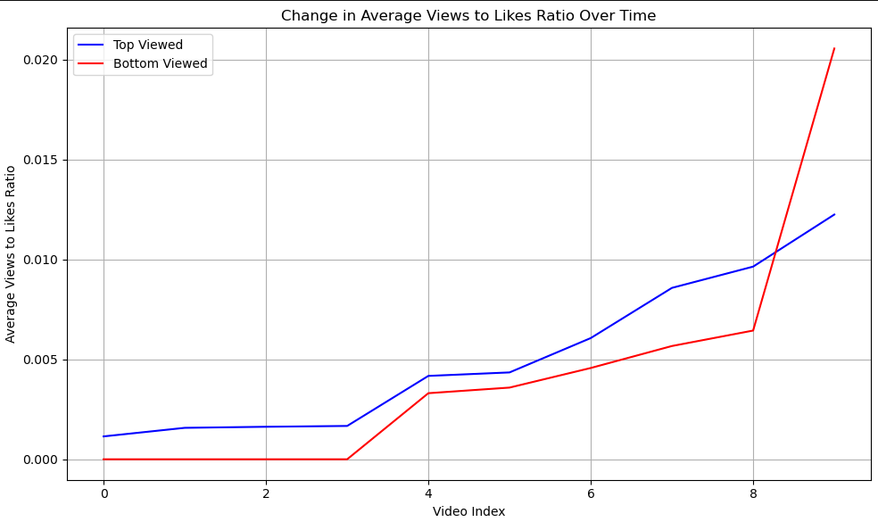
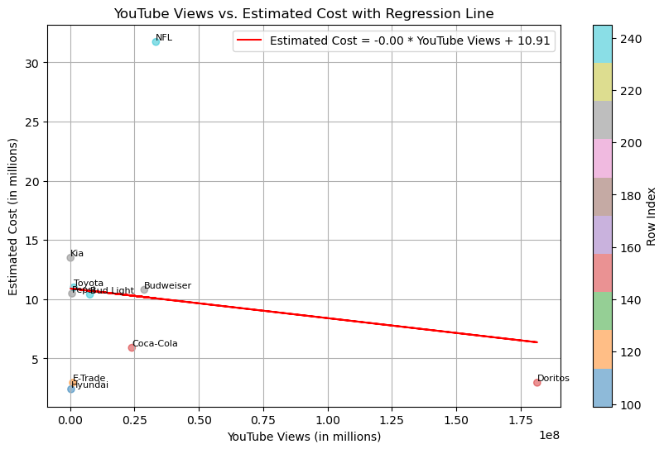
Objective 1: Data Breakdown & Exploration
Judging a video based solely on views can be misleading because views alone don’t necessarily indicate the level of engagement or satisfaction among viewers.
Instead of only looking at views, a comparative analysis was performed between the breakdowns of top-viewed and bottom-viewed commercials to identify any notable differences.
The relationship between YouTube Views and Estimated Cost, the regression line indicates that there is no discernible correlation between the cost of an advertisement and the number of views it receives. This suggests that variations in ad expenditure do not significantly influence viewership on YouTube.
Notes:
The average views-to-likes ratio over time shows contrasting trends between the top-viewed(blue) and lower-viewed(red) videos. The spite in the red ratio suggests fewer engagements, likely due to the smaller number of views compared to the top viewed where the engagements were significantly larger.

Slide 5
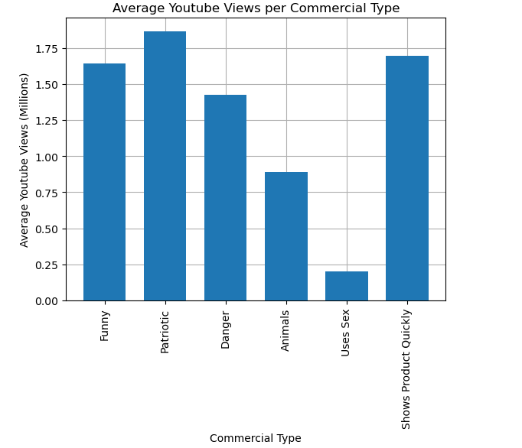
Objective 1: Data Breakdown & Exploration
The type of marketing a brand chooses to use plays a critical role in the success of a product that brand is trying to market. As data analysts we wanted to see if there was a relationship between commercial types and the YouTube views they receive. To test this theory, we grouped the commercials in the dataset by commercial type then took the average YouTube views for each type of commercial a brand could produce. Based on our findings, we concluded that super bowl commercials that are either patriotic, funny or shows the product quickly tend to have more success when it comes to the number of views they receive

Slide 6
Objective two: Analysis of commercial types
Examining the relationship between type of brands and the engagement metrics they garner during.
Analyzed the most used commercial strategies.
Find the differences between the viewer engagement per industry on the views and likes it received.

Slide 7
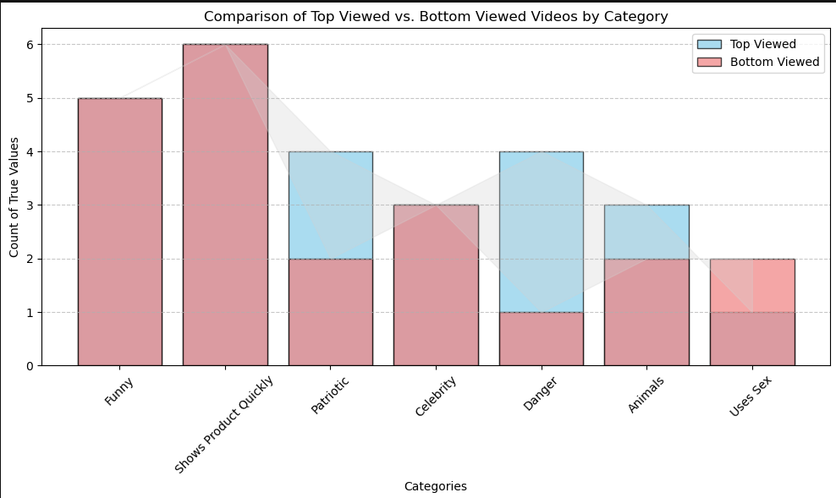
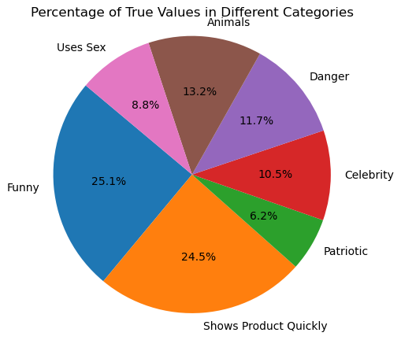
Objective two: Analysis of commercial types
Analyzing the content of an ad, particularly elements like humor and animal presence, provides valuable insights into audience engagement, messaging effectiveness, brand perception, and cultural relevance, ultimately informing strategic decisions and optimizing advertising outcomes.
The figure below shows the most used strategies companies used in their advertisements between 2000-2021.
This graph compares the top viewed and bottom viewed videos to understand if there were any differences in advertisement content that would contribute as to why an ad did well or not. Based on our findings, top viewed ads had more patriotic themes, animals and danger, but used sex less as a selling point.

Slide 8


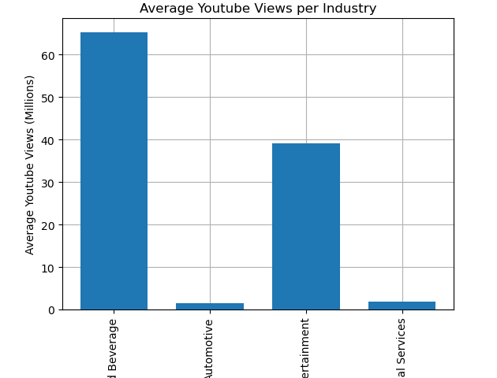
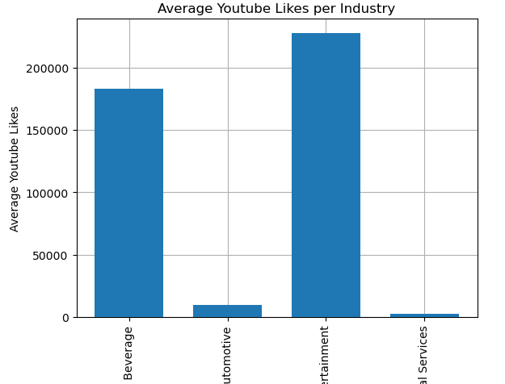
Objective two: Analysis of commercial types
The industry types a brand conducts business in is pivotal to their business and investment decisions. Different industries have different impacts on consumer needs and wants which plays a huge role in the engagement metrics they garner. Based on our analysis, brands that operate in the food and beverage industry tend to have more success when it comes to YouTube views, while brands that operate in the sports and entertainment industry that had the most success when it came to YouTube likes was sports and entertainment.

Slide 9
Objective 3: Cost and Stock Performance Analysis
To assess whether the success of Super Bowl commercials has a noticeable impact on stock performance and offer correlations between present and future cost of advertisement.
Identified the most viewed video and conducted performance and cost analysis.
Evaluated the estimated advertising cost for both specific commercial and industries.
Analyzed the potential impacts of successful advertising campaigns.

Slide 10
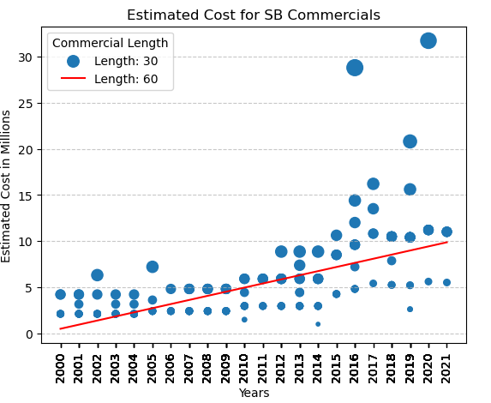
Objective 3: Cost and Stock Performance Analysis
Focusing on the most-viewed and most-liked brand an analysis of cost and stock performance was conducted.
Understanding the estimated cost to advertise plays a factor in whether an ad campaign is judged “successful” or not.
Using the data, we were able to graph the advertisement cost from 2000-2021. Although, not surprising, the graph shows the steady increase in cost to advertise over time, this is useful to understand for future projects.

Slide 11
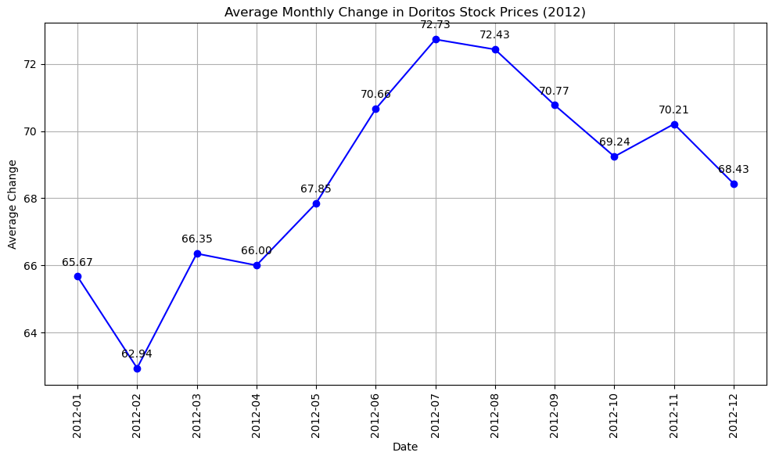
Objective 3: Cost and Stock Performance Analysis
The most viewed video in the dataset was a 2012 Doritos commercial. Analyzing stock data for Pepsi(PEP), the parent company, a dip in prices in February followed by a rise in March suggests the Super Bowl advertising campaign may have influenced stock growth

Slide 12
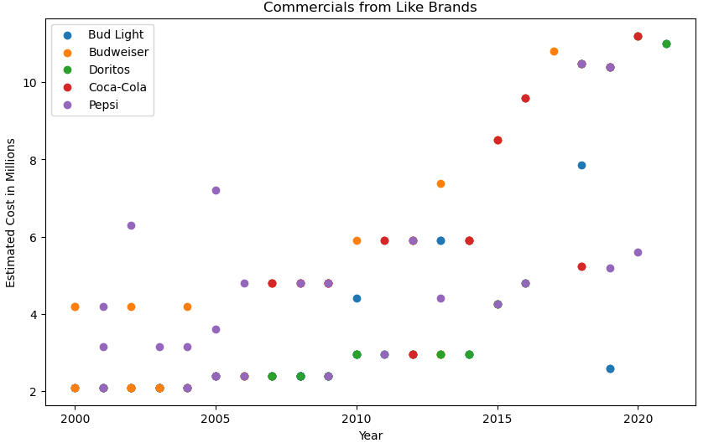
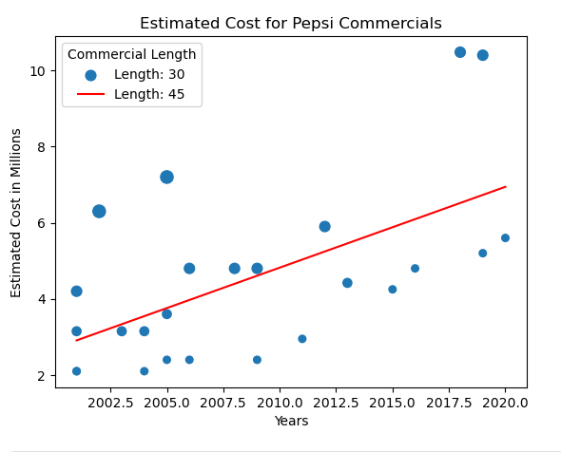
Objective 3: Cost and Stock Performance Analysis
Knowing the advertising costs for similar products or brands helps companies benchmark their own advertising spending against competitors. It provides insights into industry norms and competitive dynamics, allowing companies to assess their competitiveness and adjust their marketing strategies accordingly.
As seen on the top figure, we found like brands to the top-viewed video and compared their advertisement costs to understand potential return on investments of the market efforts.
The bottom figure, further expands on the Pepsi brand, to factor into the estimated cost of advertisement in relation to the “successfulness” of the ad-campaign for Doritos.

Slide 13
Summary
Investigate the impact of Super Bowl commercials on brand engagement and stock performance.
Based on the data analysis done, it showed that there is a potential link to successful ad-campaigns in relation to the company’s stock performance. With a well-executed ad a company can bolster brand visibility and further consumer engagement.
To examine if there is a relationship between the type of brand and the engagement metrics they garner during the Super Bowl ad time.
Based on our analysis, brands that operate in the food and beverage industry tend to have more success when it comes to YouTube views, while brands that operate in the sports and entertainment industry that had the most success when it came to YouTube likes was sports and entertainment.
Uncover trends linking commercial types to viewership metrics through comprehensive data analysis.
After analyzing the data found, we found advertising trends are dynamic and subject to rapid shifts in consumer preference. While ads can contain similar metrics, the successfulness can come down to more factors than it is available to analyze at this time.

