Slide 1
GitRepositoryAnalysisSystem
(GRAS)
教授:劉建宏教授
組別:第二組
組員:110598096 劉文揚 110598087謝狄烽
110598055林妤潔 110598085曹智凱
http://www.free-powerpoint-templates-design.com

Slide 2
CONTENTS
01
Process
02
Team Meeting
03
Task Assignments & Scheduling
04
User Story
05
System Block Diagram
06
WBS
07
Time Log

Slide 3
Process

Slide 4
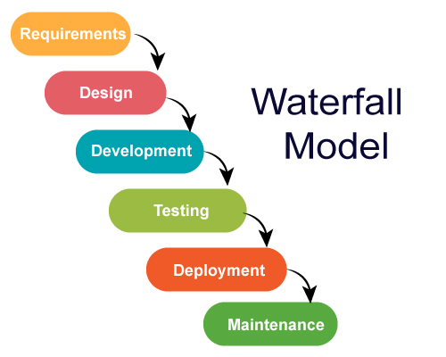
Process

Slide 5
Team Meeting

Slide 6
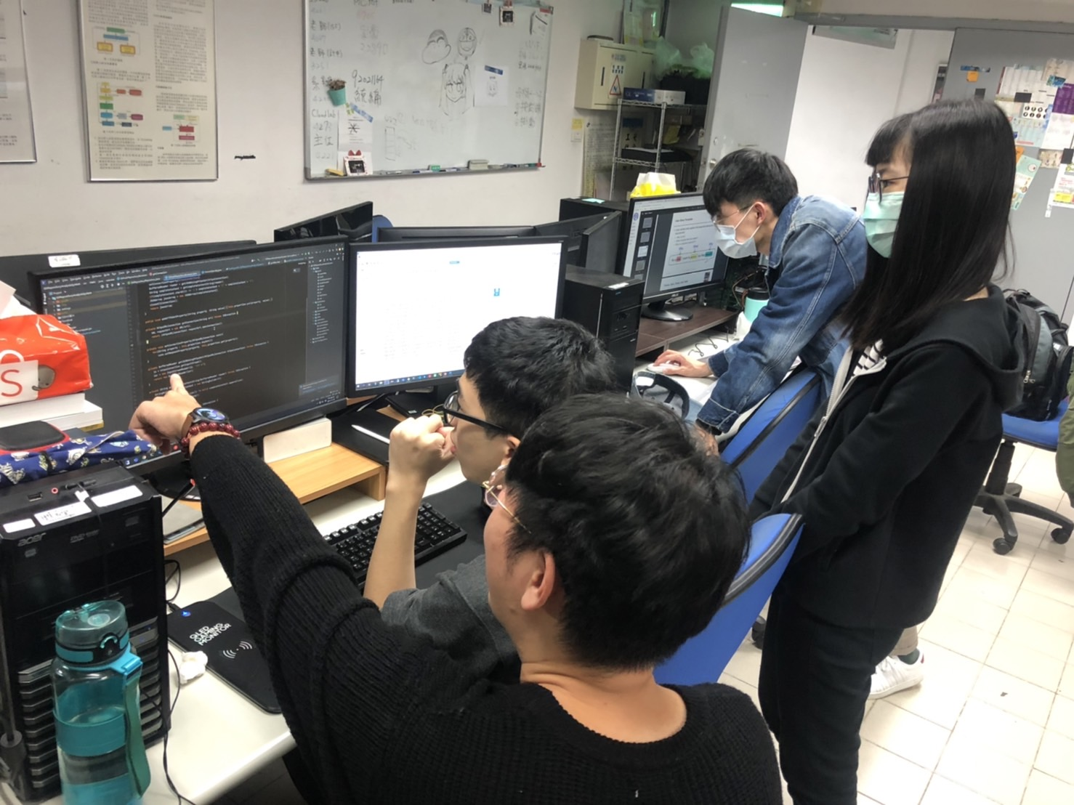
Team Meeting

Slide 7
Task Assignments &
Scheduling

Slide 8
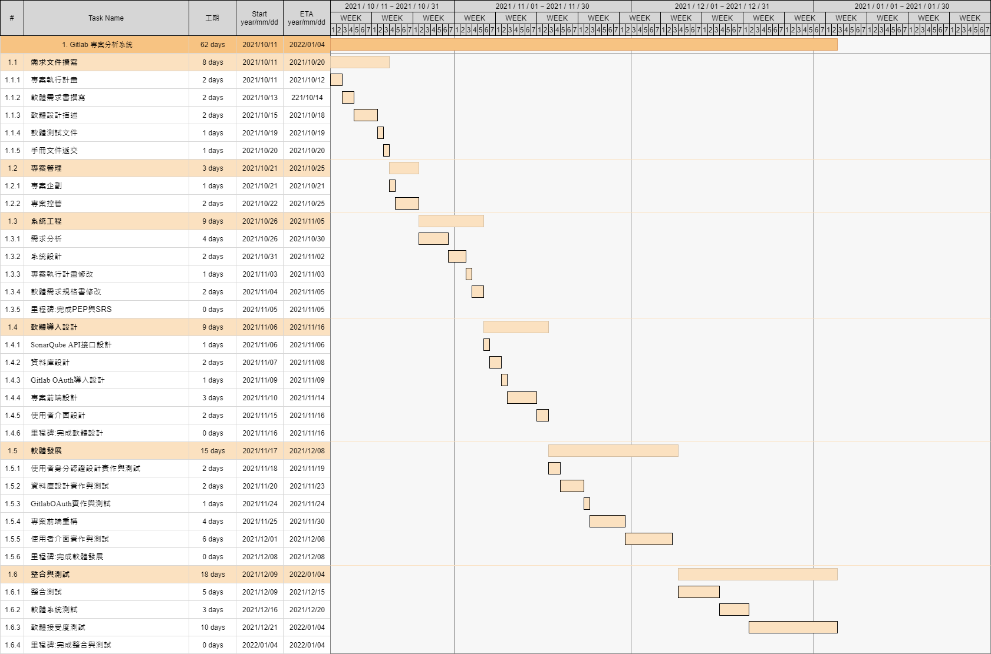
Task Assignments & Scheduling

Slide 9
User Story

Slide 10
User Story
WHAT
WHY
WHO
Login
Tracking Project
Analysis Project
Manage
User
Import multiple Project
Compare
Check issue
Improve

Slide 11
System Block Diagram

Slide 12
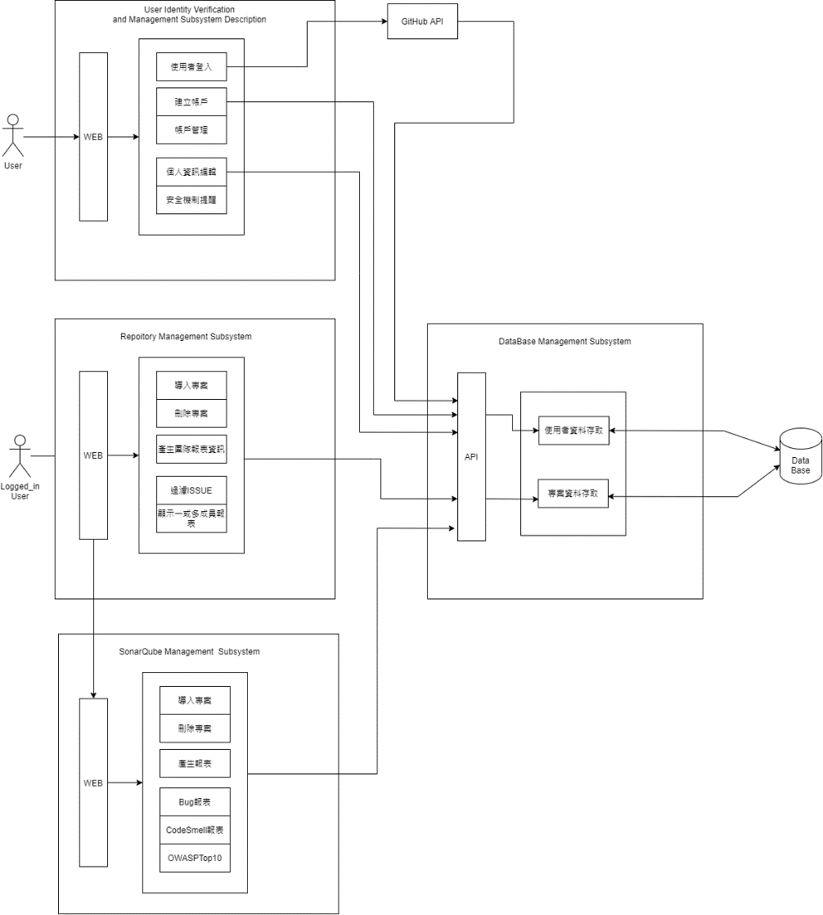
System
Block
Diagram

Slide 13
WBS

Slide 14
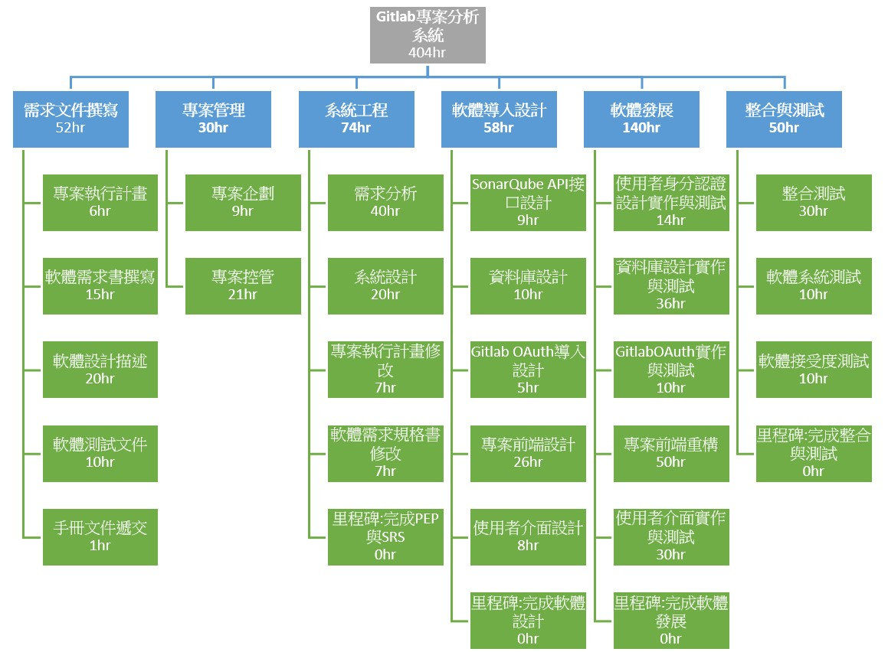
WBS

Slide 15
Time Log

Slide 16
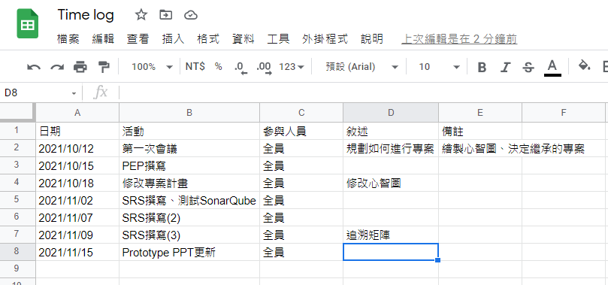
Time Log

Slide 17
Thank you

