Slide 1
Summit Voice AI × QualifyOS
The Future of Customer Service & Sales
What We've Been Building
Dan Gill & David Newsom
February 13, 2026

Slide 2
Our Journey
2020
🚀
Started Summit Marketing Group
Dan's entrepreneurial foundation – Started Summit Marketing Group
Dan & David
College roommates turned co-founders.
Two decades of friendship, one shared mission: build technology that actually helps people.
Not just for the $$$ — for the impact.
Built First Voice AI Systems
2023/24
🧠
Started building Voice AI Systems - The hard way — no plug-and-play shortcuts
2025
🏥
Pitched Aetna on Voice AI
Saw the healthcare opportunity early
Found the biggest ROI in home services – Niched down with SummitVoiceAI into the Roofing Industry
2024
🏠
Niched Down to Roofing
AI-powered sales operating system – QualifyOS – The only PreCRM sales operating system powered by ai for the complete sales cycle.
Late 2025 /Early 2026
⚡
Built QualifyOS
2025
🤝
M/W/F Masterminds Begin
Dan & David: 9:30pm hackathons after the kids are asleep
Launching QualifyOS, FlyByDate, scaling Summit Voice AI, and changing healthcare for the people it matters most to
Now
🎯
Building the Future

Slide 3
Why Roofing First?
The Results
Missed Calls
💰
40%
→
0%
Biggest ROI in home services
📞
Clear pain points (missed calls = lost revenue)
Response Time
4 hours
→
Instant
🤖
24/7 Voice AI receptionist
⚙️
Backend automation stack
Conversion Rate
12%
→
34%

Slide 4
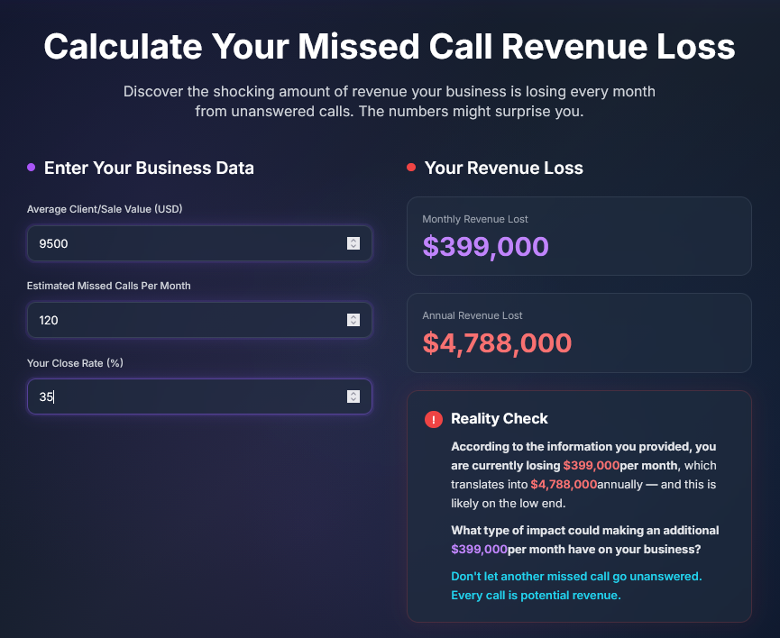
Because of the ROI

Slide 5

What We Saw in Healthcare
$262 Billion in claims denied annually — and it's only getting worse
⏰ 45+ min wait times
🔄 IVR mazes making it worse
😤📞
💰 $5M+ lost per provider yearly
📱 Reddit/Facebook complaints, no one listening
What if someone actually listened?

Slide 6
The $262 Billion Opportunity
The Healthcare Administration Crisis
$262B
in claims denied annually from $3 trillion submitted
68M
Medicare Beneficiaries (2026)
85M
Medicaid Enrollees
$1.2T
Total Medicare Spending
10,000
Americans Turn 65 Every Day
51% denial increase since 2021 • CMS now mandating AI prior authorization pilots • 10,000 aging into Medicare daily

Slide 7




The Idea: Find Them First
The Power of AI-Infastructure
🔍 Discovery
🧠 Intelligence
⚡ Response
✅ Resolution
→
→
→
6 AM
7 AM
8 AM
All Day
Reddit — r/insurance complaints
Pain Points — Extraction & tagging
📞 Phone — High priority → call
🗣️ Dialogue — Natural conversation
Facebook — Medicare groups
Contacts — Enrichment
💬 SMS — Medium → text
📊 Options — All plans
LinkedIn — Healthcare discussions
Urgency — Scoring (1-10)
📧 Email — Low → resources
✅ Match — Best fit
Blogs — Comment sections
Routing — Channel assignment
🔗 Connect — Handoff

Slide 8
How It Actually Works
6 AM
🔍
Discovery Phase
Reddit posts about insurance problems
Facebook group complaints
LinkedIn healthcare discussions
Blog comment frustrations
7 AM
🧠
Intelligence Phase
Extract struggles & pain points
Find contact information
Score urgency (green → yellow → red)
Route to appropriate response
8 AM
⚡
Response Phase
High priority → Phone call
Medium → SMS outreach
Low → Email with resources
All Day
✅
Resolution Phase
Voice AI conversation
Access ALL insurance options
Find best fit & connect to provider
Automated follow-up

Slide 9

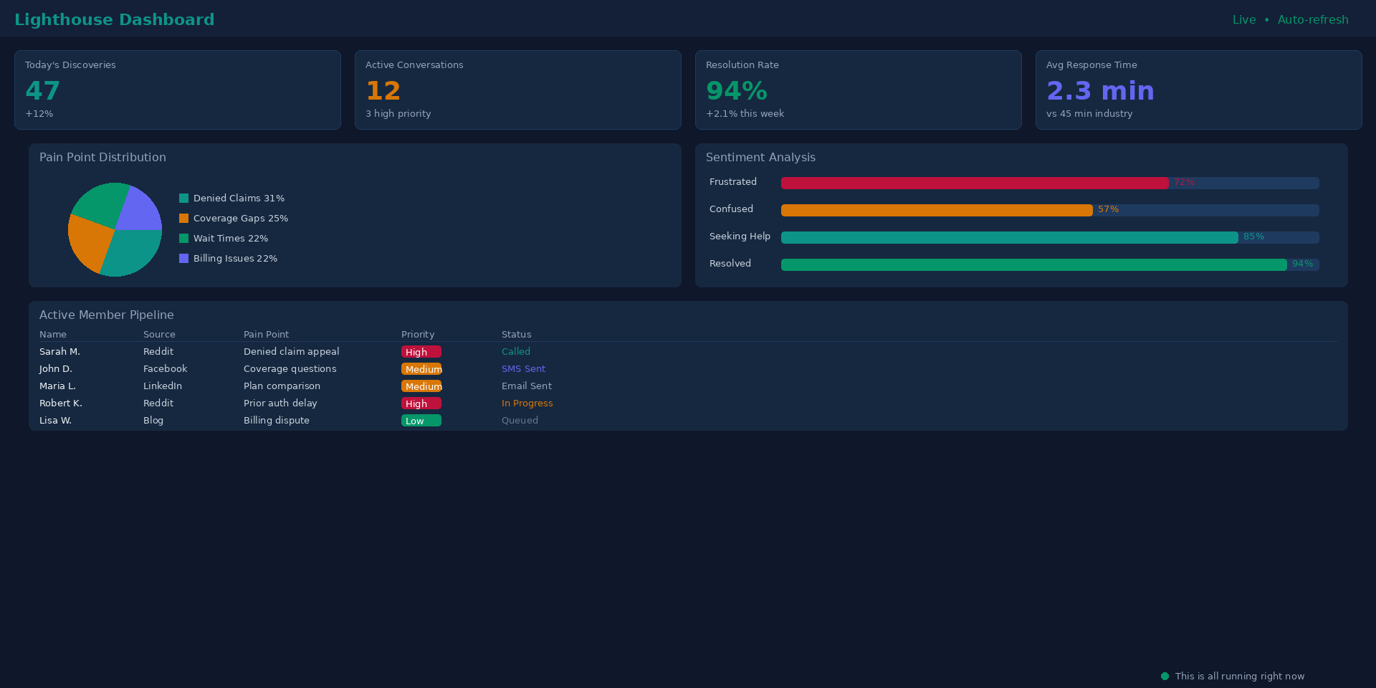

ServiceHive Dashboard
Real-Time Member Discovery & Engagement

Slide 10


QualifyOS + Summit Voice AI
The voice people actually want to talk to
🌐
24/7 Multilingual Support
27+ languages, always on
💬
Empathetic, Not Robotic
Trained on real conversations
🏥
CMS-Trained for Healthcare
Compliance-ready from day one
🔄
Real-time Translation
Break language barriers instantly
🔌
Integrates with Any System
Member: "I'm confused about my prescription coverage..."
API-first, plug and play
AI: "I understand. Let me look at your plan and explain your options clearly..."

Slide 11
Why We Win
Built Different From Day One
95%+
Automation Rate
Competitors achieve 60-70%. Our agentic AI handles routine claims with zero human touch.
48 Hours
Implementation Time
vs. 6-12 months with legacy systems. 500 charts to train, not 10,000+.
65%
Denial Reduction
Plus 40% admin cost savings and 5+ day reduction in A/R — within 90 days.
1st
Unified Platform
First to combine insurance operations + provider tools + member portal in a single ecosystem.
Real-time CMS policy updates • Instant eligibility verification • Predictive denial prevention

Slide 12
Same Tech Stack, Different Problems
🏠
Roofing
🔧
Home Services
🛡️
Insurance Brokers
▸ 0% missed calls
▸ 24/7 booking
▸ Instant quotes
▸ 34% conversion
▸ 3x lead capture
▸ Auto-qualification
📞
Call Centers
🎯
Customer Service
📦
Complex Products
▸ 87% automation
▸ 2 min resolution
▸ Guided selling
▸ 60% cost reduction
▸ 4.8★ rating
▸ 2x close rate

Slide 13
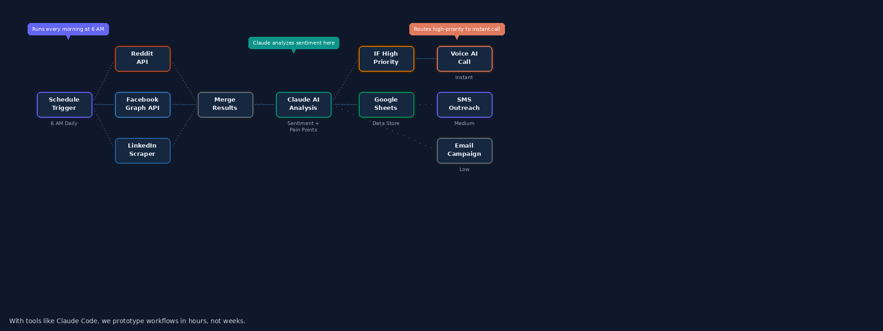
The Automation Engine
Built with n8n + Claude Code
With tools like Claude Code, we prototype workflows in hours, not weeks.
n8n
Claude AI
Voice AI
Google Sheets
Replit
Reddit API

Slide 14
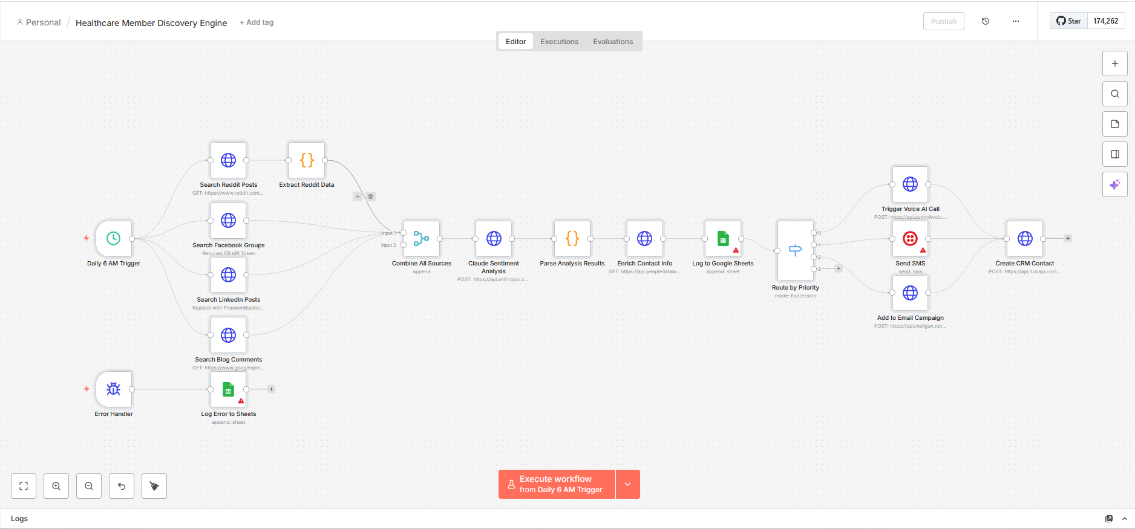
The Automation Engine
Built with n8n + Claude Code
Unlimited people with a true need – and that is the problem. They are asking for help in all the wrong places because they can’t trust the healthcare system to give honest advice. At times they can’t even reach someone that who can actually help…
Daily Search
Across All Networks
Store/Update Data
Reach Out
Help
Support

Slide 15
The Revenue Engine
Triple-Layer Revenue Model
💰
Insurance Premiums
$200-300 PMPM
▸ CMS capitation payments
▸ State Medicaid contracts
▸ Member premium collections
▸ Risk adjustment optimization
⚡
SaaS Platform
$50-150 /provider/mo
▸ Claims automation platform
▸ Prior authorization AI
▸ Analytics & reporting suite
▸ API access & integrations
📈
Performance Revenue
15-25% of Savings
▸ Denial reduction guarantees
▸ Shared savings contracts
▸ Value-based care bonuses
▸ Quality metrics improvements
70% Gross Margin • 8-Month CAC Payback • Scalable Across All Verticals

Slide 16



What's Next
Summit Voice AI
QualifyOS
▸ Expanding beyond roofing
▸ Launching publicly Q2 2026
▸ Launching publicly Q3 2026
▸ Proactive member discovery
⚡
▸ Healthcare, home services, call centers
▸ 40+ offer templates trained
▸ Airport-verified dating & Networking
▸ Multi-source intelligence
▸ 24/7 multilingual support
▸ 1,800+ document knowledge base
▸ AI-Powered FlyScore matching
▸ Voice AI orchestration
▸ Integration-ready
▸ Live AI sales coach
▸ Time-synced connections during layovers
▸ Changing how insurance listens
▸ Built from 4 months of obsession
▸ Zero direct competitors
▸ Built from 10 years of vision
This is what we do at 9:30pm after the kids are asleep. Imagine what we could do with more time.

Slide 17
Thanks for connecting.
Let's keep building.
Dan Gill • dan@summitmktggroup.com • (757) 329-5913
David Newsom • davidnewsom5@gmail.com

