Slide 1

Hi! I’m Degly
Extended Realities Enthusiast
and Systems and Computer Engineer

Slide 2
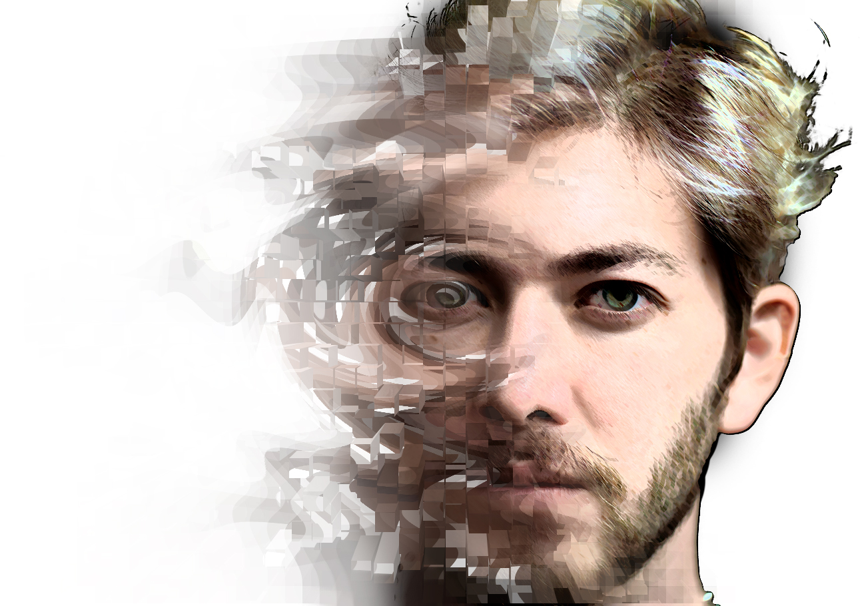
I am
an
innovator
Check out my projects

Slide 3
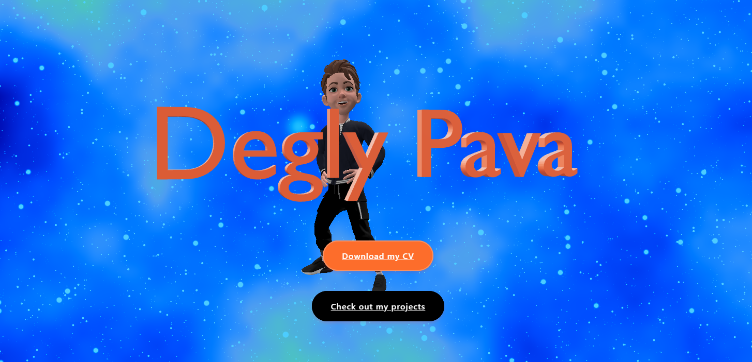
https://www.deglypava.com

Slide 4
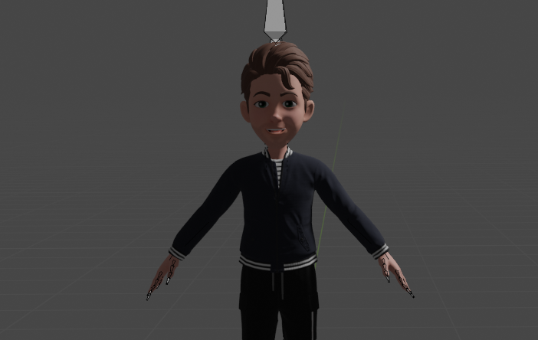


Check my website for an interactive portfolio
Developed a personal website to showcase projects and skills, featuring a uniquely generated background using GLSL and Three.js.
Adapted a Samsung AR Emoji as the centerpiece model, which is animated and rigged for dynamic visual effects. He dances!
Animated the model through Mixamo, adding dynamic movement and personality to its appearance.
Designed a distinct version of my name's model in Blender, allowing its placement anywhere in the real world via Google's augmented reality Model Viewer.
Enhanced user engagement by integrating interactions and animations utilizing Three.js, providing a dynamic and immersive experience on the website.

Slide 5
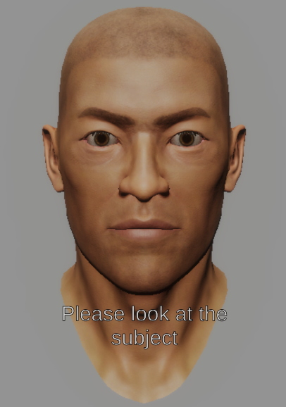
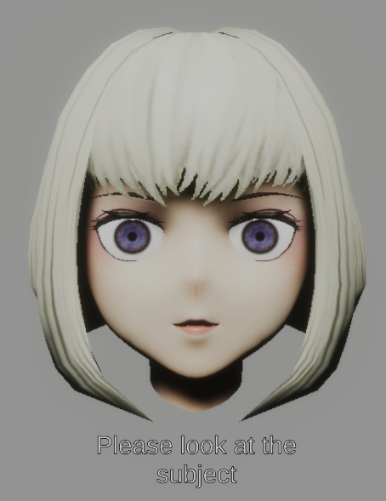
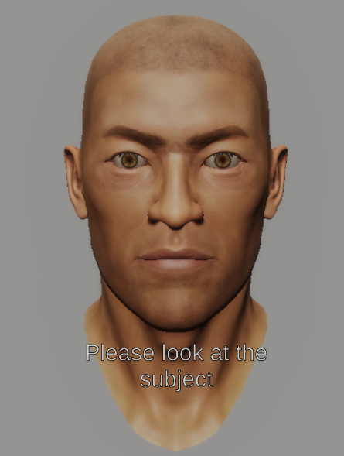
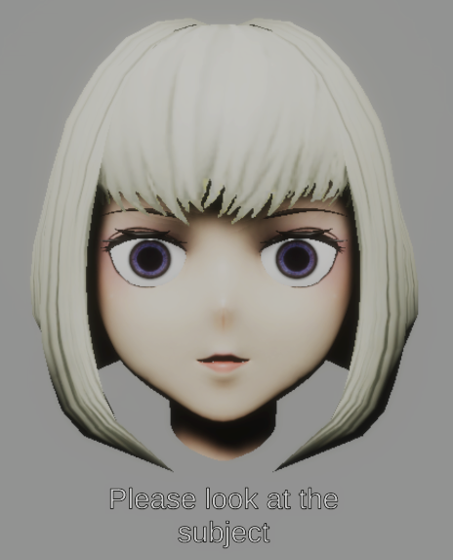
Pupil Mimicry in HCI with Virtual Agents

Slide 6
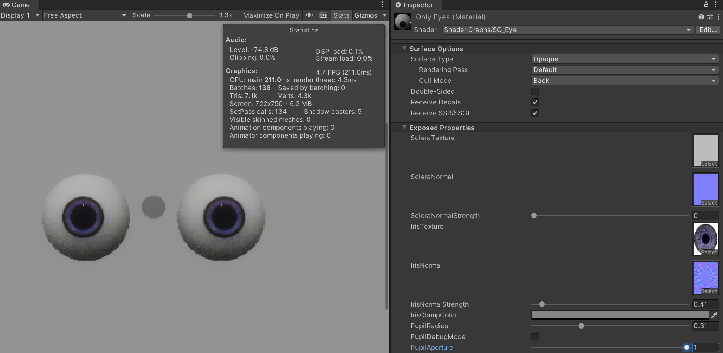
Pupil Mimicry in HCI with Virtual Agents
Designed and developed an interactive Unity environment using OpenXR and Blender to explore pupil mimicry.
Managed to create realistic real-time pupil changes.
Proved that Humans feel a connection with a virtual avatar and generate social unconscious responses.
Integrated C++ and C# scripts for precise eye-tracking integration, enhancing the realism of the experience.
Implemented advanced programming concepts including Dependency Injection and Reactive Programming for efficient code organization and responsiveness.
Prioritized a seamless user experience (UX) design for smooth and intuitive interactions within the environment.

Slide 7
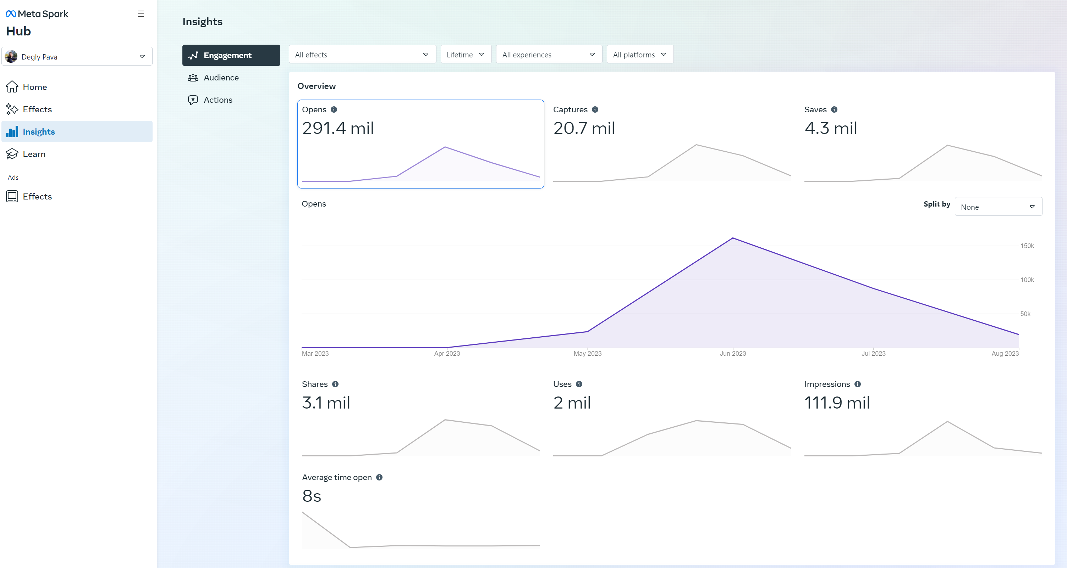
Augmented Reality Filters

Slide 8
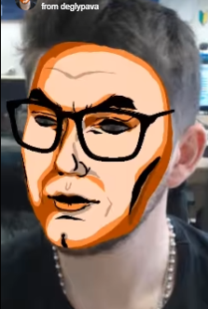
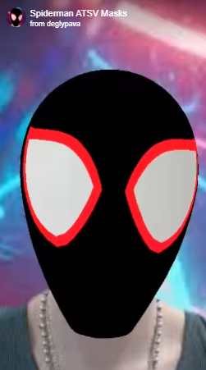
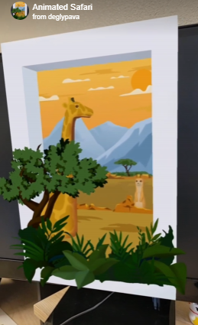
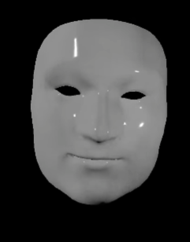
Augmented Reality Filters
Developed compelling filters and augmented reality (AR) experiences for TikTok, Snapchat, and Instagram, accumulating an impressive 291.4 mil lifetime interactions.
Utilized a diverse range of lens creation tools, including Lens Studio, TikTok Effect House, and Spark AR, to craft innovative and interactive visual content that resonated with users.
Hold certifications as a Meta AR Certified Developer and Spark AR Developer, underscoring expertise in the field.

Slide 9
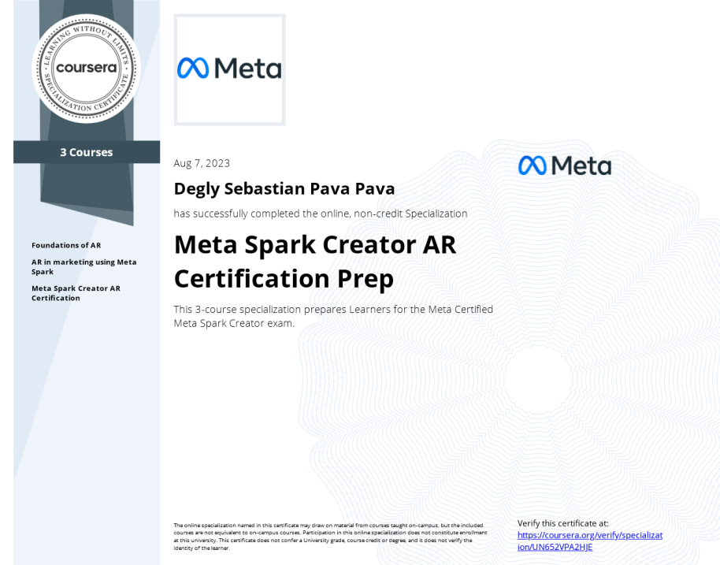
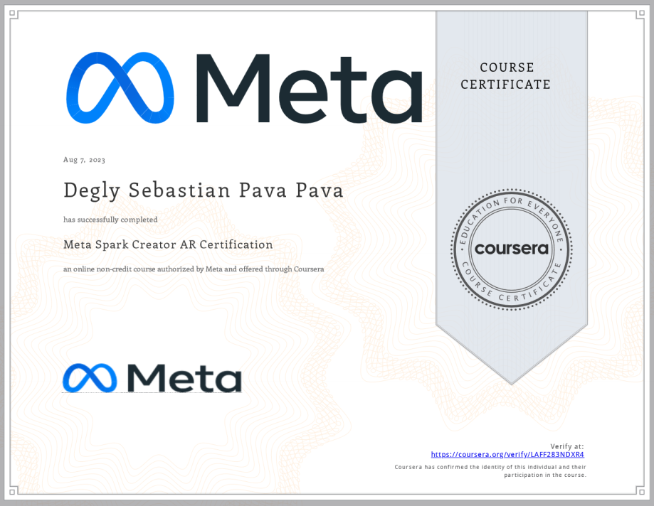
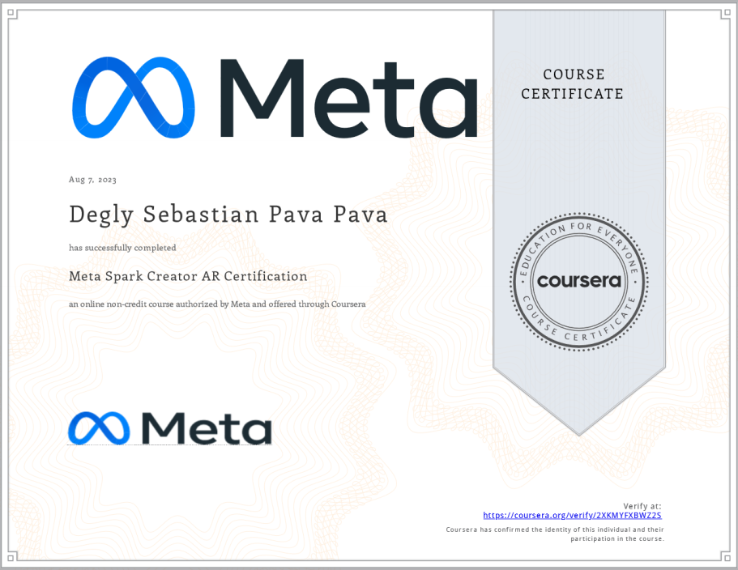
AR Certificates
Obtained through Coursera, more certificates at the end

Slide 10
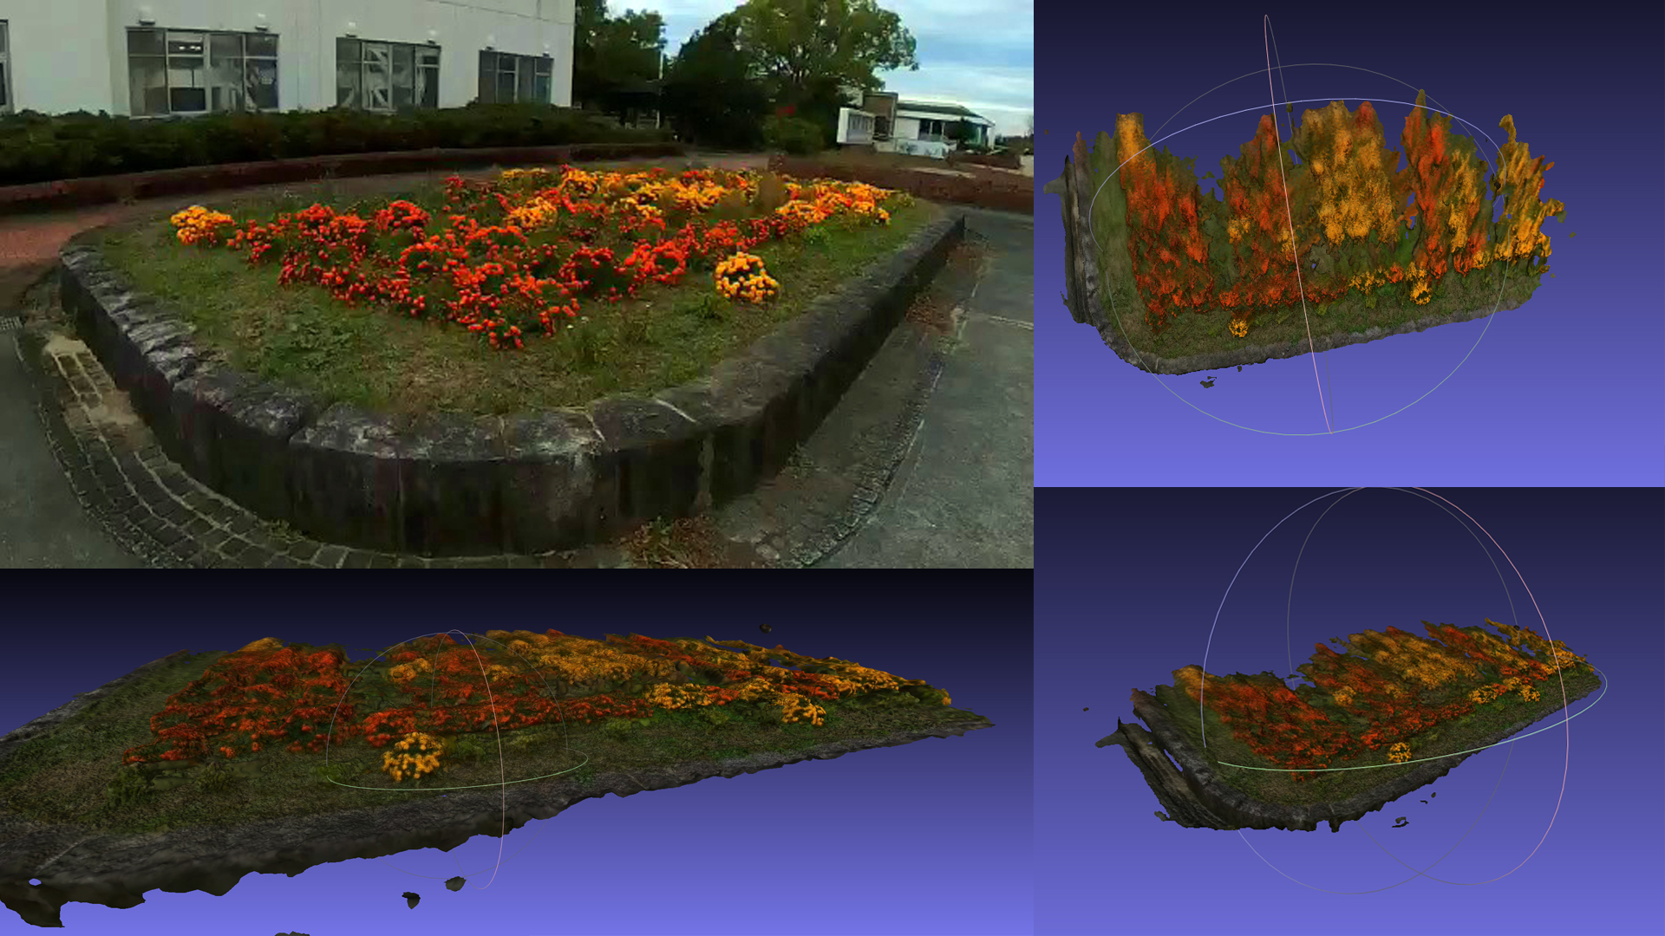
3D RECONSTRUCTIONS USING COLMAP AND MESHLAB

Slide 11
3D RECONSTRUCTIONS USING COLMAP AND MESHLAB
Accomplished an outdoor scene reconstruction through the analysis of 1983 frames extracted from a video.
Executed feature extraction on COLMAP to create a detailed mesh.
Translated the extracted mesh into usable data on Blender using MeshLab.
The project showcases expertise in 3D reconstruction, feature extraction, and mesh processing, contributing to an in-depth understanding of spatial modeling.
Project can be used to create AR Scans of people and objects.

Slide 12
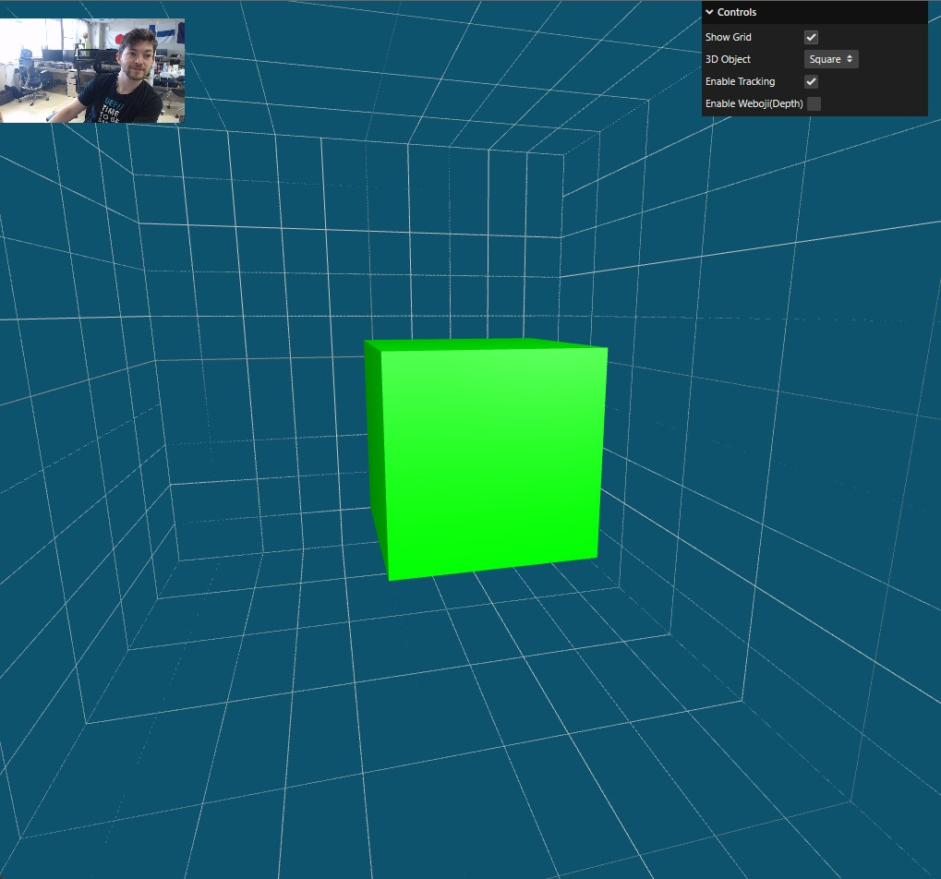
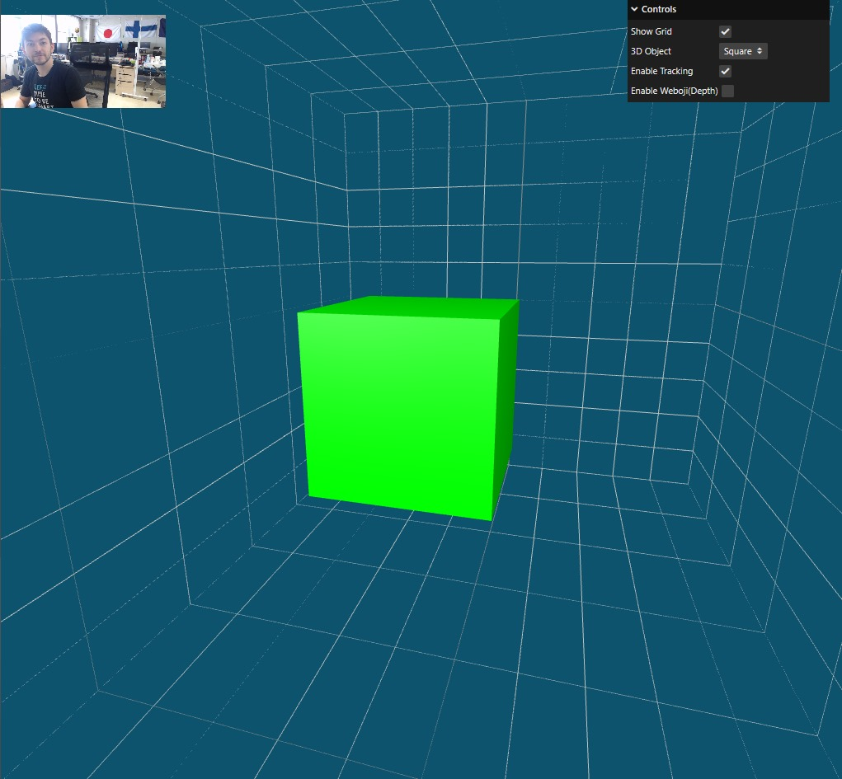
Using MediaPipe to create a Parallax effect

Slide 13
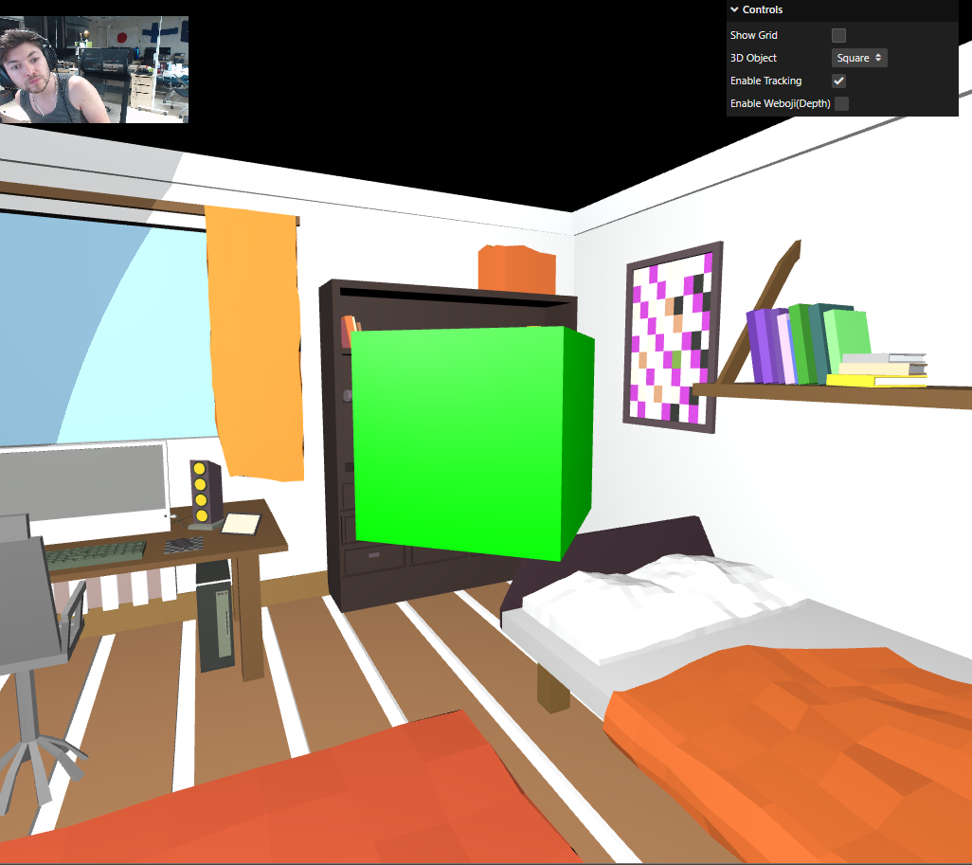
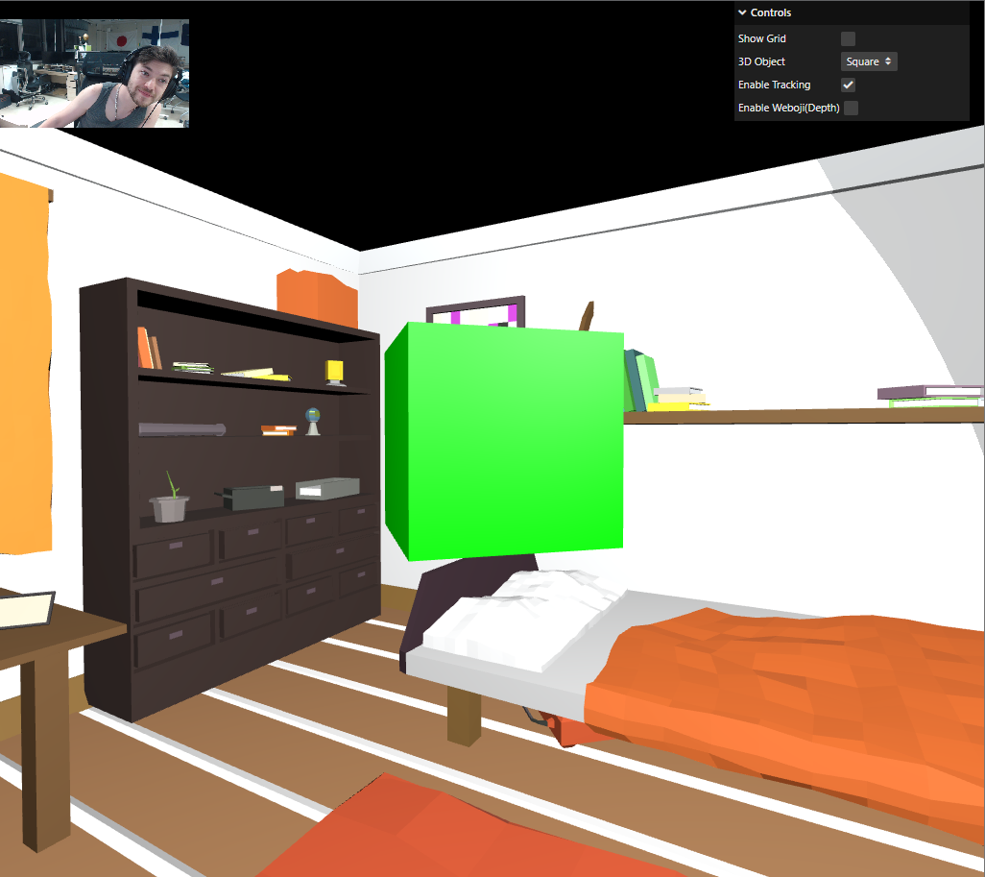
Using MediaPipe to create a Parallax effect
Captured and processed facemesh data from a webcam feed using MediaPipe.
Applied this data to accurately track user movements and actions.
Implemented the tracked movements to create a Motion Parallax effect, enhancing augmented reality experiences without a 3D screen.
Showcased the ability to bridge computer vision and interactive design to create engaging user interactions.

Slide 14
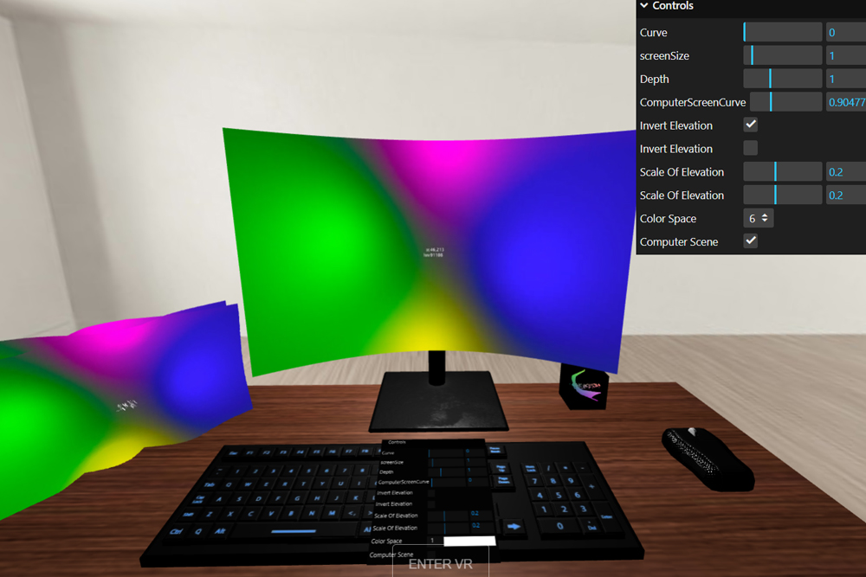
REALTIME RENDERED 3D VISUALIZER

Slide 15
REALTIME RENDERED 3D VISUALIZER
Created a real-time 3D visualizer using THREE-JS (a JavaScript 3D library) and GLSL (OpenGL Shading Language).
Developed a web simulation with a research focus, allowing users to visualize color composition and light elevation within a chosen video.
Extended the experience to virtual reality (VR), providing compatibility with the Oculus Quest 2 headset.
Demonstrated proficiency in WebGL programming and VR integration, contributing to an immersive and interactive visualization tool.
The project showcases expertise in 3D graphics programming, shader development, web simulation, and VR technology.

Slide 16
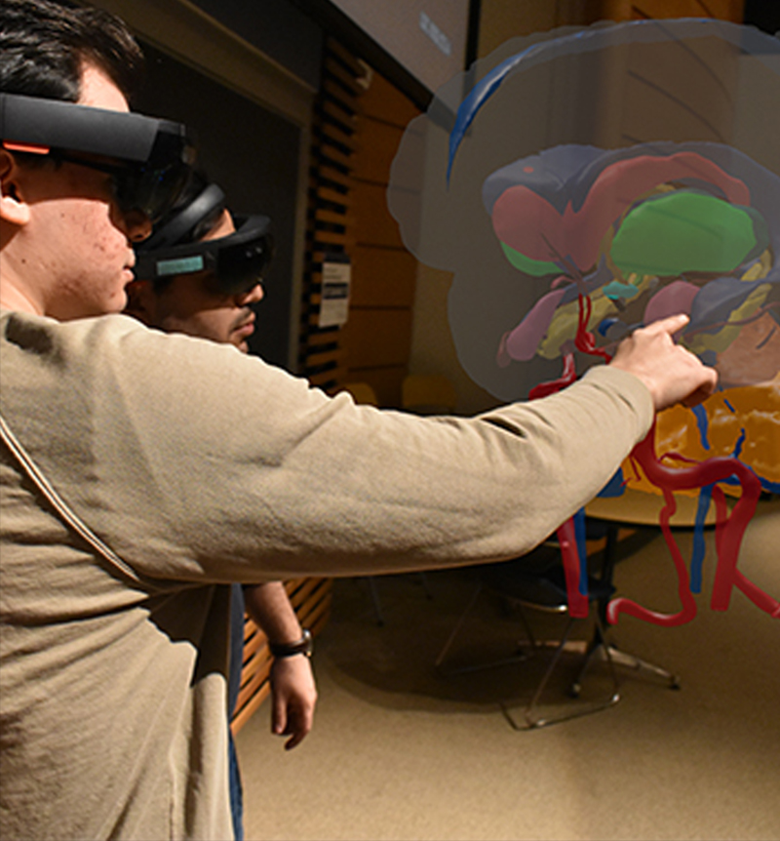
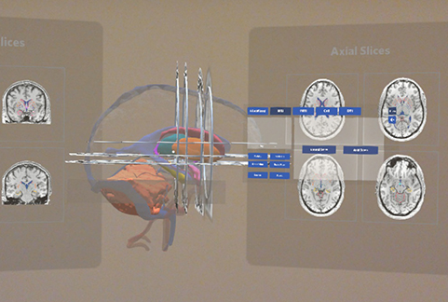
HoloBrain 2.0

Slide 17
MRI-derived brain volumetric rendering on hololens
Developed a C++ shader-based approach to convert MRI brain scans created in Blender into immersive volumetric 3D animations for the HoloLens.
Skillfully applied principles of 3D Math, Linear Algebra, Computer Graphics, and OpenGL to achieve the transformation.
Utilized Unity for crafting a user-centric design, ensuring a seamless and intuitive user experience.
Developed an educational tool utilizing holographic technology to present a floating 3D brain model.
Benefitted from the capabilities of mixed reality technology to provide an immersive and interactive learning experience.

Slide 18
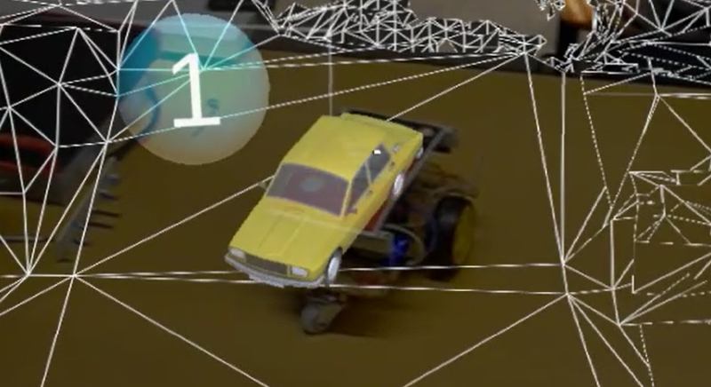
HoloLens AR Car Tracking Game

Slide 19
HoloLens AR Car Tracking Game
Developed an augmented reality (AR) car tracking project utilizing Vuforia Image Trackers.
Designed an Arduino-based car model integrated with the tracking system.
Leveraged a HoloLens device to create an OpenXR Application.
Resulted in a unique gaming experience reminiscent of Mario Kart, where players receive power-ups upon interacting with designated AR markers.
The project underscores expertise in AR technology, hardware integration, and application development, showcasing a playful and engaging use of mixed reality.

Slide 20
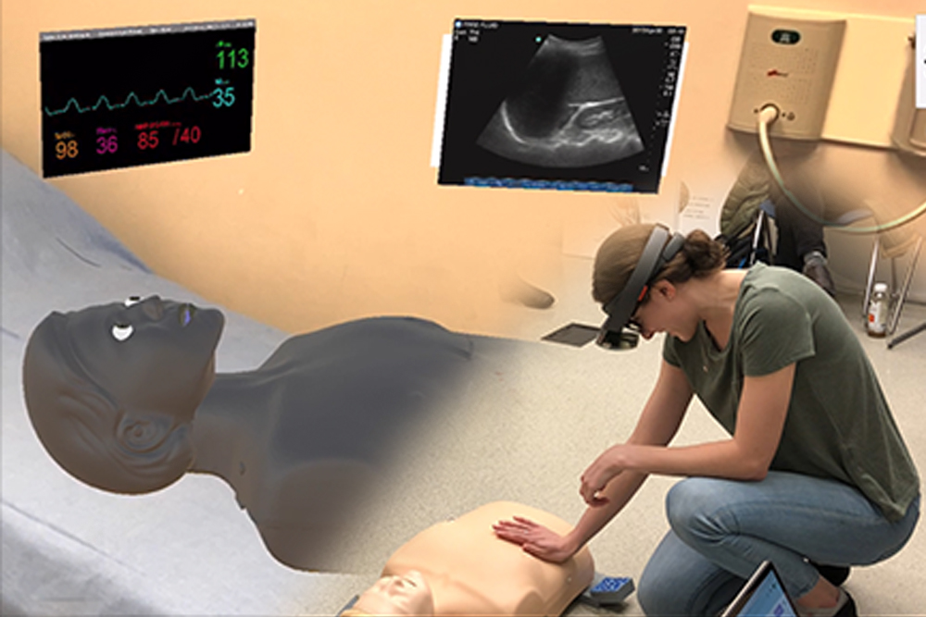
Mr Manikin Online Clinical Simulation

Slide 21
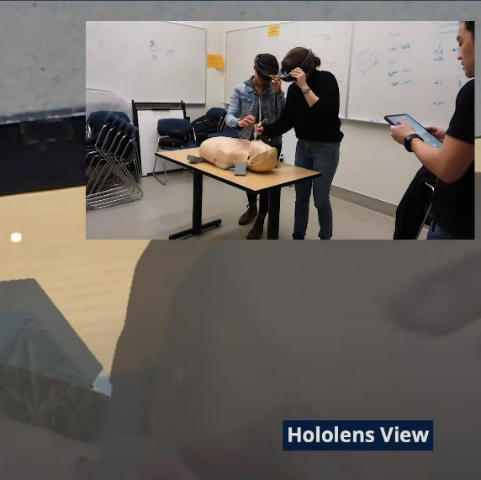
Mr Manikin Online Clinical Simulation
Utilized augmented reality to animate Annie, a mannequin instructor, enhancing the teaching of medical techniques like PCR.
Employed ARCore and ARKit for mobile development, ensuring compatibility across Android and iOS platforms.
Integrated Photon to enable real-time synchronous multiplayer functionality, enhancing collaborative learning experiences.
Employed a combination of collaboration tools, including Slack, Jira, and Git, during the game design phase, promoting seamless teamwork among a diverse team of over 10 members.

Slide 22
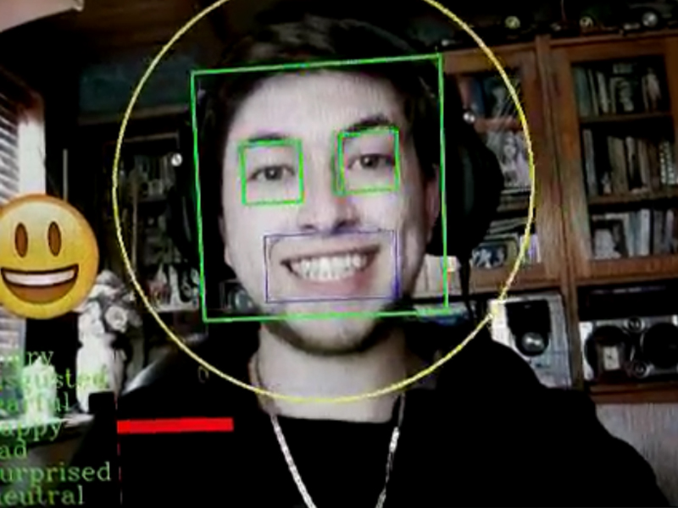
Facial Emotion Recognition with Deep CNN

Slide 23
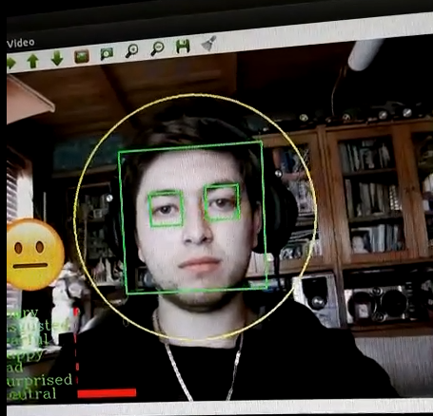
Facial Emotion Recognition with Deep CNN
Employed Deep Convolutional Neural Networks (CNNs) and extensive knowledge of emotions to create a Facial Emotion Recognition software.
Achieved a remarkable 65% accuracy in recognizing facial emotions through the utilization of OpenCV and CUDA technologies.
Incorporated a visual element by displaying emojis that correspond to the recognized emotions.
The project underscores expertise in machine learning and computer vision, effectively translating emotion understanding into software.
You can watch a humorous video demonstrating the software on my website.

Slide 24
Certificates

Slide 25
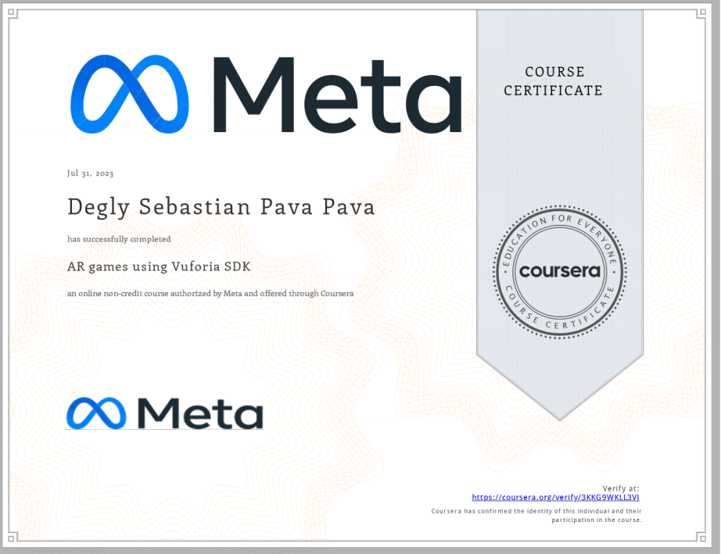
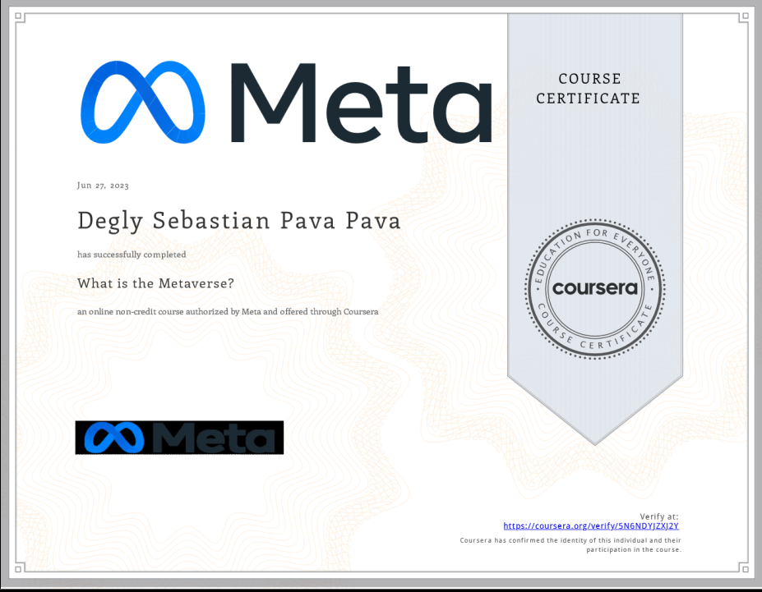
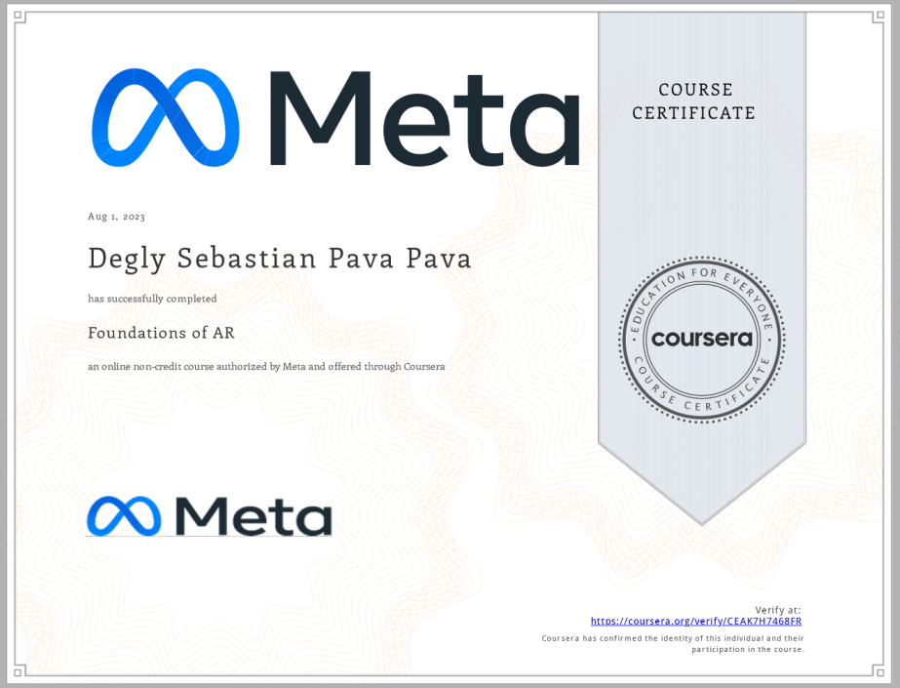


Slide 26
