Slide 1
HTML/CSS Basics
GroupDuo 2021-2022

Slide 2
What is HTML?
HTML stands for Hyper Text Markup Language
The standard markup language for creating Web pages
Markup languages are computer languages that use tags to define elements within a page
Describes the structure of a Web page
Consists of a series of elements
Elements tell the browser how to display the content
Elements label pieces of content such as "this is a heading", "this is a paragraph", "this is a link", etc.

Slide 3
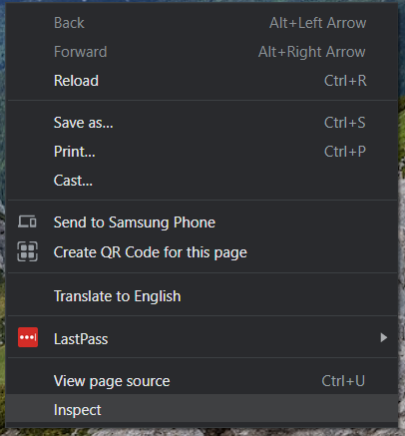
Inspect
To inspect a page, right click on any page and click inspect, or use the shortcut, F12
You can now see all the HTML/CSS for any page you are on and you can edit any of the values you want to play around with the code
You can also select "View page source" to see the source code of the page you are currently on, however you cannot edit this code.

Slide 4
Tags/Elements
Tags are the starting and ending parts of an HTML element. They begin with < symbol and end with > symbol. Whatever is written inside of < and > are called tags. Most tags must be opened (<tag>) and closed (</tag>) with the element information such as a title or text resting between the tags.
Ex. <p>This is my paragraph. You can type anything between these two tags!</p>
Some tags do not have a closing tag, such as an image, <img src="myDog.jpg">

Slide 5
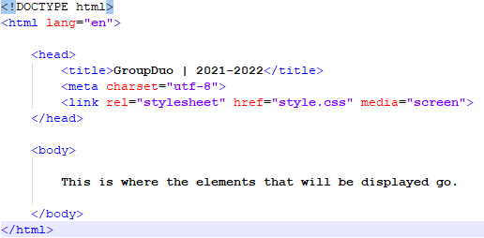
HTML File Structure
The <!DOCTYPE html> declaration defines that this document is an HTML5 document
The <html> element is the root element of an HTML page
The <head> element contains meta information about the HTML page
The <title> element specifies a title for the HTML page (which is shown in the browser's title bar or in the page's tab)
The <body> element defines the document's body, and is a container for all the visible contents, such as headings, paragraphs, images, hyperlinks, tables, lists, etc.

Slide 6
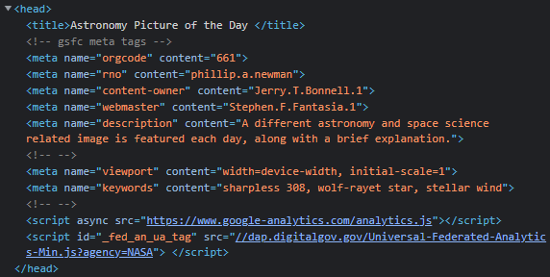
Head
HTML metadata is data about the HTML document
Metadata is not displayed on the page
Metadata typically define the document title, character set, styles, scripts, and other meta information

Slide 7
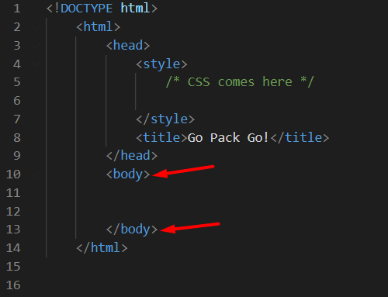
Body
The body element contains all the contents of an HTML document, such as headings, paragraphs, images, hyperlinks, tables, lists, etc.
Body tags are <body> </body> and would go between your <html></html> tags

Slide 8
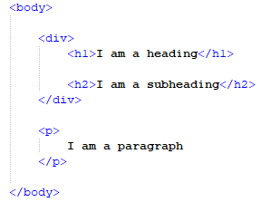
Common Elements
h1, h2, h3...
Headings
The smaller the number, the bigger the heading
Ex: <h1>This is a heading!</h1>
div
A div is a container to store or group other elements
They can be used for styling, scripting, and organization
Example shown to the right
p
This is a paragraph and is used for storing blocks of text
Ex: <p>I am a paragraph. All the paragraph text belongs between the opening and closing tags.</p>

Slide 9
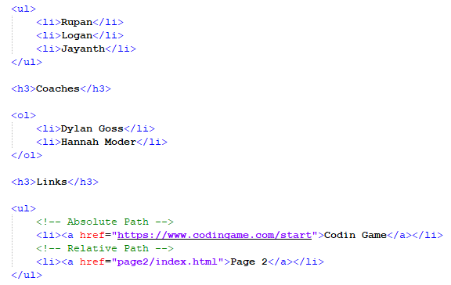
More Common Elements
List and list item elements
ul - "Unordered list", list items automatically get bullet points
ol - "Ordered list", list items automatically numbered
li - "List item", these elements go inside the opening and closing ul/ol tags and represent individual items in the list
Links
Represented by <a href="destination"></a>
The href sets the destination of the link and tells it where to go
Absolute paths – Gives an exact address (like a URL)
Relative paths – Gives directions based on current file location
The displayed text for the link goes between the opening and closing a tags
Example to the right shows a link element inside a list item element

Slide 10
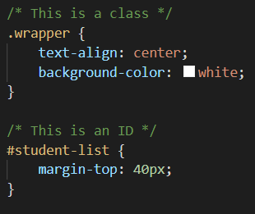
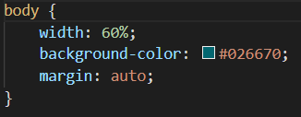
CSS Basics
CSS stands for Cascading Style Sheets
You can style your HTML page using the style.css file
This is linked to your HTML file using <link rel="stylesheet" href="style.css" media="screen"> in the head section
You can then start styling by selecting which element to style, for example you can set the background color of the <body> as such
When styling with css you always start by selecting your element, followed by opening and closing curly braces {} then within those braces is where you put your CSS which is always ended with a semicolon ;
You can also add specific classes and IDs to elements to target them specifically. This is assigned in the opening tag.
Class: Can assign to multiple elements on a page
<p class="className">…</p>
ID: Can only assign to one element on a page
<p id="idName">…</p>

Slide 11
Resources
w3schools
Mozilla
Youtube: HTML Crash Course (1 hour)
Validator – Validates your HTML for syntax
Dylan and Hannah

