Slide 1
Local Networking with Distant Warmup
Often the warmup room is far
Marshall is in the warmup room
Safest solution is to connect a second router, by wire.
WAN Port of second router goes to one of the 4 LAN ports of the main router
Note for main room:
Owlcms is connected by wire
Announcer and timekeeper are normally very close to router, WiFi is OK
Athlete-facing is far from router, so LAN wiring is suggested.
Scoreboards are far. Wiring the main one is ideal, but not mandatory.

Slide 2




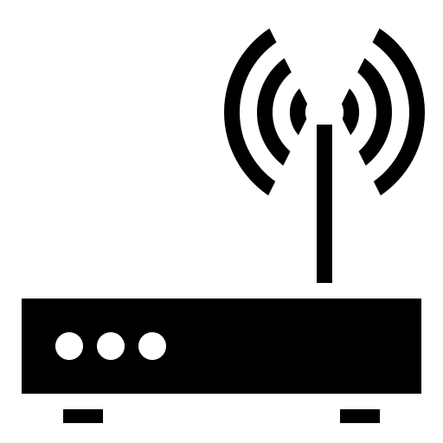

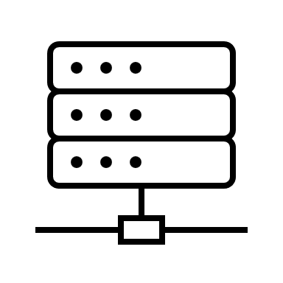
Competition Network (192.168.1.x)
Warmup Network (192.168.x.y)
Attempt Board + Secondary Scoreboards (WiFi)
Main Scoreboard (LAN)
Individual Scoreboards
publicresults
Main Router
Warmup
Router
Referee devices (USB)
WAN
Athlete-facing display (LAN)
LAN 1-4
LAN 1-4
Warmup Scoreboard (LAN)
Timekeeper (WiFi)
Announcer
(WiFi*)
Owlcms (LAN!)
Marshall (WiFi*)
This Photo by Unknown Author is licensed under CC BY
This Photo by Unknown Author is licensed under CC BY

Slide 3
Isolated Setup for Individual Scoreboards
This setup reverses the role of the routers to prevent vandalism of the competition network
The « main » router is the one in the warmup area and acts as the WAN
The competition floor router is protected because the machines on the brown network cannot see the machines in the blue network
The setup works because owlcms initiates the connection to publicresults
If you also need other machines in the attendance network that need to connect back to owlcms, then
The blue router must open of its ports (for example, port 8080) and redirect it to owlcms
The machines on the brown network will use the address of the blue router as seen on the brown network, and use that as their destination.

Slide 4
Competition Network (192.168.4.x)
Attendance Network (10.0.0.x)
Scoreboards
Individual Scoreboards
Referee devices (USB)
Competition Router
Crowd/Coaches
Router + WiFi
Athlete-facing display
owlcms 192.168.4.100
WAN
publicresults 10.0.0.234
Marshall
Announcer
This Photo by Unknown Author is licensed under CC BY
This Photo by Unknown Author is licensed under CC BY

Slide 5
Video Isolation
In this setup, the network traffic for the video streaming does not reach the competition network
This requires a port forwarding rule to be put in place on the competition router
In the example, the OBS machine sees the competition router as 10.0.0.1
The blue router forwards outside requests for port 8080 to 192.168.1.100:8080
OBS therefore uses 10.0.0.1:8080 to see owlcms

Slide 6
Competition Network (192.168.1.x)
Scoreboards
Referee devices (USB)
Video Station (OBS)
Competition Router
10.0.0.110
10.0.0.1
Athlete-facing display
owlcms 192.168.1.100
WAN
WAN
Marshall
Announcer
This Photo by Unknown Author is licensed under CC BY
This Photo by Unknown Author is licensed under CC BY

Slide 7
Full Networking Setup
Competition Network
Owlcms connected to main router using its 192.168 address
One additional secondary router per additional platform
Additional Ethernet switches be added
Owlcms should have a fixed, reserved DHCP address to support port redirection
Video Network
Connects to internet, acts as internet gateway for main router
No video traffic goes to main router, uses a port redirection to see owlcms
Public Network
The public can follow the scoreboard with Heroku

Slide 8
Networking Setup
The following pages show several networking configurations, in increasing order of capability
Goals:
To use normal home networking equipment (consumer-grade routers, switches and access points) you can get at the normal electronics outlets
To limit configuration to what a regular hobbyist normally does (set the Wi-Fi names, open gaming ports)

Slide 9

Wi-Fi 1 192.168.1.122
Simplest setup
One main router
WAN can connect to internet if needed.
Even with good Wi-Fi, the main laptop is wired
Optionally, you can wire the announcer, etc.
Main Router
WAN
10.0.0.234
192.168.0.1
192.168.0.100:8080
Owlcms DHCP Reservation 192.168.0.100:8080
LAN 1 192.168.0.110
Physical or WIFI connection
Competition Network
All machines see owlcms using its 192.168 address
IP Connection

Slide 10
Wi-Fi 1 192.168.1.122
Wired setup (bad Wi-Fi or long distances)
One main router
WAN can connect to internet if needed.
For remote rooms
Connect a switch to the router, or
Connect an access point to the router, or
Connect a router to the router (see next page)
Additional Access Point
Main Router
WAN
10.0.0.234
192.168.0.1
192.168.0.100:8080
Owlcms DHCP Reservation 192.168.0.100:8080
LAN 1 192.168.0.110
Switch for additional ports
Physical or WIFI connection
Competition Network
All machines see owlcms using its 192.168 address
IP Connection

Slide 11
Wi-Fi 2 192.168.1.115
Wi-Fi 1 192.168.1.122
Distant room using routers
You can connect a router to any of the LAN ports
On the secondary router(s)
For simplicity use different names for each Wi-Fi networks
Ideally, change the Wi-Fi channel to be different
Secondary Router
Main Router
WAN
WAN
192.168.0.240
10.0.0.234
192.168.1.1
192.168.0.1
192.168.0.100:8080 (via default gateway)
Owlcms DHCP Reservation 192.168.0.100:8080
LAN 2 192.168.1.165
LAN 1 192.168.0.110
Physical or WIFI connection
Competition Network
All machines see owlcms using its 192.168 address
One secondary router per additional platform or room
IP Connection

Slide 12
Wi-Fi 2 192.168.1.115
Wi-Fi 1 192.168.1.122
Multiple platforms
To minimize configuration and keep things simple,
Connect the other platform routers directly to the main router
Use different Wi-Fi names
Use different channels
You can connect one or more switches or access points to each router if you need more ports.
Secondary Router
Main Router
WAN
WAN
192.168.0.240
10.0.0.234
192.168.1.1
192.168.0.1
192.168.0.100:8080 (via default gateway)
Owlcms DHCP Reservation 192.168.0.100:8080
Additional Access Point
LAN 2 192.168.1.165
LAN 1 192.168.0.110
Switch for additional ports
Switch for additional ports
Physical or WIFI connection
Competition Network
All machines see owlcms using its 192.168 address
One secondary router per additional platform or room
IP Connection

Slide 13
Competition Network
All machines see owlcms using its 192.168 address
One secondary router per additional platform
Isolated Video Network
Needs a redirection to see owlcms
Avoids video traffic hitting the competition router
Wi-Fi 2 192.168.1.115
Wi-Fi 1 192.168.1.122
Secondary Router
Main Router
Internet Router
WAN
WAN
WAN
192.168.0.240
10.0.0.234
107.171.217.85
192.168.1.1
192.168.0.1
10.0.0.1
192.168.0.100:8080 (via default gateway)
Owlcms DHCP Reservation 192.168.0.100:8080
10.0.0.234:8080 port redirection configured on router 1 for 192.168.0.100:8080
YouTube Facebook streaming
OBS
Additional Access Point
Heroku publicresults
LAN 2 192.168.1.165
LAN 1 192.168.0.110
Physical or WIFI connection
Switch for additional ports
Switch for additional ports
IP Connection

