Slide 1
Local Networking with Distant Warmup
Often the warmup room is far
Marshall is in the warmup room
Safest solution is to connect a second router, by wire.
WAN Port of second router goes to one of the 4 LAN ports of the main router
Note for main room:
Owlcms is connected by wire
Announcer and timekeeper are normally very close to router, WiFi is OK
Athlete-facing is far from router, so LAN wiring is suggested.
Scoreboards are far. Wiring the main one is ideal, but not mandatory.

Slide 2




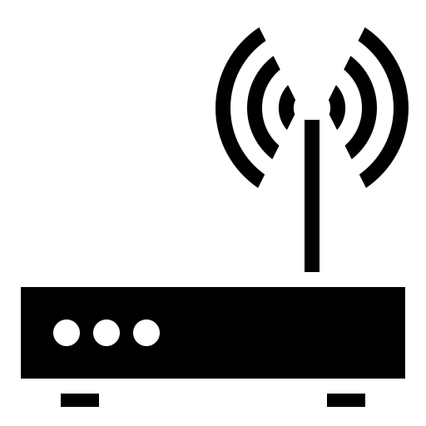

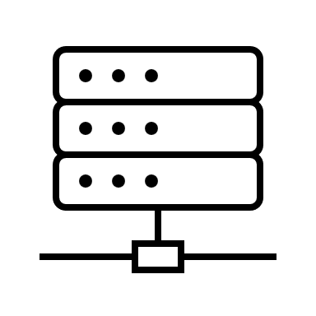
Competition Network (192.168.1.x)
Warmup Network (192.168.x.y)
Attempt Board + Secondary Scoreboards (WiFi)
Main Scoreboard (LAN)
Individual Scoreboards
publicresults
Main Router
Warmup
Router
Referee devices (USB)
WAN
Athlete-facing display (LAN)
LAN 1-4
LAN 1-4
Warmup Scoreboard (LAN)
Timekeeper (WiFi)
Announcer
(WiFi*)
Owlcms (LAN!)
Marshall (WiFi*)
This Photo by Unknown Author is licensed under CC BY
This Photo by Unknown Author is licensed under CC BY

Slide 3
Isolated Setup for Individual Scoreboards
This setup reverses the role of the routers to prevent vandalism of the competition network
The « main » router is the one in the warmup area and acts as the WAN
The competition floor router is protected because the machines on the brown network cannot see the machines in the blue network
The setup works because owlcms initiates the connection to publicresults
If you also need other machines in the attendance network that need to connect back to owlcms, then
The blue router must open of its ports (for example, port 8080) and redirect it to owlcms
The machines on the brown network will use the address of the blue router as seen on the brown network, and use that as their destination.

Slide 4
Competition Network (192.168.4.x)
Attendance Network (10.0.0.x)
Scoreboards
Individual Scoreboards
Referee devices (USB)
Competition Router
Crowd/Coaches
Router + WiFi
Athlete-facing display
owlcms 192.168.4.100
WAN
publicresults 10.0.0.234
Marshall
Announcer
This Photo by Unknown Author is licensed under CC BY
This Photo by Unknown Author is licensed under CC BY

Slide 5
Competition Network (192.168.1.x)
Scoreboards
Referee devices (USB)
Video Station (OBS)
Competition Router
10.0.0.110
10.0.0.1
Athlete-facing display
owlcms 192.168.1.100
WAN
WAN
Marshall
Announcer
This Photo by Unknown Author is licensed under CC BY
This Photo by Unknown Author is licensed under CC BY

