Slide 1
owlcms: Large Venue Setup
Goals:
Robustness:
Continuity in case an internet outage
Continuity if some equipment fails
Absence of performance impacts from Video Streaming
Ability to scale up to multiple platforms if required
Minimize cabling (less ethernet cabling, less electrical cabling)
Design Principles
Competition software runs locally
All competition computers are connected to competition-only switches
Competition traffic does not go through the router (remains within the switches)
Router is used to shield access from the outside, to send the video and results to the internet, and to provide IP addresses to the machines on the network.

Slide 2



Networking Setup
Switches
Main laptop is wired to the first platform switch
Redundant WiFi Access Points powered over Ethernet (PoE).
Announcer, referee, attempt board can be wired if desired using free ports
No interference from video traffic
One platform = one switch, other switches connect directly to main switch
Router
Provides DHCP addresses
Allows OBS to fetch scoreboards from owlcms
Allows OBS to stream out
Allows owlcms to feed Heroku public scoreboards
Video streaming
Heroku publicresults
X
WAN
Competition Router
107.171.217.85
192.168.0.1
OBS
scoreboard
Owlcms
WiFi Access Point
WiFi Access Point
PoE
PoE
PoE-capable Switch (one per platform)
Additional switch for platform 2
Physical or WIFI connection
IP traffic

Slide 3
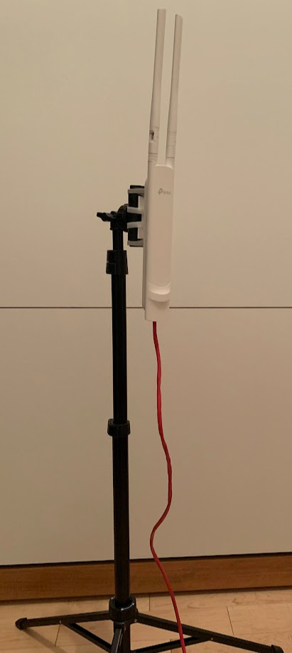
Recommendations for equipment
Use a video-capable (gaming) router
Small-business Power-over-Ethernet (PoE) switches
For example tp-link TL-SG1008P has 4 PoE ports, 4 normal ports, handles 1Gbps.
Use one per platform
PoE switches allow connecting WiFi access points without having to bring electrical wiring
Redundant WiFi access points
For example, tp-link AC1200 EAP225 Outdoor
can be mounted on a phone tripod, correct wave shape
disk-shaped antennas are meant for upside-down ceiling mount
Use one (or more) access point for the main platform area, one for warm-up area
Use the vendor’s management software to create a single unified WiFi network with redundancy and roaming (e.g. tp-link Omada)
Use proper length Ethernet cables, avoid needlessly long cables, check connectors

Slide 4
Considerations for Sound
Connect the sound input for down and timer sounds to the athlete-facing display.
Sounds are emitted immediately on decisions, directly from the browser
This avoids multiple hops through the server and back through another browser
Use a dedicated speaker for the timer and down signal
A speaker with a « line in » and a built-in amplifier works well
Alternately, any good quality wired PC speaker can do – but do not use Bluetooth/Digital speakers because of perceptible lag
Going through the announcer public-address mixer is often problematic
If the sound output is through a laptop headphone jack, it can be very difficult to set a sound mixer to work well with both announcer voice and the sounds

Slide 5
Miscellaneous
Use a well-ventilated laptop as the main owlcms computer. Wire the main computer using ethernet wiring.
Use a separate laptop for the competition clerks
This is the only laptop that needs Office (or compatible) and a printer
All other laptops can use a Linux distribution with Chromium to avoid having to perform updates before every meet.
All PCs used should be known to run cool even after a day.
Get a walkie-talkie app for communications between marshall and announcer

