Slide 1






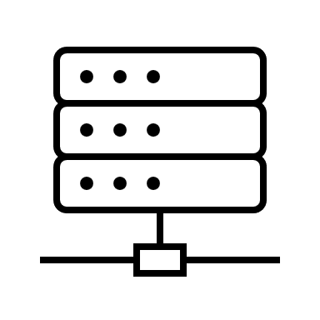
Competition Network (192.168.4.x)
Attendance Network (10.0.0.x)
Scoreboards
Individual Scoreboards
Referee devices (USB)
Competition Router
Crowd/Coaches
Router + WiFi
Athlete-facing display
owlcms 192.168.4.100
WAN
publicresults 10.0.0.234
Marshall
Announcer
This Photo by Unknown Author is licensed under CC BY
This Photo by Unknown Author is licensed under CC BY

