Slide 1
Owlcms: Checklist for Large Competitions
Goals:
Robustness:
Continuity in case an internet outage
Continuity if some equipment fails
Absence of performance impacts from Video Streaming
Key Design Principles
Competition software runs locally
Competition traffic remains within network switches
The server has a wired connection
Independent Wi-Fi network
Video traffic is kept separate

Slide 2
Laptops
Use a fast, modern laptop for owlcms
Do not run anything else on that laptop
Clearly mark the laptop as “hand-off”
Disable BitLocker if enabled (this is critical)
Disable Firewall, Runtime protections and antivirus during the competition
Assign a predetermined address to the laptop (DHCP reservation or fixed IP)
Use a separate laptop for the competition clerks
Make sure Office licence is enabled and printer is configured
For laptops as display devices
Disable runtime protections e.g. “smart screen” and suchlike that want to check over the internet

Slide 3
Competition Secretary and Clerks
Make sure you have the most recent stable version. Get comfortable with it.
Load the database as early as possible
Circulate the starting list as soon as possible after the end of registration so errors can be caught (inverted names/surnames, wrong groups, etc)
Enter all the scheduling and referee information in the software
Make sure that you allocate lot numbers
Check that you can print the starting cards – use the IWF format
Designate competition clerks (in addition to the competition director) that will handle all the key-in and produce the documents
Create reminders for the clerks
What documents to print when
Starting weights, jury sheet, result sheets, medals, final package
Checks to perform – eg. Start numbers allocated at the end of weigh-in

Slide 4
Marshal
In addition to the international or national technical official acting as Marshal, appoint a second official (provincial OK), or even an experienced athlete to assist
Assistant can grab updated cards and read the changes to the marshal doing data entry (or the opposite)
Assistant and marshal can cross-check that changes have been entered correctly
Assistant can grab athlete currently lifting so marshal can update the card with successful/unsuccessful lifts – automatic progression, etc.
Marshal input errors are the most damaging errors to competition flow as they often take a while to spot and fix.
If the system crashes, you can go on with flags if the marshal cards are correct.
A marshal error prevent going ahead even if the system is fully functional

Slide 5
Sound
Connect the speakers for down/timer sounds directly to the athlete-facing display.
Sounds are emitted immediately on decisions, directly from the browser
Use a dedicated speaker for the timer and down signal
A speaker with a « line in » and a built-in amplifier works well
Alternately, any good quality wired PC speaker can do – but do not use Bluetooth/Digital speakers because of perceptible lag
AVOID going through the announcer public-address mixer
If the sound output is through a laptop headphone jack, it can be very difficult to set a sound mixer to work well with both announcer voice and the sounds
The sound system must be tested beforehand
And even if you do, it never works on the morning of the competition.
Have access to someone with actual experience with the specific equipment you’re using
Make sure you have adapters between 1/8 and ¼ inch plugs and all the required cables.
Additional batteries for the speaker, spare microphone (they get dropped)

Slide 6
Video
It is probably simpler to use a separate camera (USB or phone with correct USB software) unless you have professional video
If you are sharing the same video input from a video camera for streaming as you are for the warmup room, test beforehand to ensure that splitter/cabling/video capture card works
Get proficient with the video streaming software (OBS or other)
Make sure you understand how scheduling works on the streaming site if you preschedule your live streaming
You may be prevented from starting a stream if the session is late (or over).
You need to know how to go back to YouTube live (or Facebook live or …) proficiently even when under stress/duress

Slide 7
Additional Items for Large Competitions
For a large competition, plan to have additional monitors
A monitor so the announcer can see the scoreboard (in addition to the laptop)
A monitor so the marshal and coaches can check that changes are as expected on the scoreboard
A monitor so the jury can see the scoreboard
Other items:
Walkie-talkies from marshall to announcer
USB hub if the jury laptop only has 3 ports

Slide 8
Networking Checklist
Frequently encountered problems (hard-learned lessons)
Avoid Facility Wi-Fi
Do NOT use facility Wi-Fi for the competition traffic itself
Facility Wi-Fi often cannot cope with video traffic and video will lag
Use a wired connection for video out if at all possible
Private Wi-Fi configuration
Owlcms server MUST be wired to a switch or router (not on Wi-Fi)
Use MIMO or redundant antennas
A single router is unlikely to cover a wide area correctly
Humans are a very effective Wi-Fi shield. Loaders and refs block signal.
Large distance between marshal, jury, main scoreboard, etc.
5GHz often not reliable, use 2.4GHz or make sure band switching is available
Keep video traffic separate from competition traffic using a switch or a separate router
Many routers fail to handle sustained video traffic; bad built-in switches fail to keep up.

Slide 9



Fully Wired Networking Setup
Switches
All competition traffic remains inside the switch
No interference from video traffic
One platform = one switch, other switches connect directly to main switch if needed
Router
Provides DHCP addresses
Allows OBS to fetch scoreboards from owlcms
Allows OBS to stream out
Allows owlcms to feed Heroku public scoreboards
Video streaming
Heroku publicresults
X
WAN
Competition Router (*)
107.171.217.85
192.168.0.1
OBS
scoreboard
Owlcms
PoE
PoE
PoE-capable Switch (one per platform)
(*) if no cabled WAN connection is available, the device can be configured as a WiFi bridge, testing beforehand required.
Physical or WIFI connection
IP traffic

Slide 10
Ideal Wi-Fi Networking Setup
Switches
Main laptop is wired to the first platform switch
Redundant WiFi Access Points powered over Ethernet (PoE).
Announcer, down signal, attempt board are wired
No interference from video traffic
One platform = one switch, other switches connect directly to main switch
Router
Provides DHCP addresses
Allows OBS to fetch scoreboards from owlcms
Allows OBS to stream out
Allows owlcms to feed Heroku public scoreboards
Video streaming
Heroku publicresults
X
WAN
Competition Router (*)
107.171.217.85
192.168.0.1
OBS
scoreboard
Owlcms
WiFi Access Point
WiFi Access Point
PoE
PoE
PoE-capable Switch (one per platform)
Additional switch for platform 2
(*) if no cabled WAN connection is available, the device can be configured as a WiFi bridge, testing beforehand required.
Physical or WIFI connection
IP traffic

Slide 11

Alternate Wi-Fi Networking Setup
Competition network
Same configuration you would normally use
All cabled computers are on the switch. Critical computers are cabled.
One port is open to the outside to allow OBS to reach owlcms
Video network
Does not interfere with competition
Should be cabled out (*)
Video Router
Competition Router
WAN
X
10.0.0.120
10.0.0.232
192.168.0.1
YouTube Facebook streaming
External port 8080 redirection to 192.168.0.100:8080
OBS
Owlcms DHCP Reservation 192.168.0.100:8080
Heroku publicresults
(*) if no cabling, the device can be configured as a WiFi bridge, testing beforehand required.
Ethernet or WiFi
Commutateur (Switch)
Logical IP connection

Slide 12
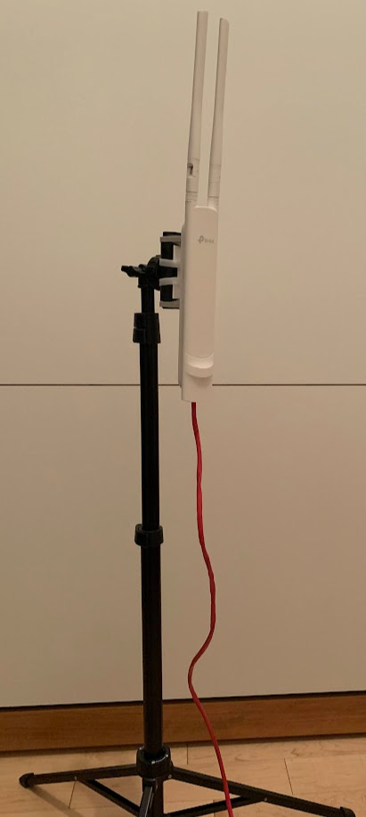
Recommendations for equipment
Use a video-capable (gaming) router for video
Use small-business Power-over-Ethernet (PoE) switches
For example tp-link TL-SG1008P has 4 PoE ports, 4 normal ports, handles 1Gbps.
Use one per platform
PoE switches allow connecting WiFi access points without having to bring electrical wiring
Use redundant WiFi access points
For example, tp-link AC1200 EAP225 Outdoor
can be mounted on a phone tripod, correct wave shape
disk-shaped antennas are meant for upside-down ceiling mount
Use one (or more) access point for the main platform area, one for warm-up area
Use the vendor’s management software to create a single unified WiFi network with redundancy and roaming (e.g. tp-link Omada)
Use proper length Ethernet cables, avoid needlessly long cables, check connectors

Slide 13
Miscellaneous
Use a well-ventilated laptop as the main owlcms computer. Wire the main computer using ethernet wiring.
Use a separate laptop for the competition clerks
This is the only laptop that needs Office (or compatible) and a printer
All PCs used should be known to run cool even after a day.
Get walkie-talkies (or a walkie-talkie app) for communications between marshall and announcer

