Slide 1

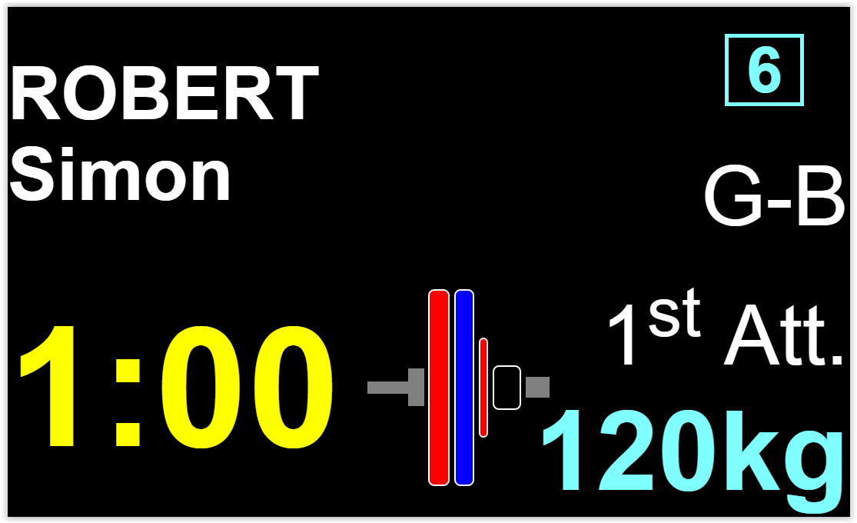

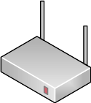

owlcms server
Browser
192.168.1.105
192.168.1.1
owlcms4.herokuapp.com
http server

Slide 2
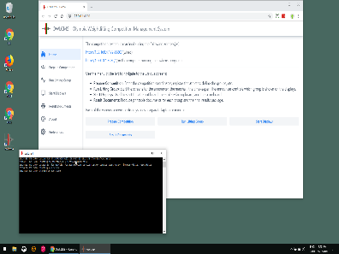
Browser
owlcms server
192.168.1.105
192.168.1.1
192.168.1.100 master laptop acting as http server

Slide 3
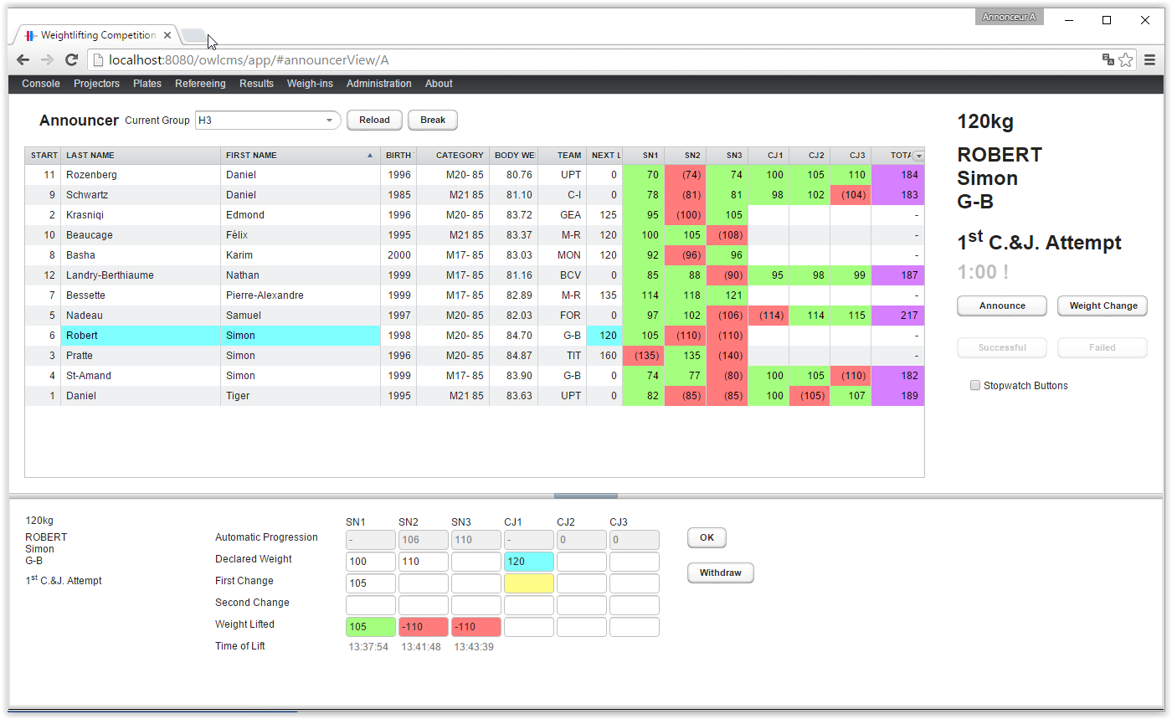
Browser
owlcms server
Master laptop talking to itself (localhost)

