Slide 1
Exploring LSTMs and Their Advantages Over RNNs
Dhaarani Shanmugam
23035833
GITHUB LINK

Slide 2
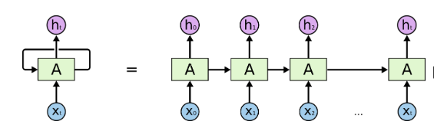
RNN NETWORK
Recurrent Neural Networks (RNNs) are a class of neural networks designed to handle sequential data, which makes them ideal for applications such as natural language processing, speech recognition, and time series prediction. RNNs are unique from other neural networks as they have connections that loop back, allowing them to maintain a "memory" of previous inputs.

Slide 3
LIMITATIONS OF RNN
RNNs process sequential data by propagating information through hidden states across time steps.
New weight = weight – Learning Rate * Gradient
Vanishing Gradient Problem: During backpropagation through time (BPTT), the gradients in RNNs can become very small (vanish) when propagating through long sequences. This makes it difficult for the network to learn dependencies from earlier time steps, effectively "forgetting" long-term context.
Exploding Gradient Problem: The gradient values grow exponentially during backpropagation, when the weight values are large, causing the gradients to increase at each step, leading to numerical instability
Short-Term Memory: Due to the above issues, RNNs often struggle to retain information from earlier time steps in long sequences.

Slide 4
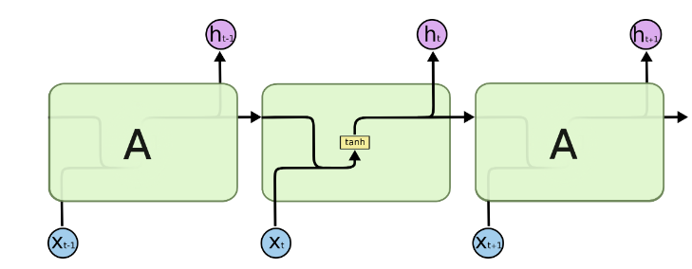
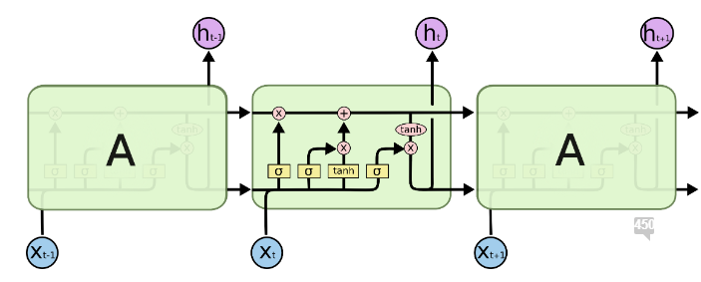
LSTM: Long Short Term Memory networks – usually just called “LSTMs” – are a special kind of RNN, capable of learning long-term dependencies. They work tremendously well on a large variety of problems, and are now widely used.It works by introducing a memory cell, a mechanism that can store information for much longer periods, making it easier for the network to learn and remember long-term relationships in the data.
In standard RNNs, this repeating module will have a very simple structure, such as a single tanh layer.
LSTMs have chain like structure, Instead of having a single neural network layer, there are four neural networks, interacting in a very special way.

Slide 5
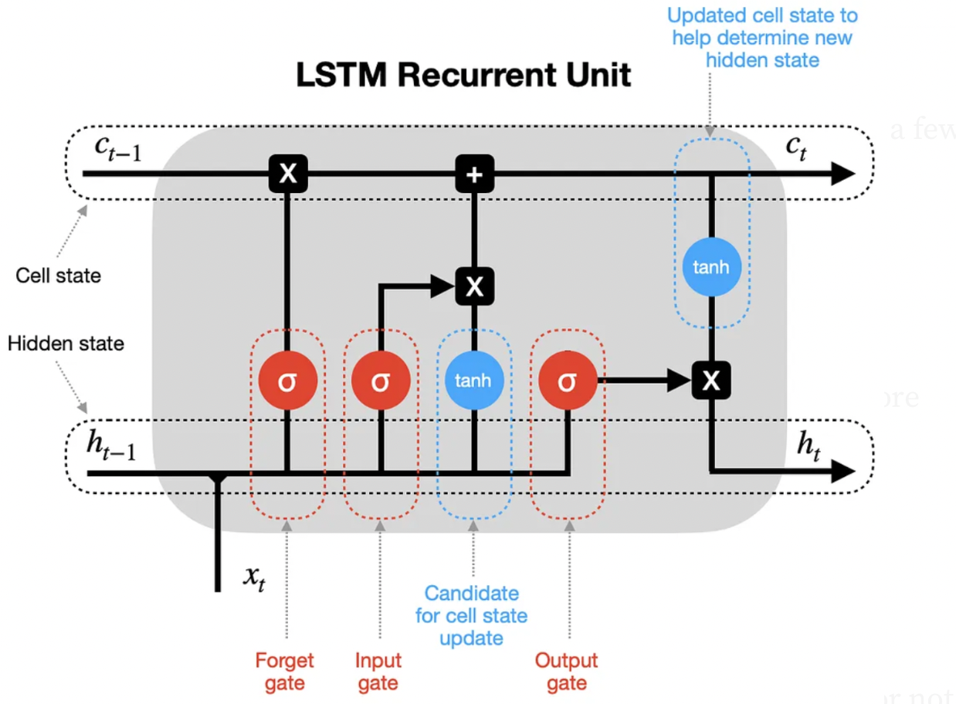
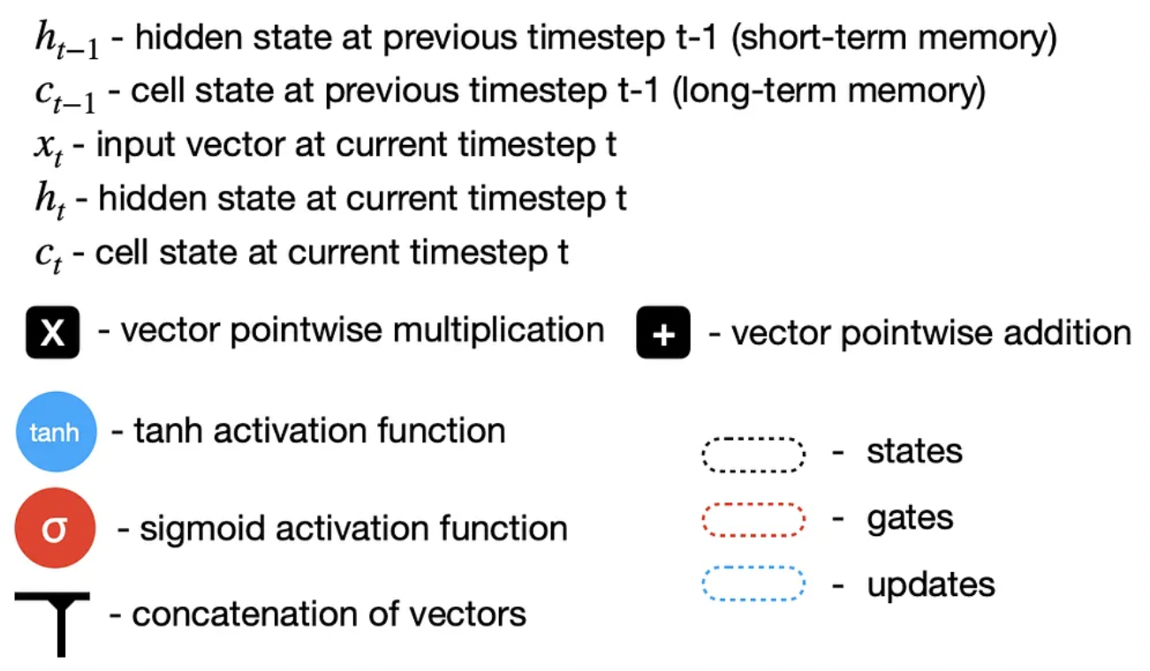
ARCHITECTURE OF LSTM:

Slide 6
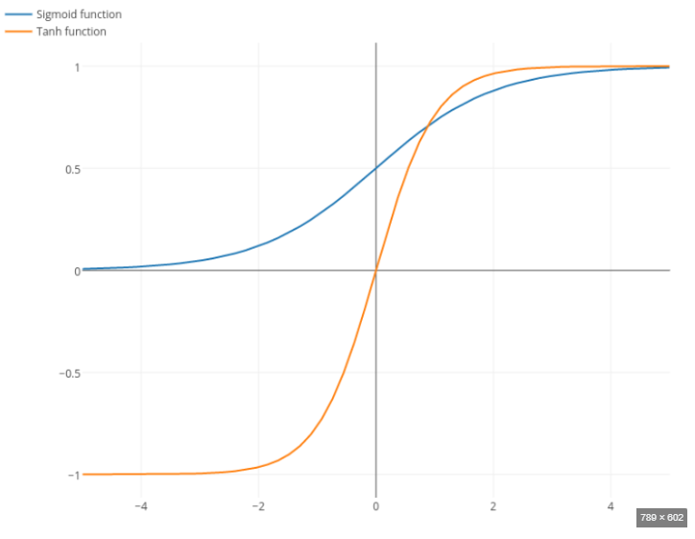
Core Idea Behind LSTM: The key to LSTM is the cell state which is responsible for long term memory and hidden state which is responsible for short term memory and various gates which adds or removes information to the cell states.
LSTM contains two activation functions:
Sigmoid Activation:
Takes any x-axis coordinate and convert it to a y-axis coordinate between 0 and 1
It helps the gates in LSTM to either update or forget the data
Tanh Activation:
Takes any x-axis coordinate and convert it to a y-axis coordinate between -1 and 1
It helps to regulates the values from and through the network

Slide 7
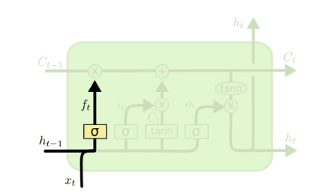

1.Forget gate: The forget gate is responsible for discarding information that is no longer needed or should not be added to the cell state.
At First the input and the previous hidden state are concatenated, the resulting vector is passed through the forget gate's sigmoid activation function. This function outputs values between 0 and 1 based on a threshold.
When this vector is multiplied element-wise with the cell state vector, only the entries corresponding to 1 remain unchanged in the cell state, while the entries multiplied by 0 are effectively forgotten. In this way, the forget gate selectively filters the information in the cell state.

Slide 8
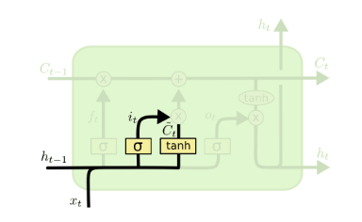
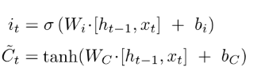
Input Gate : Input gate decide what new information we’re going to store in the cell state
Initially, the input gate uses a sigmoid function to determine what should be remembered. This process involves inputs from the previous hidden state and the current input.
A vector is then created using the tanh function, then the regulated values from the sigmoid function are multiplied with the tanh-generated vector to extract the most relevant information.
The cell state update involves combining the filtered past information and the newly selected candidate values. Next, the new candidate values are scaled by the input gate's output, and this result is added to the retained prior information to form the updated cell state.

Slide 9
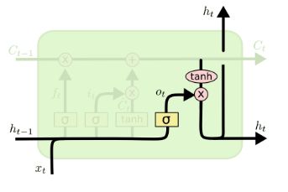
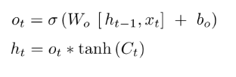
OUTPUT GATE: Determines what part of the cell state should be output at the current time step.
The output gate in an LSTM cell is responsible for extracting useful information from the current cell state to produce the output. This process begins by applying the tanh function to the cell state, generating a vector that represents the potential output.
Then, the sigmoid function is used to regulate the information, filtering the values to determine what should be retained, based on inputs from the previous hidden state and the current input
Finally, the regulated values from the sigmoid function are multiplied with the tanh-generated vector to produce the final output, which is also passed as input to the next cell.

Slide 10
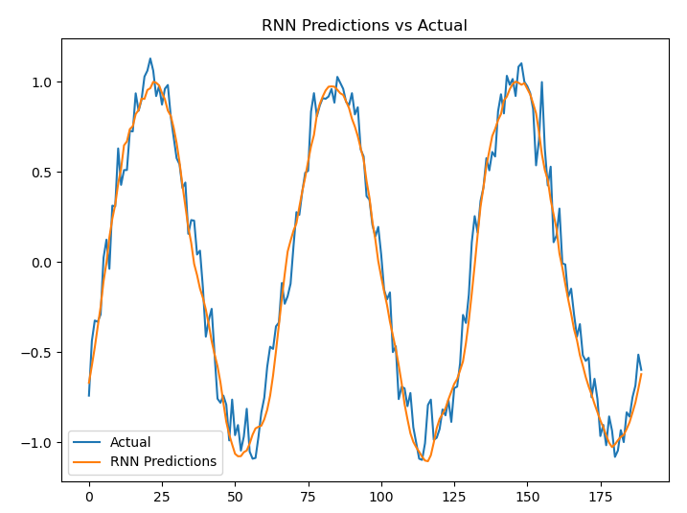
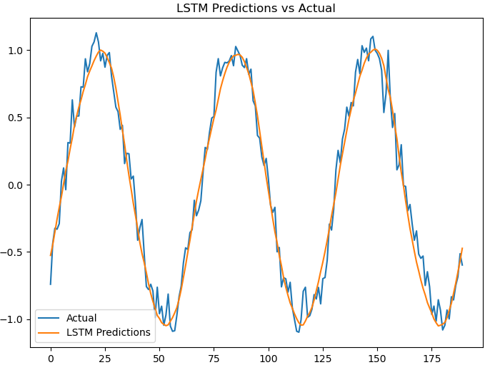
PRACTICAL FINDINGS:GITHUB LINK
Data Generation: We generate synthetic data (a noisy sine wave) to simulate a time series prediction task and scaled using Min-Max scaling
Model Building:
RNN: We use the simple RNN layer to build a simple RNN. The relu activation function is applied to the RNN layer, and a dense layer follows it to predict the next value in the time series.
LSTM : Similar to RNN model but replacing the Simple RNN layer with the LSTM layer. The LSTM layer helps capture long-term dependencies and addresses the vanishing gradient problem.
Training: Both models are trained for 10 epochs with a batch size of 32. The models are validated on a test set.
Prediction and Evaluation: After training, we make predictions using both models and visualize the results to compare the actual values with the predictions. We also calculate the mean squared error (MSE) loss for both models.

Slide 11

Key Inferences: Lower Loss for LSTM: The LSTM model has a lower los compared to the RNN model . In general, a lower loss indicates that the model's predictions are closer to the actual values, which suggests better performance. This is a typical outcome when using LSTM over standard RNNs, as LSTM networks are specifically designed to overcome the vanishing gradient problem and capture long-term dependencies better than vanilla RNNs, which tend to forget earlier information in longer sequences.
Conclusion
LSTMs represent a powerful enhancement over traditional RNNs for sequence prediction tasks, especially when long-term dependencies are important. Their ability to selectively remember or forget information allows them to effectively capture complex relationships over extended sequences, making them highly useful in a wide range of applications, from natural language processing to time series forecasting.

