Slide 1
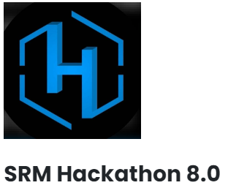
TEAM GITGUD

Slide 2
TEAM MEMBERS
S.NO | NAME | BRANCH | STREAM | YEAR
1 | DHAARUN ABHIMANYU S | B.E | CSE(AI ML) | I
2 | T SRIMATHIKALPANA | B.E | CSE(AI ML) | I
3 | NAREN VAITHYAA | B.E | CSE(AI ML) | I
4 | VARA LAKSHMI | B.E | CSE(AI ML) | I
5 | SWADHITA SP | B.E | CSE(AI ML) | I

Slide 3
AI FOR SOCIAL GOOD SIGN SPEAKS!!

Slide 4
SIGN LANGUAGE DETECTION
IDEA
TECH STACK TO BE USED
Main idea is to detect sign language, i.e., hand signs with the help of an ML model.
Use an AI in understanding these signs and interpret them, thereby helping the dumb people in need.
Effective tool to help dumb people in case of emergencies(say call the ambulance with hand signs).
Python
YOLOv7
Flask
Html/CSS/JS

