Slide 1


Smart Attend
CampusConnectionDeck
Team Members:
Anisha Ghimire
Khalid Dhabbah
Prerana Samant
Blake Brown

Slide 2
Goals
Our goal is to create an application for android and iOS devices.
In this App, the users can do the following:
Creating a new account in order to use the app
The users are able to reset their password.
The users can update their information.
The users can surf the Colleges and services in the app.
The users can surf information from canvas.
Smart Attend

Slide 3
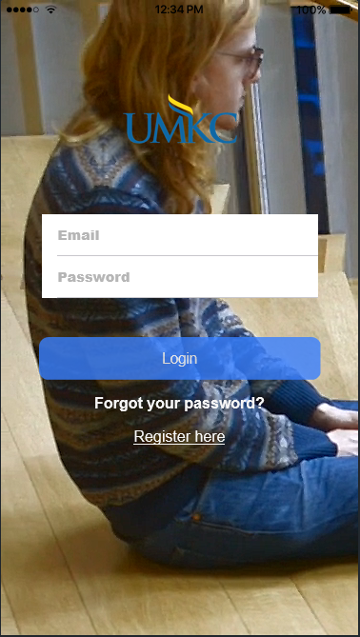
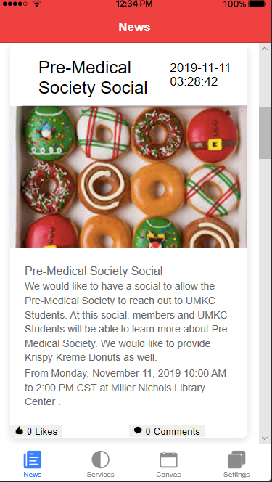
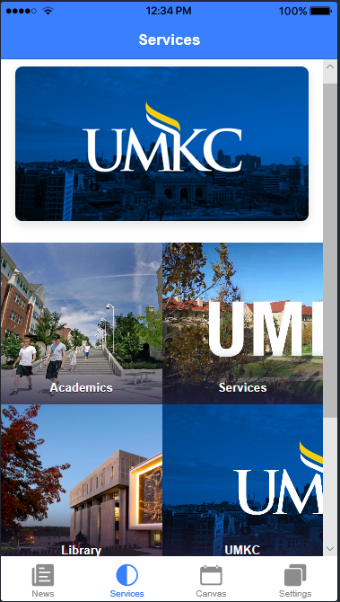
Brief about our application:
Smart Attend

Slide 4
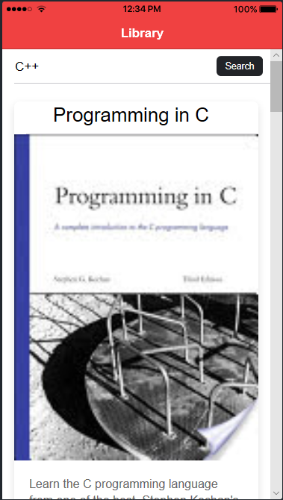
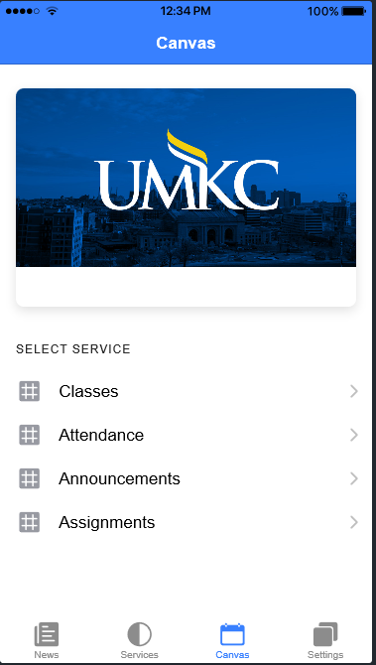
Brief about our application:
Smart Attend

Slide 5
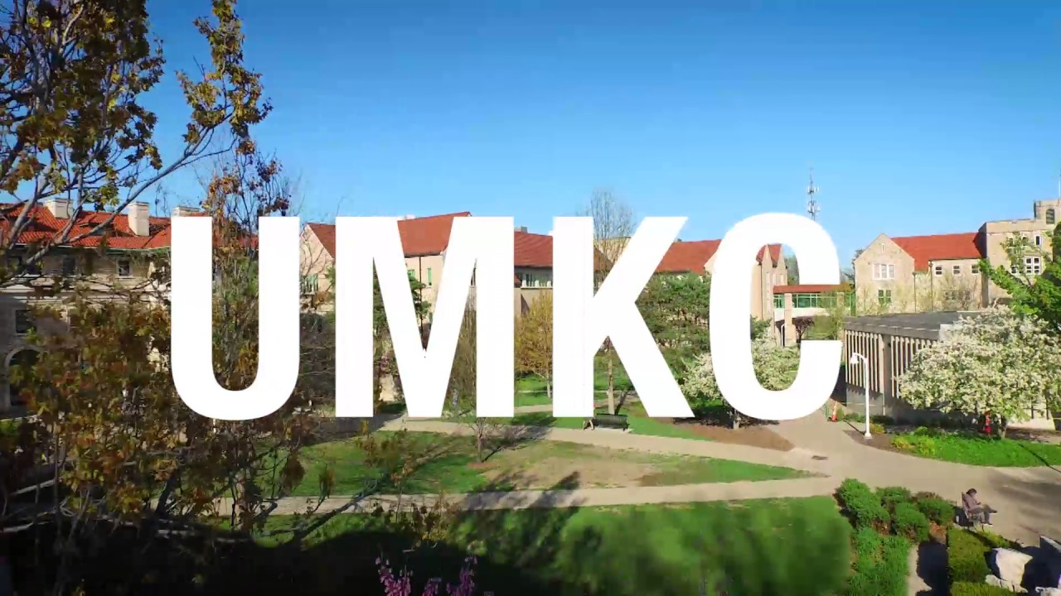
Tools, Languages, Platforms:
Ionic
Angular
Bootstrap
Firebase(Backend)
Node.js
Canvas LMS - REST API and Extensions Documentation
Google Knowledge Graph Search API
Webstorm(IDE)

