Slide 1

COMP-SCI 55510 - Advanced Software Engineering
Project Presentation (May 7th, 2019)
Dhabbah,Khalid Mohammed A(6)
Doss,Corey Jason(8)
Sun,Chen (23)
Xie,Tian Cheng(25)

Slide 2

Model as a service
Our platform is an online platform that uses machine learning (ML) and deep learning (DL) models. The platform offers seven different models that provide users with information about uploading their own images and identifying images. Users can choose the most suitable model.

Slide 3
7 Models
DenseNet121
InceptionV3
MobileNet
Nasnet
ResNet50
VGG16
xception

Slide 4
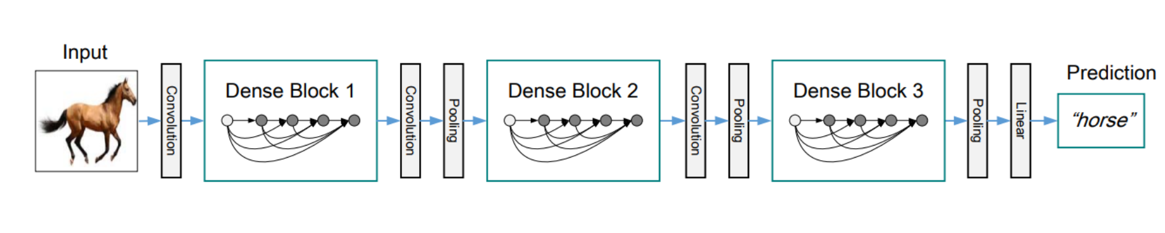
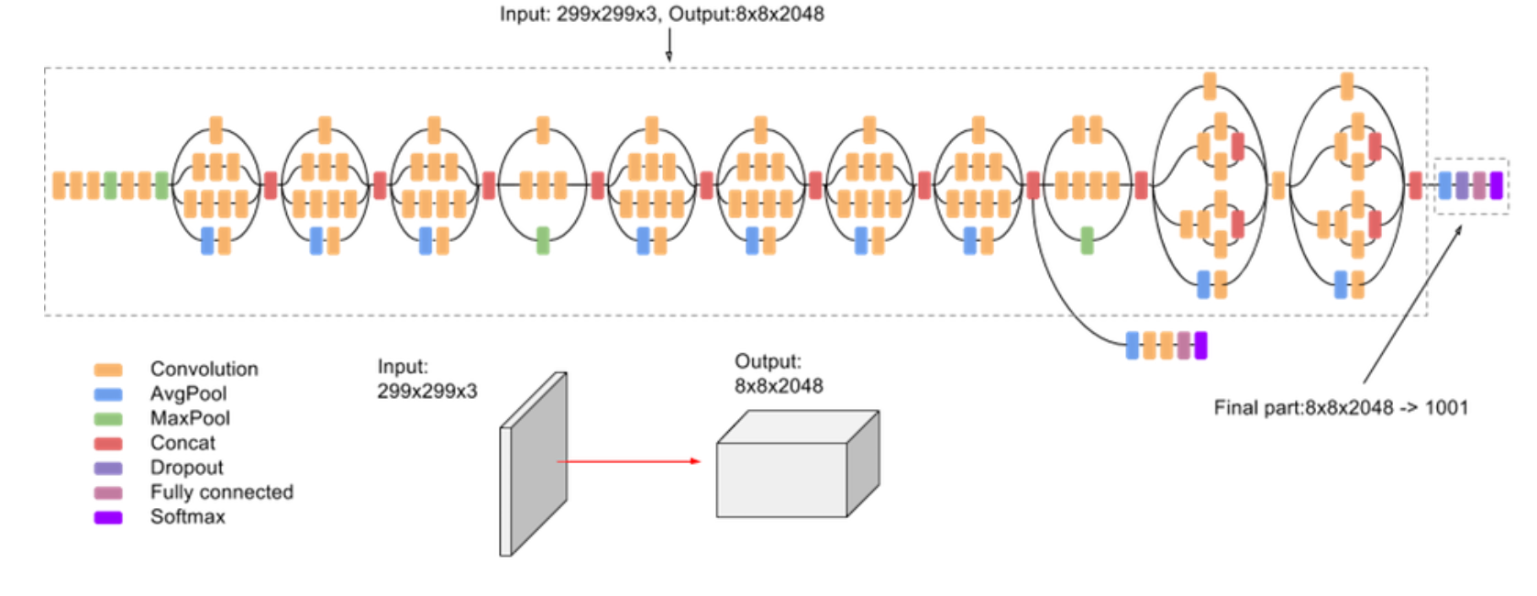
DenseNet121:It is a logical extension of ResNet.DenseNet connects the output of the previous layer instead of using summation.
InceptionV3 :Inception v3 is a widely-used image recognition model that has been shown to attain greater than 78.1% accuracy on the ImageNet dataset.

Slide 5
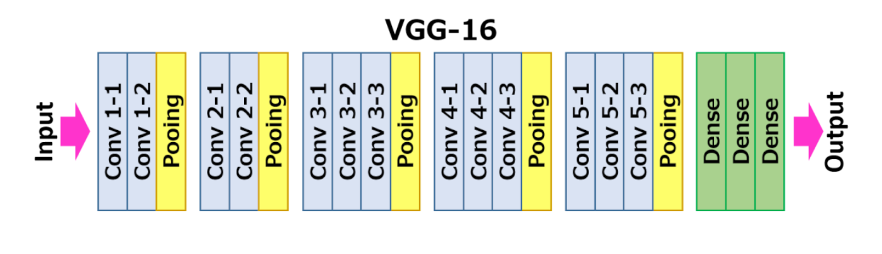
ResNet50：It is a deep convolutional networks for classification.
VGG16：It convolutional neural network is a model proposed by Oxford University in 2014.It is simple and practical, the most popular of which is VGG-16, which is a 16-layer model.

Slide 6
MobileNet:It is an efficient model for mobile and embedded devices. MobileNets is based on streamlined, using depth wise separable convolutions to build lightweight deep neural networks.
Nasnet :It classifies images. Given an image, the NasNet network will output probabilities of the different classes that an image could potentially belong to.
xception:The mapping of cross-channel correlation and spatial correlation in the feature map of the convolutional neural network can be completely decoupled. This assumption is an extreme assumption in the Inception structure.

Slide 7
Models training
Convolutional Neural Network should be involved in order to do some significant steps, which are embedding, convolution, pooling, flattening, full connection.
Also, loss and accuracy are playing a significant role. The loss is the number of errors in prediction, so it should be decreased, and the accuracy should be increased.

Slide 8
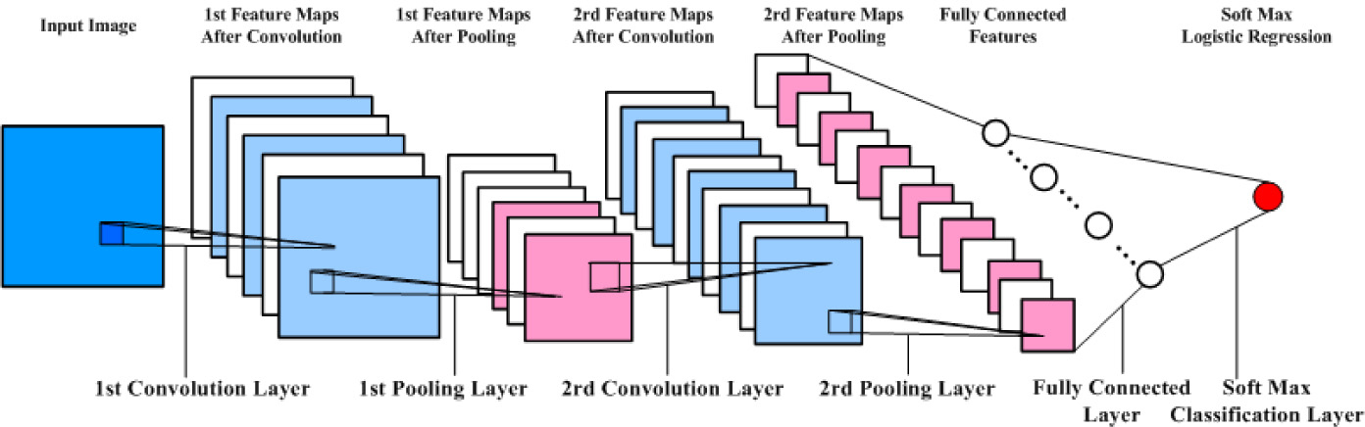
Here is how to get the output from a pre-trained CNN model we received using Jupyter Notebook.
Here is how to get the output from a pre-trained CNN model we received using Jupyter Notebook.
Here is how to get the output from a pre-trained CNN model we received using Jupyter Notebook.
Here is how to get the output from a pre-trained CNN model we received using Jupyter Notebook.
Here is how to get the output from a pre-trained CNN model we received using Jupyter Notebook.

Slide 9
Loading the model
First, Loading the model:
#Tensorflow and leras should be imported
import tensorflow as tf
from keras.models import load_model
model = load_model(‘CNN011019-223859_model.h5')
Second, many functions can be used getting information about the model, such as model.summary(): to get all the layers.
Third, save a json file for this model for future developments.
# save as JSON
json_string = model.to_json()
with open('CNN011019-223859_model.json', 'w') as file:
file.write(json_string)
Fourth, compiling the model
model.compile(loss='binary_crossentropy',
optimizer='Adam',
metrics=['accuracy'])

Slide 10
Loading the model(Cont..)
Fifth, passing a picture through the layers
#pip3 install opencv-contrib-python --user
import cv2
import numpy as np
img = cv2.imread('1.jpg')
print(img.shape)
img = cv2.resize(img,(64,64))
print(img.shape)
img = np.reshape(img,[1,64,64,3])
Finally, Getting the output
classes = model.predict_classes(img)
print(*classes)

Slide 11
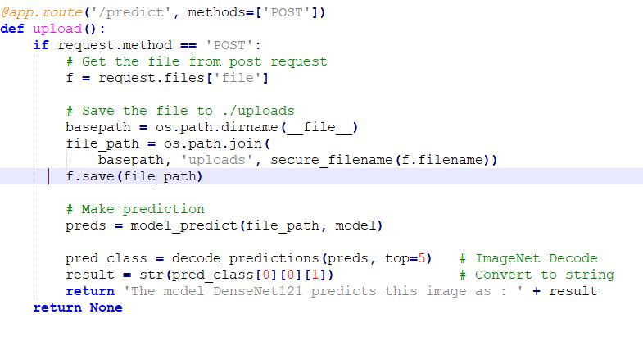
How the backend works
the frontend will use the RESTful API from the backend
the frontend will use the RESTful API from the backend
the frontend will use the RESTful API from the backend

Slide 12
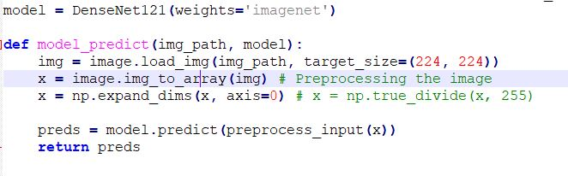
How the backend works
We are using DenseNer121 model here, and the function job is to resize the image file and transfer it to array and divide it in order to pass it through all the layers.

Slide 13
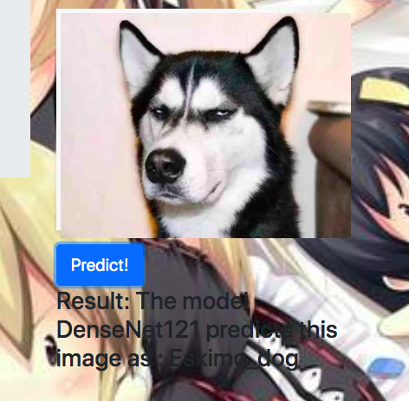
Deployment
Get the prediction result by DenseNet121

Slide 14
Reference
https://arxiv.org/abs/1704.04861
https://www.modeldepot.io/jbrandowski/nasnet-mobile
https://neurohive.io/en/popular-networks/vgg16/
https://www.kaggle.com/lamhoangtung/densenet-121-lb-0-925
https://www.kaggle.com/pytorch/densenet121
https://www.jianshu.com/p/cc830a6ed54b
https://www.osapublishing.org/boe/fulltext.cfm?uri=boe-8-5-2732&id=363511

Slide 15

Thank you!

