Slide 1
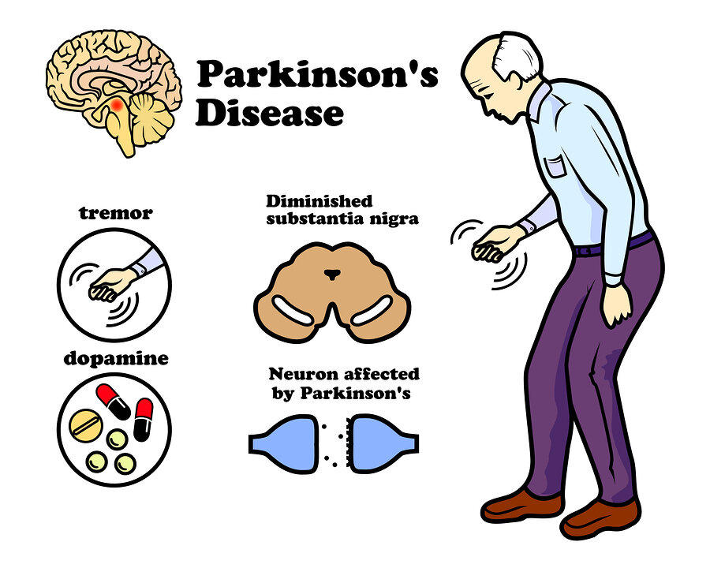
Early Prediction of Parkinson’s Disease
TY-AI-A GROUP 7
Guide:- Prof. Deepali Deshpande
Group Members: -
24. Chetanya Rathi
42. Harsh Dhabekar
44. Harshit Mundhra
45. Pushkar Helge
60. Kartik Rajput
19/05/2023 EDI 1

Slide 2

OBJECTIVES
Early Detection
Risk Assessment
Symptom Progression Prediction
Response to Treatment
Differential Diagnosis
19/05/2023 EDI 2

Slide 3



Technology Used
SVM
Decision Tree
CNN
19/05/2023 EDI 2

Slide 4
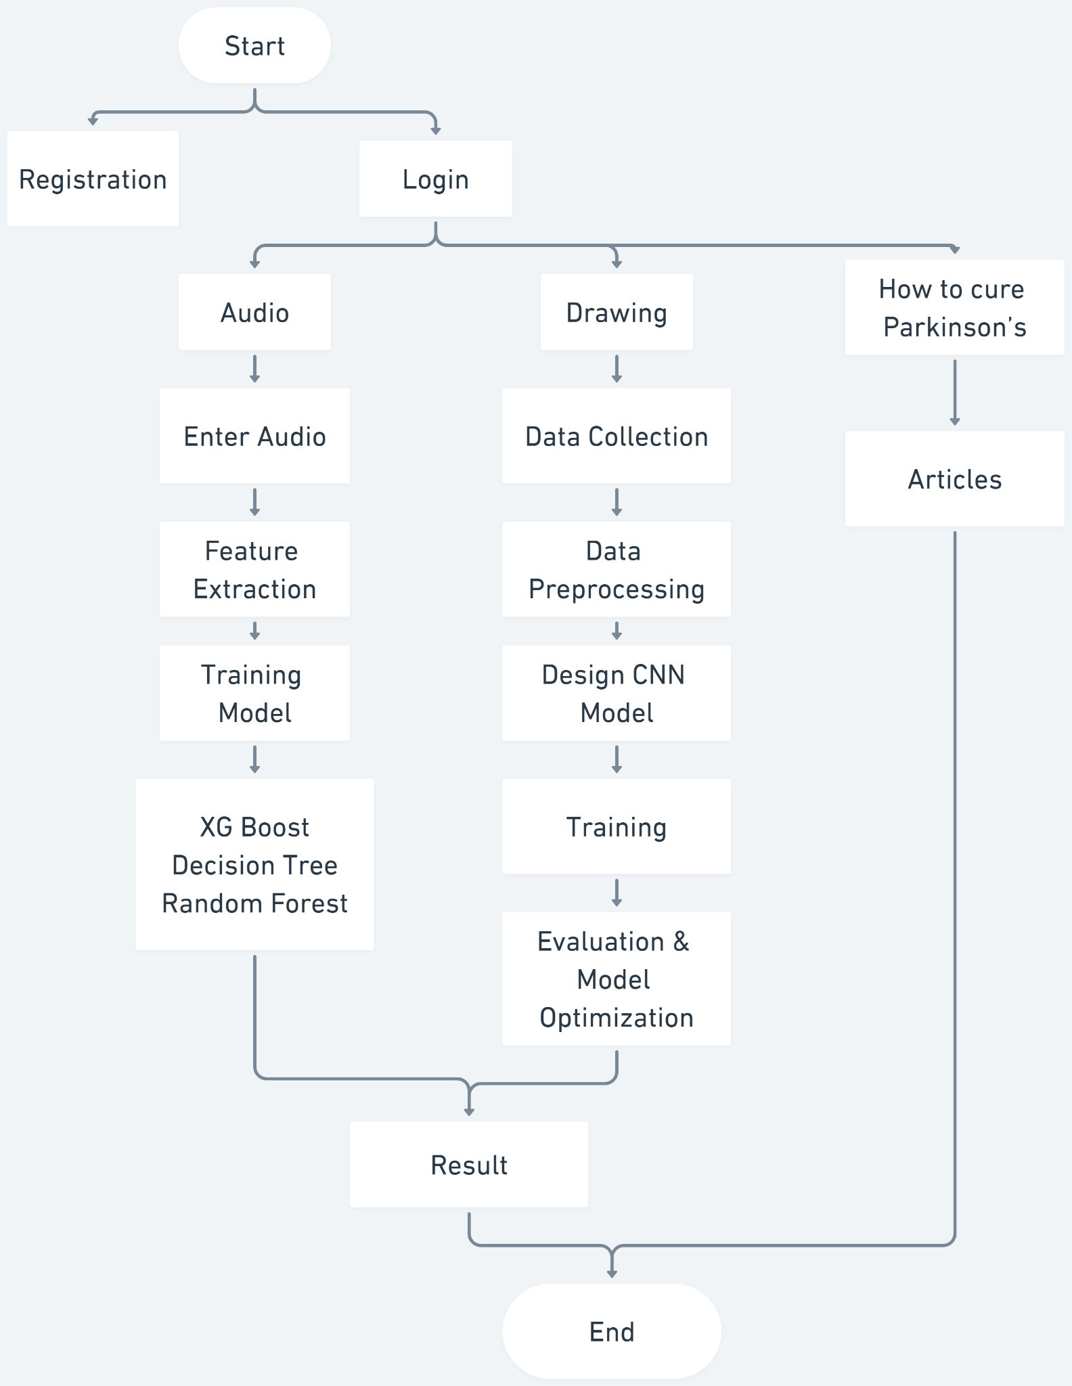
Flow Diagram
19/05/2023 4

Slide 5
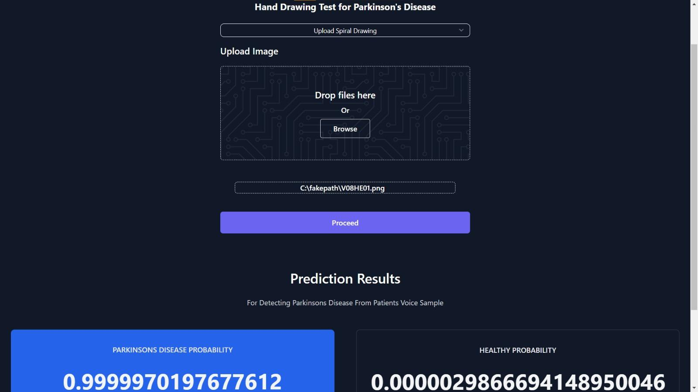
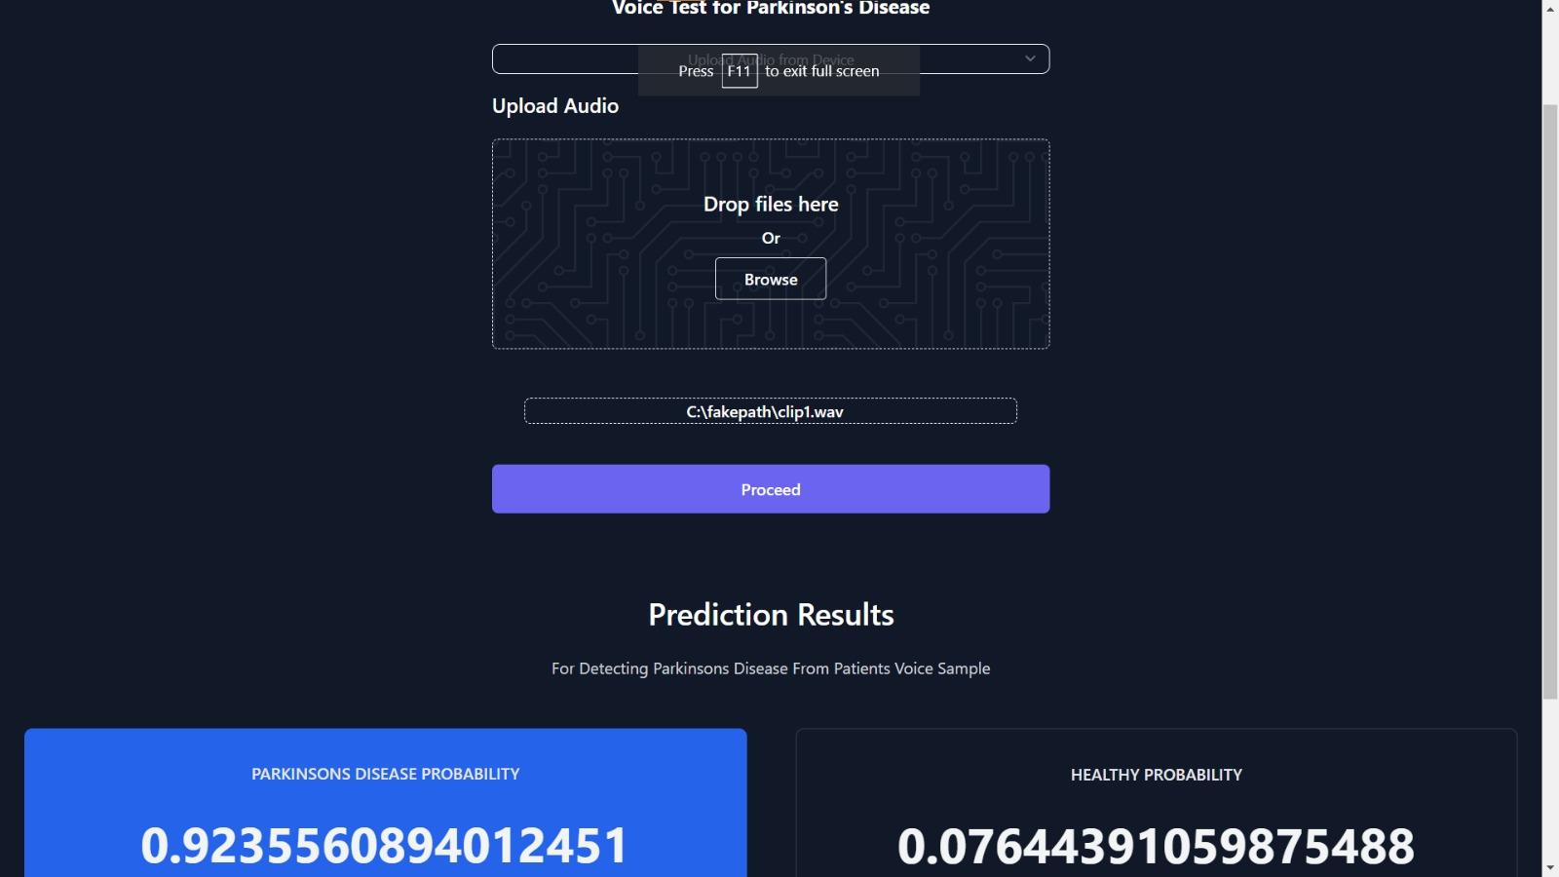
Results
19/05/2023 EDI 5

Slide 6
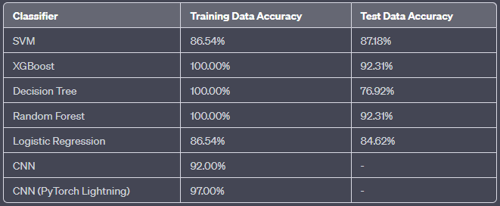
19/05/2023 EDI 6

Slide 7

Conclusion
The Parkinson's disease prediction model developed in this project shows promising potential for early detection of the disease using machine learning techniques. By leveraging multiple input parameters, including patient audio recordings, hand drawings, facial expressions, and health statistics, the model aims to provide timely identification and intervention for individuals at risk of Parkinson's disease.
The integration of different input modalities and machine learning models enhances the overall accuracy and reliability of the Parkinson's disease prediction system. The system's web interface provides a user-friendly platform for individuals to upload their data and obtain predictions regarding their disease status. This facilitates early detection, allowing for timely medical intervention and improved disease management.
19/05/2023 EDI 7

Slide 8
THANK YOU

