Slide 1
Div. – ICT
Semi – 8th
Name : Dhairvi Shah
Enrollment No. : 180320132051
Internal Guide : Prof. Ankita Tiwari
Organization : SAC-ISRO
External Guide : Sci. Anuja Sharma

Slide 2
Scatterometer L1B Flag Verification

Slide 3
Topics to be covered
Major Topics
Project Plan
Conceptual Understanding before the project
Purpose
Approach

Slide 4
Project Plan
1

Slide 5
Roadmap
Conceptual Understanding related to Project
Project Planning and Discussions
Machine Learning Applications
1
3
5
2
4
6
Optimizing Old codes and getting familiarized with coding standards
Getting Input Data for the project
Final results and optimization

Slide 6
Concepts
2

Slide 7
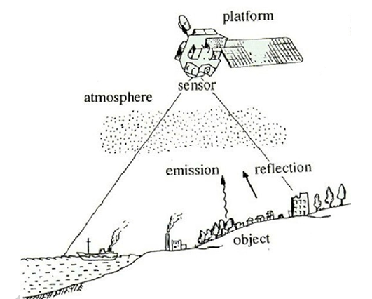
Remote Sensing
The term "remote sensing" generally refers to the use of satellite based sensor technologies to detect and classify objects on Earth.

Slide 8
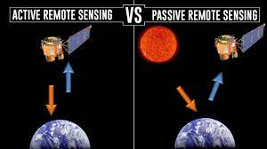
Types of Remote sensing
1)
Active sensing, emits energy in order to scan objects and sensors then detects and measures the radiation that is reflected or backscattered from the target.
E.g. SAR, Scatterometer,RADARSAT1,etc
2)
Passive sensing, reflected sunlight is the most common source of radiation measured by passive sensors. E.g. LandSat, SMAP, etc.

Slide 9
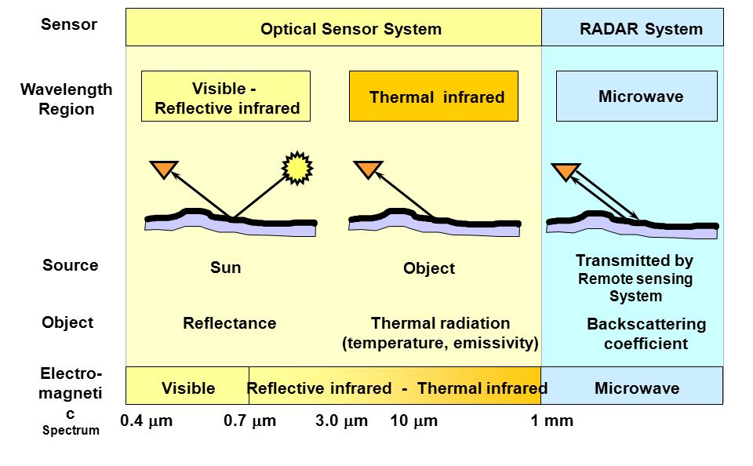
Sensors

Slide 10
Types of Microwave Sensors
Radiometer
A passive sensor that quantitatively measures the intensity of EM radiation in some band of wave length in the spectrum
SAR
(Synthetic Aperture Radar): An active remote sensor used to create high resolution 2D images or 3D reconstructions of objects.
Scatterometer
A non-imaging active remote sensor to obtain wind velocity i.e. both speed and direction on the basis of the roughness of the sea.
Altimeter
An altimeter or an altitude meter is an instrument used to measure the altitude of an object above a fixed level.

Slide 11
Scatterometer

Slide 12
Terminologies
Radar
Radio Detection And Ranging is a detection system that uses radio waves to determine the distance (ranging), angle, or velocity of objects.
Swath
The sensor sees a certain portion of the Earth's surface this area on the surface, is referred to as the swath.
Polarization
It is a way to give transmission signals a specific direction. It makes the beam more concentrated.

Slide 13
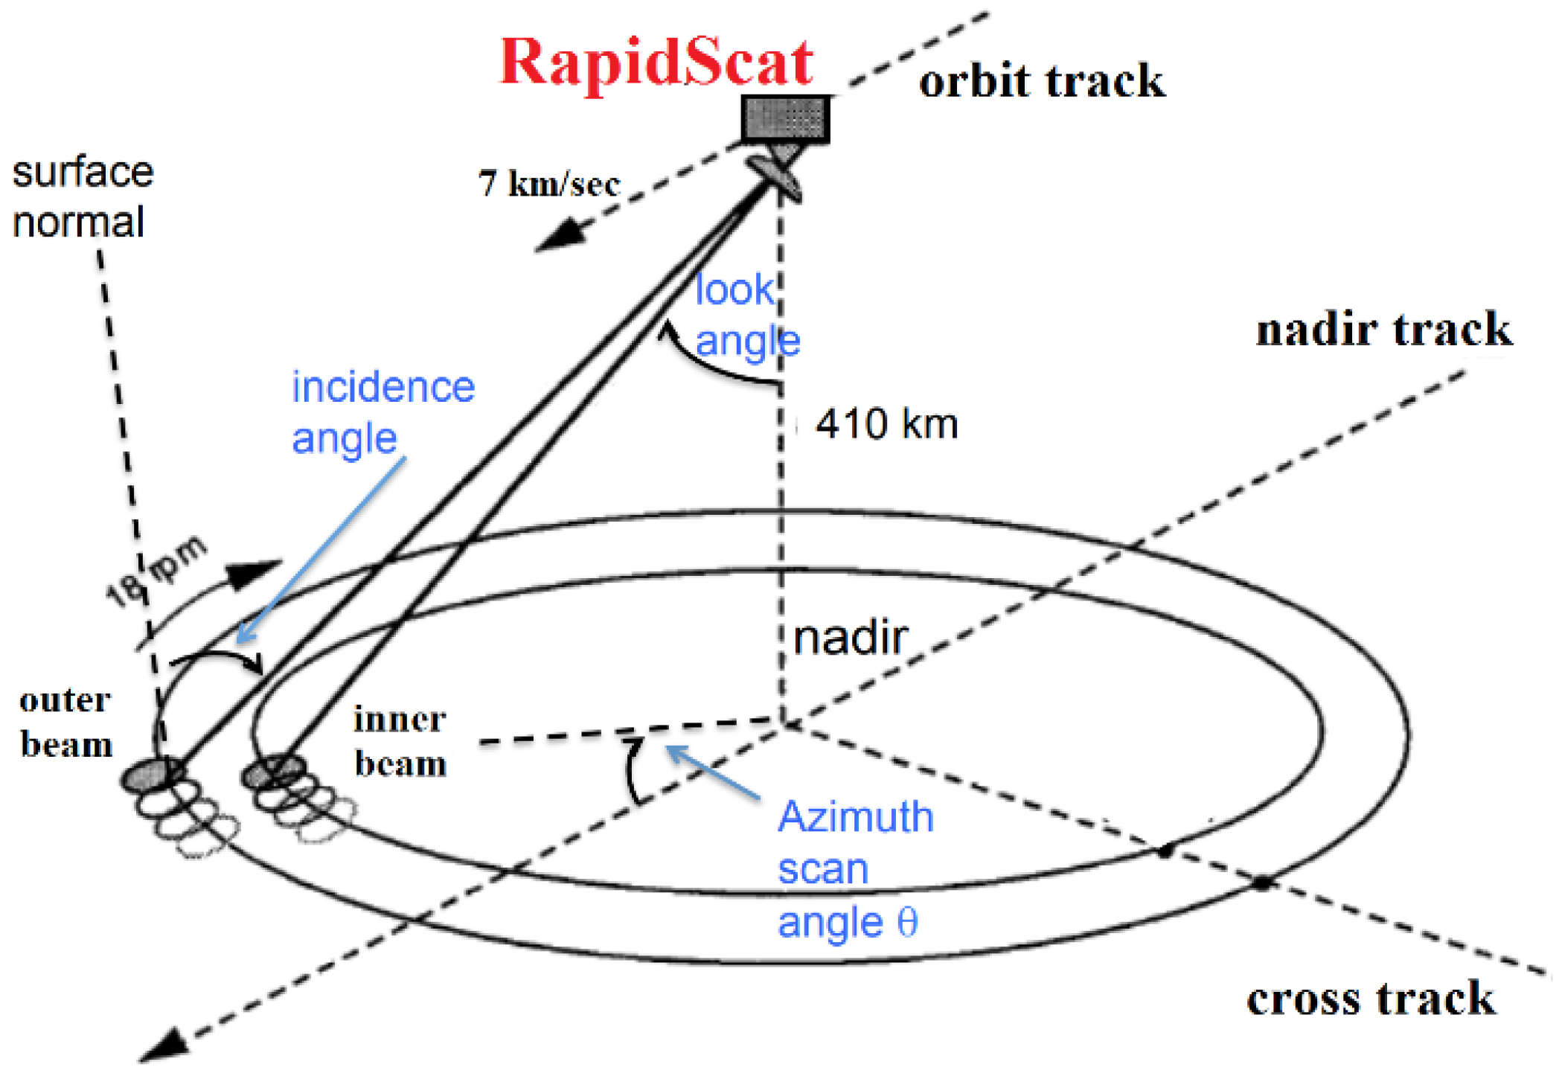
Terminologies
HH/VV
Horizontal-Horizontal / Vertical-Vertical Polarization

Slide 14
Terminologies
HDF Format
Hierarchical Data Format (HDF) is a data file format designed to assist users in the storage and manipulation of scientific data across diverse operating systems and machines.

Slide 15
Scatterometer
3

Slide 16
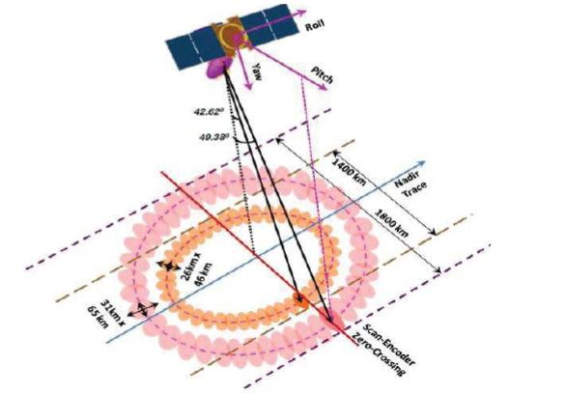
It is a non imaging , active, microwave radar.
It is Ku band (13.515GHz) Scatterometer
It uses pencil beam.
Carries a parabolic reflector antenna which measures .
Back scatter strength using dual beams HH (inner beam) and VV (outer beam) , covers 1400 km and 1800 km swaths respectively.
It takes 4 points into consideration: Inner after, Inner fore, Outer after, Outer fore
It is used to obtain wind velocity.

Slide 17
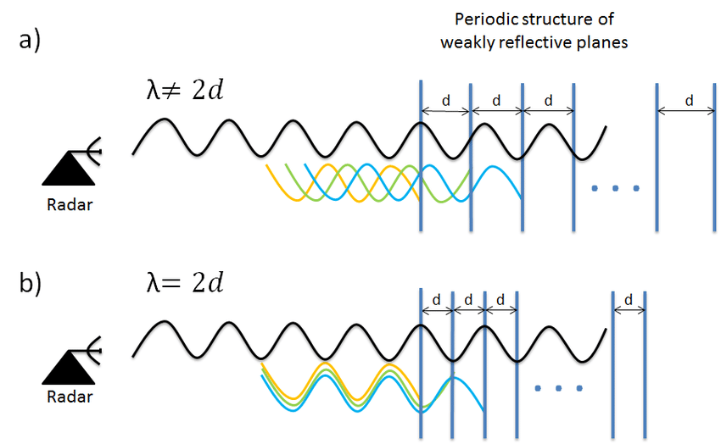
Working Principle of Scatterometer

Slide 18
Data Products
Level – 0 Raw Instrumental Data / Sensor Data
Level -1B Geolocated and Calibrated data (Scan mode data)
Level -2A
Swath Grid Data
Level -2B Swath Grid
Level – 3W
Global Grid
Level - 3s
Global Sigma0

Slide 19
Level -1B
OAT
Data
Science Data
Attributes
The project is based on the Level – 1B Data Product of Scatterometer.
It is obtained in HDF format (Hierarchical Data Format).
L1B file, basically provides with Sigma0 parameter.
Sigma-0 informs us about the backscattered strength of the target. It provides us with knowledge about wind vector and weather conditions.
This HDF file also contains physical parameters like:

Slide 20
Sigma0 flags
Sigma0 parameter is used to depict Backscattered Strength but is not completely reliable Where as Sigma-0 flag is an important parameter packed in Level – 1B data product. It provides Knowledge about:
Node
South to North (Ascending)
North to South (Descending)
Scan - Direction
Aft
Fore
Beam, Sigma0 Quality, Validity and Sea Land Boundary

Slide 21
Purpose
4

Slide 22
Purpose
For this model, historic data from sensors like ScatSat-1 will train the model that will not only verify the flag values but also predict them for future phases of Scatsat-1 and upcoming projects like Oceansat-3 using Machine Learning Technique.
Data required are obtained from L1B Data product.

Slide 23
Approach
5

Slide 24
HDF file extraction
Input Data formation
Machine Learning Modelling
Algorithm selection

Slide 25
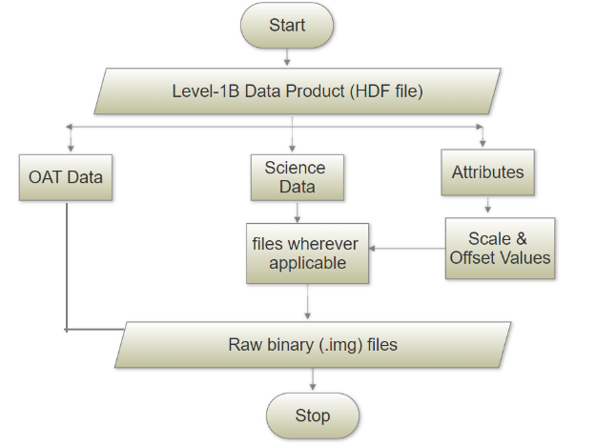
HDF FILE EXTRACTION
Geometrically and radio metrically corrected and packed data, data products, are synchronized for time and then data is separated ½ revolution wise.
HDF file input is given that helps in extracting OAT Data, Science Data and Attributes (Scale, Offset, and other important information).
During Packing of data in HDF file format float data is compressed to short with certain calculations.
So to get the data I recomputed the data by Scale * Data + Offset

Slide 26
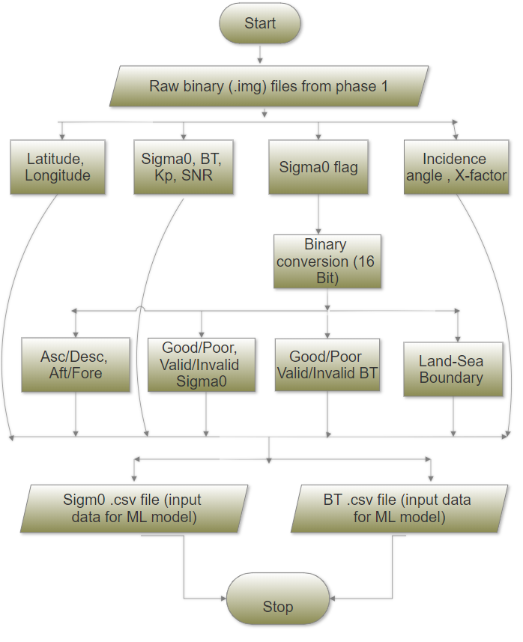
Input Data Formation
a. Sigma0 flag file is first converted to binary data.
b. From those bits only [15,13,12,11,8] for sigma0 and [15,13,10,9,8] bits for brightness and temperature.
c. Other than those bits, Latitude, Longitude, Sigma0/Brightness and Temperature, Kp, SNR, I-angle and X-factor are considered.
d. All these parameters are stored in csv form as the output.
e. Eight such csv files are obtained in form of Inner/Outer HH/VV Footprint/Slices.csv for sigma0 and brightness temperature.
f. The output files are then used for machine learning applications.

Slide 27
Algorithm Selection
Algorithm is the well-stated set of rules for carrying out computational tasks. Here, we can choose from :
Supervised Learning
Unsupervised Learning
Reinforcement Learning

Slide 28
Algorithm Selection (continue)
Input data obtained is the labelled data. Hence, Supervised Learning Algorithms are applicable.
Independent Variables (X) | Dependent Variables (Y)
Latitude, Longitude | Descending/Ascending
Sigma0 / Brightness temperature | After /Fore
SNR, Incidence angle | Good/Poor sigma0/Brightness Temperature
X-Factor, Kp | Valid/Invalid sigma0/Brightness Temperature
 | Sea-Land Boundary

Slide 29
Machine Learning Application
Multiple Input Single Output (MISO)
Here all the independent variables are used to predict one dependent variable at a time. Algorithms applied are:
Decision Tree
K-Neighbors
Logistic Regression
Random Forest
Naïve Bayes

Slide 30
MISO (Continue)
The Accuracy of each algorithm can be compared as below:

Slide 31
Machine Learning Application (Continue)
2. Multiple Input Multiple Output (MIMO)
Here All the independent variables predict each dependent variables. The Algorithms applied here are:
Decision Tree
Random Forest
K-Neighbors

Slide 32
MIMO (Continue)
The Accuracy of each algorithm can be plotted as below:

Slide 33
Result & Analysis
From the given overall result, It can be concluded that Decision Tree, Random Forest and K-Neighbors provides us with great accuracy.
 | K-Neighbors | Random Forest | Decision Tree | Logistic Regression | Naïve Bayes
MISO | 99.17% | 99.92% | 99.86% | 63.43% | 36.58%
MIMO | 97.92% | 99.82% | 99.72% | N/A | N/A

Slide 34
Result & Analysis
If Time complexity of all the applied techniques are:
Technique | Time to train the model (approx.)
Random Forest | 22-23 hrs.
Decision Tree | 17-18 hrs.
Naïve Bayes | 4-5 hrs.
K-Neighbors | 30-35 Min
Logistic Regression | 10-15 Min

Slide 35
Conclusion
To conclude :
Random Forest can be used for prediction of Sigma0 Flags for upcoming missions if one wants maximum accuracy, While K-Neighbors should be used to decrease time complexity.

Slide 36
Future Enhancement
New SVM or ANN can be applied to this model.
For ANN batches i.e. neurons can be generated on which predictions can be made.
For SVM we need to apply row reduction.

Slide 37
Overall Summary
SQL
Advanced python coding
Database Connection though java and python
PostgreSQL
Database Management
Machine Learning Applications
Latex
Before starting with the project I optimize some old codes in order to understand the data I would be working with as well as to know the coding standards. As a result skills acquired by me until now are:

Slide 38
Thank You

